Slide 1





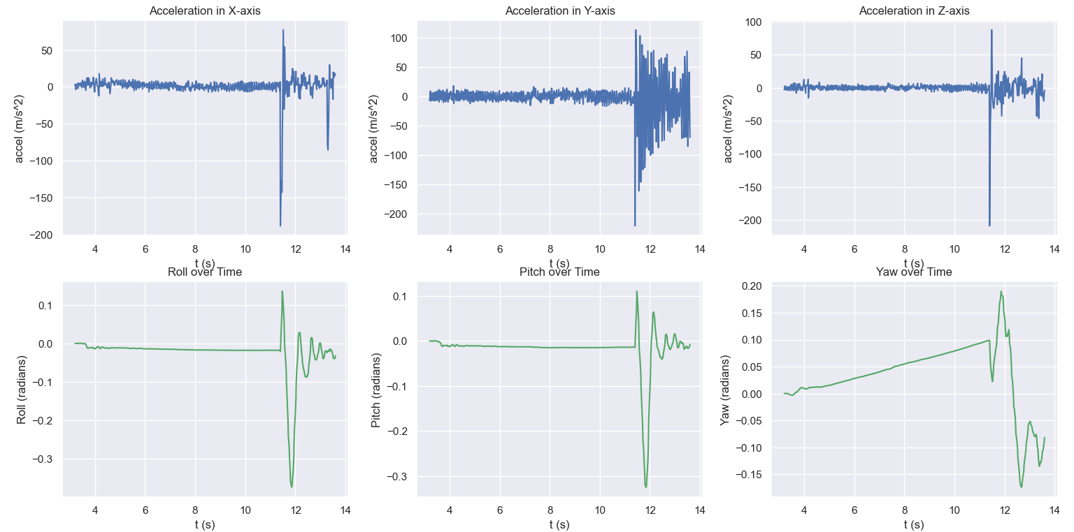
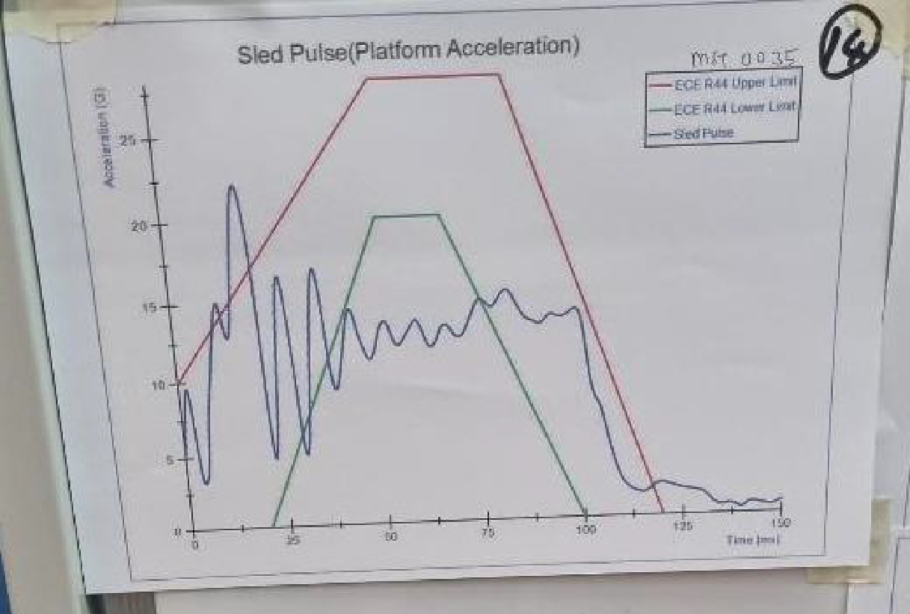
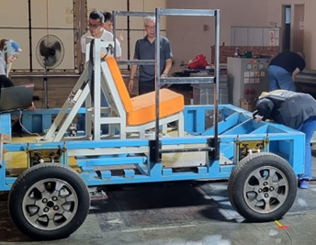
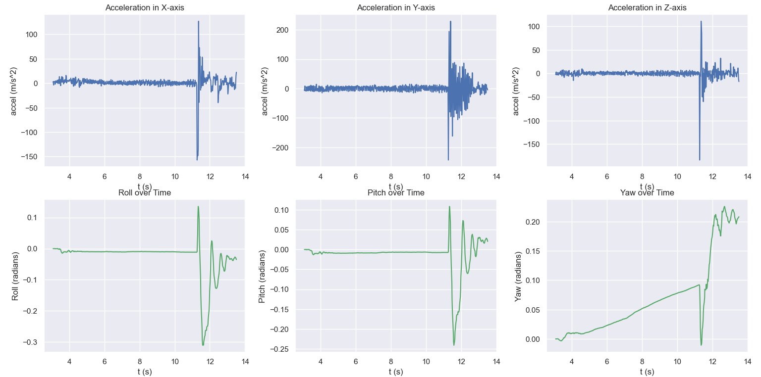
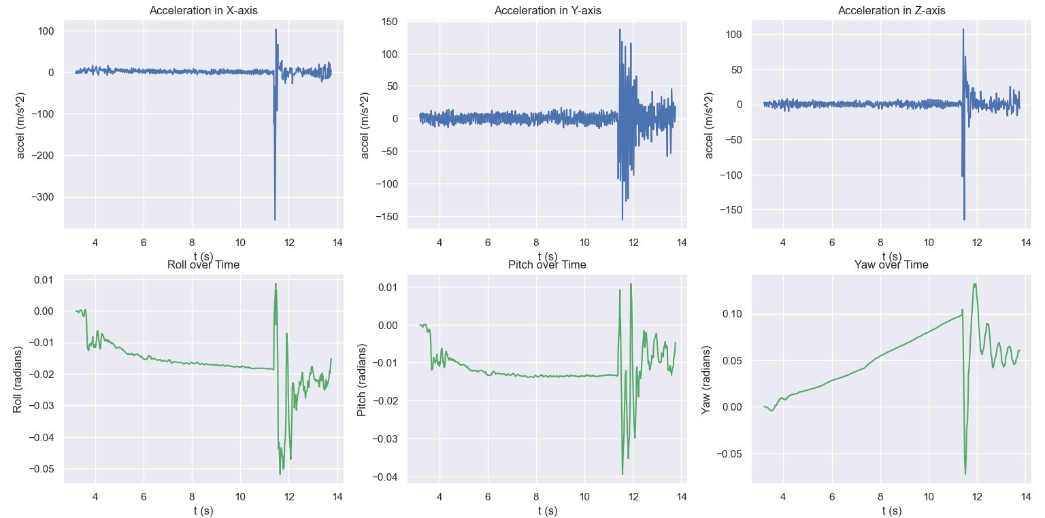

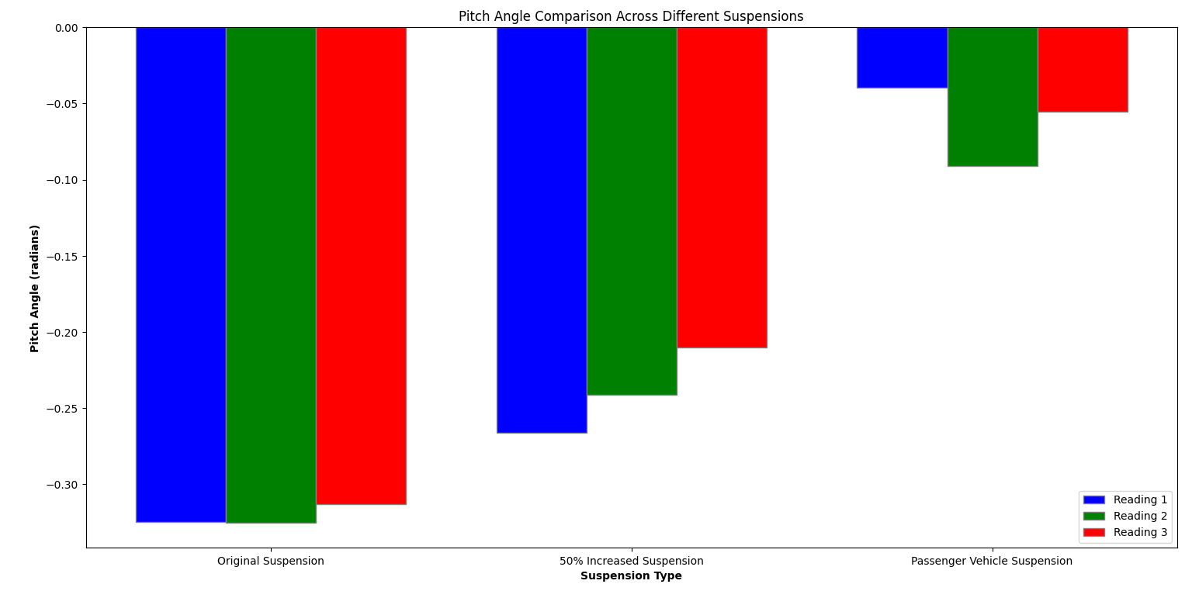

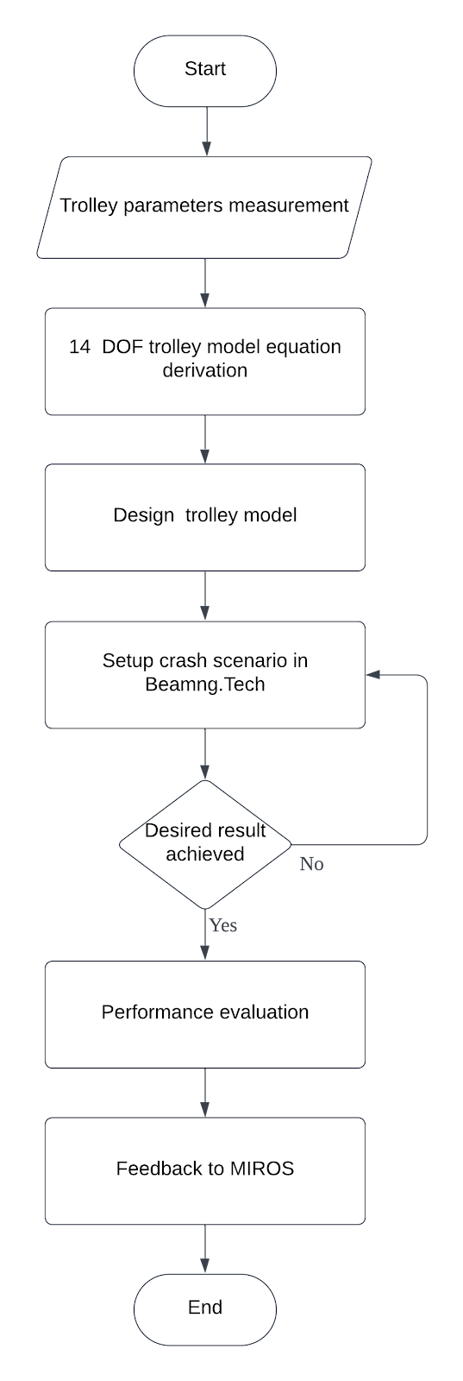


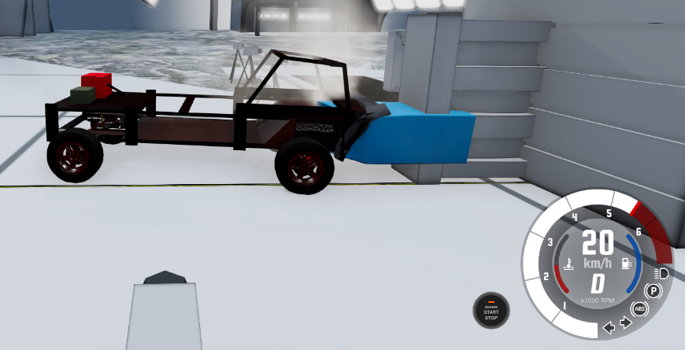
OPTIMIZATION OF THE DYNAMIC PERFORMANCE OF SLED TEST TROLLEY USING BEAMNG.TECH
NAME : PALANI A/L SUNTHARAJAN
SUPERVISOR : ASSOC. PROF IR. DR. MOHD AZMAN BIN ABDULLAH
PANEL 1 : MRS. ANITA AKMAR BINTI KAMAROLZAMAN
PANEL 2 : MRS. NORASRA BINTI A. RAHMAN
Introduction/Problem Statement
Results & Discussion
The accurate evaluation of Child Restraint Systems (CRS) is critical for ensuring the safety of young passengers in vehicles.
ASEAN NCAP certifies CRS available in the ASEAN region by following two European standards: UNECE Regulation No. 44 and UNECE Regulation No. 129. The sled test system is used to ensure that products in ASEAN countries comply with these standards.
a 3-year-old (P3), will be seated on the CRS and strapped onto a trolley. The trolley is accelerated along the track to simulate a frontal impact collision with the sled system at 50 km/h.
MIROS PC3 crash test lab at Melaka has acquired a new hydraulic sled braking system that needs to be calibrated in accordance to the regulation to test CRS.
Unwanted dynamic responses of the trolley such as pitching motion when colliding with the sled system, causes inaccuracies and fails to replicate the precise pulse and accelerations needed to comply with the European regulations.
SCOPE OF PROJECT
This research seeks to improve the accuracy and reliability of CRS testing methodologies in MIROS PC3 through replication of the trolley model in BEAMNG.TECH simulation and recreate the test scenario to fine tune the trolleys parameters and reduce the unwanted motions from the trolley such as pitching during impact.
Original suspension parameter values
2. 50% increase of spring stiffness and damping coefficient
3. Suspension parameters from small passenger vehicle
4. Pitch angle difference between 3 suspension parameters
Objectives
To develop a trolley model based on its real counterpart and simulate the sled crash test scenario of trolley using BEAMNG.TECH.
To remove pitching and other unwanted motion by tuning the suspension parameters of the trolley.
To Improve CRS performance evaluations by using the data obtained from simulation and provide feedback to MIROS.
Methodology
Flowchart
Crash simulation
Conclusions
Objective has been achieved. The unwanted pitching motion can be reduced by tuning the suspension system of the trolley for accurate CRS testing. The trolley model that was designed through BEAMNG.TECH provided accurate trolley dynamics data.
Improvement:
Integration with Mathlab Simulink to further validate trolley model dynamics.
Reference
Norlen, M., et al., 2011. An overview of road traffic injuries among children in Malaysia and its implication on road traffic injury prevention strategy. Kajang: MIROS.
BeamNG, no date. Beamng/BeamNGpy: Python API for beamng.tech, GitHub. Available at: https://github.com/BeamNG/BeamNGpy/tree/master
Yahaya Ahmad, Khairil Anwar Abu Kassim, Mohd Hafzi Md. Isa, Zanita Zainuddin, Mohd Rasid Osman, Salina Mustaffa, and Siti Zaharah Ishak, 2021. Comparing CRS Performance between UN R44 and ASEAN NCAP CRS Sled Pulse. Malaysian Institute of Road Safety Research (MIROS).

