Slide 1
Fraudulent Product Detection Using Customer Reviews and Ratings on Amazon Product Data
GUIDE DETAILS STUDENT DETAILS
Ms’ T. SINDHU PALANIVELRAJAN P – 2019202039
MCA REGULAR

Slide 2
MOTIVATION & OBJECTIVE
In recent years, Customers buy a lot of products on online which leads to increased rate in online fraud activities. Many fraud and defective products are sold online even on very known eCommerce platforms^{[7]}.
For example, Shopclues is a ecommerce platform valued over $1.1B dollars in 2016 but due to increased sales of fake products and lack of tech commitment, the company failed and just sold for $70M^{[6]}.
Objectives:
To recognize the sentiments from the review texts.
To identify outlier nodes/ biased reviews.
To calculate the fraudulent score of the product from its loyal product reviews.

Slide 3
INTRODUCTION
As Ecommerce Industry evolving largely, many complex problems arises. One of the main problem is selling low-quality products, Customers can’t able to find good products in the market.
Customers write a lot of reviews these days about the product qualities. One important factor is to identify the helpful reviews and with Only those reviews and ratings from previous users of the product can give a hint about the quality of the product.
Several machine learning algorithms are developed over the years with an increasing trend in anomaly detection techniques. These techniques can be utilized to intimate the upcoming buyer that there is a possibility of buying a low-quality or fraudulent product from the seller.

Slide 4
LITERATURE REVIEW
S.No. | Author name & Paper title | Concept in the paper (Algorithm, Advantages, Limitations, Future enhancement) | Paper details
1. | Hutto, C. and Gilbert, E., 2014, May. Vader: A parsimonious rule-based model for sentiment analysis of social media text. | Algorithm: Valence Aware Dictionary for sEntiment Reasoning (VADER) Advantages: It is a Rule based Model Machine learning model which outperforms traditional ML approaches. Limitations: Not Explored much in Editorial and Product review classes. Future Enhancement: This approach will be tuned and used to calculate sentiment for Amazon Product Dataset. | In Proceedings of the international AAAI conference on web and social media (Vol. 8, No. 1, pp. 216-225). https://ojs.aaai.org/index.php/ICWSM/article/view/14550

Slide 5
LITERATURE REVIEW
S.No. | Author name & Paper title | Concept in the paper (Algorithm, Advantages, Limitations, Future enhancement) | Paper details
2. | Haque, T.U., Saber, N.N. and Shah, F.M., 2018, May. Sentiment analysis on large scale Amazon product reviews. | Algorithm: Bag of words, Tf-TDf and various ML Algorithms Advantages: Implemented in large scale Data and got SVM Accuracy of 94% Limitations: Limited to amazon product dataset and not much explored on other kind of reviews. Future Enhancement: generalize algorithm for more types of datasets | In 2018 IEEE international conference on innovative research and development (ICIRD) (pp. 1-6). IEEE. https://ieeexplore.ieee.org/abstract/document/8376299

Slide 6
LITERATURE REVIEW
S.No. | Author name & Paper title | Concept in the paper (Algorithm, Advantages, Limitations, Future enhancement) | Paper details
3. | Dou, Y., Liu, Z., Sun, L., Deng, Y., Peng, H. and Yu, P.S., 2020, October. Enhancing graph neural network-based fraud detectors against camouflaged fraudsters. | Algorithm: Graph Neural Network Advantages: camouflage fraudsters are identified easily Limitations: Unweighted graphs are not explored Future Enhancement: This Graph Anomaly detection techniques can be tuned and implemented to find fraud reviews and fraudulent products. | In Proceedings of the 29th ACM International Conference on Information & Knowledge Management (pp. 315-324). https://dl.acm.org/doi/abs/10.1145/3340531.3411903?casa_token=1gLP8lIl8ugAAAAA:EE-KX-Rt7DEBIqRZqyGj3MlqkHgZvMc54cZvdEdk1AOlZjR9JtDhpU8QqMAZmLuOfYHN8kNBCvqlJn0

Slide 7
LITERATURE REVIEW
S.No. | Author name & Paper title | Concept in the paper (Algorithm, Advantages, Limitations, Future enhancement) | Paper details
4. | Kevin C Lee, Sentiment Analysis — Comparing 3 Common Approaches: Naive Bayes, LSTM, and VADER | Algorithm: Survey of Naive Bayes, LSTM and VADER approaches in sentiment Analysis Advantages: VADER has powerful lexicon and comprehensive linguistic rules Limitations: Sarcastic reviews context cannot be captures. Future Enhancement: This approach will be tuned and used to calculate sentiment for Amazon Product Dataset. | towardsdatascience.com https://towardsdatascience.com/sentiment-analysis-comparing-3-common-approaches-naive-bayes-lstm-and-vader-ab561f834f89

Slide 8
DATASET DETAILS
Types of dataset:
Product data for clothing, shoes and jewelry products:
Contains clothing, shoes and jewelry product reviews (5.73M Reviews for 1.5M Products)^{[5]}.
Meta product data:
It is the description off the products with their basic details like product name, product price, sales rank, also bought, also viewed etc… (1.5M Products)^{[5]}.
Input format: Product review data, Meta data
Output format: Fraudulent Score for each product

Slide 9
IMPLEMENTATION PLATFORM / FRAMEWORK
Python/Jupyter Notebook
Python/Google Colab

Slide 10
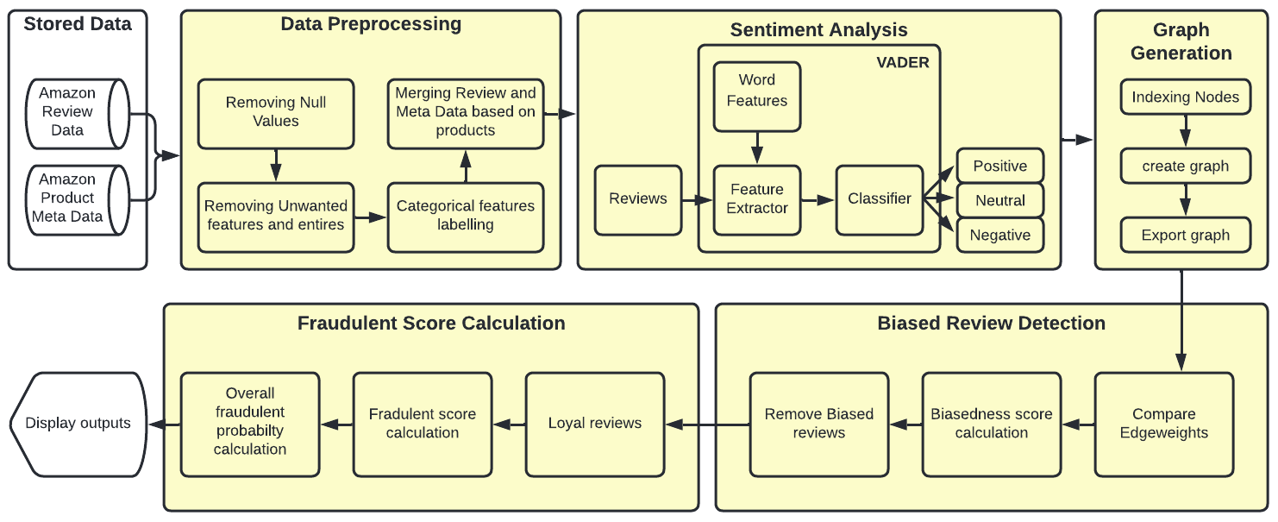
OVERALL ARCHITECTURE (with completed modules highlighted)

Slide 11
MODULE DESCRIPTION
Data preprocessing
Sentiment Analysis on reviews
Graph Generation
Biased Reviews Detection
Fraudulent Score Calculation

Slide 12
Module 1: DATA PREPROCESSING
DESCRIPTION:
In this Module, Data will be cleaned and preprocessed by the following procedures: Null values are removed, Unwanted features are removed and categorical features will be labeled.
Unwanted reviews are those reviews which are not helpful are removed.
Finally the Review Data with the product ID will be mapped with the product ID in meta data and all the features are combined into a single dataset.
INPUT : Amazon Reviews Data & Product Meta Data for clothing, shoes and jewelry category
OUTPUT : Cleaned & Preprocessed data (csv file)

Slide 13
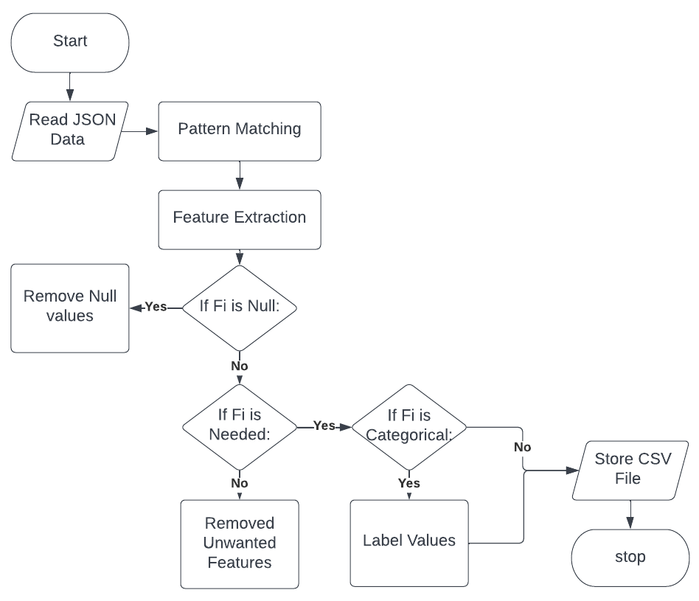
Module 1: DATA PREPROCESSING
Algorithm: Data Preprocessing
Begin
Read Dataset Files in JSON (D1, D2)
For i in D1, D2:
Extract Patterns for features(F)
For all features Fi from F:
If Fi has Null Values:
Remove Null Values
If Fi is NOT needed:
Remove Fi
If Fi is Categorical:
Label Categories
D1 Join D2 on ProductID
Save CSV File
End
Flowchart:

Slide 14
Module 2: SENTIMENT ANALYSIS ON REVIEWS
DESCRIPTION :
In the preprocessed data we have a feature column ‘review text’ which contains the customer reviews for the products.
To analyse the sentiment of the reviews a customer sentiment analysis function is implemented. These sentiments will be either ‘positive’ or ‘negative’ or ‘neutral’ class.
A sentiment score ranges from -4 to 4. A positive sentiment score means a positive sentiment and if the context is strong then it will be near from 1 to 4 and vice versa.
INPUT : Review Texts
OUTPUT : Sentiment & Sentiment scores (negative, neutral, positive)

Slide 15
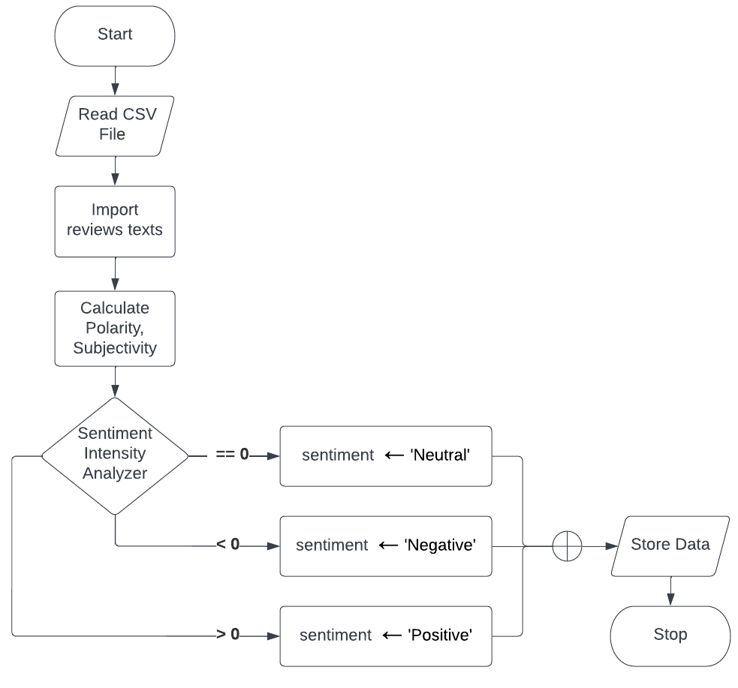
Module 2: SENTIMENT ANALYSIS ON REVIEWS
Algorithm: Sentiment Analysis
Begin
Read review texts from CSV File (R)
For i in R:
Calculate Polarity (Pi)
Calculate Subjectivity (Si)
For i in R:
Sentiment score (s) ← SentimentIntensityAnalyzer(Ri, Pi, Si)
If s > 0:
Ri ← ‘Positive’
Elif s < 0:
Ri ← ‘Negative’
Else:
Ri ← ‘Neutral’
Store Pi, Si, Ri values
Save CSV File
End
Flowchart:

Slide 16
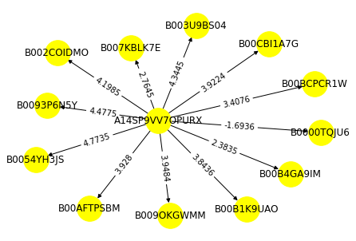
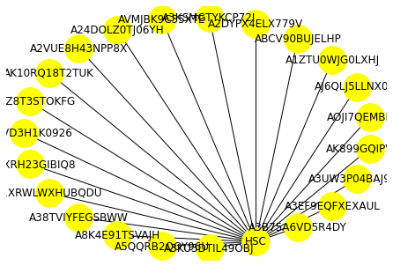
Module 3: GRAPH GENERATION
Ratings Graph:
DESCRIPTION :
The need for graph generation arised due to the scale of the data and its domain^{[1]}.
The relation between product and customer is a bipartite relationship, no two products are related and no two users are related. Graph representation are the fastest way to interpret these type of data^{[2]}.
The preprocessed and sentiment analyzed data points are then converted into a weighted directed bipartite graph.
First set is the Product ID and second set is the Reviewer ID. If a product is reviewed by a user then there is an edge between these two nodes and their corresponding ratings {W = <R>} will be the Edgeweight
INPUT : preprocessed, sentiment calculated data
OUTPUT : graph objects (ratings graph, seller graph)
Seller Graph:

Slide 17
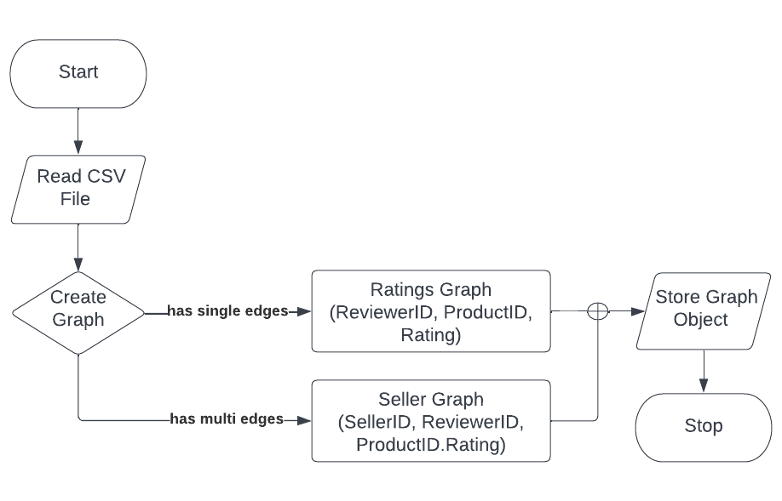
Module 3: GRAPH GENERATION
Algorithm: Graph Generation
Begin
Read data from CSV File (D)
Create RatingsGraph(R), SellerGraph(S)
For i in D:
Nodes ← ReviewerID(Ui), ProductID(Pi)
EdgeWeight ← Ratings(Ri)
RatingsGraph.AddEdge(Ui, Pi, Ri)
For i in D:
Nodes ← SellerID(Si), ReviewerID(Ui)
EdgeWeight ← Ratings(Ri), ProductID(Pi)
SellerGraph.AddEdge(Si, Ui, Pi.Ri)
Store RatingsGraph
Store SellerGraph
End
Flowchart:

Slide 18
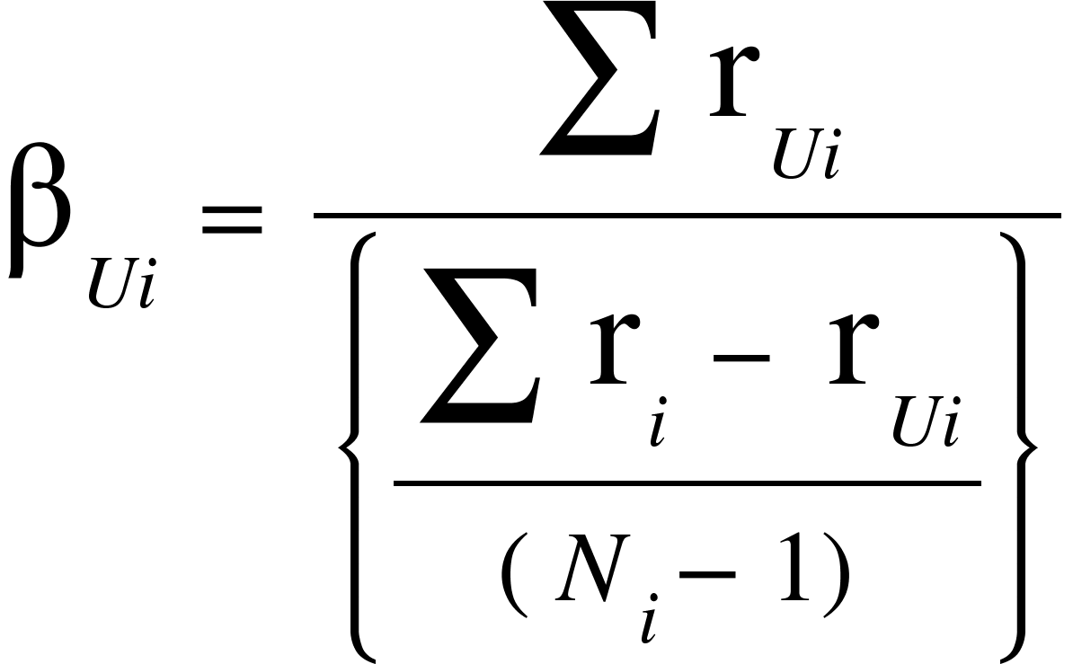
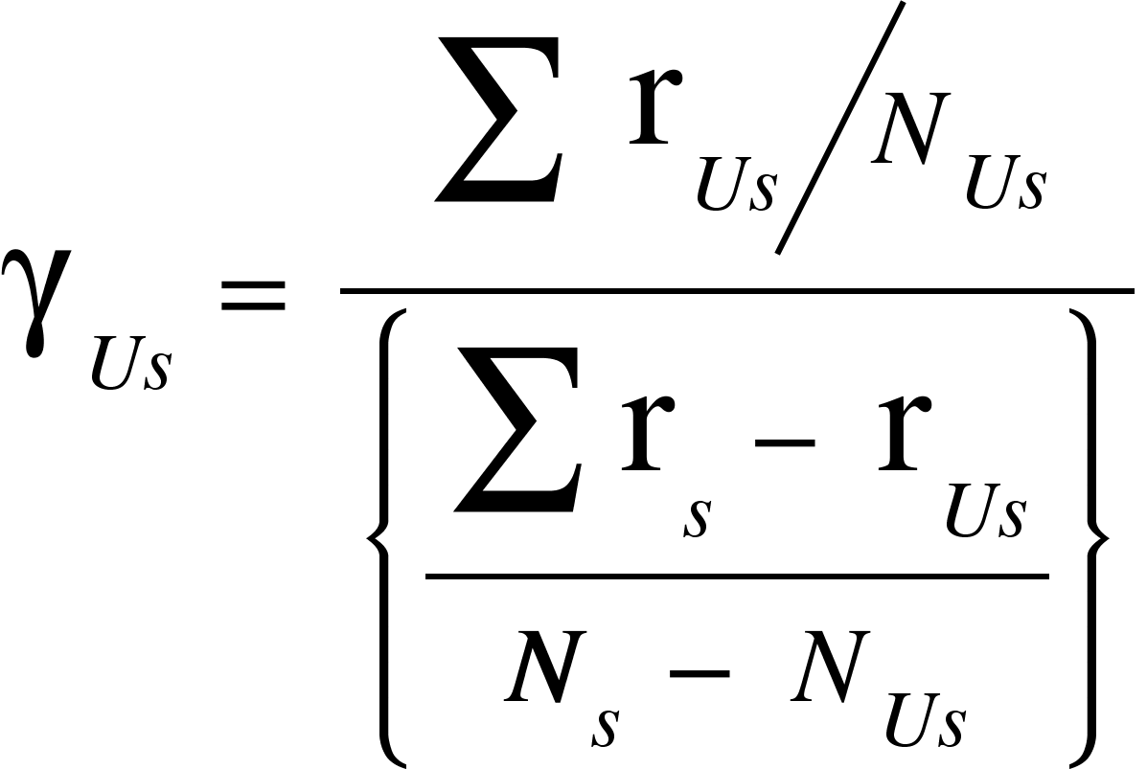
Module 4: BIASED REVIEWS DETECTION
DESCRIPTION :
Reviewers with biased reviews can create a greater impact while buying. These biased reviewers should be identified and reviews given by them are removed.
A Biasedness score (β) is calculated for each reviewer per product
A Biasedness score (ɣ) is calculated for each reviewer per seller
Where,
β_{Ui} Biasedness score of user(U) for product(i)
r_{Ui} Ratings by user(U) for product(i)
r_{i} Ratings for product(i)
N_{i} Number of ratings for product(i)
Where,
ɣ_{Us} Biasedness score of user(U) for seller(s)
r_{Us} Ratings by user(U) for seller(s)
r_{s} Ratings for seller(s)
N_{s} Number of ratings for seller(s)
N_{Us} Number of ratings by user(U) for seller(s)

Slide 19
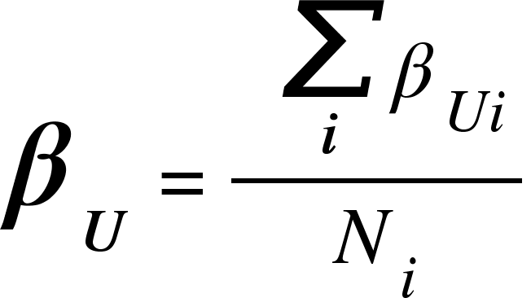
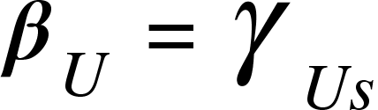
Module 4: BIASED REVIEWS DETECTION
There are 4 main categories for biased reviews we are concentrating for now,
Type 1 - User will always give a positive review, ratings for all the products bought irrespective of its quality.
Type 2 - User will always give a negative, ratings review for all the products bought irrespective of its quality.
Type 3 - User will give positive reviews, ratings for all the products bought from a specific seller.
Type 4 - User will give negative reviews, ratings for all the products bought from a specific seller.
A value of 0.25 is set as threshold limit, If the β_{U} value is lesser than the threshold then the user is potentially a biased reviewer.
INPUT : Ratings Graph, Seller Graph
OUTPUT : Combined Biasedness Score for Type 1, 2, 3, 4 Biased Reviews
Where,
β_{U} Combined Biasedness score of user(U)
β_{Ui} Biasedness score of user(U) for product(i)
N_{i} Number of products(i) reviewed by user(U)
Where,
β_{U} Combined Biasedness score of user(U)
ɣ_{Us} Biasedness score of user(U) for seller(s)

Slide 20
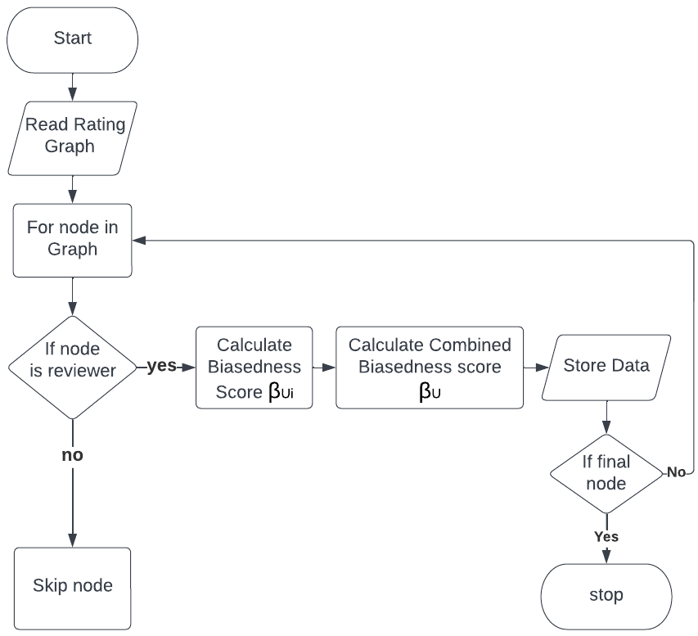
Module 4: BIASED REVIEWS DETECTION
Algorithm: Biasedness score (β)
Begin
Read Ratings Graph (R)
For node in R:
β_{Ui} ← 0
If node is ReviewerID:
r_{Ui} ← node.edge weight
For j in node.neighbors:
r_{i} ← r_{i} + j.edge weight
N_{i} ← N_{i} + 1
Calculate β_{Ui}
Store Biasedness Score
Calculate Type 1 and Type 2 Biasedness values
For Biasedness Score in Reviewer (U):
β_{U} ← Avg(β_{U} + β_{Ui})
Store Combined Biasedness Score for each user(U)
Save CSV File
End
Flowchart:

Slide 21

Module 4: BIASED REVIEWS DETECTION
Algorithm: Biasedness score (ɣ)
Begin
Read Seller Graph (S)
For node in S:
ɣ_{Us} ← 0
If node is ReviewerID:
For j in node.ratings:
r_{Us} ← r_{Us} + j.edge weight
N_{Us} ← N_{Us} + 1
For k in node.neighbors:
r_{s} ← r_{s} + k.edge weight
N_{s} ← N_{s} + 1
Calculate ɣ_{Us}
Calculate Type 3 and Type 4 Biasedness values
For Biasedness Score in Reviewer (U):
β_{U} ← ɣ_{Us}
Store Combined Biasedness Score for each user(U)
Save CSV File
End
Flowchart:

Slide 22
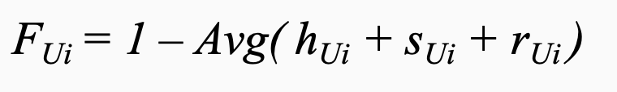
Module 5: Fraudulent Score Calculation
Unbiased and Helpful reviews are given as input to this module. These reviews are considered as loyal reviews.
Fraudulent score (F) will be calculated for each product based on the helpfulness score, sentiment score and ratings.
Based on the fraudulent score, the probability of a product being a ‘good’ or ‘bad’ can be calculated and known by the future buyers or the platform owner.
Overall fraudulent score for a product is the average of all the fraudulent score for the given product by all the users.
INPUT : Unbiased Reviews Data for each product
OUTPUT : Fraudulent Score for each product
Where,
F_{Ui} Fraudulent score for product(i) by user(U)
h_{Ui} Helpfulness score for product(i) by user(U)
s_{Ui} Sentiment score for product(i) by user(U)
r_{Ui} Ratings for product(i) by user(U)

Slide 23
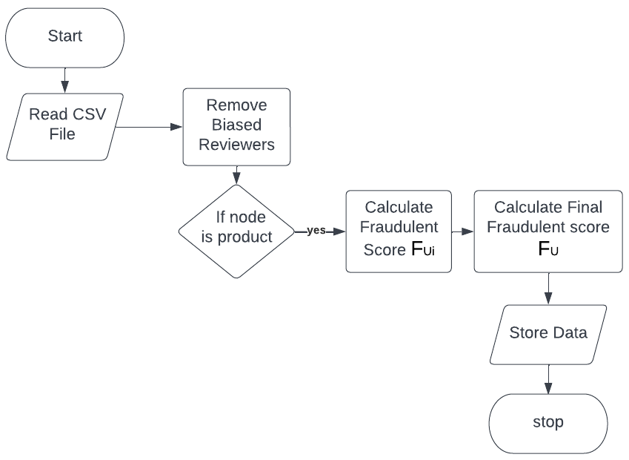
Module 5: Fraudulent Score Calculation
Algorithm: Fraudulent Score
Begin
Read Data from CSV File (D)
Remove Biased Reviewers
For i in D:
F_{i} ← 0
If i is ProductID:
N_{i} ← 0
For j in D:
F_{Ui} ← 0
If j is ReviewerID and j.ProductID == i:
N_{i} ← N_{i} + 1
F_{Ui} ← h_{Ui} + s_{Ui} + r_{Ui}
F_{i} ← (F_{i} + F_{Ui} ) / N_{i}
Calculate Final Fraudulent Class, Set Threshold
Store Fraud values, classes (F)
Push Stored Data to Server
End
Flowchart:

Slide 24
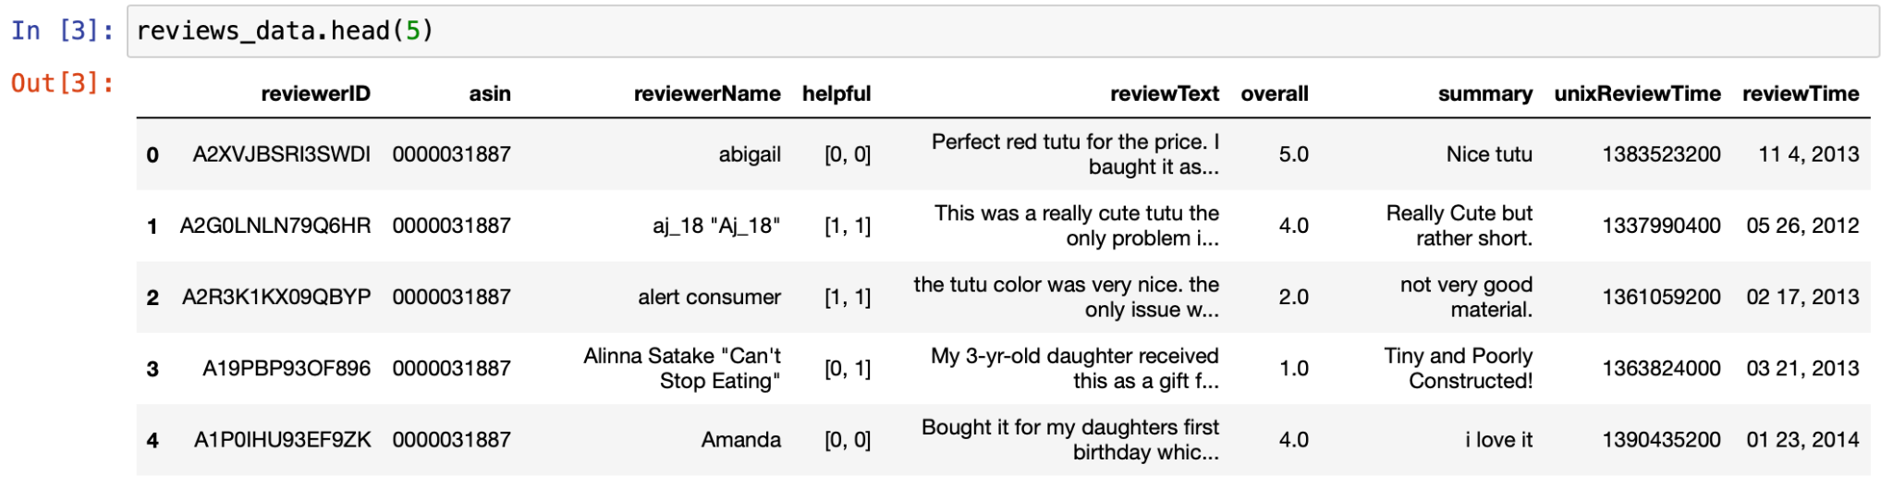
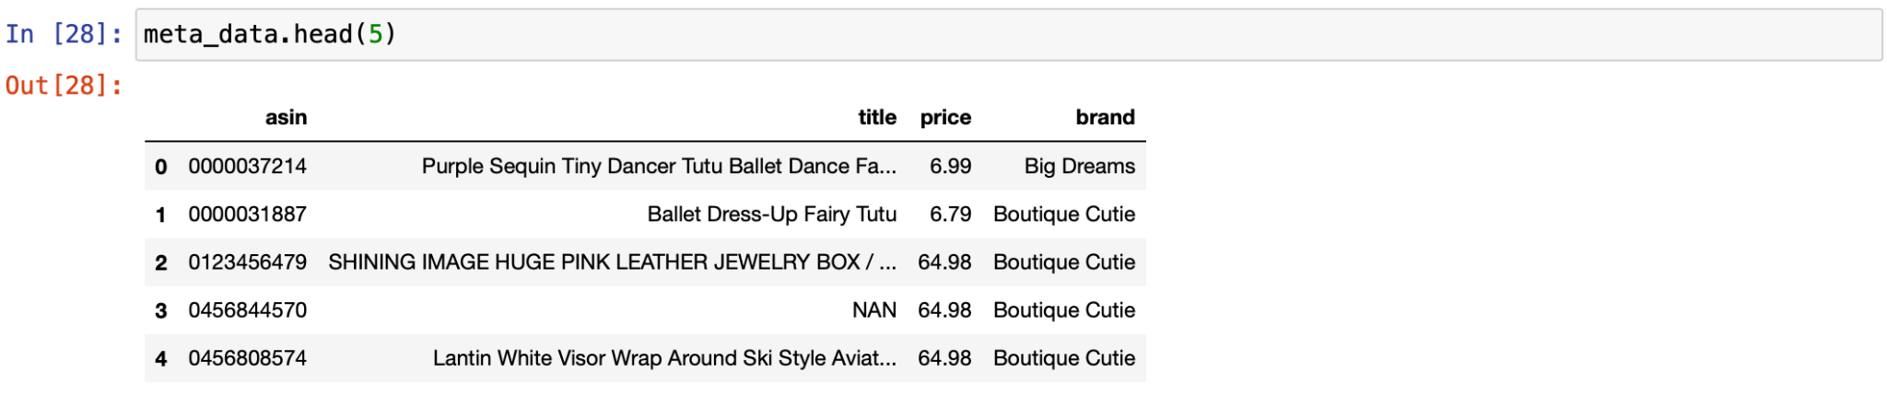
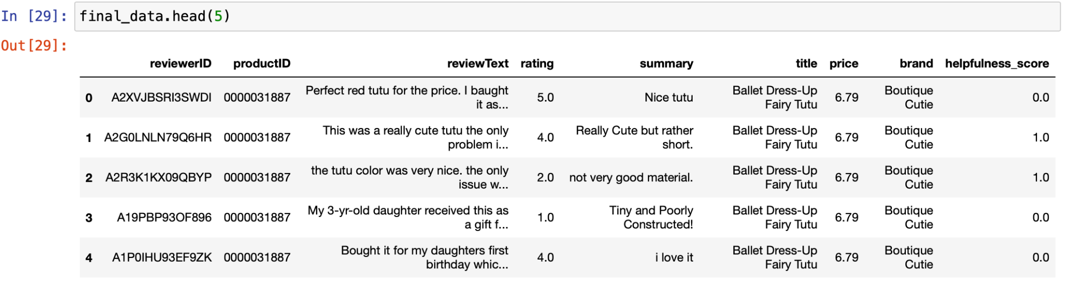
Screenshots: Data Preprocessing

Slide 25
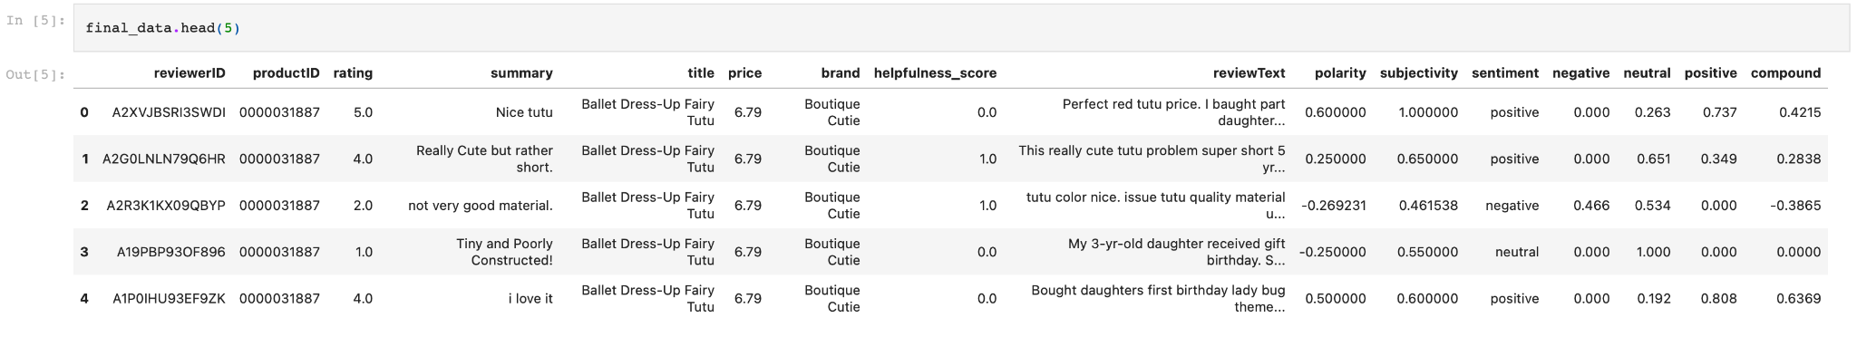
Screenshots: Sentiment Analysis

Slide 26
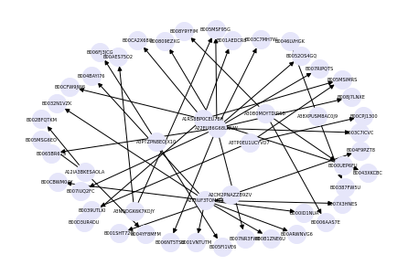
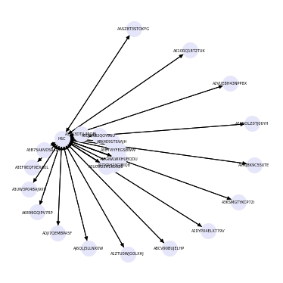
Screenshots: Graph Generation
Ratings Graph for first 100 nodes
Graph for Seller ‘HSC’

Slide 27
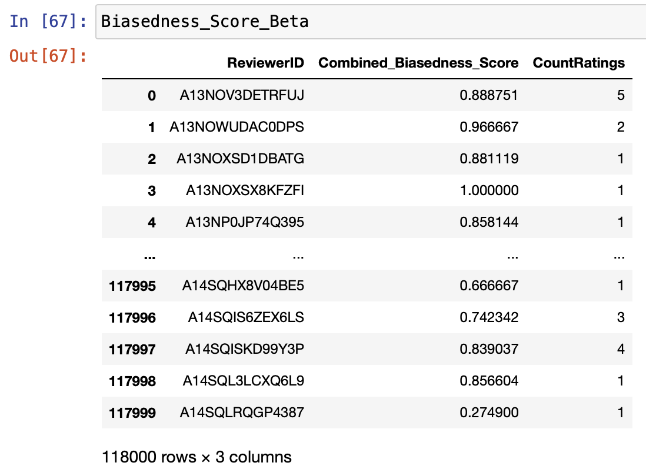
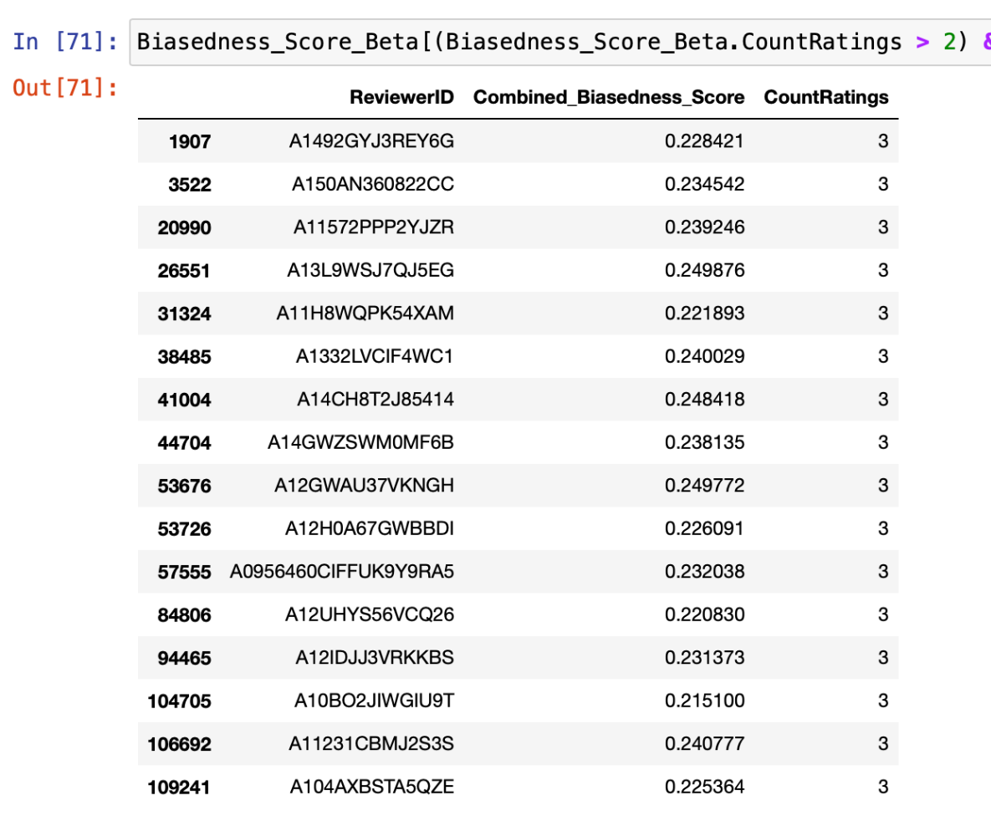
Screenshots: Biased Reviews Detection (β)

Slide 28
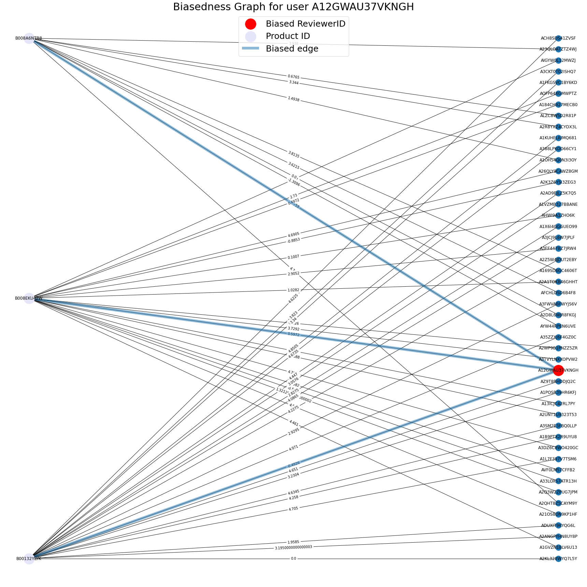
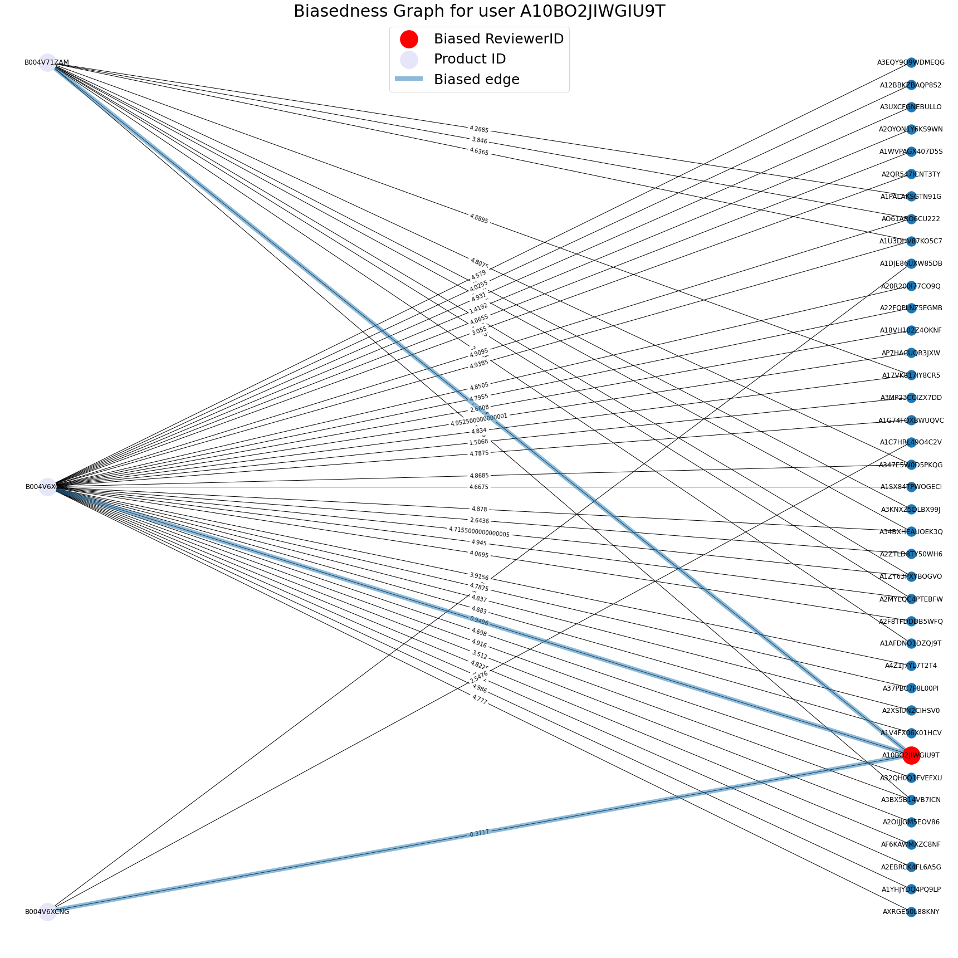
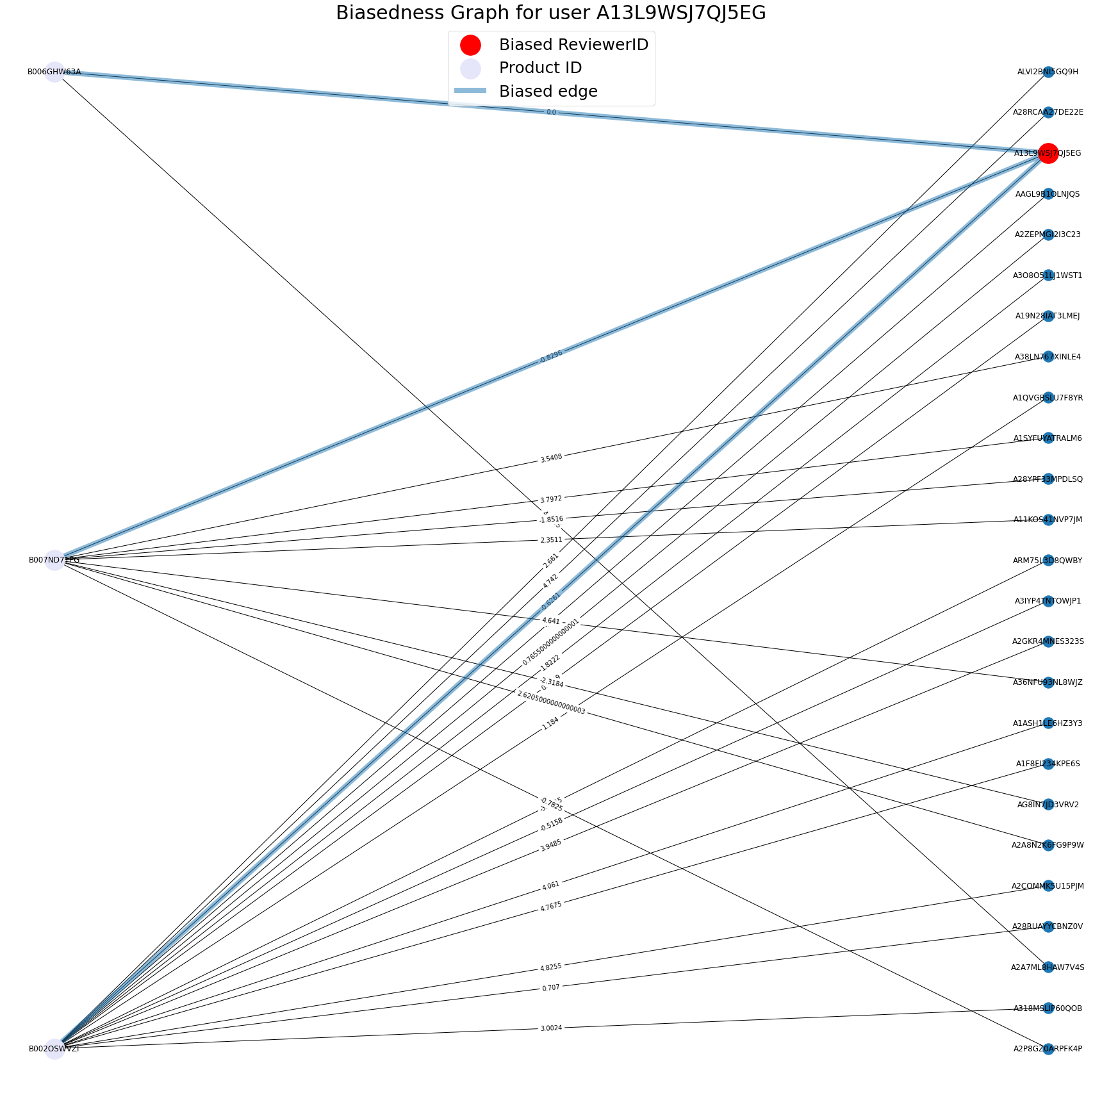
Screenshots: Biased Reviews Detection (β)
Product - Reviewer graph for reviewers categorized as potentially biased under Type 1 and Type 2 Biasedness

Slide 29
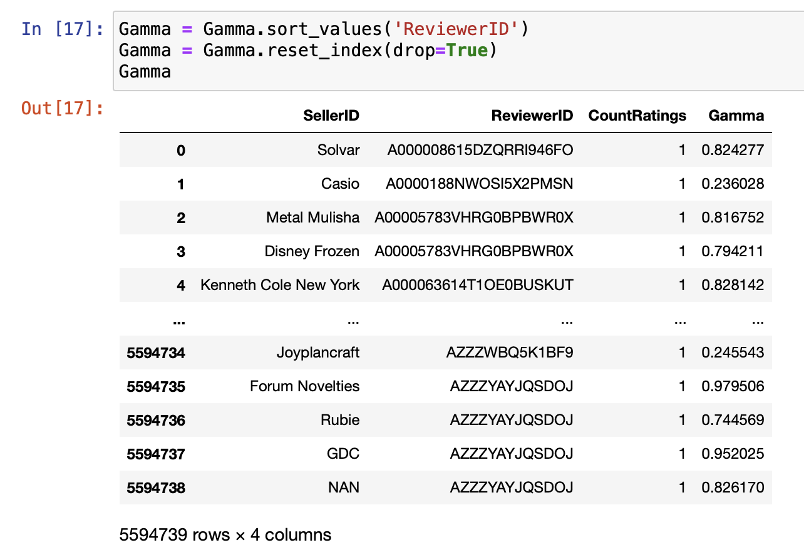
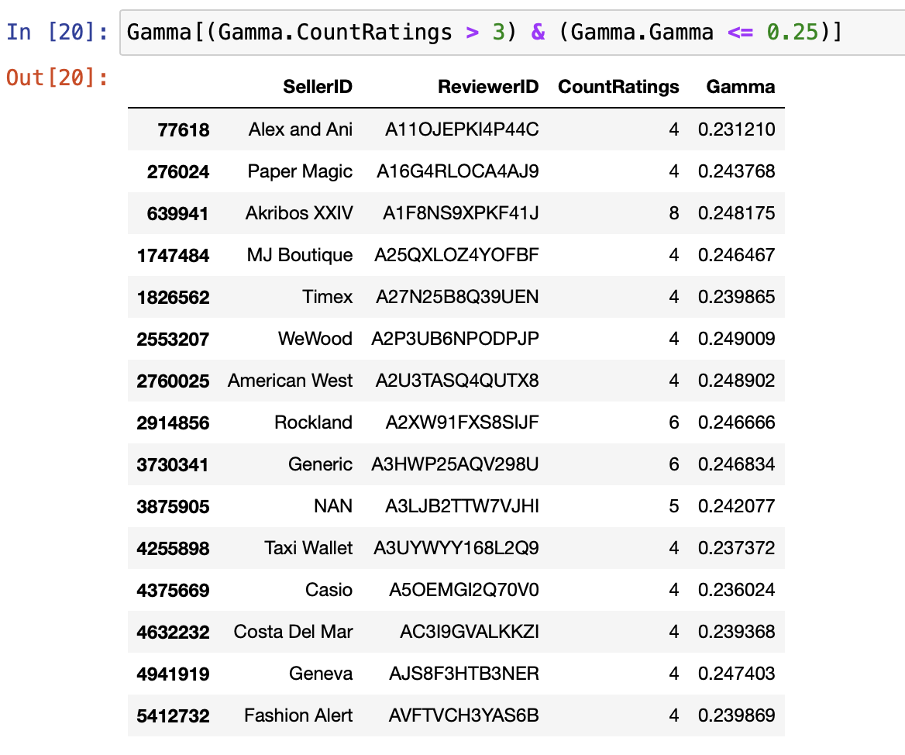
Screenshots: Biased Reviews Detection (ɣ)

Slide 30
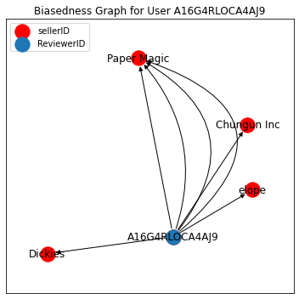
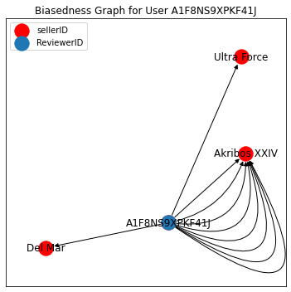
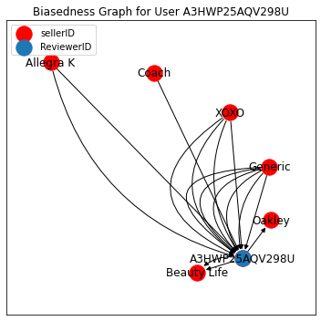
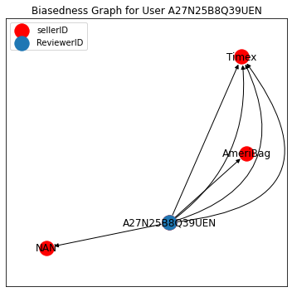
Screenshots: Biased Reviews Detection (ɣ)
Seller - Reviewer graph for reviewers categorized as potentially biased under Type 3 and Type 4 Biasedness

Slide 31
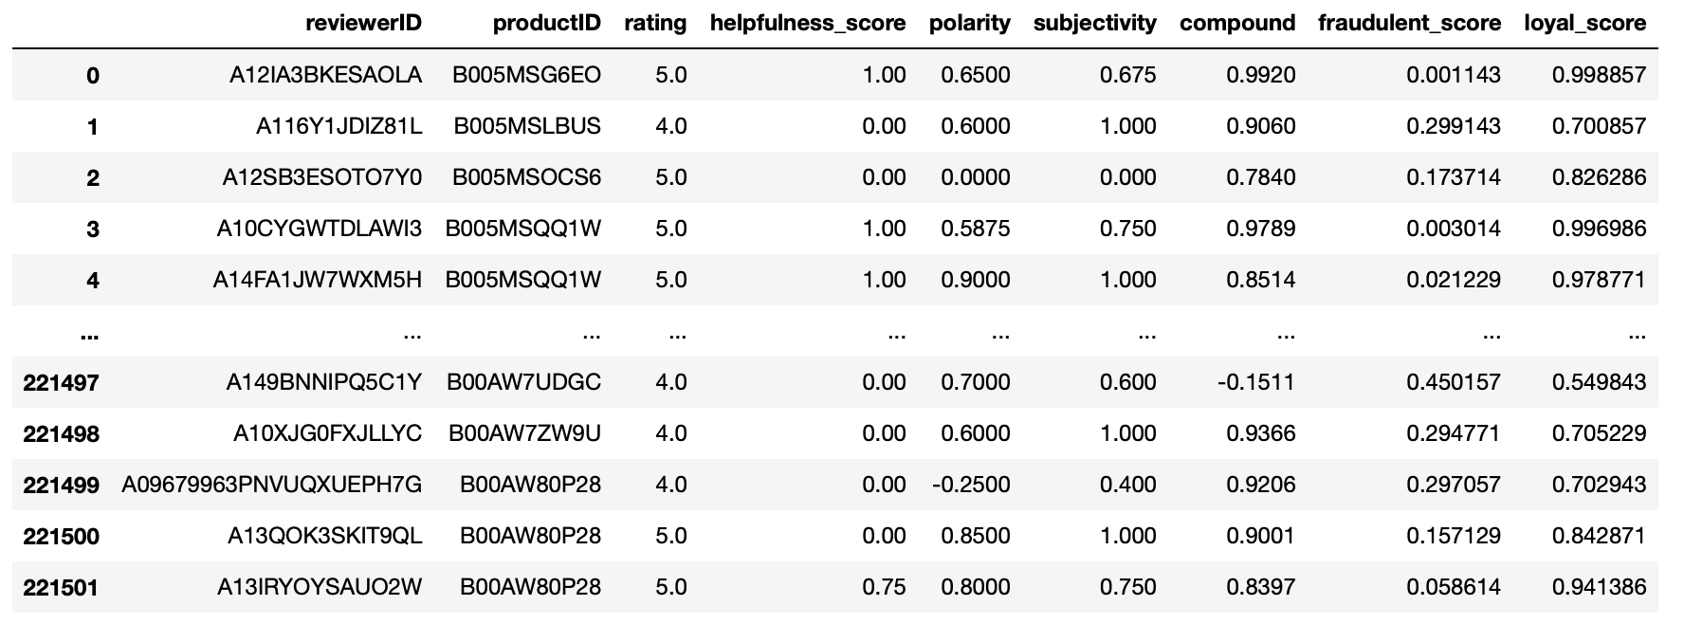
Screenshots: Fraudulent Score Calculation

Slide 32
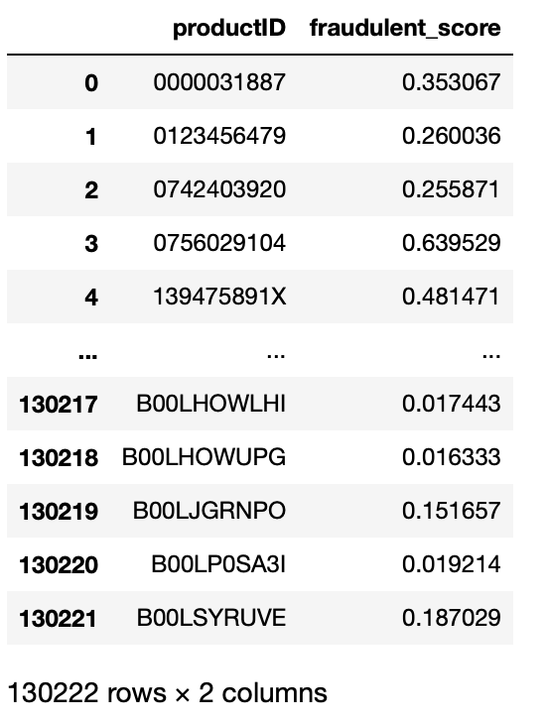
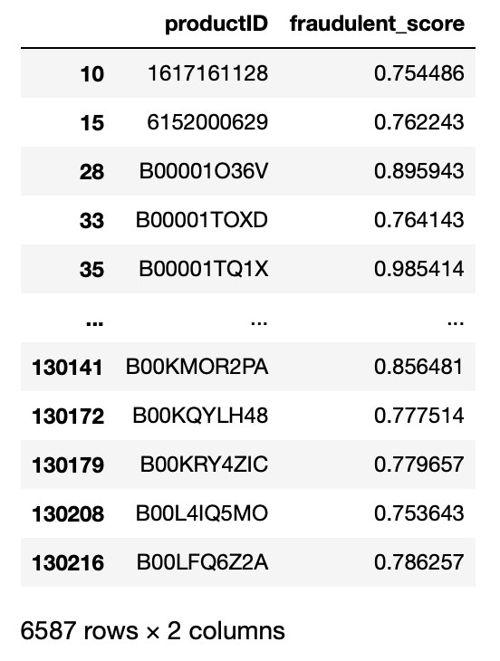
Screenshots: Fraudulent Score Calculation
Out of 1.3 Lakh products processed with most of the Biased reviewers are removed, A total of 6587 products are identified as potentially fraud products with Fraudulent score >0.75.
Total Products and their Fraud Scores
Products with Fraud Scores > 0.75

Slide 33
Conclusion & Summary
Fraudulent Product Detection will help Ecommerce Platforms and Customers to avoid buying low quality and spam products. It will also helps to detect fraud sellers.
We have Successfully Implemented an Algorithm for Detecting different types of biased reviewers with little help on analysing the sentiments from the state of art “VADER” model.
An Algorithm to detect fraud products are also implemented successfully, and a total of 5.05 % of products are found potentially fraudulent.
Future Enhancement:
In Future, A more suitable machine learning method will be applied to enhance the performance of the model for calculating fraudulent scores and detecting fraudulent products.
Several other types of biased reviewers will be considered and the algorithm to detect biased reviewers will be encoded with Graph neural networks.

Slide 34
REFERENCES
Base Paper: Li, A., Qin, Z., Liu, R., Yang, Y. and Li, D., 2019, November. Spam review detection with graph convolutional networks. In Proceedings of the 28th ACM International Conference on Information and Knowledge Management (pp. 2703-2711).
[1] Hutto, C. and Gilbert, E., 2014, May. Vader: A parsimonious rule-based model for sentiment analysis of social media text. In Proceedings of the international AAAI conference on web and social media (Vol. 8, No. 1, pp. 216-225).
[2] T. U. Haque, N. N. Saber and F. M. Shah, "Sentiment analysis on large scale Amazon product reviews," 2018 IEEE International Conference on Innovative Research and Development (ICIRD), 2018, pp. 1-6, doi: 10.1109/ICIRD.2018.8376299.
[3] Akoglu, L., McGlohon, M. and Faloutsos, C., 2010, June. Oddball: Spotting anomalies in weighted graphs. In Pacific-Asia conference on knowledge discovery and data mining (pp. 410-421). Springer, Berlin, Heidelberg.
[4] Kevin C Lee, Sentiment Analysis — Comparing 3 Common Approaches: Naive Bayes, LSTM, and VADER,. https://towardsdatascience.com/sentiment-analysis-comparing-3-common-approaches-naive-bayes-lstm-and-vader-ab561f834f89
[5] https://jmcauley.ucsd.edu/data/amazon/
[6]https://www.businessinsider.in/business/startups/news/shopclues-sold-heres-a-timeline-of-how-the-unicorn-startup-went-down/articleshow/71847099.cms
[7] https://www.statista.com/statistics/792047/india-e-commerce-market-size/

Slide 35
THANK YOU

