Slide 1

Ansible
Palani Karthikeyan

Slide 2

Course Agenda
Day 1 - Linux & Windows Essentials and administration
commands
Day 2 - Ansible – architecture, ad-hoc commands and
YMAL
Day 3 - Ansible playbooks
Day 4 - Control execution flow, Interactive control structures, Encrypting data with Vault.
Day 5 – Ansible blocks , roles and Galaxy

Slide 3
Course Objectives
Automate Linux system administration tasks on managed hosts with Ansible.
Learn how to write Ansible Playbooks to standardize task execution.
Manage encryption for Ansible with Ansible Vault.

Slide 4

What is Configuration Management?
Configuration management is the process of maintaining infrastructure and software in a desired and consistent state.
It’s a way to make sure that a system performs as expected as changes are made over time.
This is particularly important when it comes to applying changes to the resources.
The goal, especially with automation, is to keep the configuration changes transparent and documented.

Slide 5
Introducing Ansible
Objectives
Describe Ansible concepts, architecture, and common use cases.
Install Ansible on a control node and describe the distinction between community Ansible and Red Hat Ansible Engine.
Ansible was first released by Michael DeHaan in 2012 as a small side project, and it has had a meteoric rise in popularity.

Slide 6
What is Ansible?
Ansible is an open-source IT engine that automates application deployment, cloud provisioning, intra service orchestration, and other IT tools.
Ansible is easy to deploy because it does not use any agents.
Ansible uses playbook to describe automation jobs, and playbook uses very simple language i.e. YAML

Slide 7
What is Ansible?
Ansible is an open source automation platform which was purchased by Red Hat in October 2015.
Ansible works by connecting to nodes using SSH, pushing a desired state configuration and dis-connecting.
Ansible is agentless.

Slide 8
What is Ansible?
After connecting to your nodes, Ansible pushes small programs called as “Ansible Modules”.
Ansible runs that modules on your nodes and removes them when finished.
Ansible manages your inventory in simple text files (These are the hosts file).

Slide 9
Ansible
Ansible is written entirely in Python.
The main runner and all of the modules are Python 2.6 compatible, which means that they’ll work
with any version of Python2 above version 2.6.

Slide 10
Ansible
Ansible works by running commands via SSH, so there’s no need to install any server software.
This is a huge plus for two reasons :
Your machines run your application without any CPU or memory-hungry daemons running in the background.
You get everything that SSH provides for free.

Slide 11
Why use Ansible?
Its modularity regarding plugins, modules, inventories, and playbooks make Ansible the perfect companion to orchestrate large environments.
Ansible is very lightweight and consistent, and no constraints regarding the operating system or underlying hardware are present.
It is also very secure due to its agentless capabilities and due to the use of OpenSSH security features.

Slide 12
Why Ansible ?
Ansible Is Simple
Ansible Is Powerful
Ansible Is Agentless
Notes:
The main qualities of Ansible are:
• Simple: Playbooks are readable and easy to understand. Playbooks will contain some tasks that will be executed in the order in which they are written. No special coding skills are required.
• Powerful: Ansible can manage infrastructure, networks, operating systems, and other resources, straight out of the box. It enables us to orchestrate the entire infrastructure and environment lifecycle (cloud and on premises).
• Agentless: Uses Open SSH and Windows Remote Management. No additional firewall ports need to be open.

Slide 13
Ansible has a number of important strengths
Cross platform support (remote node)
Human-readable automation
Perfect description of applications
Easy to manage in version control
Support for dynamic inventories
Orchestration that integrates easily with other systems

Slide 14
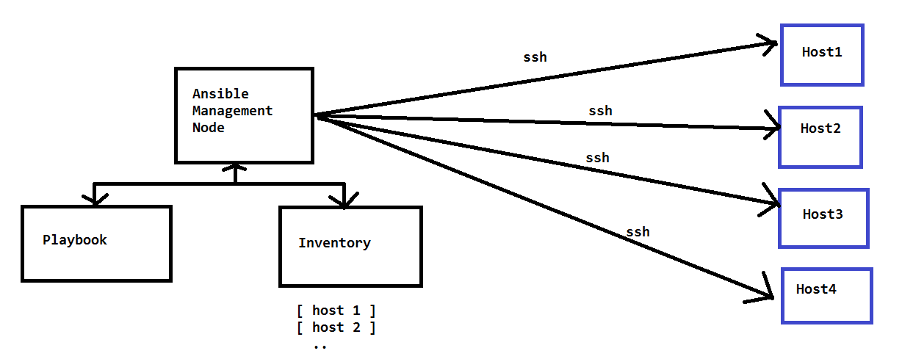
How Ansible Works?

Slide 15
Control System
Currently Ansible can be run from any machine with Python 2 or Python 3installed.
This includes Red Hat, Debian, CentOS, macOS, any of the BSDs, and so on.
Windows is not supported for the control node.

Slide 16

Agentless model
An agent is a proprietary software program which is installed across distributed networks for the purpose of executing work and feeding data back to the centralized server.
In an agentless design, information is transmitted to or collected from computers without installing proprietary agents.
This is accomplished by communicating with the software that is already installed on the computer, including the operating system and natively installed components.

Slide 17
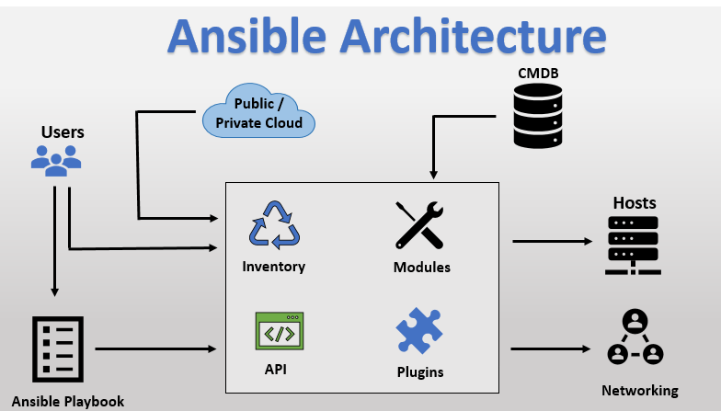

Slide 18






Ansible Architecture
USER
cloud
Host Inventory
ANSIBLE Engine (python)
Connected plugin
Core
module
Playbook
Custom
module
Plugin
Node systems

Slide 19
Installing Ansible
Ansible is available in the package repositories for operating systems such as Ubuntu
( apt-get ) and Fedora ( yum )
The latest version available is to grab the source code from https://github.com/ansible/ansible and build it yourself.

Slide 20
Download Ansible from Github and build it.
git clone git://github.com/ansible/ansible.git --recursive
cd ansible
make
sudo make install

Slide 21

Install ansible ( Control System)
To enable the Ansible Engine repository for RHEL 7, run the following command:
$ sudo subscription-manager repos --enable rhel-7-server-ansible-2.9-rpms
$ git clone https://github.com/ansible/ansible.git
$ cd ./ansible
$ make rpm
$ sudo rpm -Uvh ./rpm-build/ansible-*.noarch.rpm
yum install –y https://dl.fedoraproject.org/pub/epel/epel-release-latest-7.noarch.rpm
yum install –y ansible
ansible - - version

Slide 22

pip
Ansible can be installed with pip, the Python package manager.
curl https://bootstrap.pypa.io/get-pip.py -o get-pip.pypython
python get-pip.py
pip install ansible

Slide 23
Virtual env
Ansible can also be installed inside a new or existing virtualenv
$ python -m virtualenv ansible # Create a virtualenv if one does not already exist
$ source ansible/bin/activate # Activate the virtual environment
$ pip install ansible
If you wish to install Ansible globally, run the following commands
$ sudo python get-pip.py
$ sudo pip install ansible

Slide 24
Ansible terms
Ansible control server (or) master server(or) ansible server - m/c - ansible installed ; run the playbook
Module - like command (or) executable utility - executed on the client M/C
Inventory - File (default inventory:/etc/ansible/hosts) - contains data about client(node) details
Playbook - yaml file - contains collection of ansible module and tasks
Task - action (or) collection of play
Play - execution
Fact - Client info - information fetched from the client system

Slide 25
What’s an Inventory?
In configuration management, the tool that you’re using needs to know which machines it should run on. This is known as an inventory .
With Puppet and Chef, this information is stored on a central server. As there is no central server in Ansible.
By default, Ansible will read /etc/ansible/hosts as its default inventory file.

Slide 26
Inventory
By default, the Inventory is described by a configuration file, whose default location is in /etc/ansible/hosts
The configuration file lists either the IP address or hostname of each node that is accessible by ansible.
Every host is assigned to a group such as web servers, db servers etc. The inventory file can be in one of many formats such as yaml.

Slide 27
Inventory File
root@hostname ~]# vi /etc/ansible/hosts{Enter}
[ansible_group_name]
node1 ansible_ssh_host=10.20.30.40 ansible_ssh_pass=password1
node2 ansible_ssh_host=10.20.30.50 ansible_ssh_pass=password2
..
nodeN ansible_ssh_host=10.20.30.N ansible_ssh_pass=passwordN

Slide 28
Configuration Options in the Inventory
ansible_host
This allows you to use a different name for a host
in the inventory file and in your playbooks than
its actual hostname. This can be useful when you
want to name a machine but its IP address can
change. For example, in your inventory file:
alpha ansible_host=192.168.33.10
You will be able to refer to the machine alpha
everywhere, but Ansible will connect to the IP.

Slide 29
Configuration Options in the Inventory
ansible_user
The user to log in as to the remote machine via SSH.
ansible_user=Michael
would be the same as:
ssh michael@host1.example.com

Slide 30
Configuration Options in the Inventory
ansible_port
The port on which your SSH server is listening.
This is an alias for hostname:port .
ansible_port=50822
would be the same as:
ssh host1.example.com –p 50822

Slide 31
Configuration Options in the Inventory
ansible_ssh_private_key_file
The SSH key file used to log in.
ansible_ssh_private_key_file=/path/to/id_rsa
would be the same as
ssh –i /path/to/id_rsa

Slide 32
Configuration Options in the Inventory
ansible_ssh_pass
If the user you’re connecting to a machine as
requires a password, you can specify it in the
inventory file with ansible_ssh_pass .
Note : This is highly insecure, and you should use
SSH key authentication or use the --ask-pass flag
on the command line to provide the password at
run time.

Slide 33
Configuration Options in the Inventory
ansible_ssh_common_args
Any additional arguments to provide to any calls to SSH, SFTP, or SCP commands.
ansible_ssh_common_args='-o
ForwardAgent=yes'
would be the same as:
ssh –o ForwardAgent=yes host1.example.com

Slide 34
Configuration Options in the Inventory
ansible_ssh_extra_args
This is the same as ansible_ssh_common_args ,
but the arguments specified are only used when
Ansible runs an SSH command

Slide 35
Inventory Groups
where we have web servers, databases, load balancers, and more as targets.
Being able to group these servers together and target them as a single entity is important. Ansible supports this use case through the use of inventory groups .

Slide 36
Inventory Groups
As your inventory files are in the INI file format, you can use the normal INI sectionheading
syntax to define a group of servers, as follows:
[web]
host1.example.com
host2.example.com
[database]
db.example.com

Slide 37
Inventory Groups
In this inventory file, we have two hosts denoted as web servers and one as a database server.
Square brackets are used as section markers in the INI format, so the group name is set to whatever appears in the square brackets.

Slide 38
QUIZ
Which of the following terms best describes the Ansible architecture?
a. Agentless
b. Client/Server
c. Event-driven
d. Stateless

Slide 39
QUIZ
Which network protocol does Ansible use by default to communicate with managed nodes?
a. HTTP
b. HTTPS
c. SNMP
d. SSH

Slide 40
QUIZ
Which of the following files defines the actions that Ansible performs on managed nodes?
a. Host inventory
b. Manifest
c. Playbook
d. Script

Slide 41
QUIZ
What syntax is used to define Ansible Playbooks?
a. Bash
b. Perl
c. Python
d. YAML

Slide 42
Ansible - Ad hoc Commands
An Ansible ad-hoc command uses the /usr/bin/ansible command-line tool to automate a single task on one or more managed nodes.
Ad-hoc commands are quick and easy, but they are not reusable.
Syntax :-
ansible [pattern] -m [module] -a "[module options]"

Slide 43
To test all the nodes(client)
# client nodes are reachable or not?
root@host~]# ansible -m ping all {Enter}
# To test particular group nodes(client) m/c are reachable or not?
root@host~]# ansible <groupname> -m ping all {Enter}
# Example:-
# ----------
# root@host~]# ansible DB -m ping all {Enter} #
Here DB is group name

Slide 44
Use cases for ad-hoc tasks
Ad-hoc tasks can be used to reboot servers, copy files, manage packages and users, and much more.
Examples :-
ansible demo -m command -a 'fdisk -l‘
ansible host01 -m command -a 'fdisk -l' -u <non-rootusername> --become –K
ansible all -m copy -a 'src=/home/student/process.log dest=/tmp‘
ansible group -m fetch -a 'src=/root/test.php dest=/tmp‘
ansible demo -m yum -a "name=nginx state=latest"

Slide 45
YAML
YAML means yet another markup language.
It is a data serialization language that works well with the modern programming language, and it is human-friendly.
YAML is an indentation-based markup language which aims to be both easy to read and easy to write.
It is used to define the data structures that are very easy to understand.
These data structures are very easy to manage and maintain by the users.
YAML is case sensitive.
YAML is language independent.

Slide 46
YAML Syntax
YAML document consists of the following elements.
Scalars - Scalars are ordinary values: numbers, strings, booleans.
number-value: 53
floating-point-value: 4.253592
boolean-value: true
string-value: 'hello’ # strings can be both 'single-quoted' and "double-quoted"
Lists - Lists are collections of elements
servers:
- Linux
- Unix
- Winx
- minix
- aix
Every element of the list is indented and starts with a dash and a space

Slide 47
Dictionaries are collections of key: value mappings.
All keys are case-sensitive.
serverinfo:
name: Linux
hostname: krosumlabs
kernel: Linux
version: 3.8
network:
interfaces: ['eth0','eth1']
IPs: ['10.20.30.40','10.34.42.46']
alias: {'host01': 'host01.example.com','host02': 'host02.example.com}
dict_name:
- Key1:
- Value
Note that a space after the colon is mandatory.

Slide 48
Goals of YAML
The various goals of YAML are as follows:
Human-readable: YAML is human readable. Humans can easily read it.
Portable: YAML can work across multiple programming languages easily.
Consistent: YAML is consistent, and it is able to support generic tools.
Support various languages: YAML matches the native data structure of agile methodologies like PHP, JavaScript, Perl, Ruby, and Python.
One-pass processing: when a programming language goes through the YAML file, it only needs to go through once to complete its task.
Extensive and expressive: YAML is extensive, that means it should be easily readable by the human, and it is expressive.
Easy Implementation: The implementation of YAML is easy and useful.

Slide 49
YAML Data Types
YAML Data types
values in yaml is key-value pairs
key: value

Slide 50
YAML Data Types
Numeric types
---------------
|__ int ->12
|__ float ->12.0
|__ hexidecimal - start from 0x ->ex: 0x1234
|__ octal - starts from 0 ->ex: 02345
v: 123
f: 1.234
a: 0x3455
g: 01234

Slide 51
YAML Data Types
string
-------
var: this is sample data\n
ff: "this is sample data\n"
Multiline string
----------------
var: >
statement1
statement2
...
statement

Slide 52
YAML Data Types
Null
null (or) ~
var: null
boolean
|__True False
|(or)|
On Off

Slide 53
YAML Data Types
array_name: [element1,element2,element3,element4...elementN]
(or)
array_name:
- element1
- element2
- element3
Dictionaries
dict_name: { Key1: value,Key2: value...KeyN: Value}
(or)
dict_name:
- Key1:
- Value

Slide 54
Playbook
Playbooks are simple YAML files.
These files are descriptions of the desired state of your systems.
Ansible then does the hard work of getting your systems to that state no matter what state they are currently in.
Playbooks make your installations, upgrades and day-to-day management repeatable and reliable.
Playbooks are simple to write and maintain.
Playbooks are written in a natural language so they are very easy to evolve and edit.
Playbook contains Plays.
Plays contain tasks.
tasks call modules.

Slide 55
Playbook format
filename.yaml (or) filename.yml
---
<s><s>member:<space>sample playbook
member:<space>memberdetails
member:<space>memberdetails
member:
<s><s>member:<space>memberdetails1
member:<space>memberdetails2
member:<space>memberdetails3

Slide 56
Playbooks are divided into various section
1. Target section
2. Variable section
3. Task section
4. Handler section
5. Template section

Slide 57
adhoc command
ansible demo -s -m user -a 'name=raj state=present'
# adhoc command
File: p1.yml - playbook
---
- name: adding newuser
hosts: demo
become: yes
tasks:
- name: adding new user
user: name=raj state=present

Slide 58
Target section - parent section
Target Section
---
-<s>name:<s>name of the playbook
<><>hosts:<s>name of the host (or) group

Slide 59
Task section
Target section
tasks:
- name: NAME OF THE TASKS
module: module arguments

Slide 60
Write a playbook Install httpd2 package on the remote system.
---
- name: mysample playbook
hosts: demo
# target section is done (or)
tasks:
- name: Installing httpd package
yum: name=httpd
state=present
---
- name: mysample playbook
hosts: demo
# task section is done
tasks:
- name: Installing httpd package
yum:
name: httpd
state: present

Slide 61
Inventory variables
You can set variables on hosts or groups of hosts
Variables can make tasks behave differently when applied to different hosts
Variables can be inserted into templates
Some variables control how Ansible connects

Slide 62
Setting host vars
Directly in the inventory (hosts) file
[server1]
host01.example.com ansible_connection=local
host02.example.com
In file host_vars/host02.example.com
[core_servers]
host01.example.com ansible_connection=local
host02.example.com
ansible_ssh_host: 10.20.30.41
ansible_ssh_user: root
server:
- var1
- var2

Slide 63
Setting group vars
group_vars/dns_servers
group_vars/all
# More YAML
servers:
- server1
- server2
# More YAML, applies to every host
# Note: host vars take priority over group vars

Slide 64
Order of variable
Extra variable # runtime
Local variable
Node variable
Group variable

Slide 65
Facts
Facts are variables containing information collected automatically about the target host
Things like what OS is installed, what interfaces it has, what disk drives it has
Can be used to adapt roles automatically to the target system
Gathered every time Ansible connects to a host (unless playbook has "gather_facts: no")

Slide 66
Showing facts
ansible host01 -m setup | less

Slide 67
ansible gathering facts
ansible demo -m setup|grep ansible_memfree_mb
# How much memory is free avaiable under demo(group)
ansible demo -m setup|grep mem

Slide 68
Example
---
- name: Web Server Playbook
hosts: webservers
become: yes
tasks:
- name: Pinging web server
ansible.builtin.ping:
data: pong

