Slide 1
SoftwareDevelopmentLifeCycle
Palani Karthikeyan

Slide 2
Software Engineering
Software Engineering is the process of designing, developing, testing, and maintaining software.
It is a systematic and disciplined approach to software development that aims to create high-quality, reliable, and maintainable software.
The main goal of Software Engineering is to develop software applications for improving quality, budget, and time efficiency.

Slide 3
Key Principles of Software Engineering
Modularity
Abstraction
Reusability
Maintenance
Testing
Design Patterns
Agile methodologies
Continuous Integration & Deployment

Slide 4
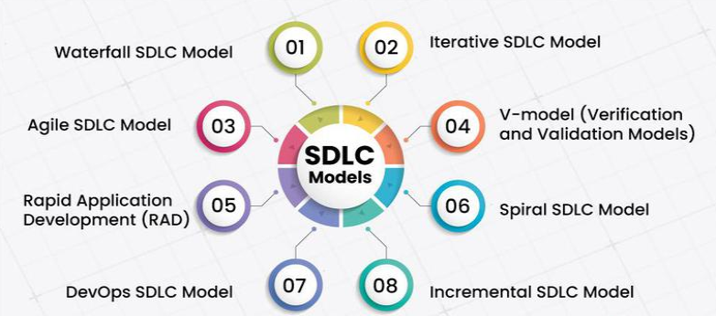
SDLC Models

Slide 5
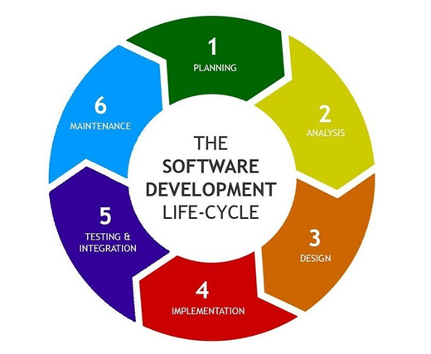
SDLC

Slide 6
SDLC Process
1. Improved relation with Client & Team
2. It offers basic project planning, scheduling and cost estimation.
3. Provide standard set of activities and rules
4. Increase and enhance development speed
5. Maintain project tracking & control
6. Decrease any type of project risk
7. Decide entry and exit criteria of each phase

Slide 7
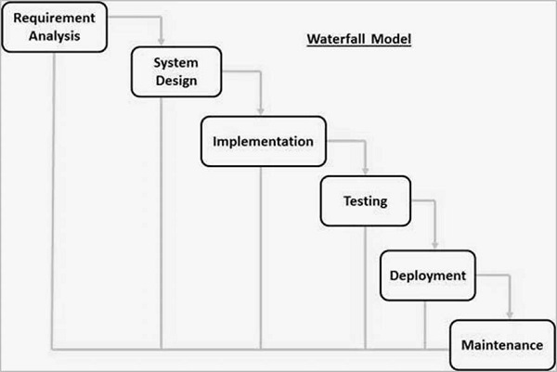
Waterfall Model
Requirements
Design
Development
Testing
Deployment
Maintenance
Notes:
Requirements: The first phase involves gathering requirements from stakeholders and analyzing them to understand the scope and objectives of the project.
Design: Once the requirements are understood, the design phase begins. This involves creating a detailed design document that outlines the software architecture, user interface, and system components.
Development: The Development phase include implementation involves coding the software based on the design specifications. This phase also includes unit testing to ensure that each component of the software is working as expected.
Testing: In the testing phase, the software is tested as a whole to ensure that it meets the requirements and is free from defects.
Deployment: Once the software has been tested and approved, it is deployed to the production environment.
Maintenance: The final phase of the Waterfall Model is maintenance, which involves fixing any issues that arise after the software has been deployed and ensuring that it continues to meet the requirements over time.

Slide 8
Feasibility Study
The feasibility study involves understanding the problem and then determining the various possible strategies to solve the problem.

Slide 9
Requirements Analysis and Specification
The requirement analysis and specification phase aims to understand the exact requirements of the customer and document them properly.
Requirement should be clear and well-defined.
Requirement gathering and analysis
Requirement specification

Slide 10
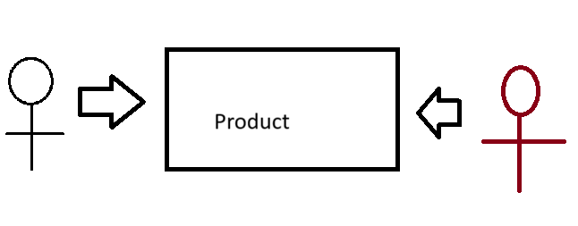
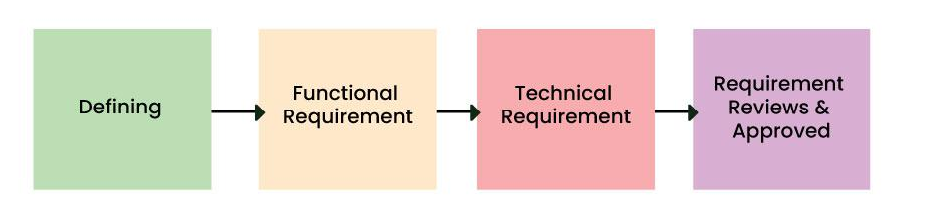
Functional and Non-functional Requirements

Slide 11
Non-Functional Requirements
Portability
Security
Maintainability
Reliability
Scalability
Performance
Reusability
Flexibility

Slide 12
Case Study
Functional and Non-Functional Requirements about Milk delivery App

Slide 13
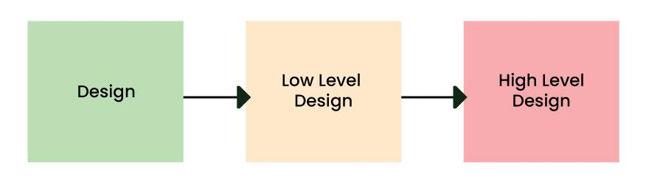
Design
The goal of this phase is to convert the requirements acquired in the SRS into a format that can be coded in a programming language.
It includes high-level and detailed design as well as the overall software architecture

Slide 14
Software Design
The software design process can be divided into the following three levels of phases design:
Interface Design
Architectural Design
Detailed Design

Slide 15
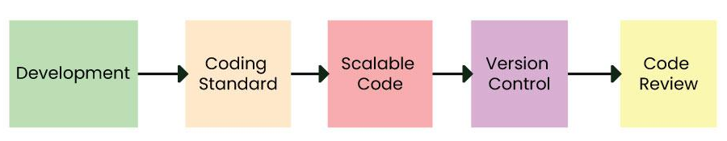
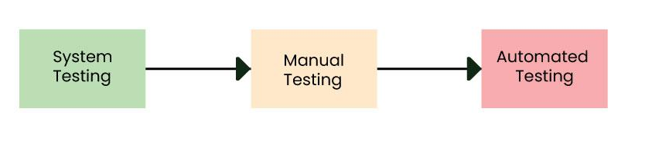
Coding and Unit Testing
In the coding phase software design is translated into source code using any suitable programming language.
Thus, each designed module is coded.
The unit testing phase aims to check whether each module is working properly or not.

Slide 16
Integration and System testing
Integration of different modules is undertaken soon after they have been coded and unit tested
Alpha testing: Alpha testing is the system testing performed by the development team.
Beta testing: Beta testing is the system testing performed by a friendly set of customers.
Acceptance testing: After the software has been delivered, the customer performs acceptance testing to determine whether to accept the delivered software or reject it.

Slide 17
Maintenance
Corrective Maintenance: This type of maintenance is carried out to correct errors that were not discovered during the product development phase.
Perfective Maintenance: This type of maintenance is carried out to enhance the functionalities of the system based on the customer’s request.
Adaptive Maintenance: Adaptive maintenance is usually required for porting the software to work in a new environment such as working on a new computer platform or with a new operating system.

Slide 18
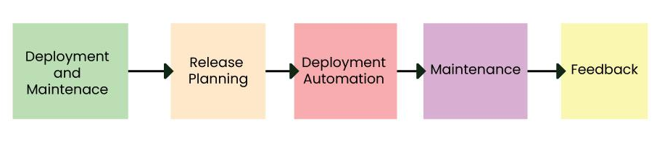
Maintenance

Slide 19
Advantages of Waterfall Model
Easy to Understand
Individual Processing
Properly Defined
Clear Milestones
Properly Documented
Reinforces the design

Slide 20
Limitations of Waterfall Model
No Feedback Path
Difficult to accommodate Change Requests
No Overlapping of Phases
Limited Flexibility
Limited Stakeholder Involvement
Lengthy Development Cycle

Slide 21
When to Use Waterfall Model?
Well-understood Requirements
Very Little Changes Expected
Small to Medium-Sized Projects
Predictable
Regulatory Compliance is Critical
Client Prefers a Linear and Sequential Approach
Limited Resources

Slide 22
Summary
The Waterfall Model has good conventional software development processes.
This model is sequential technique provides an easily understood and applied structured framework.

Slide 23
Iterative model
In Iterative model we start developing the software with some requirements and when it is developed, it is reviewed.
If there are requirements for changes in it, then we develop a new version of the software based on those requirements.
This process repeats itself many times until we get our final product.

Slide 24
Iterative model
we are repeating the development process again and again.
For example, we develop the first version of the software following the SDLC process with some software requirements.
After the first version is developed, if there is a need to change the software , then a new version is developed with the second iteration.

Slide 25
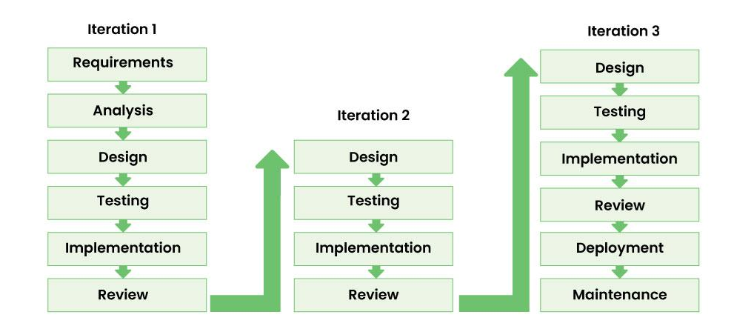
Iterative model

Slide 26
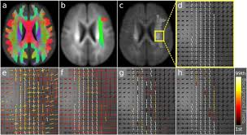
Iterative model

Slide 27
Phases of iterative model
Requirement gathering & analysis
Requirement Collection
Project cost plan
Design
Implementation
Testing
Deployment
Review and Maintenance

Slide 28
Advantage of Iterative model
In iterative models, bugs and errors can be identified quickly.
Under this model, software is prepared quickly with some specifications.
Testing and debugging the software becomes easier during each iteration.
We get reliable feedback from users along with blueprints.
This model is easily adaptable to constantly changing needs.
During the software development process, additional time is devoted to development and limited time to documentation.
Risks are identified and resolved during iteration.

Slide 29
Disadvantage of Iterative model
Iterative model is not suitable for small projects.
Since we have to repeat iterations many times in the software development process due to which we require more resources.
Since the requirements are constantly changing, we have to make frequent changes in the software.
Due to constantly changing requirements, the budget of the project also increases and it takes more time to complete it.
In this model, it is complicated to control the entire process of software development.
It is very difficult to tell by what date the complete software will be ready.

Slide 30
Incremental / Developement Model
In Incremental Model, the software development process is divided into several increments and the same phases are followed in each increment.
In simple language, under this model a complex project is developed in many modules or builds.
Each modules are added to the software in each increment until the complete system is created.

Slide 31
Incremental Model
If we understand the entire principle of Incremental methodology, then it starts by developing an initial implementation.
The user feedback is taken on it.
It is developed through several versions until an accepted system is developed.
Important functionalities of the software are developed in the initial iterations.

Slide 32
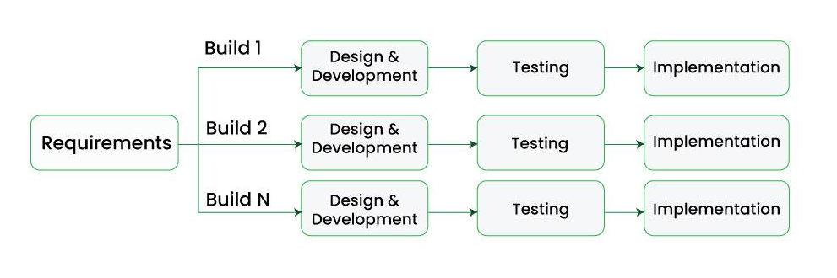
Incremental Model
Each subsequent release of a software module adds functions to the previous release.
This process continues until the final software is obtained.

Slide 33
Incremental Model
College Management System
EASY
Industry Automation

Slide 34
Advantages of Incremental Model
Important modules/functions are developed first and then the rest are added in chunks.
Working software is prepared quickly and early during the software development life cycle (SDLC).
This model is flexible and less expensive to change requirements and scope.
The customer can respond to each module and provide feedback if any changes are needed.
Project progress can be measured.
It is easier to test and debug during a short iteration.
Errors are easy to identify.
Notes:
Communication: In the first phase, we talk face to face with the customer and collect his mandatory requirements. Like what functionalities does the customer want in his software, etc.
Planning: In this phase the requirements are divided into multiple modules and planning is done on their basis.
Modeling: In this phase the design of each module is prepared. After the design is ready, we take a particular module among many modules and save it in DDS (Design Document Specification). Diagrams like ERDs and DFDs are included in this document.
Construction: Here we start construction based on the design of that particular module. That is, the design of the module is implemented in coding. Once the code is written, it is tested.
Deployment: After the testing of the code is completed, if the module is working properly then it is given to the customer for use. After this, the next module is developed through the same phases and is combined with the previous module. This makes new functionality available to the customer. This will continue until complete modules are developed.

Slide 35
Disadvantages of Incremental Model
Management is a continuous activity that must be handled.
Before the project can be dismantled and built incrementally,
The complete requirements of the software should be clear.
This requires good planning and designing.
The total cost of this model is higher.

Slide 36


Prototyping model
Prototyping model is not a complete product it is just functional replica of software.
It is applied when customers do not know the exact project requirements

Slide 37
Prototype model
Prototype model is an activity in which prototypes of software applications are created.
First a prototype is created and then the final product is manufactured based on that prototype.
The prototype model was developed to overcome the shortcomings of the waterfall model.
This model is created when we do not know the requirements well.
The specialty of this model is that this model can be used with other models as well as alone.

Slide 38
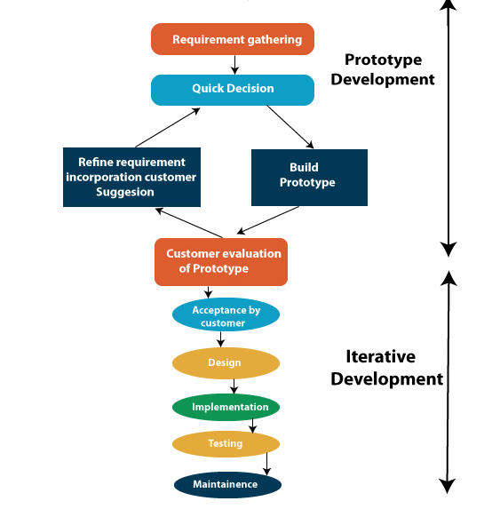
Prototype model

Slide 39

Customer prototype - landing page

Slide 40
Customer prototype - video
Video prototype
|->Technology
|->pixels
|->resolution
|->duration

Slide 41
Advantages of Prototype model
Prototype Model is suggested to create applications whose prototype is very easy and which always includes human machine interaction within it.
When we know only the general objective of creating software,
but we do not know anything in detail about input, processing and output.
Then in such a situation we make it a Prototype Model.
When a software developer is not very sure about the capability of an algorithm or its adaptability to an operating system, then in this situation, using a prototype model can be a better option.

Slide 42
Disadvantages of Prototype model
When the first version of the prototype model is ready, the customer himself often wants small fixes and changes in it rather than rebuilding the system.
Whereas if the system is redesigned then more quality will be maintained in it.
Many compromises can be seen in the first version of the Prototype Model.

Slide 43
V-Model
V-Model is an SDLC model, it is also called Verification and Validation Model.
In V-Model, the execution of each process is sequential, that is, the new phase starts only after the previous phase ends.
It is based on the association of testing phase with each development phase that is in V-Model with each development phase.
Its testing phase is also associated in a V-shape in other words both software development and testing activities take place at the same time.

Slide 44
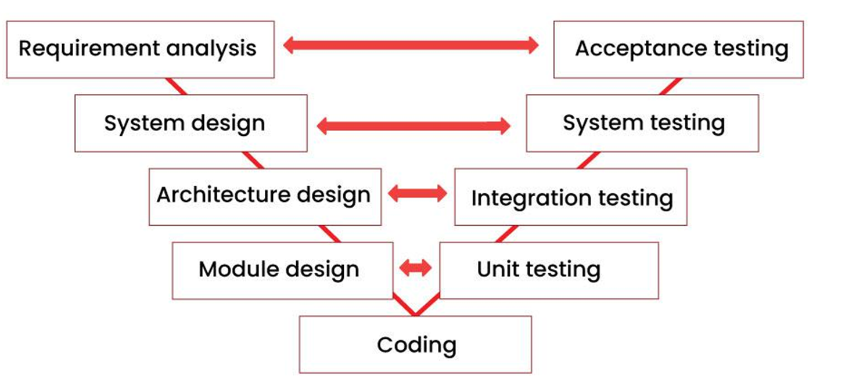

Slide 45
Requirements analysis
This is the first phase of the development cycle, in which the requirements of the product are analyzed according to the customer's needs.
In this phase, acceptance tests are designed for later use.

Slide 46
System design
When we have the requirements of the product, after that we prepare a complete design of the system.
In this phase, a complete description of the hardware and all the technical components required to develop the product.

Slide 47
Architectural design
In this phase architectural specifications are designed.
It contains the specification of how the software will link internally and externally with all the components.
Therefore, this phase is also called high level design (HLD).

Slide 48
Module design
In this phase the internal design of all the modules of the system is specified.
Therefore it is called low level design (LLD).
It is very important that the design of all modules should be according to the system architecture.
Unit tests are also designed in the module design phase.

Slide 49
Coding phase
In the coding phase, coding of the design and specification done in the previous phases is done. This phase takes the most time.
Validation Phases of V-Model

Slide 50
Acceptance testing
It's done by customer (or) system user
In acceptance testing, the acceptance tests created in the requirement analysis phase are executed.
This testing ensures that the system is compatible with other systems.

Slide 51
System testing
In system testing, the system tests created in the system design phase are executed.
System tests check the complete functionality of the system.
In this, more attention is given to performance testing and regression testing.

Slide 52
Integration testing
In integration testing, the integration tests created in the architectural design phase are executed.
Integration testing ensures that all modules are working well together.

Slide 53
Unit testing
In the unit testing phase, the unit tests created during the module design phase are executed.
Unit testing is code level testing, it only verifies the technical design. Therefore it is not able to test all the defects.

Slide 54
Advantages of V-Model
This is a simple and easy to use model.
Planning, testing and designing tests can be done even before coding.
This is a very disciplined model, in which phase by phase development and testing goes on.
Defects are detected in the initial stage itself.
Small and medium scale developments can be easily completed using it.

Slide 55
Disadvantages of V-Model
This model is not suitable for any complex projects.
There remains both high risk and uncertainty.
This is not a suitable model for an ongoing project.

Slide 56
RAD
RAD model stands for rapid application development model.
The methodology of RAD model is similar to that of incremental or waterfall model.
RAD focuses on building applications (or) components in a very short amount of time.
It is used for small projects.

Slide 57
RAD
If the project is large then it is divided into many small projects and these small projects are planned one by one and completed.
In this way, by completing small projects, the large project gets ready quickly.
In RAD model, the project is completed within the given time and all the requirements are collected before starting the project.
It is very fast and there are very less errors in it.

Slide 58
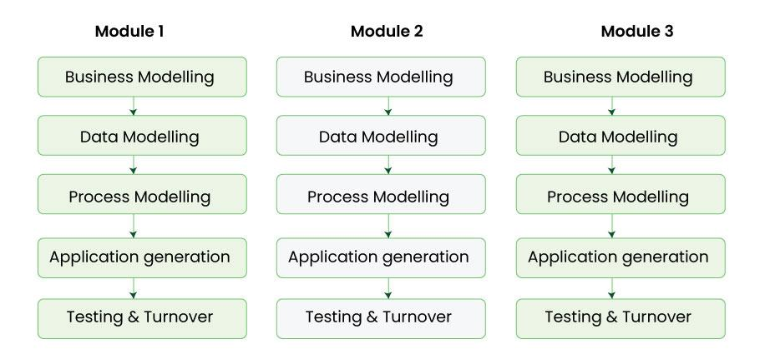
RAD
The main objective of RAD model is to reuse code, components, tools, processes in project development.

Slide 59
Phases RAD model
Business modeling
In this phase, the business model is designed on the basis of whatever functions the business has.
Business workflow.
A complete business analysis is done in this phase.

Slide 60
Data modeling
Data modeling
Using the business model we had prepared.
The data objects required for the business are defined.

Slide 61
Process modeling
Process modeling:
The data objects that we defined in the data modeling phase are converted to establish the business information flow.
It is necessary to achieve specific business objectives.

Slide 62
Application generation
Application generation:
In this phase we start building the software based on the output of the above three phases.
For this we take the help of automation tools.
However, in this phase we do not develop the actual software but make a working prototype.

Slide 63
Testing and turnover
Whatever prototype we have prepared or whatever components and interfaces we have, they are tested in this phase.
Since prototypes are tested separately during each iteration.
The overall testing time in rapid application development is reduced.

Slide 64
Advantage of RAD Model
It reduces the time taken in development.
In this the components are reused.
It is flexible and it is easy to make any changes in it.
It is easy to transfer like scripts because high level abstraction and intermediate codes are used in it.
There are very few defects in it because it is a prototype by nature.
In this, productivity can be increased in less time with less people.
It is cost effective.
It is suitable for small projects.

Slide 65
Disadvantages of RAD Model
In this we need highly skilled developers and designers.
It is very difficult to manage.
It is not suitable for project that are complex and takes long time.
In this, feedback from the client is required for the development of each phase.
Automated code generation is very expensive.
This model is suitable only for component based and scalable systems.

Slide 66
Spiral Model
Spiral model is a software development process model.
This model has characteristics of both iterative and waterfall models. This model is used in projects which are large and complex.
This model was named spiral because if we look at its figure,it looks like a spiral, in which a long-curved line starts from the center point and makes many loops around it.
The number of loops in the spiral is not decided in advance but it depends on the size of the project and the changing requirements of the user.
We also call each loop of the spiral a phase of the software development process.

Slide 67
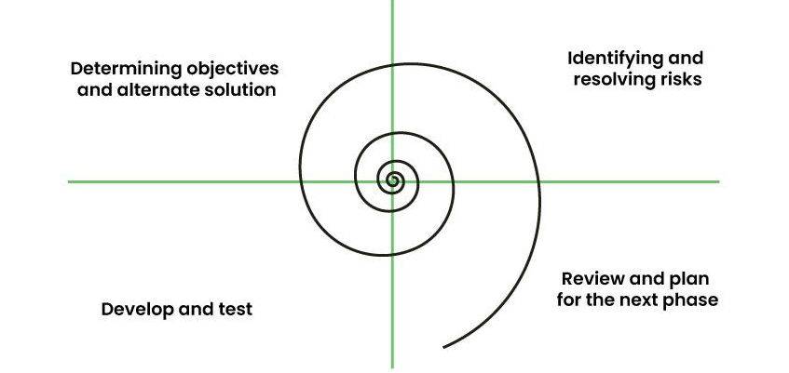
Spiral model

Slide 68
Spiral model
A software project goes through these loops again and again in iterations.
After each iteration a more and more complete version of the software is developed.
The most special thing about this model is that risks are identified in each phase and they are resolved through prototyping.
This feature is also called Risk Handling.
In Spiral Model the entire process of software development is described in four phases which are repeated until the project is completed.

Slide 69
Spiral model
Determining objectives and alternate solutions
Identifying and resolving risks
Develop and test
Review and plan for the next phase

Slide 70
Advantages of Spiral Model
If we have to add additional functionality or make any changes to the software, then through this model we can do so in the later stages also.
Spiral model is suitable for large and complex projects.
It is easy to estimate how much the project will cost.
Risk analysis is done in each phase of this model.
The customer can see the look of his software only in the early stages of the development process.
Since continuous feedback is taken from the customer during the development process, the chances of customer satisfaction increases.

Slide 71
Disadvantage of Spiral Model
This is the most complex model of SDLC, due to which it is quite difficult to manage.
This model is not suitable for small projects.
The cost of this model is quite high.
It requires more documentation than other models.
Experienced experts are required to evaluate and review the project from time to time.
Using this model, the success of the project depends greatly on the risk analysis phase.

Slide 72
Agile
Mostly used model in todays IT projects
Agile means “The ability to respond to changes from requirements, technology and people”
Divides requirements into multiple iterations & provide specific functionality for the release.

Slide 73
Agile Model
Agile model is a combination of iterative and incremental models, that is, it is made up of iterative and incremental models.
In Agile model, focus is given to process adaptability and customer satisfaction.

Slide 74
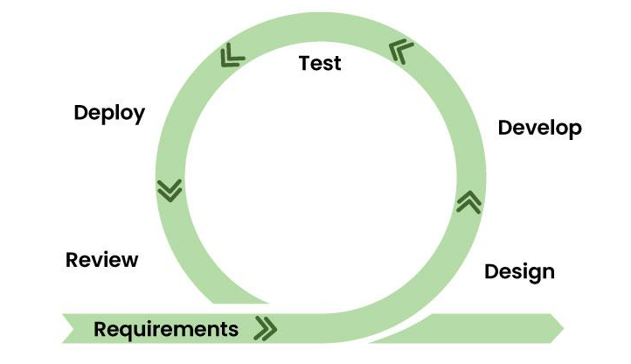
Agile Model

Slide 75
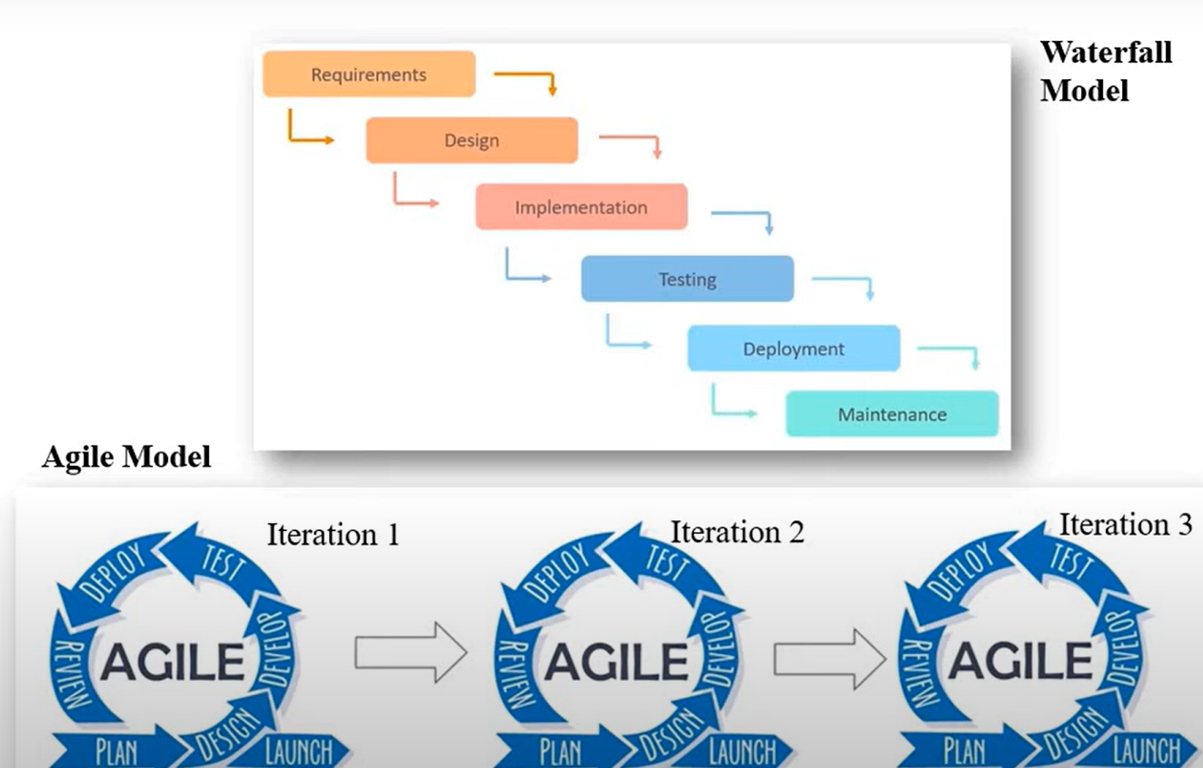

Slide 76
Principles of Agile model
There is a customer representative in the development team to maintain contact with the customer during software development and to understand the requirement.
When an iteration is completed, stakeholders and customer representatives review it and re-evaluate the requirements.

Slide 77
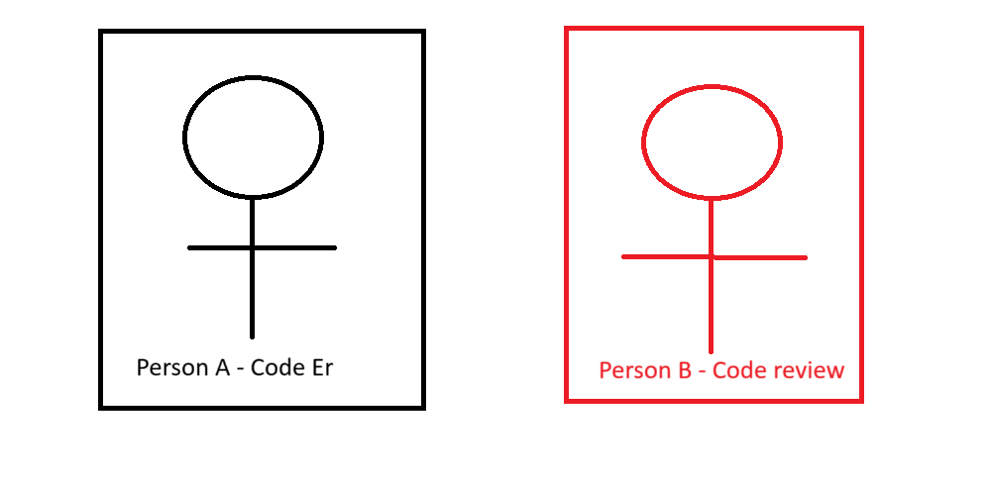
Team – Size is 2

Slide 78
Principles of Agile model
Incremental versions of the software have to be delivered to the customer representative after a few weeks.
In this model it is advised that the size of the development team.
Agile model focuses on the fact that whenever any changes have to be made in the software, it should be completed quickly.

Slide 79
Advantages of Agile Model
Satisfied customers
Improved quality
Predictability
Reduced risk
communication
Notes:
Satisfied Customers
By involving customers in the development process, Agile teams keep them in the loop and show that they value their opinion
Improved quality
Agile methodologies use an iterative approach to project management, meaning processes are improved upon each time an interval is repeated.
Predictability
Agile teams work in short time periods, sometimes referred to as sprints. These fixed durations (e.g., two weeks) make it easier for project managers to measure team performance and assign resources accordingly. It is also easier to predict costs for shorter time periods than for a long-term project, simplifying the estimation process.
Reduced risk
Developers regularly assess progress during sprints, meaning they have better visibility into the project and can spot potential obstacles quickly.
communication

Slide 80
Disadvantages of Agile Model
It cannot handle complex dependencies.
Due to lack of formal documentation in this, there is confusion in development.

