Slide 1
Software Quality Management:
Managing the quality of the software process and products
BEST Summer Course 2002 on Quality Control Systems
FEUP, September 19th 2002
João Pascoal Faria
Prof. Auxiliar, FEUP
Software Architect, Sidereus, S.A.
email: jpf@fe.up.pt

Slide 2
Acknowledgments
This presentation is mainly based on slides of Ian Sommerville accompanying the book “Software Engineering”, 6th edition, Addison-Wesley, 2001

Slide 3
Objectives
To introduce the notion of software quality and describe common software quality attributes and quality-factors
To introduce the verification and validation process
To introduce the software quality management process and key quality management activities
To explain the role of standards in software quality management
To explain the main approaches to verification and validation and quality control: testing, inspections and reviews and measurements
To explain why formal development methods are important to improve software quality

Slide 4
Index
Introduction to software quality
  software product, software development process, product quality, product quality attributes, product quality factors, quality of service, process quality, quality-related activities
Quality assurance and standards
Quality planning and control
Software testing
Software inspections and reviews
Software measurement and metrics
The role of formal methods
Conclusions

Slide 5
Product and process
Business System
goals
Business Process
Demand
Costumer or Market
Product or Service
resources
Is a
Is a
software product
software development process

Slide 6
What is a software product?
Software product = computer programs (sources and executables) + associated documentation
Software products may be
  Custom - developed for a particular customer, according to its specifications
  Generic (“package”) - developed for a general market, to be sold to a range of different customers
Types of software products
  Business support software
    Includes software engineering tools in the software engineering business
  Personal productivity software
    spreadsheets, word processing tools, …
  Embedded software
  …

Slide 7
What is a software development process?
Is the definition of a set of activities whose goal is the development or evolution of a software product
  To be followed/instantiated in individual software development projects
It’s the main business process in a software development business
Generic activities in all software processes are:
  Specification - what the system should do and its development constraints
  Development - production of the software system
  Validation - checking that the software is what the customer wants
  Evolution - changing the software in response to changing demands
New or changed
requirements
(problem)
Software Development
Process
New or changed
software product
(solution)

Slide 8
The importance of software
The economies of ALL developed nations are dependent on software
More and more systems are software controlled
  Including an increasing number of safety-critical and mission-critical systems, with high demands on dependability
More and more businesses depend on software for their success
  Software and Information Systems are critical success factors in an increasing number of businesses and organizations
Software engineering expenditure (in the development and maintenance of software products) represents a significant fraction of GNP (Gross National Product) in all developed countries

Slide 9
What is product quality?
Quality, simplistically, means that a product should meet its specification
  The software product should deliver the required functionality (functional requirements) with the required quality attributes (non–functional requirements)
This is problematical for software systems
  Tension between customer quality requirements (efficiency, reliability, ...) and developer quality requirements (maintainability, reusability, ...)
  Some quality requirements are difficult to specify in an unambiguous way
  Software specifications are usually incomplete and often inconsistent
  The quality compromise: we cannot wait for specifications to improve before paying attention to quality, and procedures must be put into place to improve quality in spite of imperfect specification
Quality attributes are frequently conflicting and increase development costs, so there is a need for weighting and balancing
Software engineering is concerned with the cost-effective development of good software

Slide 10
The current status of software quality
Microsoft Windows XP End-User License Agreement:
11. LIMITED WARRANTY FOR PRODUCT ACQUIRED IN THE US AND CANADA.
Microsoft warrants that the Product will perform substantially in accordance with the accompanying materials for a period of ninety days from the date of receipt.
(…)
If an implied warranty or condition is created by your state/jurisdiction and federal or state/provincial law prohibits disclaimer of it, you also have an implied warranty or condition, BUT ONLY AS TO DEFECTS DISCOVERED DURING THE PERIOD OF THIS LIMITED WARRANTY (NINETY DAYS).
(…)
Some states/jurisdictions do not allow limitations on how long an implied warranty or condition lasts, so the above limitation may not apply to you.
(…)
YOUR EXCLUSIVE REMEDY. Microsoft's and its suppliers' entire liability and your exclusive remedy shall be, at Microsoft's option from time to time exercised subject to applicable law, (a) return of the price paid (if any) for the Product, or (b) repair or replacement of the Product, that does not meet this Limited Warranty and that is returned to Microsoft with a copy of your receipt.
(..)
This Limited Warranty is void if failure of the Product has resulted from accident, abuse, misapplication, abnormal use or a virus.

Slide 11
Product quality attributes (1)
Attributes of good software (beyond delivering the required functionality):
Efficiency
  Software should not make wasteful use of system resources (disk and memory space, CPU time, etc.) and should present appropriate response times
Usability (ease of use)
  Software must be usable by the users for which it was designed
Dependability (reliability, availability, security, safety,…)
  Software must be trustworthy
Maintainability (ease of maintenance)
  Software must evolve to meet changing needs
  Software costs more to maintain than it does to develop. For systems with a long life, maintenance costs may be several times development costs
…

Slide 12
Product quality attributes (2)
Other quality attributes:
  Resilience
  Robustness
  Understandability
  Testability
  Adaptability
  Modularity
  Simplicity
  Portability
  Reusability
  Learnability

Slide 13
Main dimensions of dependability
Reliability - The probability of failure-free system operation over a specified time in a given environment for a given purpose
Availability - The probability that a system, at a point in time, will be operational and able to deliver the requested services
  It’s possibly to have high availability with low reliability if failures are repaired quickly
Safety - The system’s ability to operate, normally or abnormally, without danger of causing human injury or death and without damage to the system’s environment
Security – The system’s ability to protect itself from accidental or deliberate external attack

Slide 14
Dependability and critical systems
For critical systems, it is usually the case that the most important system property is the dependability of the system
Types of critical systems:
  Safety–critical system – a system whose failure may result in injury, loss of life or major environment damage
    e.g. an insulin delivery system
  Mission-critical system – a system whose failure may result in the failure of some goal-directed activity
    e.g. a navigational system for a space aircraft
  Business-critical system – a system whose failure may result in the failure of the business using the system
    e.g. a customer account system in a bank

Slide 15
Usability

Slide 16
Does usage and time cause degradation of a software product quality?
By definition, should not, but …
A program running continuously for a long period of time (without shutting down) may work increasingly slower or even crash
  e.g. because of memory leaks or memory fragmentation
  fortunately, original quality is restored by shutting down and restarting
  do you know products like this?
Performance decreases with the number of concurrent users and the size of the data
  may req. hardware upgrade and, consequently, software upgrade (good 4 business)
Maintainability decreases with time
  may req. preventive maintenance (migration to knew technologies, etc.)
Software becomes obsolete very quickly
  because of fast evolution of technology, requirements or knowledge
  sometimes software is used for longer time than expected (remember Y2K bug)
  requires continuous innovation and evolution

Slide 17
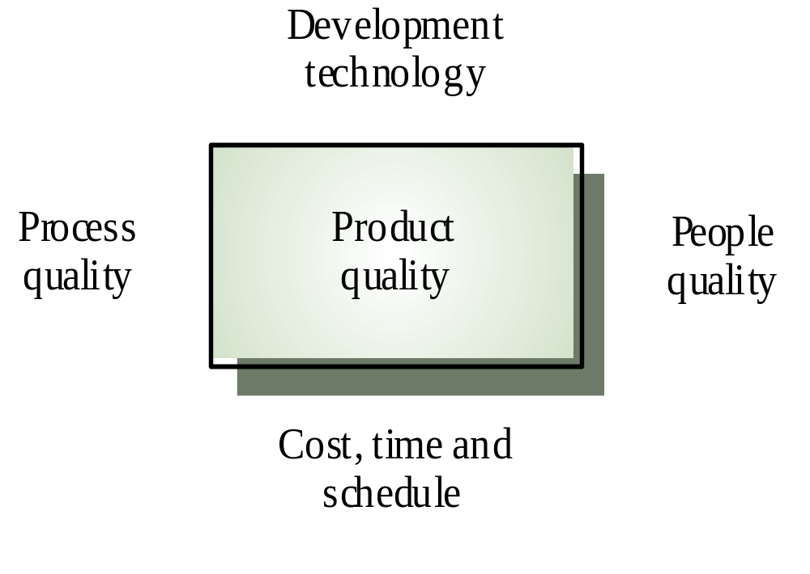
Principal product quality factors (1)
Software development process
Budget and Schedule

Slide 18
Principal product quality factors (2)
Process quality
  A good process is usually required to produce a good product
  For manufactured goods, process is the principal quality determinant
  For design-based activity (like software development), other factors are also involved especially the capabilities of the designers
  For large projects with ‘average’ capabilities, the development process determines product quality
People quality
  For small projects, the capabilities of the developers is the main determinant
  Corollary: you need lower quality people (and higher quality process) in larger projects?
  Project Size x People Quality = Constant ?
Development technology
  Is particularly significant for small projects
Budget and schedule
  In all projects, if an unrealistic schedule is imposed then product quality will suffer

Slide 19
Process quality attributes
Process characteristic | Description
Understandability | To what extent is the process explicitly defined and how easy is it to understand the process definition?
Visibility | Do the process activities culminate in clear results so that the progress of the process is externally visible?
Supportability | To what extent can the process activities be supported by CASE tools?
Acceptability | Is the defined process acceptable to and usable by the engineers responsible for producing the software product?
Reliability | Is the process designed in such a way that process errors are avoided or trapped before they result in product errors?
Robustness | Can the process continue in spite of unexpected problems?
Maintainability | Can the process evolve to reflect changing organisational requirements or identified process improvements?
Rapidity | How fast can the process of delivering a system from a given specification be completed?

Slide 20
People quality attributes

Slide 21
Quality of service
Some product-related services and their quality attributes
  User Training
  User Help
    Quick and useful response (avoid “Help does not Help”)
  Product repair and new versions deployment
    Quick and effective repair
    Conservation qualities:
      Things that worked well in the old version, continue to work well in the new version (regression tests are very important here), and don’t require new user training
      Installation of the new version doesn’t cause loss of user data (backward compatibility)
      Installation of the new version doesn’t require system down for too much time
    Progress qualities:
      Things that worked wrong or didn’t work at all in the old version, now work well in the new version, or new useful features have been added
Not focused in this presentation (more focused on product than service)

Slide 22
Quality-related activities (1)
Software Verification and Validation (V & V)
  Goals:
    Establish the existence of defects in a product
    Assess whether or not the product is usable in an operational situation
  Verification
    Ensure that we are building the product right, i.e., according to its specification
  Validation
    Ensure that we are building the right product, i.e., according to user needs
  V & V are integral part of the development process
  Concerned directly with product quality

Slide 23
Quality-related activities (2)
Software Quality Management (SQM)
  Goals: Ensure that the required level of quality is achieved in software products, namely, that defined standards and procedures are followed
  SQM should aim to develop a ‘quality culture’ where quality is seen as everyone’s responsibility
  Sub-activities:
    (Organization–wide) Quality assurance
      Establish organisational procedures and standards for quality in a quality manual
    (Project–wide) Quality planning
      Select applicable procedures and standards for a particular project and modify these as required. Produce a quality plan.
    (Project–wide) Quality control (QC)
      Ensure that procedures and standards are followed by the software development team. Produce quality review reports
  Quality management should be separate from project management to ensure independence of budget and schedule pressures
  Concerned directly with process quality and, indirectly, product quality

Slide 24
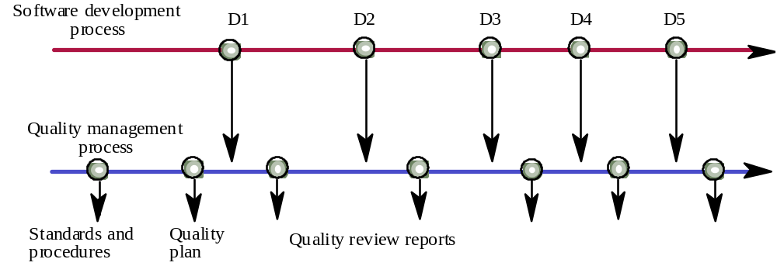
Quality management and software development
deliverables

Slide 25
Main approaches for V&V and QC
Tests
  Dynamic technique, concerned with exercising and observing product behaviour to discover defects
  The system is executed with test data (defined test cases) and its operational behaviour is observed to discover defects (differences between observed and expected)
  Used mainly for V & V
  GUI testing difficult to automate; API testing easier to automate
Inspections and reviews
  Static technique - concerned with the analysis of the static system representation (source code, documentation, …) to discover problems
  May be supplement by tool-based document and code analysis
Measurements
  The value of defined metrics is automatically measured on selected components of the product, for prediction or control purposes
  Used mainly for CQ
All involve planning, execution and result analysis and reporting

Slide 26
Index
Introduction
Quality assurance and standards
Quality planning and control
Software testing
Software inspections and reviews
Software measurement and metrics
The role of formal methods
Conclusions

Slide 27
Quality assurance and standards
Standards are the key to effective quality management
They may be international, national, organizational or project standards
Product standards define characteristics that all components should exhibit e.g. a common programming style
Process standards define how the software process should be enacted

Slide 28
Importance of standards
Encapsulation of best practice - avoids repetition of past mistakes
Framework for quality assurance process – it involves checking standard compliance
Provide continuity - new staff can understand
the organisation by understand the standards
applied

Slide 29
Problems with standards
Not seen as relevant and up-to-date by software engineers
  Practitioners should be involved in development. Engineers should understand the rationale underlying a standard
  Standards and their usage should be reviewed regularly. Standards can quickly become outdated and this reduces their credibility amongst practitioners
Involve too much bureaucratic form filling
Unsupported by software tools so tedious manual work is involved to maintain standards
  Detailed standards should have associated tool support. Excessive clerical work is the most significant complaint against standards

Slide 30
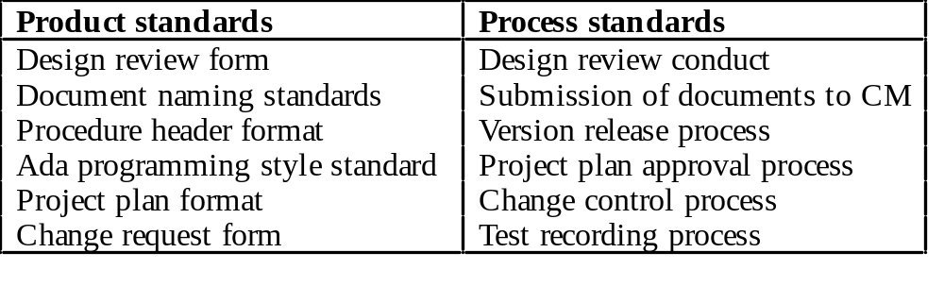
Product and process standards

Slide 31
Documentation standards
Particularly important - documents are the tangible manifestation of the software
Documentation process standards
  How documents should be developed, validated and maintained
Document standards
  Concerned with document identification, structure, presentation, changes highlighting, etc.
Document interchange standards
  How documents are stored and interchanged between different documentation systems
  XML is an emerging standard for document interchange which will be widely supported in future

Slide 32
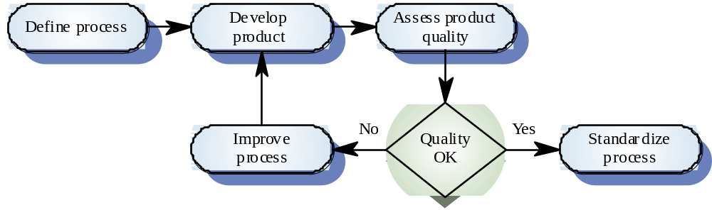
Development of process standards
Care must be taken not to impose inappropriate process standards

Slide 33
ISO 9000
International set of standards for quality management (ISO 9000:2000, ISO 9001:2000, ISO 9004:2000, etc.)
Applicable to a range of organisations from manufacturing to service industries
ISO 9001:2000 specifies requirements for a quality management system for any organization that needs to demonstrate its ability to consistently provide product that meets customer and applicable regulatory requirements and aims to enhance customer satisfaction, in all business sectors
  Integrates previous standards ISO 9001, ISO 9002 and ISO 9003
  ISO 9001 is a generic model that must be instantiated for each organisation
ISO 9004:2000 provides guidance for continual improvement of a quality management system to benefit all parties (employees, owners, suppliers, society in general,…) through sustained customer satisfaction. It should be used to extend the benefits obtained from ISO 9001:2000 to all parties that are interested in or affected by the business operations.

Slide 34
ISO 9000 certification
Quality standards and procedures should be documented in an organisational quality manual
External body may certify that an organisation’s quality manual conforms to ISO 9000 standards (namely ISO 9001)
Customers are, increasingly, demanding that suppliers are ISO 9000 certified

Slide 35
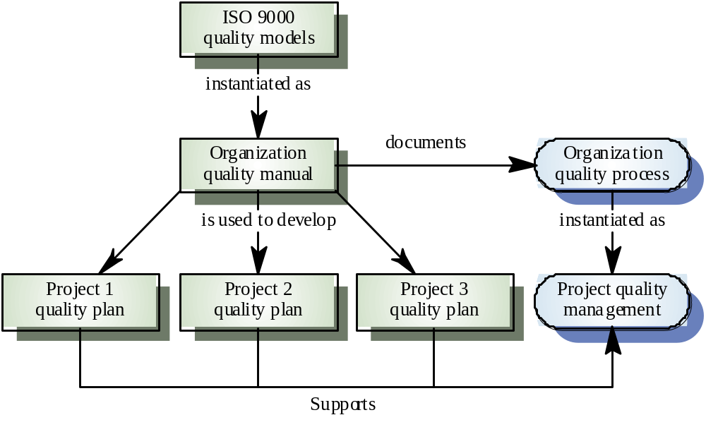
ISO 9000 and quality management

Slide 36
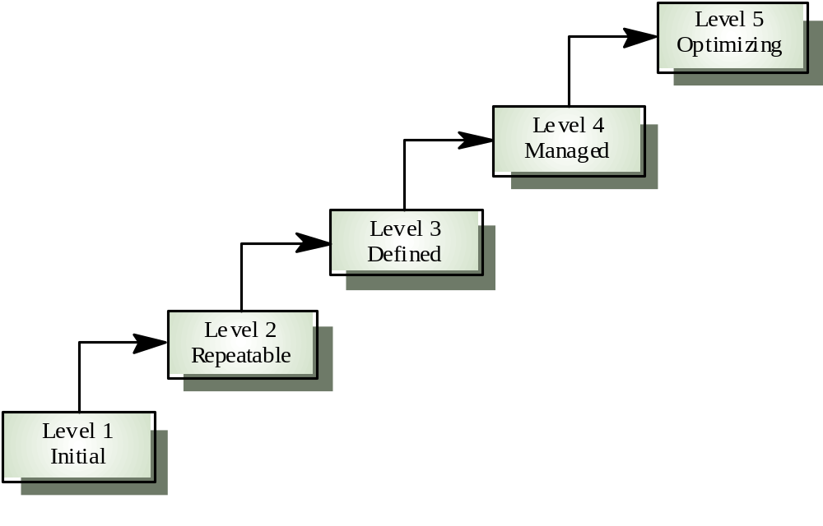
The Software Engineering Institute (SEI) Capability Maturity Model for Software (CMM)
Is a model for
judging the maturity of the software processes of an organization
identifying the key practices that are required to increase the maturity of these processes

Slide 37
CMM maturity levels
1) Initial. The software process is characterized as ad hoc, and occasionally even chaotic. Few processes are defined, and success depends on individual effort and heroics.
2) Repeatable. Basic project management processes are established to track cost, schedule, and functionality. The necessary process discipline is in place to repeat earlier successes on projects with similar applications.
3) Defined. The software process for both management and engineering activities is documented, standardized, and integrated into a standard software process for the organization. All projects use an approved, tailored version of the organization's standard software process for developing and maintaining software.
4) Managed. Detailed measures of the software process and product quality are collected. Both the software process and products are quantitatively understood and controlled.
5) Optimizing. Continuous process improvement is enabled by quantitative feedback from the process and from piloting innovative ideas and technologies.

Slide 38
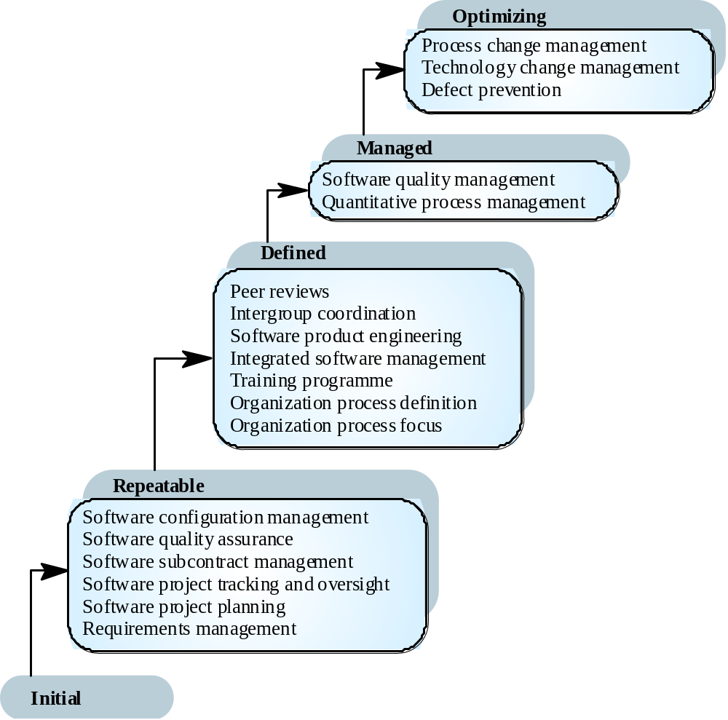
CMM key process areas

Slide 39
The CMM and ISO 9000
There is a clear correlation between the key processes in the CMM and the quality management processes in ISO 9000
The CMM is more detailed and prescriptive and includes a more detailed framework for improvement
Organisations rated as level 2 in the CMM are likely to be ISO 9000 compliant

Slide 40
Index
Introduction
Quality assurance and standards
Quality planning and control
Software testing
Software inspections and reviews
Software measurement and metrics
The role of formal methods
Conclusions

Slide 41
Quality planning
A quality plan sets out (within a particular project) the desired product qualities and how these are assessed and define the most significant quality attributes
It should define the quality assessment process
It should set out which organisational standards should be applied and, if necessary, define new standards
Quality plans should be short, succinct documents
  If they are too long, no-one will read them

Slide 42
Quality control
Checking the software development process (within a particular project) to ensure that procedures and standards, as defined in the quality plan, are being followed
Two approaches to quality control
  (Manual) Quality reviews – main approach
  (Automated) Quality measurement

Slide 43
Index
Introduction
Quality assurance and standards
Quality planning and control
Software testing
Software inspections and reviews
Software measurement and metrics
The role of formal methods
Conclusions

Slide 44
Black-box and white-box tests
Black-box testing
  An approach to testing where the program is considered as a ‘black-box’
  The program test cases are based on the system specification
  Test planning can begin early in the software process
White-box testing
  Sometime called structural testing
  Derivation of test cases according to program structure. Knowledge of the program is used to identify additional test cases
  Objective is to exercise all program statements (not all path combinations)
    Test coverage measures ensure that all statements have been executed at least once

Slide 45
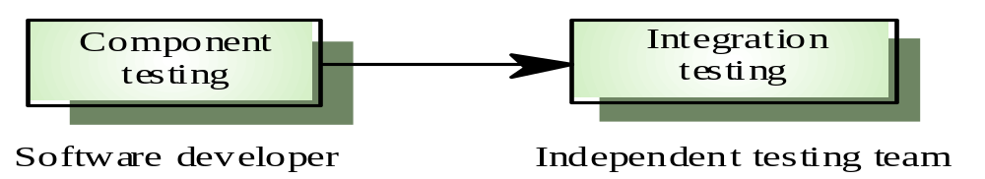
Component and integration testing
Component testing
  Testing of individual program components
  Usually the responsibility of the component developer (except sometimes for critical systems)
  Tests are derived from the developer’s experience
Integration testing
  Testing of groups of components integrated to create a system or sub-system
  The responsibility of an independent testing team
  Tests are based on a system specification (black-box)

Slide 46
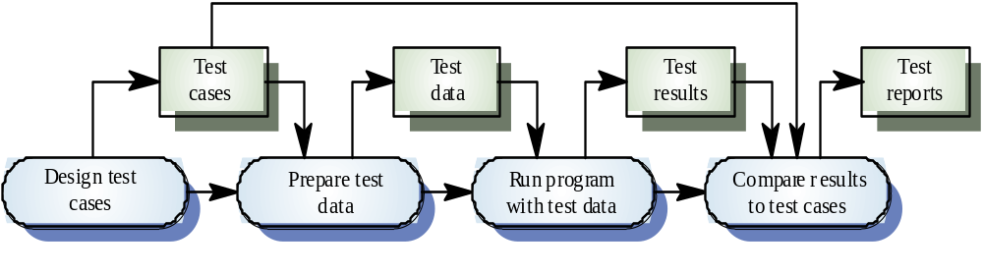
The defect testing process
inputs and expected results

Slide 47
Index
Introduction
Quality assurance and standards
Quality planning and control
Software testing
Software inspections and reviews
Software measurement and metrics
The role of formal methods
Conclusions

Slide 48
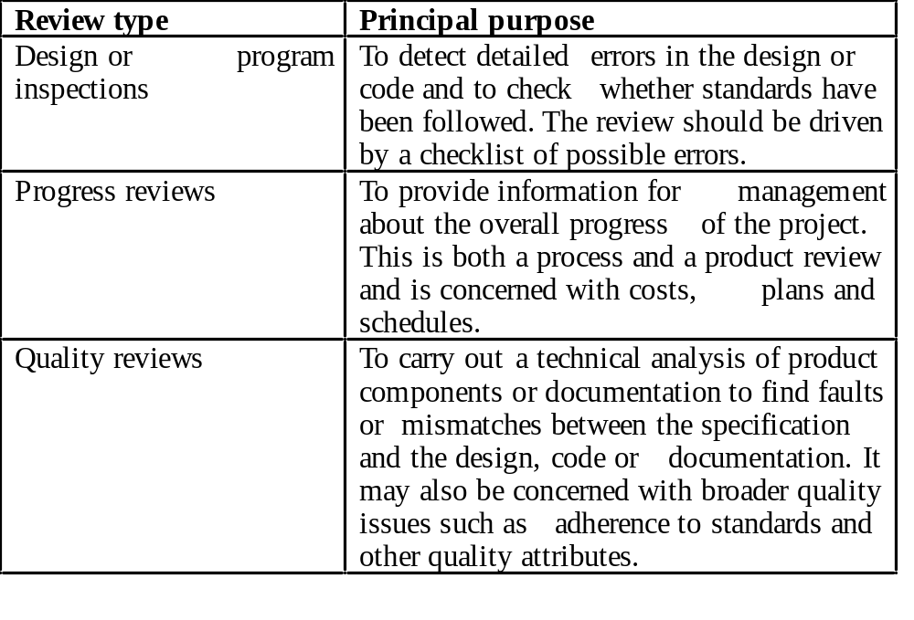
Types of review
Part of software verification and validation
Part of software project management
Part of software quality management

Slide 49
Review results
Comments made during the review should be classified:
  No action. No change to the software or documentation is required.
  Refer for repair. Designer or programmer should correct an identified fault.
  Reconsider overall design. The problem identified in the review impacts other parts of the design. Some overall judgement must be made about the most cost-effective way of solving the problem.
Requirements and specification errors may have to be referred to the client.

Slide 50
Index
Introduction
Quality assurance and standards
Quality planning and control
Software testing
Software inspections and reviews
Software measurement and metrics
The role of formal methods
Conclusions

Slide 51
Software metric
A software metric is a property of a software product, process or related documentation that takes a numeric value that can be measured
  Lines of code in a program, number of person-days required to develop a component, etc.
We are interested here in measuring (quantifying) the quality of a software product
Main difficulty: distance between what we want to know (usually an external quality attribute) and what we are able to measure (usually an internal attribute)
  higher with static metrics – see next
Although some companies have introduced measurement programmes, the systematic use of measurement is still uncommon and there are few standards in this area

Slide 52
Types of product metrics
Dynamic metrics
  Are collected by measurements made of a program in execution
  Are closely related to software quality attributes, such as efficiency and reliability
  It is relatively easy to measure the response time of a system (performance attribute) or the number of failures (reliability attribute)
Static metrics
  Are collected by measurements made of the system representations (source files, documentation, etc.)
  Have an indirect (and difficult to establish) relationship with quality attributes, such as complexity, understandability and maintainability

Slide 53
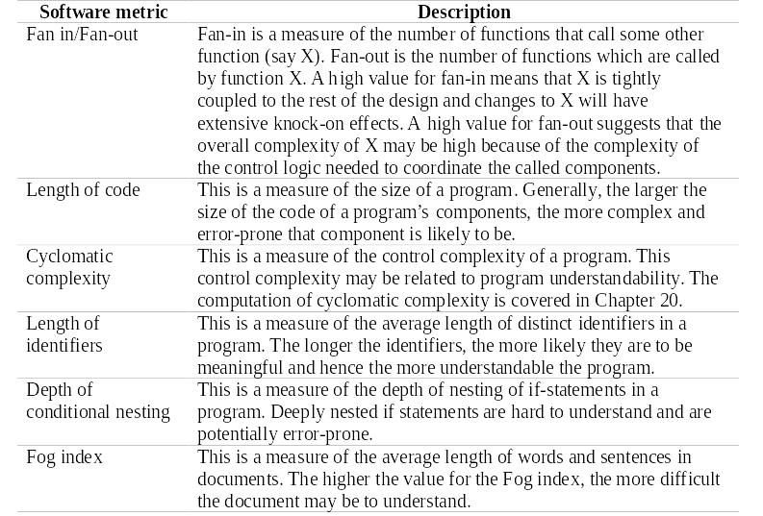
Examples of static metrics

Slide 54
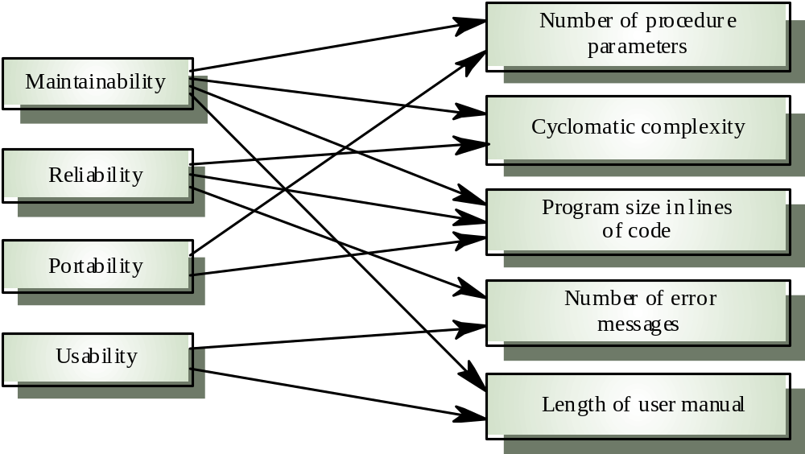
Relationship between static metrics and quality attributes
Internal attribute
(static metric)
External attribute
(quality attribute)
?

Slide 55
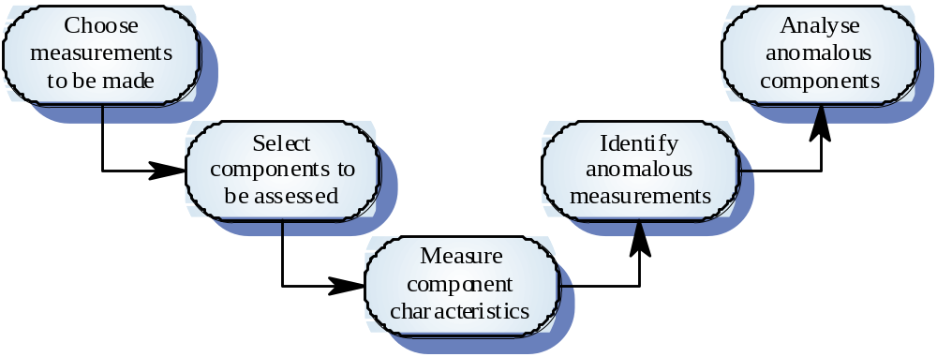
Product measurement process
select metrics
collected data

Slide 56
Measurement analysis
It is not always obvious what data means
  Analysing collected data is very difficult
Data analysis must take local circumstances into account
Example of measurement surprises:
  Reducing the number of faults in a program leads to an increased number of help desk calls
    The program is now thought of as more reliable and so has a wider more diverse market. The percentage of users who call the help desk may have decreased but the total may increase
    A more reliable system is used in a different way from a system where users work around the faults. This leads to more help desk calls

Slide 57
Index
Introduction
Quality assurance and standards
Quality planning and control
Software testing
Software inspections and reviews
Software measurement and metrics
The role of formal methods
Conclusions

Slide 58
Formal methods
Collection of techniques based on mathematical representation and analysis of software
Formal methods include
  Formal specification
  Specification analysis and proof
  Transformational development
  Program verification

Slide 59
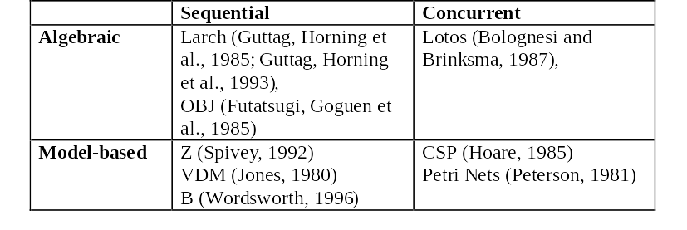
Formal specification languages
The system is specified in terms of its operations and their relationships
The system is specified in terms of a state model that is constructed using mathematical constructs such as sets and sequences. Operations are defined by modifications to the system’s state

Slide 60
Expectations about formal methods
The rigour and detailed analysis that are an essential part of formal methods are expected to lead to programs with fewer errors and that are more suited to user’s needs
Formal specifications are precise and unambiguous. They remove areas of doubt in a specification
Formal specification forces an analysis of the system requirements at an early stage. Incompleteness and inconsistencies can be discovered and resolved. This reduces requirements errors.
Correcting errors at this stage is cheaper than modifying a delivered system.
Formal specification techniques and formal methods in general were seen by many researchers as the most likely route to dramatic improvements in software quality

Slide 61
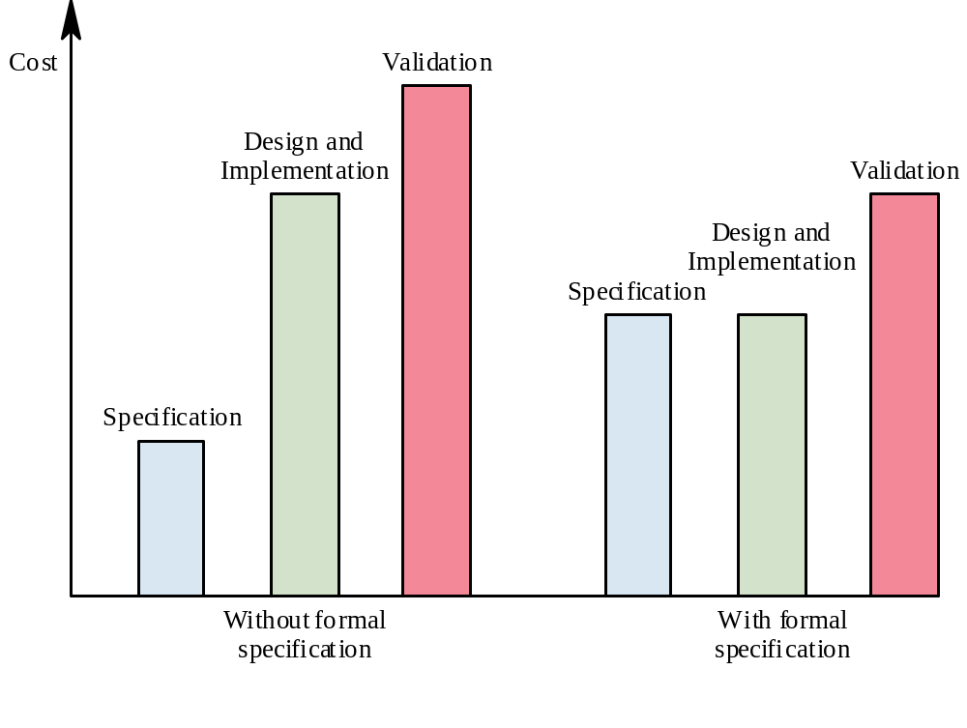
Development costs with formal specification

Slide 62
Rigour, Complexity and Quality
15%
Quality
100%
Formal methods (mathematical)
35%
Rigour
Traditional methods
50%
Source:
Luis Neves, Sidereus S.A.
0 %
Complexity
100%

Slide 63
Limitations of formal methods
Formal methods have not become mainstream software development techniques for several reasons
  Other software engineering techniques have been successful at increasing system quality. Hence the need for formal methods has been reduced
  Market changes have made time-to-market rather than software quality the key factor. Formal methods do not reduce time to market
    Solution: automatic code generation from specifications?
  The scope of formal methods is limited. They are not well-suited to specifying and analysing user interfaces and user interaction, which constitute a greater and greater part of many systems
    Solution: combine GUI prototyping with formal specification of other parts?
  Formal methods are hard to scale up to large systems
    Solution: increased tool support?
Formal specification techniques are most applicable in the development of critical systems

Slide 64
Index
Introduction
Quality assurance and standards
Quality planning and control
Software testing
Software inspections and reviews
Software measurement and metrics
The role of formal methods
Conclusions

Slide 65
Key points
Software quality management is concerned with ensuring that software meets its required standards
Quality assurance procedures should be documented in an organisational quality manual
Software standards are an encapsulation of best practice
Reviews are the most widely used approach for assessing software quality

Slide 66
Key points
Software measurement gathers information about both the software process and the software product
Product quality metrics should be used to identify potentially problematical components
There are no standardised and universally applicable software metrics

Slide 67
More information
Ian Sommerville, “Software Engineering”, 6th edition, Addison-Wesley, 2001
ISO 9000
http://www.iso.ch/iso/en/iso9000-14000/iso9000/iso9000index.html
SEI Capability Maturity Model
http://www.sei.cmu.edu/cmm/cmm.html
International Conference on Software Quality
http://www.icsq.org/
Certified Software Quality Engineer (CSQE) Body of Knowledge
http://www.asq.org/cert/types/csqe/bok.html
Instituto Português da Qualidade
www.ipq.pt

