Slide 1
Natural Language Processing

Slide 2
Natural Language Processing
Natural Language Processing(NLP) is defined as the branch of Artificial Intelligence that provides computers with the capability of understanding text and spoken words in the same way a human being can.
It incorporates machine learning models, statistics, and deep learning models into computational linguistics i.e. rule-based modeling of human language to allow computers to understand text, spoken words and understands human language, intent, and sentiment.

Slide 3
Natural Language Processing
Humans communicate with each other using words and text. The way that humans convey information to each other is called Natural Language.
Every day humans share a large quality of information with each other in various languages as speech or text.
However, computers cannot interpret this data, which is in natural language, as they communicate in 1s and 0s. The data produced is precious and can offer valuable insights.
Hence, you need computers to be able to understand, emulate and respond intelligently to human speech.

Slide 4
Natural Language Processing
Natural Language Processing or NLP refers to the branch of Artificial Intelligence that gives the machines the ability to read, understand and derive meaning from human languages.

Slide 5
Natural Language Processing
NLP combines the field of linguistics and computer science to decipher language structure and guidelines and to make models which can comprehend, break down and separate significant details from text and speech.

Slide 6
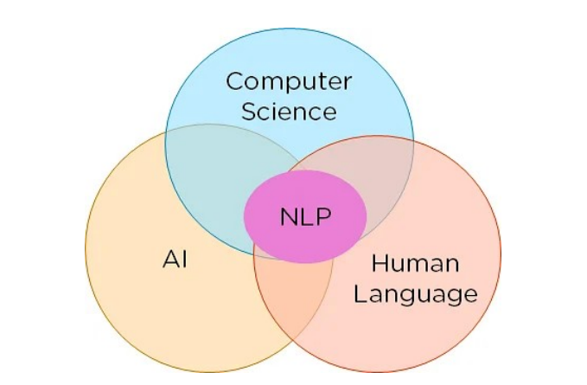
Natural Language Processing

Slide 7
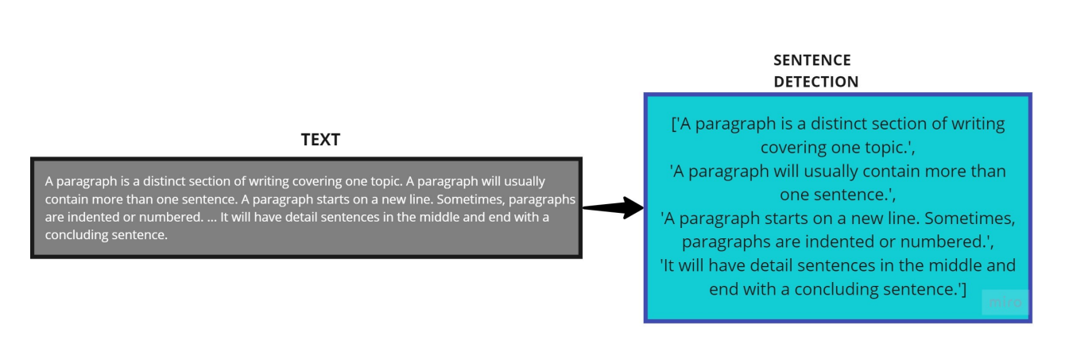
Corpus to Documents

Slide 8
NLP Steps
Segmentation
Tokenizing
Removing Stop Words
Stemming
Lemmatization
Part of Speech Tagging
Named Entity Tagging

Slide 9
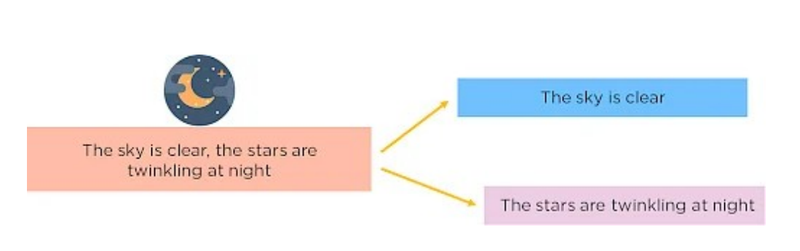
Segmentation

Slide 10
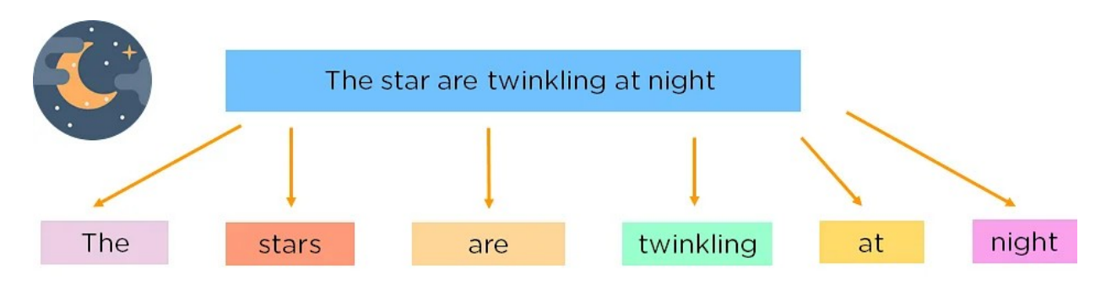
Tokenizing

Slide 11
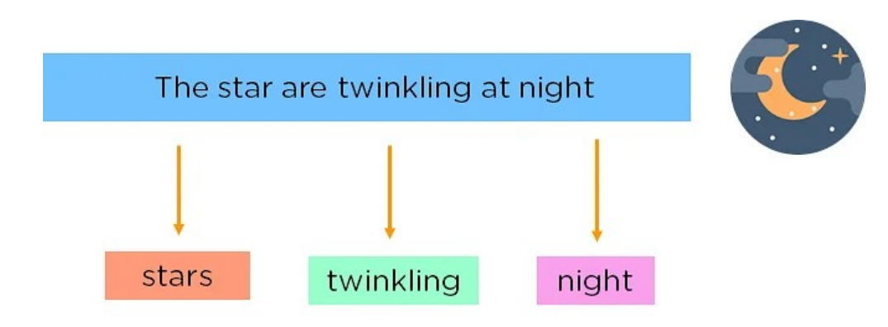
Removing Stop Words

Slide 12
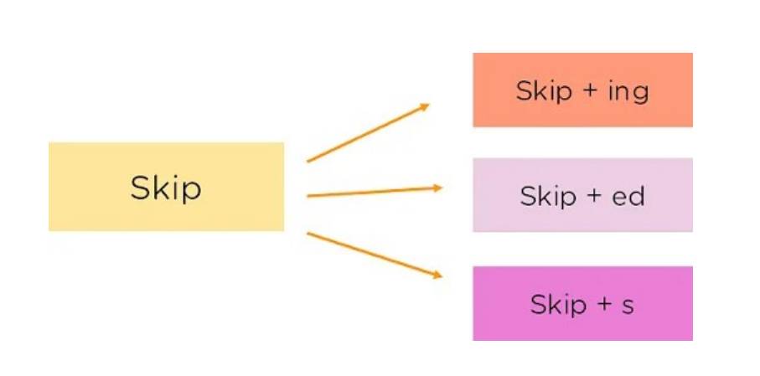
Stemming

Slide 13
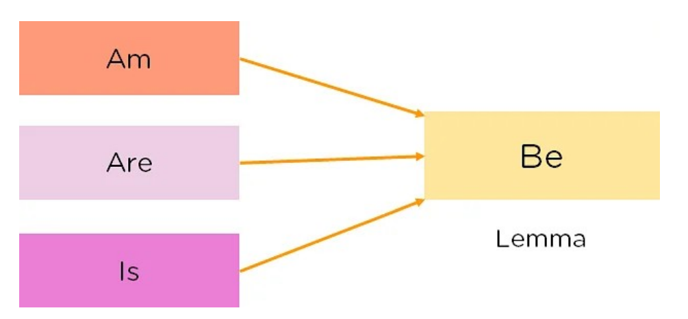
Lemmatization

Slide 14
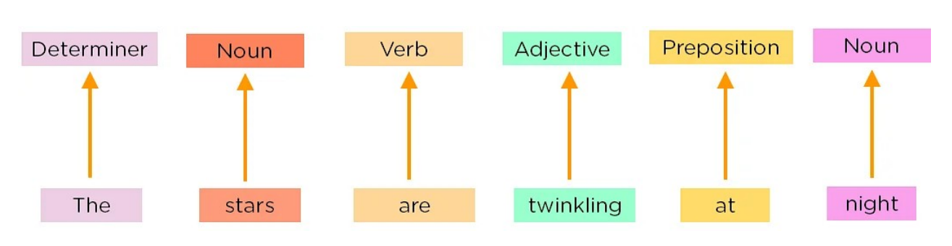
Part of Speech Tagging

Slide 15
Named Entity Tagging
Next, introduce your machine to pop culture references and everyday names by flagging names of movies, important personalities or locations etc that may occur in the document.
You do this by classifying the words into subcategories.
This helps you find any keywords in a sentence.
The subcategories are person, location, monetary value, quantity, organization, movie.
After performing the preprocessing steps, you then give your resultant data to a machine learning algorithm like Naive Bayes, etc., to create your NLP application.

Slide 16
Word2vec
Hands on
https://rare-technologies.com/word2vec-tutorial/

Slide 17
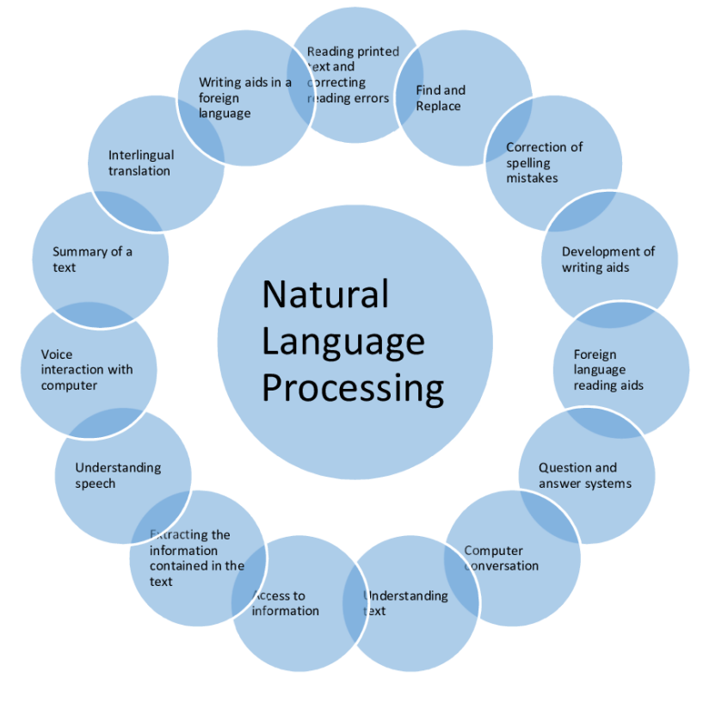
Applications of NLP

