Slide 1
Retrieval-Augmented Generation (RAG)

Slide 2
RAG
Retrieval augmented generation, or RAG, is an architectural approach that can improve the efficacy of large language model (LLM) applications by leveraging custom data.
This is done by retrieving data/documents relevant to a question or task and providing them as context for the LLM.

Slide 3
Use cases for RAG
Question and Answer Chatbots
Search augmentation

Slide 4
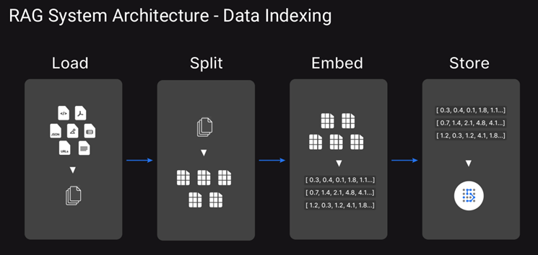

Slide 5
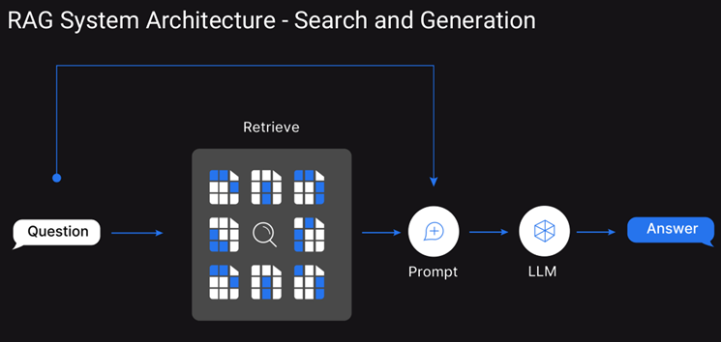

Slide 6
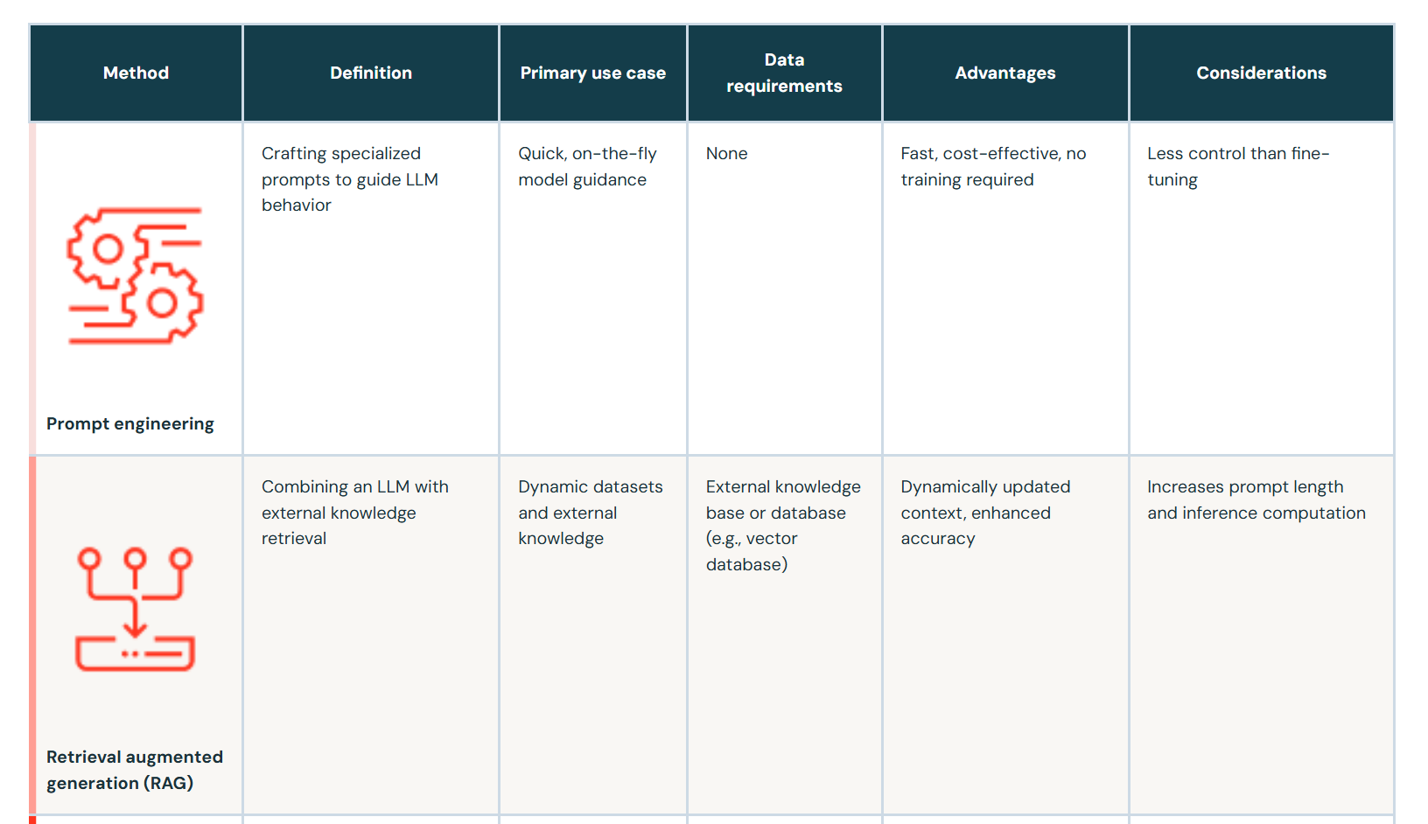
prompt engineering vs RAG vs fine-tune vs pretrain

Slide 7
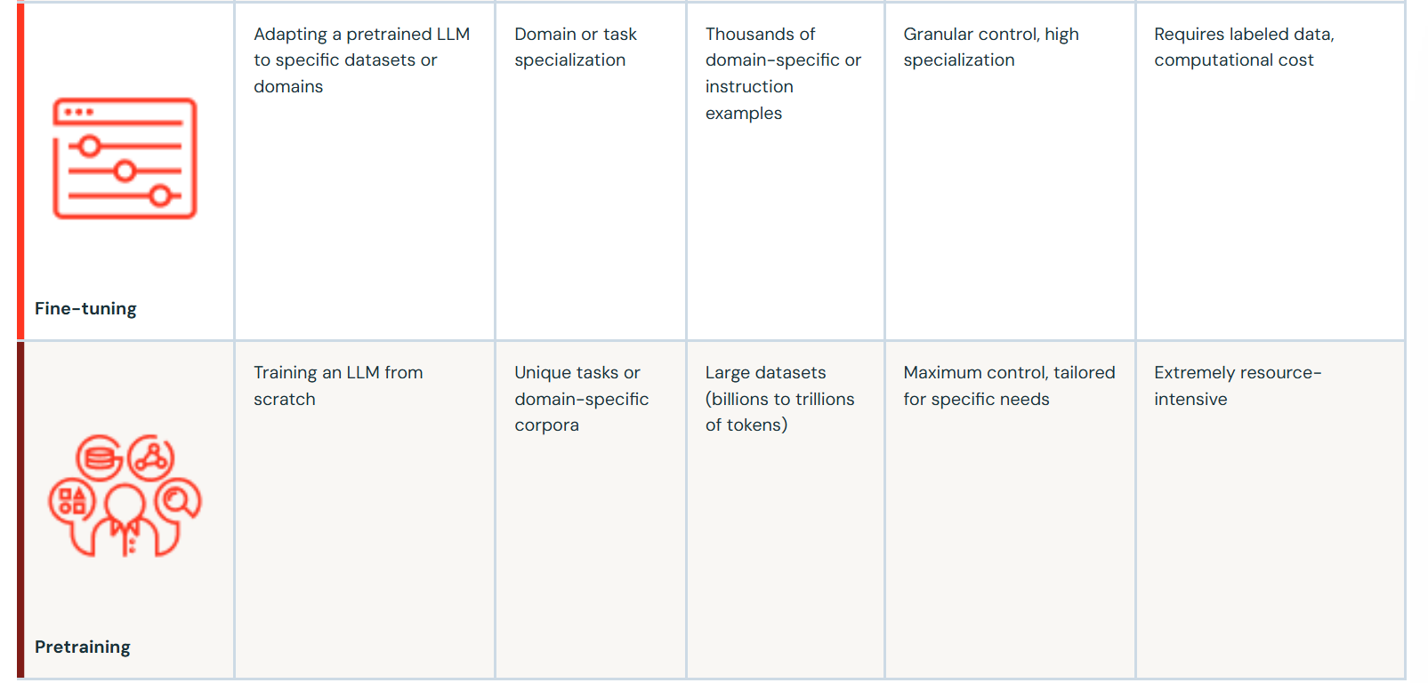

Slide 8
BLEU (Bilingual Evaluation Understudy)
The BLEU (Bilingual Evaluation Understudy) score is a metric used to evaluate the quality of text generated by machine translation systems.
It compares the n-grams (sequences of words) in the machine-generated output to the n-grams in a reference translation.
The idea is that a good translation will share many n-grams with the reference, indicating that it is close to what a human might produce.

Slide 9
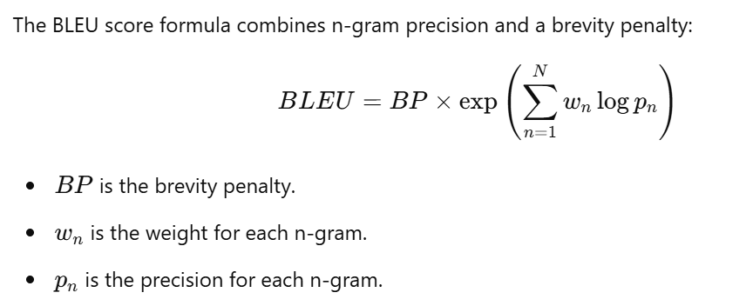
BLEU Score Formula

Slide 10
Interpretation
Higher BLEU score: A higher score (close to 1) means that the machine-generated translation is closer to the human reference in terms of the n-grams used.
Lower BLEU score: A lower score (closer to 0) suggests that the machine-generated translation differs significantly from the human translation.

Slide 11
ROUGE (Recall-Oriented Understudy for Gisting Evaluation)
The ROUGE (Recall-Oriented Understudy for Gisting Evaluation) score is a popular evaluation metric for text summarization and machine-generated text.
It compares the overlap of n-grams (or other text units like words or word sequences) between the machine-generated output and a reference (human-generated) text.
Reference text based

Slide 12
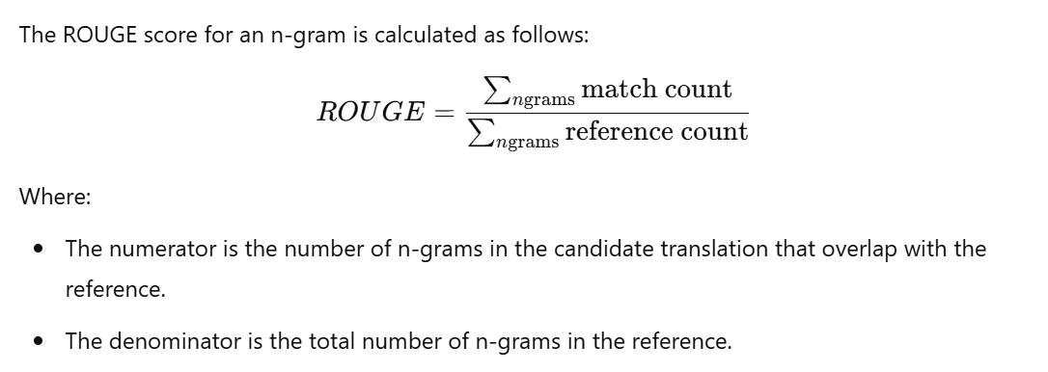
ROUGE Score Formula

Slide 13
ROUGE Score Interpretation
Higher Precision: More of the candidate’s n-grams match the reference’s n-grams.
Higher Recall: The candidate captures more of the reference’s n-grams.
F-measure: A balance between precision and recall, and typically a good indicator of overall quality.

