Slide 1
Shared Memory Programming with Pthreads
T. Yang. UCSB CS240A. Spring 2016

Slide 2
Outline
# Chapter Subtitle
Shared memory programming: Overview
POSIX pthreads
Critical section & thread synchronization.
  Mutexes.
  Producer-consumer synchronization and semaphores.
  Barriers and condition variables.
  Read-write locks.
Thread safety.
Copyright © 2010, Elsevier Inc. All rights Reserved
Notes:
The University of Adelaide, School of Computer Science
Chapter 2 — Instructions: Language of the Computer

Slide 3
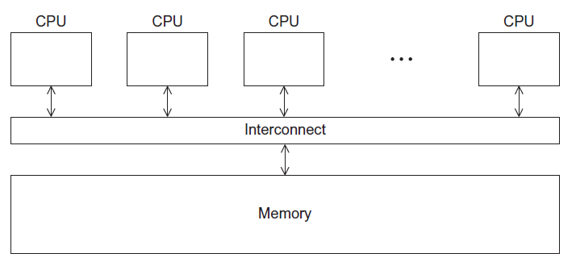
Shared Memory Architecture
Copyright © 2010, Elsevier Inc. All rights Reserved

Slide 4
Processes and Threads
A process is an instance of a running (or suspended) program.
Threads are analogous to a “light-weight” process.
In a shared memory program a single process may have multiple threads of control.
Copyright © 2010, Elsevier Inc. All rights Reserved

Slide 5
Logical View of Threads
Threads are created within a process
A process
Process hierarchy
T2
T4
T1
P1
shared code, data
and kernel context
sh
sh
sh
T5
T3
foo

Slide 6
Concurrent Thread Execution
Two threads run concurrently if their logical flows overlap in time
Otherwise, they are sequential (we’ll see that processes have a similar rule)
Examples:
  Concurrent:
  A & B, A&C
  Sequential:
  B & C
Thread A
Thread B
Thread C
Time

Slide 7
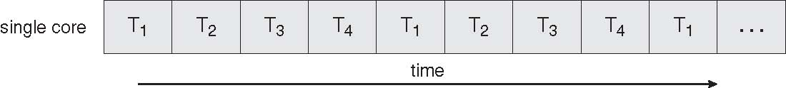
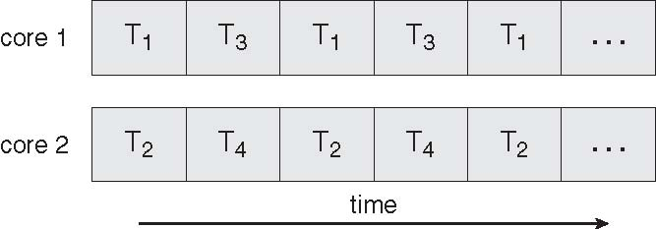
Execution Flow on one-core or multi-core systems
Concurrent execution on a single core system
Parallel execution on a multi-core system

Slide 8
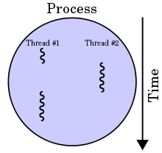

Benefits of multi-threading
Responsiveness
Resource Sharing
  Shared memory
Economy
Scalability
  Explore multi-core CPUs

Slide 9
Thread Programming with Shared Memory
Program is a collection of threads of control.
  Can be created dynamically
Each thread has a set of private variables, e.g., local stack variables
Also a set of shared variables, e.g., static variables, shared common blocks, or global heap.
  Threads communicate implicitly by writing and reading shared variables.
  Threads coordinate by synchronizing on shared variables
Shared memory
s
s = ...
i: 2
i: 5
Private memory
i: 8
P0
P1
Pn
Notes:
CS267 Lecture 2
Example: think of a thread as a subroutine that gets called on on processor, executed on another
Like concurrent programming on a uniprocessor (as studied in CS162).

Slide 10
Shared Memory Programming
Several Thread Libraries/systems
Pthreads is the POSIX Standard
  Relatively low level
  Portable but possibly slow; relatively heavyweight
OpenMP standard for application level programming
  Support for scientific programming on shared memory
  http://www.openMP.org
Java Threads
TBB: Thread Building Blocks
  Intel
CILK: Language of the C “ilk”
  Lightweight threads embedded into C
Notes:
CS267 Lecture 2
POSIX = Portable Operating System Interface
Slow if needs to go to OS for every thread operation
Java threads built on POSIX threads:
Are objects (like other objects in Java)
(1) create Java thread object
(2) send it a message saying “run” etc

Slide 11
Overview of POSIX Threads
POSIX: Portable Operating System Interface for UNIX
  Interface to Operating System utilities
PThreads: The POSIX threading interface
  System calls to create and synchronize threads
  In CSIL, compile a c program with gcc -lpthread
PThreads contain support for
  Creating parallelism and synchronization
  No explicit support for communication, because shared memory is implicit; a pointer to shared data is passed to a thread
Notes:
CS267 Lecture 2

Slide 12
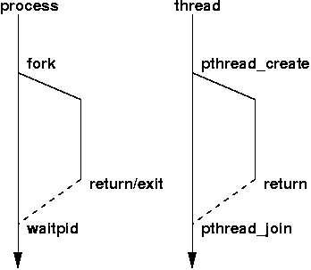
Creation of Unix processes vs. Pthreads

Slide 13
C function for starting a thread
pthread.h
One object for each thread.
pthread_t
int pthread_create (
pthread_t* thread_p /* out */ ,
const pthread_attr_t* attr_p /* in */ ,
void* (*start_routine ) ( void ) /* in */ ,
void* arg_p /* in */ ) ;
Copyright © 2010, Elsevier Inc. All rights Reserved

Slide 14
A closer look (1)
int pthread_create (
pthread_t* thread_p /* out */ ,
const pthread_attr_t* attr_p /* in */ ,
void* (*start_routine ) ( void ) /* in */ ,
void* arg_p /* in */ ) ;
We won’t be using, so we just pass NULL.
Allocate before calling.
Copyright © 2010, Elsevier Inc. All rights Reserved

Slide 15
A closer look (2)
int pthread_create (
pthread_t* thread_p /* out */ ,
const pthread_attr_t* attr_p /* in */ ,
void* (*start_routine ) ( void ) /* in */ ,
void* arg_p /* in */ ) ;
Pointer to the argument that should
be passed to the function start_routine.
The function that the thread is to run.
Copyright © 2010, Elsevier Inc. All rights Reserved

Slide 16
Function started by pthread_create
Prototype:
void* thread_function ( void* args_p ) ;
Void* can be cast to any pointer type in C.
So args_p can point to a list containing one or more values needed by thread_function.
Similarly, the return value of thread_function can point to a list of one or more values.
Copyright © 2010, Elsevier Inc. All rights Reserved

Slide 17
Wait for Completion of Threads
pthread_join(pthread_t *thread, void **result);
  Wait for specified thread to finish. Place exit value into *result.
We call the function pthread_join once for each thread.
A single call to pthread_join will wait for the thread associated with the pthread_t object to complete.
Copyright © 2010, Elsevier Inc. All rights Reserved

Slide 18
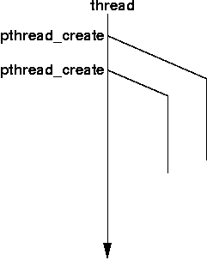
Example of Pthreads
#include <pthread.h>
#include <stdio.h>
void *PrintHello(void * id){
printf(“Thread%d: Hello World!\n", id);
}
void main (){
pthread_t thread0, thread1;
pthread_create(&thread0, NULL, PrintHello, (void *) 0);
pthread_create(&thread1, NULL, PrintHello, (void *) 1);
}

Slide 19
Example of Pthreads with join
#include <pthread.h>
#include <stdio.h>
void *PrintHello(void * id){
printf(“Hello from thread %d\n", id);
}
void main (){
pthread_t thread0, thread1;
pthread_create(&thread0, NULL, PrintHello, (void *) 0);
pthread_create(&thread1, NULL, PrintHello, (void *) 1);
pthread_join(thread0, NULL);
pthread_join(thread1, NULL);
}

Slide 20
Some More Pthread Functions
pthread_yield();
  Informs the scheduler that the thread is willing to yield
pthread_exit(void *value);
  Exit thread and pass value to joining thread (if exists)
Others:
pthread_t me; me = pthread_self();
  Allows a pthread to obtain its own identifier pthread_t thread;
Synchronizing access to shared variables
  pthread_mutex_init, pthread_mutex_[un]lock
  pthread_cond_init, pthread_cond_[timed]wait

Slide 21
Compiling a Pthread program
gcc −g −Wall −o pth_hello pth_hello . c −lpthread
link in the Pthreads library
Copyright © 2010, Elsevier Inc. All rights Reserved

Slide 22
Running a Pthreads program
. / pth_hello
Hello from thread 1
Hello from thread 0
. / pth_hello
Hello from thread 0
Hello from thread 1
Copyright © 2010, Elsevier Inc. All rights Reserved

Slide 23

Difference between Single and Multithreaded Processes
Shared memory access for code/data
Separate control flow -> separate stack/registers

Slide 24
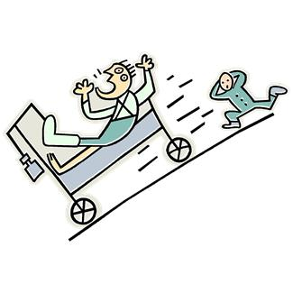
CRITICAL SECTIONS
Copyright © 2010, Elsevier Inc. All rights Reserved

Slide 25

Data Race Example
static int s = 0;
Thread 0
for i = 0, n/2-1
s = s + f(A[i])
Thread 1
for i = n/2, n-1
s = s + f(A[i])
Also called critical section problem.
A race condition or data race occurs when:
  two processors (or two threads) access the same variable, and at least one does a write.
  The accesses are concurrent (not synchronized) so they could happen simultaneously
Notes:
CS267 Lecture 2

Slide 26
Synchronization Solutions
Busy waiting
Mutex (lock)
Semaphore
Conditional Variables

Slide 27
Example of Busy Waiting
static int s = 0; static int flag=0
Thread 0
int temp, my_rank
for i = 0, n/2-1
temp0=f(A[i])
while flag!=my_rank;
s = s + temp0
flag= (flag+1) %2
Thread 1
int temp, my_rank
for i = n/2, n-1
temp=f(A[i])
while flag!=my_rank;
s = s + temp
flag= (flag+1) %2
A thread repeatedly tests a condition, but, effectively, does no useful work until the condition has the appropriate value.
Weakness: Waste CPU resource. Sometime not safe with compiler optimization.
Notes:
CS267 Lecture 2

Slide 28

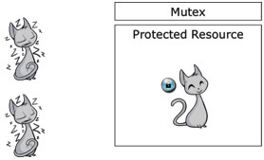
Mutexes (Locks)
Acquire mutex lock
Critical section
Code structure
Mutex (mutual exclusion) is a special type of variable used to restrict access to a critical section to a single thread at a time.
guarantee that one thread “excludes” all other threads while it executes the critical section.
When A thread waits on a mutex/lock,
CPU resource can be used by others.
Only thread that has acquired the lock
can release this lock
Unlock/Release mutex

Slide 29
Execution example with 2 threads
Thread 1
Thread 2
Acquire mutex lock
Acquire mutex lock
Critical section
Unlock/Release mutex
Critical section
Unlock/Release mutex

Slide 30
Mutexes in Pthreads
A special type for mutexes: pthread_mutex_t.
To gain access to a critical section, call
To release
When finishing use of a mutex, call
Copyright © 2010, Elsevier Inc. All rights Reserved

Slide 31
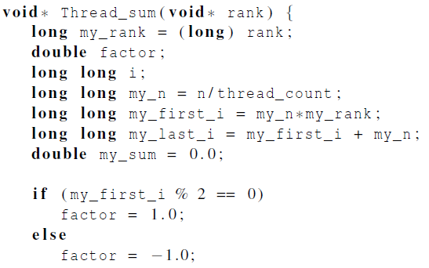
Global sum function that uses a mutex (1)
Copyright © 2010, Elsevier Inc. All rights Reserved

Slide 32
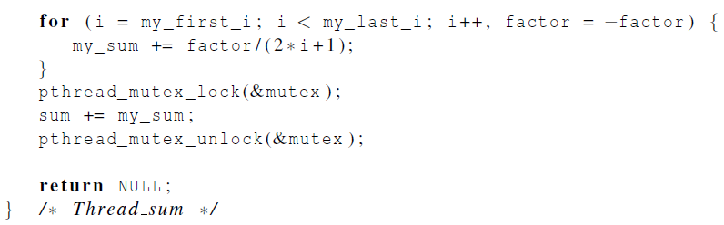
Global sum function that uses a mutex (2)
Copyright © 2010, Elsevier Inc. All rights Reserved

Slide 33

Semaphore: Generalization from mutex locks
Semaphore S – integer variable
Can only be accessed /modified via two
(atomic) operations with the following
semantics:
  wait (S) { //also called P()
  while S <= 0 wait in a queue;
  S--;
  }
  post(S) { //also called V()
  S++;
  Wake up a thread that waits in the queue.
  }

Slide 34
Why Semaphores?
Synchronization | Functionality/weakness
Busy waiting | Spinning for a condition. Waste resource. Not safe
Mutex lock | Support code with simple mutual exclusion
Semaphore | Handle more complex signal-based synchronization
Examples of complex synchronization
  Allow a resource to be shared among multiple threads.
    Mutex: no more than 1 thread for one protected region.
  Allow a thread waiting for a condition after a signal
    E.g. Control the access order of threads entering the critical section.
    For mutexes, the order is left to chance and the system.

Slide 35

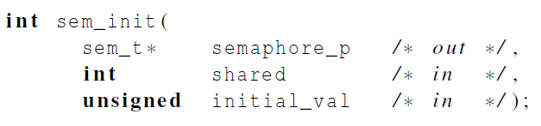
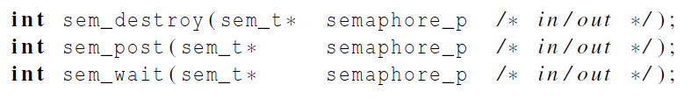
Syntax of Pthread semaphore functions
Semaphores are not part of Pthreads;
you need to add this.
Copyright © 2010, Elsevier Inc. All rights Reserved

Slide 36
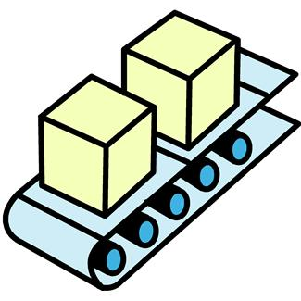
Producer-consumer Synchronization and Semaphores
Copyright © 2010, Elsevier Inc. All rights Reserved

Slide 37
Producer-Consumer Example
T0
T1
T2
Thread x produces a message for Thread x+1.
  Last thread produces a message for thread 0.
Each thread prints a message sent from its source.
Will there be null messages printed?
  A consumer thread prints its source message before this message is produced.
  How to avoid that?

Slide 38
Flag-based Synchronization with 3 threads
Thread 0
Thread 1
Thread 2
Write a msg to #1
Write a msg to #2
Write a msg to #0
Set msg[1]
Set msg[2]
Set msg[0]
If msg[0] is ready
If msg[1] is ready
If msg[2] is ready
Print msg[0]
Print msg[1]
Print msg[2]
To make sure a message is received/printed, use busy waiting.

Slide 39
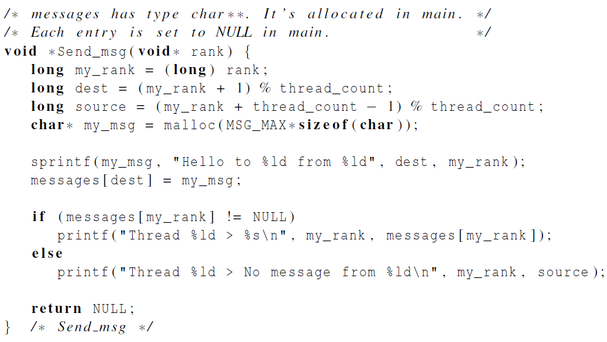
First attempt at sending messages using pthreads
Produce a message for a destination thread
Consume a message
Copyright © 2010, Elsevier Inc. All rights Reserved

Slide 40
Semaphore Synchronization with 3 threads
Thread 0
Thread 1
Thread 2
Write a msg to #1
Write a msg to #2
Write a msg to #0
Set msg[1]
Post(semp[1])
Set msg[2]
Post(semp[2])
Set msg[0]
Post(semp[0])
Wait(semp[0])
Print msg[0]
Wait(semp[1])
Print msg[1]
Wait(semp[2])
Print msg[2]

Slide 41
Message sending with semaphores
sprintf(my_msg, "Hello to %ld from %ld", dest, my_rank);
messages[dest] = my_msg;
sem_post(&semaphores[dest]);
/* signal the dest thread*/
sem_wait(&semaphores[my_rank]);
/* Wait until the source message is created */
printf("Thread %ld > %s\n", my_rank, messages[my_rank]);

Slide 42

READERS-WRITERS PROBLEM
Copyright © 2010, Elsevier Inc. All rights Reserved

Slide 43
Synchronization Example for Readers-Writers Problem
A data set is shared among a number of concurrent threads.
  Readers – only read the data set; they do not perform any updates
  Writers – can both read and write
Requirement:
  allow multiple readers to read at the same time.
  Only one writer can access the shared data at the same time.
Reader/writer access permission table:
 | Reader | Writer
Reader | OK | No
Writer | NO | No

Slide 44
Readers-Writers (First try with 1 mutex lock)
writer
do {
mutex_lock(w);
// writing is performed
mutex_unlock(w);
} while (TRUE);
Reader
do {
mutex_lock(w);
// reading is performed
mutex_unlock(w);
} while (TRUE);
 | Reader | Writer
Reader | ? | ?
Writer | ? | ?

Slide 45
Readers-Writers (First try with 1 mutex lock)
writer
do {
mutex_lock(w);
// writing is performed
mutex_unlock(w);
} while (TRUE);
Reader
do {
mutex_lock(w);
// reading is performed
mutex_unlock(w);
} while (TRUE);
 | Reader | Writer
Reader | no | no
Writer | no | no

Slide 46
2nd try using a lock + readcount
writer
do {
mutex_lock(w);// Use writer mutex lock
// writing is performed
mutex_unlock(w);
} while (TRUE);
Reader
do {
readcount++; // add a reader counter.
if(readcount==1) mutex_lock(w);
// reading is performed
readcount--;
if(readcount==0) mutex_unlock(w);
} while (TRUE);

Slide 47
Readers-Writers Problem with semaphone
Shared Data
  Data set
  Lock mutex (to protect readcount)
  Semaphore wrt initialized to 1 (to synchronize between readers/writers)
  Integer readcount initialized to 0

Slide 48
Readers-Writers Problem
A writer
do {
sem_wait(wrt) ; //semaphore wrt
// writing is performed
sem_post(wrt) ; //
} while (TRUE);

Slide 49
Readers-Writers Problem (Cont.)
Reader
do {
mutex_lock(mutex);
readcount ++ ;
if (readcount == 1)
sem_wait(wrt); //check if anybody is writing
mutex_unlock(mutex)
// reading is performed
mutex_lock(mutex);
readcount - - ;
if (readcount == 0)
sem_post(wrt) ; //writing is allowed now
nlock(mutex) ;
} while (TRUE);

Slide 50
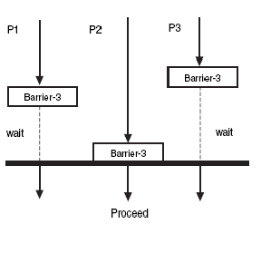
Barriers
Synchronizing the threads to make sure that they all are at the same point in a program is called a barrier.
No thread can cross the barrier until all the threads have reached it.
Availability:
  No barrier provided by
Pthreads library and needs
a custom implementation
  Barrier is implicit in
  OpenMP
and available in MPI.
Copyright © 2010, Elsevier Inc. All rights Reserved

Slide 51
Condition Variables
Why?
More programming primitives to simplify code for synchronization of threads
Synchronization | Functionality
Busy waiting | Spinning for a condition. Waste resource. Not safe
Mutex lock | Support code with simple mutual exclusion
Semaphore | Signal-based synchronization. Allow sharing (not wait unless semaphore=0)
Barrier | Rendezvous-based synchronization
Condition variables | More complex synchronization: Let threads wait until a user-defined condition becomes true

Slide 52
Synchronization Primitive: Condition Variables
Used together with a lock
One can specify more general waiting condition compared to semaphores.
A thread is blocked when condition is no true:
  placed in a waiting queue, yielding CPU resource to somebody else.
  Wake up until receiving a signal

Slide 53
Pthread synchronization: Condition variables
int status; pthread_condition_t cond;
const pthread_condattr_t attr;
pthread_mutex mutex;
status = pthread_cond_init(&cond,&attr);
status = pthread_cond_destroy(&cond);
status = pthread_cond_wait(&cond,&mutex);
-wait in a queue until somebody wakes up. Then the mutex is reacquired.
status = pthread_cond_signal(&cond);
- wake up one waiting thread.
status = pthread_cond_broadcast(&cond);
- wake up all waiting threads in that condition

Slide 54
How to Use Condition Variables: Typical Flow
  Thread 1: //try to get into critical section and
  wait for the condition
  Mutex_lock(mutex);
  While (condition is not satisfied)
  Cond_Wait(mutex, cond);
  Critical Section;
  Mutex_unlock(mutex)
  Thread 2: // Try to create the condition.
    Mutex_lock(mutex);
    When condition can satisfy, Signal(cond);
    Mutex_unlock(mutex);

Slide 55
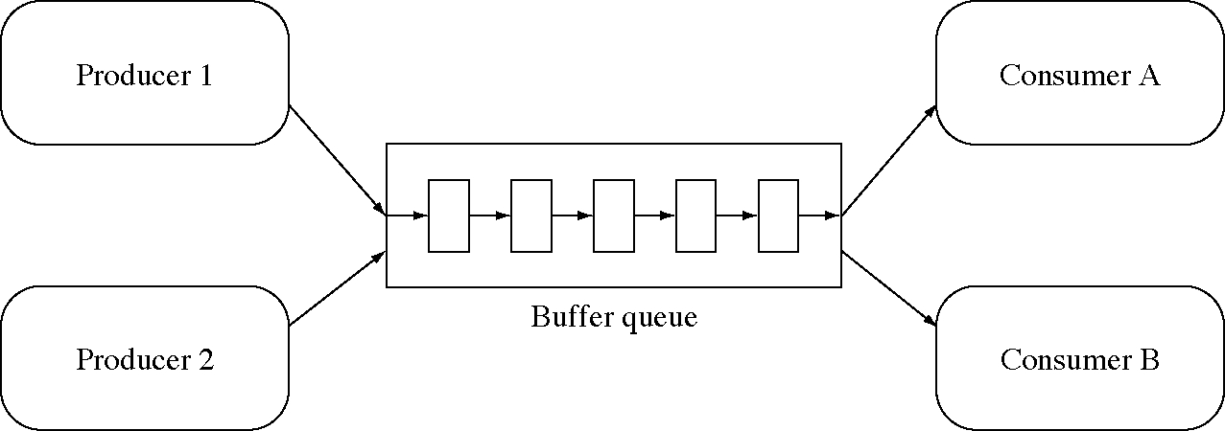
Condition variables for in producer-consumer problem with unbounded buffer
Producer deposits data in a buffer for others to consume

Slide 56
First version for consumer-producer problem with unbounded buffer
int avail=0; // # of data items available for consumption
Consumer thread:
  while (avail <=0); //wait
  Consume next item; avail = avail-1;
  Producer thread:
  Produce next item; avail = avail+1;
  //notify an item is available

Slide 57
Condition Variables for consumer-producer problem with unbounded buffer
int avail=0; // # of data items available for consumption
Pthread mutex m and condition cond;
Consumer thread:
  multex_lock(&m)
  while (avail <=0) Cond_Wait(&cond, &m);
  Consume next item; avail = avail-1;
  mutex_unlock(&mutex)
  Producer thread:
  mutex_lock(&m);
  Produce next item; availl = avail+1;
  Cond_signal(&cond); //notify an item is available
  mutex_unlock(&m);

Slide 58
When to use condition broadcast?
When waking up one thread to run is not sufficient.
Example: concurrent malloc()/free() for allocation and deallocation of objects with non-uniform sizes.

Slide 59
Running trace of malloc()/free()
Initially 10 bytes are free.
m() stands for malloc(). f() for free()
Thread 1:
m(10) – succ
f(10) –broadcast
m(7) – wait
Resume m(7)-wait
Thread 2:
m(5) – wait
Resume m(5)-succ
f(5) –broadcast
Thread 3:
m(5) – wait
Resume m(5)-succ
m(3) –wait
Resume m(3)-succ
Time

Slide 60
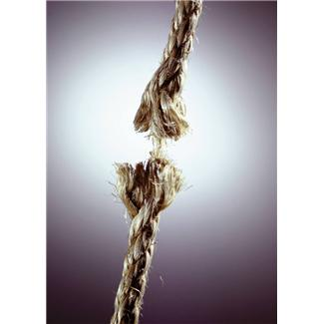
Issues with Threads: False Sharing, Deadlocks, Thread-safety
Copyright © 2010, Elsevier Inc. All rights Reserved

Slide 61
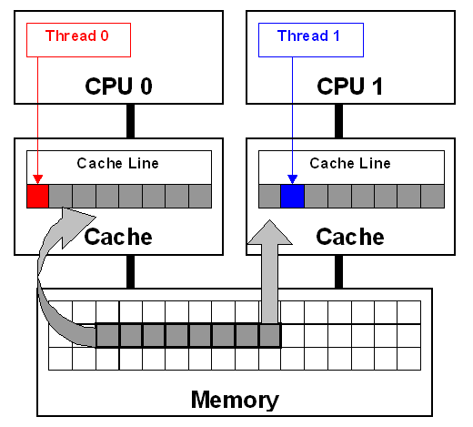
Problem: False Sharing
Occurs when two or more processors/cores access different data in same cache line, and at least one of them writes.
  Leads to ping-pong effect.
Let’s assume we parallelize code with p=2:
  for( i=0; i<n; i++ )
  a[i] = b[i];
  Each array element takes 8 bytes
  Cache line has 64 bytes (8 numbers)

Slide 62
False Sharing: Example (2 of 3)
  Execute this program in two processors
  for( i=0; i<n; i++ )
  a[i] = b[i];
cache line
a[0]
a[1]
a[2]
a[3]
a[4]
a[5]
a[6]
a[7]
Written by CPU 0
Written by CPU 1

Slide 63
False Sharing: Example
  Two CPUs execute:
  for( i=0; i<n; i++ )
  a[i] = b[i];
a[0]
a[1]
a[2]
a[3]
a[4]
a[5]
a[6]
a[7]
cache line
Written by CPU 0
Written by CPU 1
a[0]
a[2]
a[4]
CPU0
...
inv
data
a[1]
a[3]
a[5]
CPU1

Slide 64
Matrix-Vector Multiplication with Pthreads
Parallel programming book by Pacheco book P.159-162

Slide 65
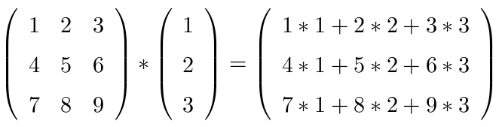
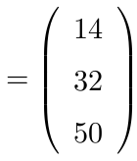
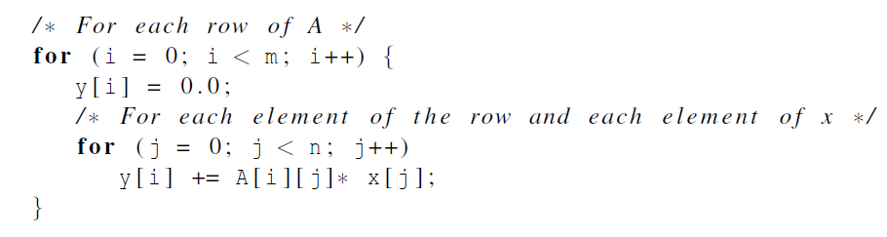
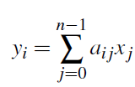
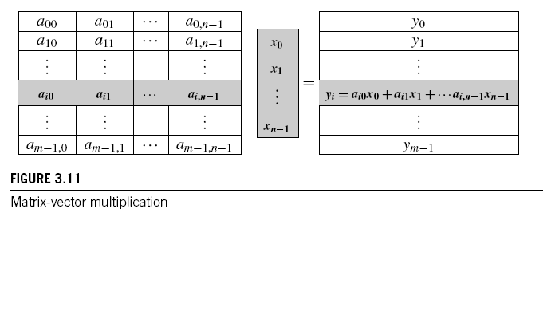
Sequential code

Slide 66
Block Mapping for Matrix-Vector Multiplication
Task partitioning
For (i=0; i<m; i=i+1)
Task graph
Mapping to
threads
Task Si for Row i
y[i]=0;
For (j=0; j<n; j=j+1)
y[i]=y[i] +a[i][j]*x[j]
S0
S1
Sm
...
S0
S1
S2
S3
...
Thread 0
Thread 1

Slide 67
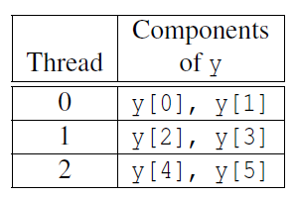
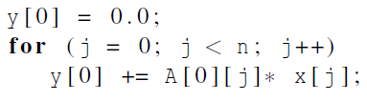
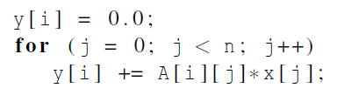
Using 3 Pthreads for 6 Rows: 2 row per thread
S0, S1
S2, S3
S4,S5
Code for S0
Code for Si

Slide 68
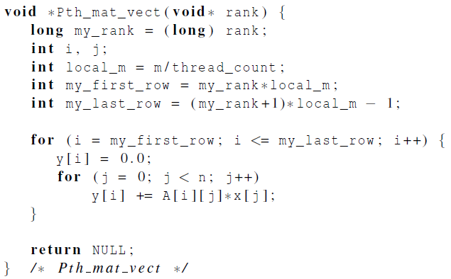
Pthread code for thread with ID rank
i-th thread calls Pth_mat_vect( &i)
m is # of rows in this matrix A.
n is # of columns in this matrix A.
local_m is # of rows handled by
this thread.
Task Si
Copyright © 2010, Elsevier Inc. All rights Reserved

Slide 69
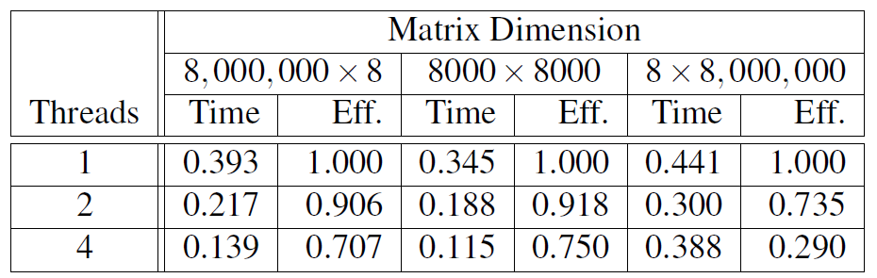
Impact of false sharing on performance of matrix-vector multiplication
(times are in seconds)
Why is performance of 8x8,000,000 matrix bad?
How to fix that?
Copyright © 2010, Elsevier Inc. All rights Reserved

Slide 70
Deadlock and Starvation
Deadlock – two or more threads are waiting indefinitely for an event that can be only caused by one of these waiting threads
Starvation – indefinite blocking (in a waiting queue forever).
Let S and Q be two mutex locks:
P₀ P₁
Lock(S); Lock(Q);
Lock(Q); Lock(S);
. .
. .
. .
Unlock(Q); Unlock(S);
Unlock(S); Unlock(Q);

Slide 71
Deadlock Avoidance
Order the locks and always acquire the locks in that order.
Eliminate circular waiting
:
P₀ P₁
Lock(S); Lock(S);
Lock(Q); Lock(Q);
. .
. .
. .
Unlock(Q); Unlock(Q);
Unlock(S); Unlock(S);

Slide 72
Thread-Safety
A block of code is thread-safe if it can be simultaneously executed by multiple threads without causing problems.
When you program your own functions, you know if they are safe to be called by multiple threads or not.
You may forget to check if system library functions used are thread-safe.
  Unsafe function: strtok()from C string.h library
  Other example.
    The random number generator random in stdlib.h.
    The time conversion function localtime in time.h.

Slide 73
Concluding Remarks
A thread in shared-memory programming is analogous to a process in distributed memory programming.
  However, a thread is often lighter-weight than a full-fledged process.
When multiple threads access a shared resource without controling, it may result in an error: we have a race condition.
  A critical section is a block of code that updates a shared resource that can only be updated by one thread at a time
  Mutex, semaphore, condition variables
Issues: false sharing, deadlock, thread safety
Copyright © 2010, Elsevier Inc. All rights Reserved

