Slide 1
Programming with Posix Threads

Slide 2
Threads
A thread is a single sequence stream within in a process.
Because threads have some of the properties of processes, they are sometimes called lightweight processes.

Slide 3
Processes vs. Threads
Text
Text
Text
Data
Data
Data
Stack
Stack
Stack1
Stack2
Process1
Process2
Thread1
Thread2

Slide 4
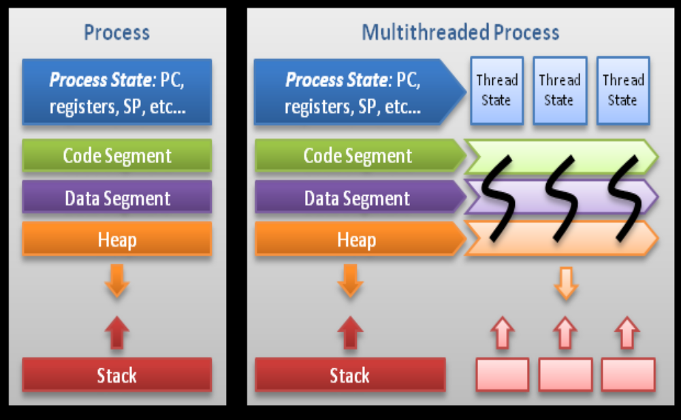

Slide 5
Some Terms
Thread Safe
Reentrant
Multi-threaded

Slide 6
Commonly used pThread API’s
pthread_create( )
pthread_detach( )
pthread_equal( )
pthread_exit( )
pthread_join( )
pthread_self( )
sched_yield( )
pthread_cancel()
pthread_mutex_init()
pthread_mutex_destroy()
pthread_mutex_lock()
pthread_mutex_trylock()
pthread_mutex_unlock()

Slide 7
pThread API’s contd…..
pthread_cond_destroy( )
pthread_cond_init( )
pthread_cond_broadcast( )
pthread_cond_signal( )
pthread_cond_timedwait()
pthread_cond_wait()
pthread_mutexattr_gettype
pthread_mutexattr_settype
pthread_setconcurrency()
pthread_getconcurrency()
pthread_mutexattr_getprotocol
pthread_mutexattr_setprotocol
pthread_setschedparam
pthread_attr_setschedpolicy
sched_get_priority_max
sched_set_priority_min

Slide 8
Thread State Transitions
Ready
Wait satisfied
Blocked
Preempted
Start
Scheduled
Wait for resource
Running
Done or cancelled
Terminated

Slide 9
#include <pthread.h>
#include <stdio.h> void *thread_routine(void* arg){ printf("Inside newly created thread \n");
} void main(){ pthread_t thread_id; void *thread_result; pthread_create( &thread_id, NULL, thread_routine, NULL ); printf("Inside main thread \n"); pthread_join( thread_id, &thread_result );
} pluto.nvc.cs.vt.edu$ cc p.c -lpthread

Slide 10
/////////////////////////////// Join Example:-
#include <pthread.h>
#include <stdio.h>
#include <string.h> void *thread_routine(void* arg){ printf("Inside newly created thread \n"); return (void*) strdup("Thread return value string");
} void main(){ pthread_t thread_id; void *thread_result =0; pthread_create( & thread_id, NULL, thread_routine, NULL ); printf("Inside main thread \n"); pthread_join( thread_id, &thread_result ); if ( thread_result != 0 ) printf("In main %s\n", thread_result );
}

Slide 11
int pthread_create( pthread_t *tid, // Thread ID returned by the system const pthread_attr_t *attr, // optional creation attributes void *(*start)(void *), // start function of the new thread void *arg // Arguments to start function
);
Description: Create a thread running the start function.

Slide 12
int pthread_exit( void *valud_ptr, // Return value.
);
Description: Terminate the calling thread, returning the value value_ptr to any joining thread. int pthread_equal( pthread_t t1, // ID of thread1 pthread_t t2, // ID of thread2
);
Description: Return zero if equal.
Non-zero if not.

Slide 13
int pthread_join( pthread_t thread, // ID of thread void **value_ptr // return value of thread
);
Description: Wait for thread to terminate, and return thread’s exit value if value_ptr is not NULL. This also detaches thread on successful completion. int pthread_detach( pthread_t thread, // ID of thread to detach
);
Description: Does not terminate a thread. Storage is freed immediately on termination. Detached threads Cannot be joined or canceled.

Slide 14
int pthread_cancel( pthread_t thread, // ID of thread to cancel
);
Description: Cancellation provides a way to request that a thread terminate gracefully when you no longer need it to complete its normal execution. Each thread can control how and whether cancellation affect it and repair the shared state as it terminates due to cancellation. pthread_t pthread_self( );
Description: Used to get the ID of the current thread. int sched_yield( );
Description: Make the calling thread from running state to ready state, giving way for other threads.

Slide 15
//////////////////////////////////// Cancel Example:- void *thread_routine(void* arg){ printf("Inside thread \n"); sleep( 30 ); printf("After sleep \n");
} void main(){ pthread_t thread_id; void *thread_result =0; pthread_create( & thread_id, NULL, thread_routine, NULL ); sleep(3); printf("Main thread\n"); pthread_cancel( thread_id ); printf("End of main\n");
}

Slide 16
Some facts
* If multiple threads want to wait for the completion of a thread, they cannot do so by calling pthread_join(), Instead these threads should wait on a condition variable which is set by the waited thread after completion.
* Main thread vs Other Threads
1) Input arguments are different.
2) When main thread returns all other threads are aborted.
3) If u want the main thread to exit, but other threads to keep running then call pthread_exit in the main function.
* Avoid fork and signals in threads.

Slide 17
Synchronization(Mutexes)
pthread_mutex_init()
pthread_mutex_destroy()
pthread_mutex_lock()
pthread_mutex_trylock()
pthread_mutex_unlock()

Slide 18
pthread_mutex_t mutex=PTHREAD_MUTEX_INITILIZER; int shared_data =1; void *consumer(void* arg) { for(int I =0; I < 30 ; I ++ ){ pthread_mutex_lock( &mutex ); shared_data--; /* Critical Section. */ pthread_mutex_unlock( &mutex );
} printf("Returning from Comsumer =%d\n”, shared_data);
} void main() { pthread_t thread_id; pthread_create( & thread_id, NULL, consumer, NULL ); for(int I =0; I < 30 ; I ++ ){ pthread_mutex_lock( &mutex ); shared_data ++; /* Producer Critical Section. */ pthread_mutex_unlock( &mutex );
}
/*pthread_exit(0); /* Return from main thread. */ printf("End of main =%d\n”, shared_data);
}

Slide 19
int pthread_mutex_lock( pthread_mutex_t *mutex
);
Description: Lock a mutex. If the mutex is currently locked, the calling thread is blocked until mutex is unlocked. On return, the thread owns the mutex until it calls pthread_mutex_unlock. int pthread_mutex_trylock( pthread_mutex_t *mutex
);
Description: Lock a mutex. If the mutex is currently locked, returns immediately with EBUSY. Otherwise, calling thread becomes owner until it unlocks.

Slide 20
int pthread_mutex_unlock( pthread_mutex_t *mutex
);
Description: UnLock a mutex. The mutex becomes unwoned. If any threads are waiting for the mutex, one is awakened(scheduling policy SCHED_FIFO and SCHED_RR policy waiters are chosen in priority order, then any others are chosen in unspecified order.

Slide 21
int pthread_mutex_init( pthread_mutex_t *mutex, const pthread_mutexattr_t * attr
);
Description: Initialize a mutex. The attr argument specifies optional creation attributes. int pthread_mutex_destroy( pthread_mutex_t *mutex
);
Description: Destroy a mutex that you no longer need.

Slide 22
Producer-Consumer example

Slide 23
pthread_mutex_t read_mutex=PTHREAD_MUTEX_INITIALIZER; pthread_mutex_t w_mutex=PTHREAD_MUTEX_INITIALIZER;
#define QUEUE_SIZE 10
#define ITERATIONS 1000 int in =0, out =0; int shared_data =1; int n_consumer =0; int queue_is_empty(){ if ( in == out ) return 1; else return 0 ;
} int queue_is_full(){ if ( in == (out+1 %QUEUE_SIZE) ) return 1; else return 0 ;
} void main() {pthread_t thread_id; pthread_create(&thread_id,NULL, consumer, NULL); pthread_create(&thread_id,NULL, consumer, NULL); sleep(5); pthread_create(&thread_id,NULL, producer, NULL); pthread_create(&thread_id,NULL, producer, NULL); pthread_exit(0);
}

Slide 24
void *consumer(void* arg){ int i; n_consumer ++; for (i =0; i < ITERATIONS; ) { if (queue_is_empty()){sched_yield(); continue;} pthread_mutex_lock( &read_mutex ); if ( queue_is_empty() ){ pthread_mutex_unlock(&read_mutex); continue;
}
/*read from queue[ in ] */ in = (in +1) % QUEUE_SIZE; pthread_mutex_unlock( &read_mutex ); i++;
} printf("Returning from Comsumer\n"); n_consumer --;
}

Slide 25
void *producer(void* arg ) { int i; for (i =0; n_consumer; i ++) { if (queue_is_full())
{sched_yield();continue;} pthread_mutex_lock( &w_mutex ); if ( queue_is_full() ){ pthread_mutex_unlock(&w_mutex ); continue;
}
/* write to queue[out] */ out = (out +1) % QUEUE_SIZE; pthread_mutex_unlock( &w_mutex );
} printf("Returning from Producer\n");
}

Slide 26
int pthread_cond_init( pthread_cond_t *cond, const pthread_condattr_t *attr
);
Description: Initialize a condition variable cond. The attr argument specifies optional creation attributes. int pthread_cond_destroy( pthread_cond_t *cond
);
Description: Destroy condition variable cond that you no longer need.

Slide 27
int pthread_cond_wait( pthread_cond_t *cond, pthread_mutex_t *mutex
);
Description: Wait on condition variable cond, until awakened by a signal or broadcast. int pthread_cond_signal( pthread_cond_t *cond
);
Description: Signal condition variable cond, walking one waiting thread. If SCHED_FIFO or SCHED_RR policy threads are waiting, the highest priority waiter is awakened. Otherwise an unspecified waiter is awakened.

Slide 28
int pthread_cond_timedwait( pthread_cond_t *cond, pthread_mutex_t *mutex, const struct timespec *abstime
);
Description: Wait on condition variable cond, until awakened by a signal or broadcast or until the absolute time abstime is reached. int pthread_cond_broadcast( pthread_cond_t *cond
);
Description: Broadcast condition variable cond, waking all current waiters.

Slide 29
Producer-Consumer using condition wait
//Initializations pthread_mutex_t read_mutex=PTHREAD_MUTEX_INITIALIZER; pthread_mutex_t write_mutex=PTHREAD_MUTEX_INITIALIZER; pthread_mutex_t qempty_cond_mutex=PTHREAD_MUTEX_INITIALIZER; pthread_cond_t q_notempty_cond =PTHREAD_COND_INITIALIZER; pthread_mutex_t qfull_cond_mutex = PTHREAD_MUTEX_INITIALIZER; pthread_cond_t q_notfull_cond = PTHREAD_COND_INITIALIZER;

Slide 30
void *consumer(void* arg) { int i; n_consumer ++; for (i =0; i < ITERATIONS; i++) { pthread_mutex_lock( &read_mutex ); while ( queue_is_empty() ){ pthread_cond_wait(&q_notempty_cond,
&qempty_cond_mutex );
}
/*read from queue[ in ] */ in = (in +1) % QUEUE_SIZE; pthread_mutex_unlock( &read_mutex ); pthread_cond_signal(&q_notfull_cond);
} printf("Returning from Comsumer\n"); n_consumer --;
}

Slide 31
void *producer(void* arg ) { int i; for (i =0; n_consumer; i ++) { pthread_mutex_lock( &write_mutex ); while ( queue_is_full() ){ pthread_cond_wait(&q_notfull_cond,
&qfull_cond_mutex );
}
/* write to queue[out] */ out = (out +1) % QUEUE_SIZE; pthread_mutex_unlock( &write_mutex ); pthread_cond_signal(&q_notempty_cond );
} printf("Returning from Producer\n");
}

Slide 32
Attributes for pthreads & mutex.
* detach state, stack size, stack addr, cancel state, cancel type, get/set sched policy and param, inheritedsched.
Priority aware mutexes, get/set protocol, prioceiling

Slide 33
Pthread_attr_t thread_attr; pthread_attr_init(&thread_attr); size_t stack_size; pthread_attr_getstacksize(&thread_attr, &stack_size ); int status = pthread_attr_setsstacksize(&thread_attr, stack_size * 1.5 ); if ( status != 0 ) {
/// handle error
} pthread_create( & thread_id, & thread_attr, thread_routine, “Arg1” );

Slide 34
References
Programming with Posix threads- David R. Butenhof(0-201-63392-2)
Download source code from http://www.awl.com/cseng/series/professionalcomputing.
Unix man pages

