Slide 1
Fundamental concepts on Generative AI
- Palani Karthikeyan

Slide 2
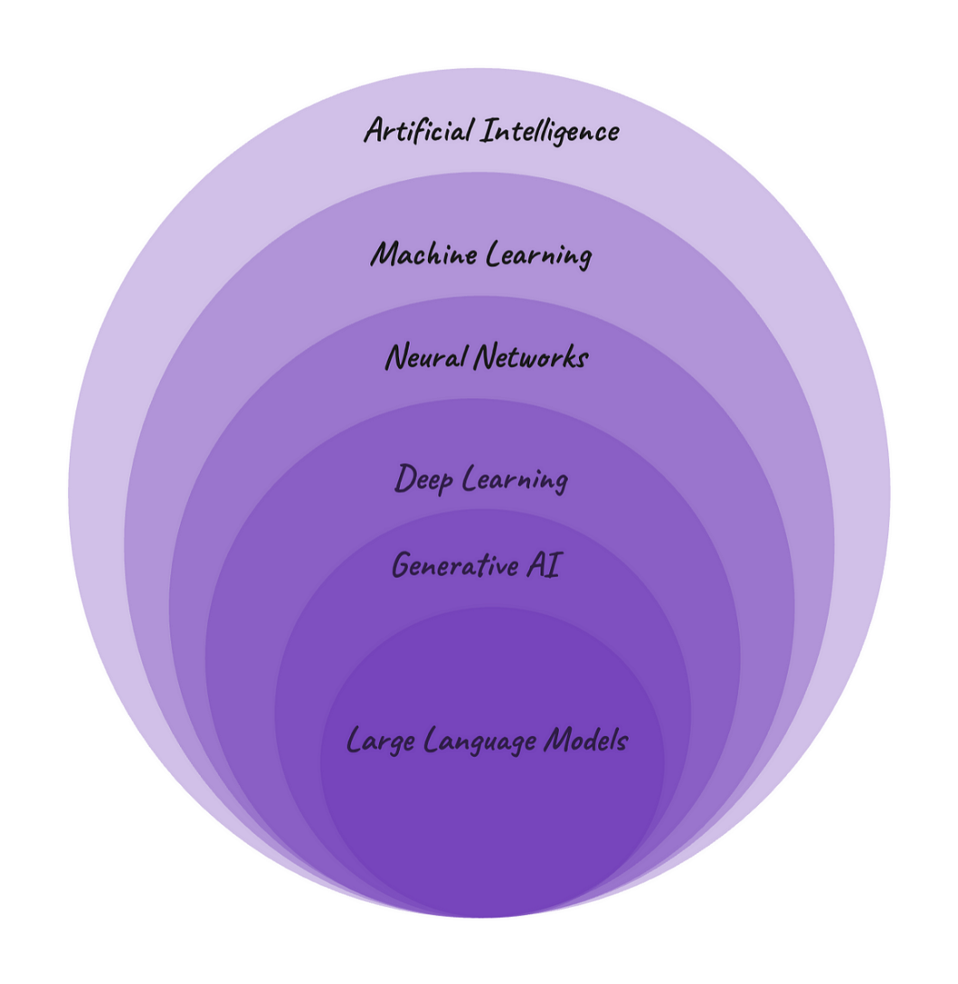

Slide 3
Machine Learning
Machine Learning (ML) is a field of artificial intelligence (AI) that enables computers to learn from data and make decisions or predictions without being explicitly programmed.

Slide 4
Key Concepts in Machine Learning
Data
Model
Learning Algorithm
Training
Prediction/Inference
Feedback

Slide 5
Types of Machine Learning
Supervised Learning:
Definition: Trained on a labelled dataset.
Goal: The goal is to learn a function that maps inputs to correct outputs.
Examples:
Classification: Spam in Email .
Regression: House-price prediction
Algorithms: Linear Regression, Logistic Regression, Support Vector Machines (SVM), K-Nearest Neighbors (KNN), Decision Trees, Neural Networks.

Slide 6
Types of ML (cont.)
Unsupervised Learning:
Definition: Find patterns or structures in the data, such as grouping similar data points or reducing the data's dimensionality.
Goal: Discover hidden patterns in the data without explicit labels.
Examples:
Clustering: Grouping customers based on purchasing behaviour.
Dimensionality Reduction: Reducing the number of features while preserving the important structure (e.g., PCA).
Algorithms: K-Means Clustering, DBSCAN, Hierarchical Clustering, Principal Component Analysis (PCA), t-SNE.

Slide 7
Types of ML (cont.)
Semi-supervised Learning:
Definition: Hybrid between supervised and unsupervised learning. It tries to learn from the small labelled dataset and then generalize to the unlabeled data.
Goal: Utilize a mix of labelled and unlabeled data to improve learning efficiency.
Examples:
Using labelled data to identify important features in a large set of unlabeled data.

Slide 8
Reinforcement Learning:
Definition: In reinforcement learning, an agent learns by interacting with an environment. It takes actions, receives feedback in the form of rewards or penalties, and uses this information to improve its future actions.
Goal: Learn the optimal actions to take in an environment to maximize cumulative rewards over time.
Examples:
Training an AI to play a game like Chess or Go.
Robotics for path planning or motion control.
Algorithms: Q-Learning, Deep Q-Networks (DQN), Policy Gradient Methods.

Slide 9
Steps in a Machine Learning Project
Data Collection
Data Pre-processing
Model Selection
Training
Evaluation
Hyper parameter Tuning
Deployment
Monitoring and Maintenance

Slide 10
Common Applications of Machine Learning:
Healthcare: Disease diagnosis, medical imaging, drug discovery, personalized medicine.
Finance: Fraud detection, credit scoring, algorithmic trading, risk management.
Retail: Customer segmentation, recommendation systems, inventory management.
Natural Language Processing (NLP): Language translation, speech recognition, sentiment analysis, chatbots.
Computer Vision: Image classification, object detection, facial recognition, autonomous vehicles.
Robotics: Self-learning robots, path planning, motion control.

Slide 11
Supervised and unsupervised machine learning

Slide 12
Supervised ML Algorithm Versus Unsupervised ML Algorithm
Aspect | Supervised Learning | Unsupervised Learning
Data | Labelled (inputs and corresponding outputs) | Unlabeled (only inputs, no outputs)
Goal | Predict output labels or values | Discover patterns or groupings in the data
Algorithms | Classification, Regression | Clustering, Dimensionality Reduction
Use Cases | Spam detection, Image recognition, Forecasting | Customer segmentation, Anomaly detection

Slide 13
Unsupervised Learning Versus Supervised Learning

Slide 14
A Large Language Model (LLM) typically undergoes a combination of supervised and unsupervised learning during its training process.

Slide 15
1. Unsupervised Learning (Pre training Phase)
Unsupervised Pre training:
LLMs like GPT are primarily trained in an unsupervised manner in the initial phase.
During this phase, they are exposed to vast amounts of text data without labelled outputs.
The model learns to predict the next word in a sentence (autoregressive model), which is an unsupervised task where the model tries to capture patterns, grammar, facts about the world, reasoning abilities, and some level of common sense.
Objective: The model learns to understand and generate human-like text by identifying statistical relationships and patterns in data, rather than learning from explicit labels.
Example: A sentence like "The cat sat on the ___"
would be used to predict the next word ("mat") during training

Slide 16
2. Supervised Learning (Fine tuning Phase)
Supervised Fine-tuning:
After pretraining, LLMs often undergo supervised fine-tuning.
In this phase, the model is trained with labelled data where human-provided examples and corrections are used to improve its performance on specific tasks like question-answering, summarization, or classification.
The model's predictions are compared to the true answers (labels), and it adjusts based on the errors.
Objective:
Fine-tuning helps the model specialize and perform better on particular tasks, such as following instructions or performing sentiment analysis.
Example:
A task like question answering where the model learns to map a question to a correct answer using labeled examples.
For instance, "What is the capital of France?" → "Paris."

Slide 17
Pretraining:
LLMs are trained using unsupervised learning by predicting the next word in a sequence without explicit labels.
Fine-tuning:
LLMs may undergo supervised learning using labeled datasets for specific tasks or improvements.
Thus, LLMs leverage a hybrid approach, combining both supervised and unsupervised learning methods.

Slide 18
Deep Learning

Slide 19
Deep Learning
DL is a subset of machine learning
Focuses on algorithms inspired by the structure and function of the brain, specifically artificial neural networks.
High ability to solve complex problems in areas like computer vision, natural language processing, and speech recognition with high accuracy.
Deep learning models are designed to automatically learn from large amounts of data and improve their performance over time, especially when the data is vast and unstructured.

Slide 20
Key Concepts in Deep Learning
Neural Networks:
Deep learning models are built on artificial neural networks (ANNs).
These networks consist of layers of interconnected nodes (or neurons) that simulate the behaviour of the human brain.

Slide 21
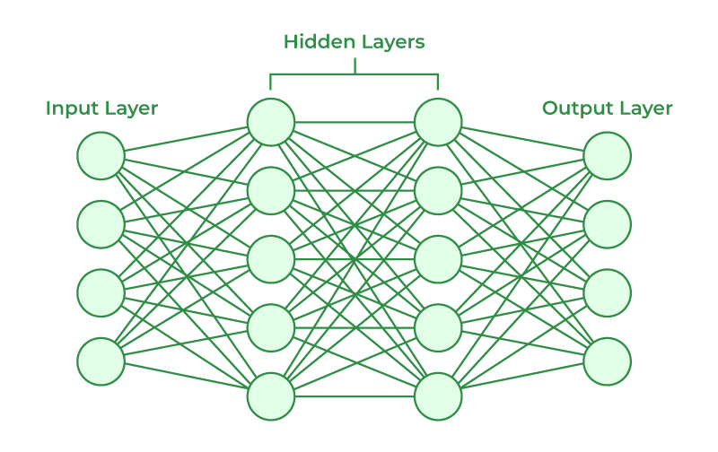
A neural network consists of three main types of layers:
Input layer: Takes the raw input data.
Hidden layers: Process and transform the data through complex computations. These are the "deep" parts of the network.
Output layer: Produces the final prediction or classification result.

Slide 22
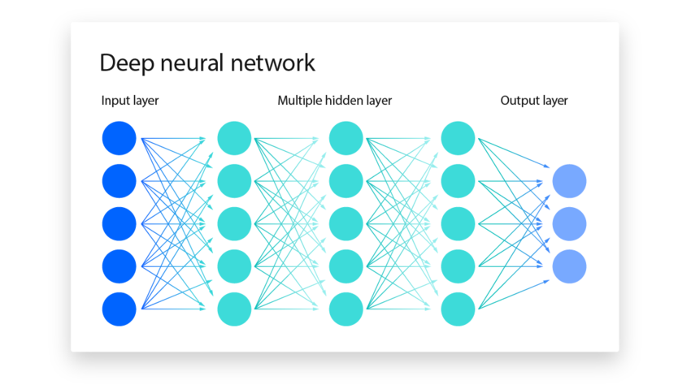
Deep Neural Networks (DNNs)
Deep Neural Networks are neural networks with many hidden layers (typically 3 or more).
The "depth" refers to the number of layers, and these layers allow the model to capture complex patterns in the data.
DNNs can automatically learn hierarchical features, where lower layers capture simple features (like edges or textures), and higher layers combine them into more complex features (like shapes or objects).

Slide 23
Activation Functions:
Activation functions introduce non-linearity to the network, enabling it to learn complex patterns. Common activation functions include:
ReLU (Rectified Linear Unit): f(x)=max⁡(0,x)f(x) = \max(0, x)
Sigmoid: f(x)=11+e−xf(x) = \frac{1}{1 + e^{-x}}
Tanh: f(x)=tanh⁡(x)f(x) = \tanh(x)
Softmax: Often used for classification tasks to output probabilities.

Slide 24
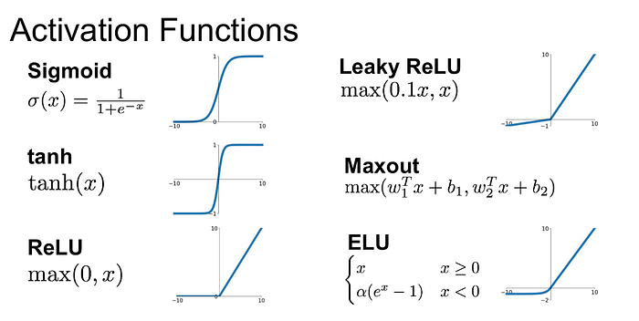

Slide 25
4. Backpropagation:
Backpropagation is the learning algorithm used to train neural networks.
It involves calculating the gradient (partial derivatives) of the error function with respect to each weight in the network, and then updating the weights using gradient descent or other optimization algorithms to minimize the error.

Slide 26
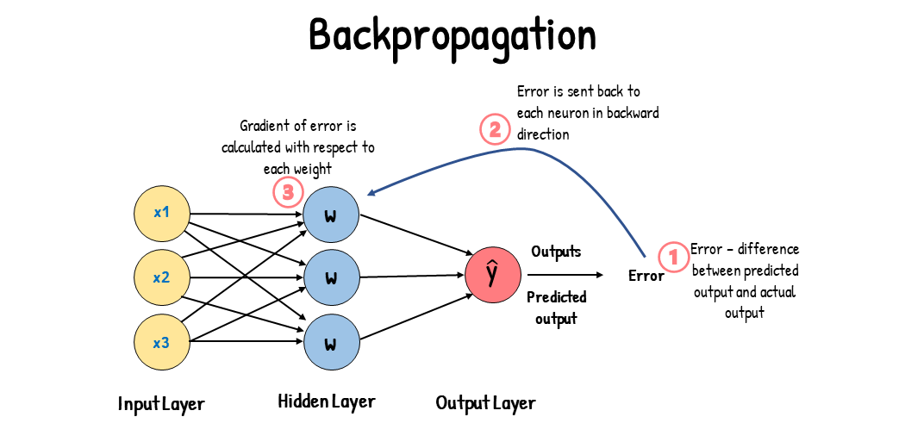
5. Optimization Algorithms:
Optimization techniques like Stochastic Gradient Descent (SGD), Adam, and RMSprop are used to adjust the weights in the network to minimize the loss function (error).

Slide 27
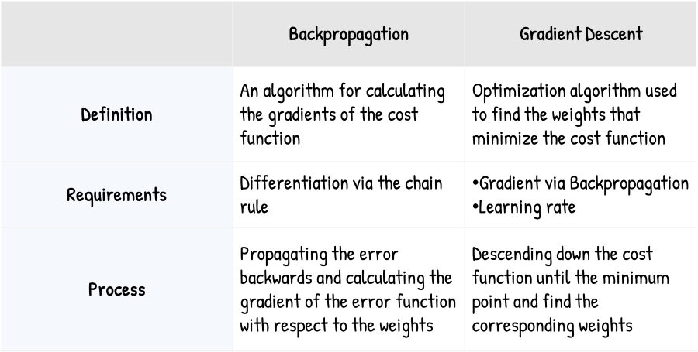

Slide 28
6. Loss Function:
The loss function measures how well or poorly the model is performing. For classification tasks, the loss function might be cross-entropy, and for regression tasks, it could be mean squared error (MSE).

Slide 29
Types of Deep Learning Architectures
1. Convolutional Neural Networks (CNNs):
CNNs are designed for processing grid-like data, such as images. They use convolutional layers to automatically detect patterns like edges, textures, and objects in the image.
CNNs are highly effective for tasks like:
Image classification (e.g., identifying objects in images)
Object detection
Image segmentation
Face recognition

Slide 30
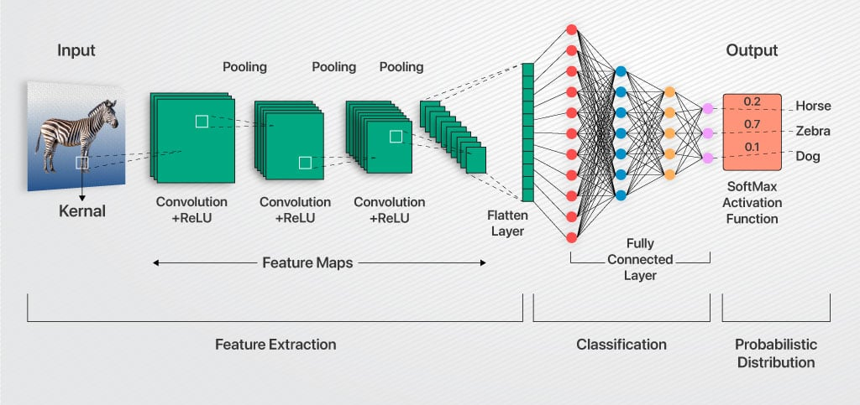

Slide 31
2. Recurrent Neural Networks (RNNs):
RNNs are designed for sequential data, such as time series, speech, or text. RNNs maintain an internal state (memory) that helps them capture dependencies between sequential data points.
RNNs are used for:
Natural language processing (e.g., language translation, text generation)
Speech recognition
Time series forecasting

Slide 32
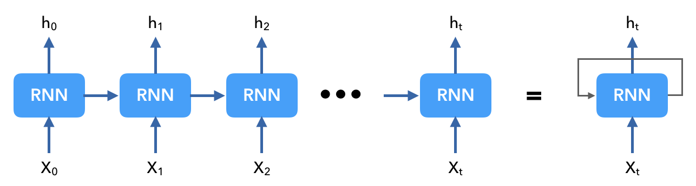
Common types of RNNs include:
Vanilla RNN: A basic form of RNN, where outputs are fed back into the network.

Slide 33
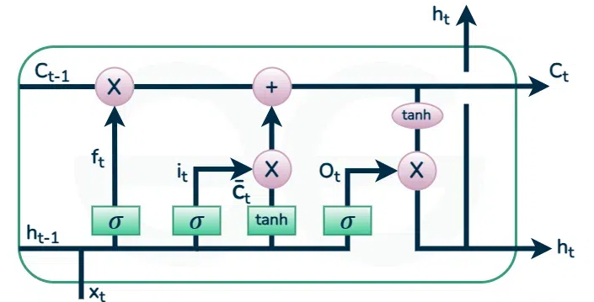
Long Short-Term Memory (LSTM): A type of RNN that mitigates the vanishing gradient problem, making it effective at learning long-term dependencies.
Gated Recurrent Unit (GRU): A variation of LSTM with a simpler architecture.

Slide 34
3. Generative Adversarial Networks (GANs)
GANs consist of two networks: a generator and a discriminator. The generator creates synthetic data, and the discriminator evaluates how realistic the generated data is.
The two networks compete in a game-theoretic setup:
the generator tries to produce data that fools the discriminator, while the discriminator learns to distinguish between real and fake data.
GANs are used for:
Image generation (e.g., generating realistic images from noise)
Image-to-image translation (e.g., turning sketches into photos)
Video generation
Style transfer

Slide 35
4. Transformer Networks
Transformers are a deep learning architecture that has revolutionized natural language processing tasks.
Unlike RNNs, transformers do not rely on sequential processing and instead use self-attention mechanisms to model relationships between words in a sentence.
The key innovation is the self-attention mechanism, which allows the model to weigh the importance of different words in a sentence relative to each other.

Slide 36
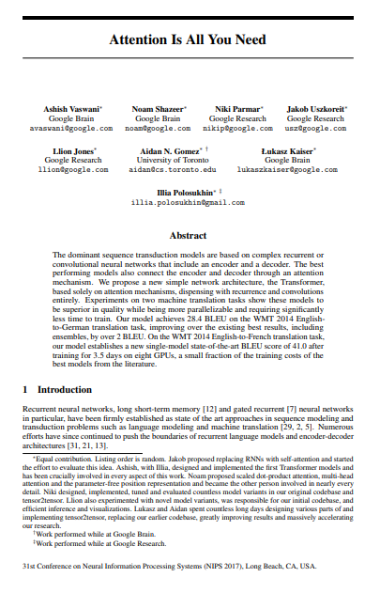
Transformers are the backbone of models like BERT (Bidirectional Encoder Representations from Transformers), GPT (Generative pretrained Transformer), and T5 (Text-to-Text Transfer Transformer).
They are used in tasks like:
Machine translation
Text summarization
Sentiment analysis
Question answering

Slide 37
5. Autoencoders
Autoencoders are unsupervised neural networks used for tasks like dimensionality reduction, feature learning, and anomaly detection.
They work by encoding input data into a compressed representation and then decoding it back to reconstruct the original input. The goal is to minimize the reconstruction error.
Autoencoders are used for:
Data compression
Image denoising
Anomaly detection

Slide 38
Key Benefits of Deep Learning
Automated Feature Extraction: Deep learning models automatically learn relevant features from raw data, eliminating the need for manual feature engineering.
High Accuracy: When provided with large amounts of labeled data, deep learning models can achieve state-of-the-art performance in tasks like image recognition, language translation, and more.
Scalability: Deep learning models scale well with increased data, often improving performance as more data is provided.
Versatility: Deep learning can be applied to a wide range of tasks, from computer vision and natural language processing to robotics and medicine.

Slide 39
Challenges of Deep Learning
Data Requirements: Deep learning models often require vast amounts of labeled data for training, which may not always be available.
Computationally Intensive: Training deep learning models is resource-heavy, requiring powerful hardware like GPUs or TPUs and long training times.
Interpretability: Deep learning models are often seen as "black boxes," meaning it can be difficult to interpret how the model makes decisions, which is critical in some fields (e.g., healthcare or finance).
Overfitting: Deep models are prone to overfitting, especially with limited data, meaning they might perform well on training data but poorly on unseen data.

Slide 40
Applications of Deep Learning
Computer Vision:
Image recognition, object detection, facial recognition, autonomous vehicles, medical image analysis.
Natural Language Processing (NLP):
Language translation, sentiment analysis, chatbot development, text summarization, speech recognition.
Speech Recognition:
Voice assistants (e.g., Alexa, Siri), transcription, language modeling.
Healthcare:
Predicting disease, drug discovery, medical image analysis, personalized medicine.
Gaming and Entertainment:
Game AI (e.g., AlphaGo), content generation (e.g., DeepFake), music composition, and video game characters' behaviour.

Slide 41
Summary
Deep learning is a powerful subset of machine learning that enables models to automatically learn complex patterns from vast amounts of data.
With the advent of advanced architectures like CNNs, RNNs, GANs, and transformers, deep learning has become the go-to method for solving tasks in computer vision, NLP, and more.
Despite its remarkable capabilities, deep learning also requires large datasets, substantial computational resources, and can be difficult to interpret.

Slide 42
Machine Learning versus Deep Learning

Slide 43
ML Versus DL
1. Definition:
Machine Learning (ML): Machine Learning is a broader field of AI that involves algorithms and statistical models that allow computers to learn from data and make predictions or decisions based on it, without being explicitly programmed.
Deep Learning (DL): Deep Learning is a subset of machine learning that uses neural networks with many layers (deep neural networks) to learn from large amounts of data. It is specifically designed for tasks that involve complex patterns like image recognition, natural language processing, etc.

Slide 44
2. Algorithm Complexity:
Machine Learning:
ML includes a wide range of algorithms, such as:
Linear Regression
Logistic Regression
Decision Trees
Support Vector Machines (SVM)
K-Nearest Neighbors (KNN)
These algorithms are generally simpler compared to deep learning methods.
Deep Learning:
DL primarily uses artificial neural networks, specifically deep neural networks (DNNs) with multiple layers.
These networks are more complex and are capable of automatically learning hierarchical patterns in data.

Slide 45
3. Data Requirements:
Machine Learning:
ML algorithms often perform well with smaller datasets (tens of thousands of data points).
The quality and features of the data (feature engineering) are very important to model performance.
Deep Learning:
DL models require large amounts of data to perform well.
They tend to thrive with huge datasets (millions of data points), as the more data you provide, the better they learn and generalize.

Slide 46
4. Feature Engineering:
Machine Learning:
In ML, feature engineering plays a critical role.
The model requires domain knowledge to identify the most relevant features in the data for the algorithm to use.
Deep Learning:
One of the key advantages of DL is that it can automatically learn features from the data without the need for manual feature engineering.
The model learns the representations of the data through its layers.

Slide 47
5. Computation Power:
Machine Learning:
ML algorithms are typically less computationally expensive and can be trained on regular CPUs.
Even with smaller datasets, ML models can run efficiently.
Deep Learning:
DL models, due to their complexity, require a lot more computational power, especially during the training phase.
These models often require specialized hardware like Graphics Processing Units (GPUs) or Tensor Processing Units (TPUs) to accelerate the training process.

Slide 48
6. Training Time:
Machine Learning:
ML models generally take less time to train compared to deep learning models, especially when using simpler algorithms.
Deep Learning:
Training deep learning models can take hours, days, or even weeks, depending on the complexity of the model and the amount of data available.

Slide 49
7. Interpretability:
Machine Learning:
ML models are often more interpretable.
For example, decision trees or linear regression models allow for understanding how the model makes its decisions.
Deep Learning:
DL models are often considered black boxes.
Their decision-making process is difficult to interpret because of the complexity and the large number of layers in the networks.

Slide 50
8. Performance:
Machine Learning:
ML algorithms can be very effective, especially for simpler tasks or tasks where the data is smaller or well-structured.
They can handle linear and non-linear data well but may not perform as well on complex tasks like image or speech recognition.
Deep Learning:
DL algorithms excel in tasks that involve high-dimensional data like images, speech, and text.
For example, deep learning models outperform traditional ML models in tasks such as image classification, object detection, and natural language understanding (e.g., in models like GPT).

Slide 51
9. Use Cases:
Machine Learning:
Suitable for problems like:
Predictive analytics (e.g., stock price prediction)
Classification (e.g., email spam filtering)
Regression (e.g., predicting house prices)
Time series forecasting (e.g., sales prediction)
Deep Learning:
Best for tasks that involve unstructured data, such as:
Computer Vision: Image classification, object detection, facial recognition
Natural Language Processing (NLP): Language translation, speech recognition, text generation
Reinforcement Learning: Autonomous driving, game playing
(e.g., AlphaGo)
Speech and Audio Processing: Voice assistants (e.g., Siri, Alexa)

Slide 52
10. Examples of Models:
Machine Learning Models:
Linear Regression, Decision Trees, Random Forest, Support Vector Machines (SVM), Naive Bayes, K-Means Clustering
Deep Learning Models:
Convolutional Neural Networks (CNNs) for image data
Recurrent Neural Networks (RNNs) and Long Short-Term Memory (LSTM) networks for sequential data
Transformers (e.g., BERT, GPT) for natural language processing

Slide 53
summary
Aspect | Machine Learning | Deep Learning
Data Requirement | Works well with smaller datasets | Requires large amounts of data
Feature Engineering | Manual feature engineering needed | Automatically learns features
Computation Power | Requires less computational power | Requires high computational resources (GPUs/TPUs)
Training Time | Faster training | Longer training times
Model Complexity | Simpler models | More complex, multi-layered models
Interpretability | More interpretable | Often considered "black-box"
Performance | Good for simpler problems | Excels in complex tasks (images, text, etc.)
Examples | Linear Regression, SVM, Random Forest | CNNs, RNNs, Transformers, GANs

Slide 54
Conclusion:
Machine Learning is ideal for simpler tasks with structured data or when the amount of data is not very large.
It's easier to implement, requires less computational power, and offers more interpretability.
Deep Learning excels at complex tasks, especially with large and unstructured data (like images, text, and audio).
Although it requires more computational resources and large datasets, it often outperforms traditional ML models in challenging tasks, but at the cost of interpretability and longer training times.
In practice, both ML and DL can be used together, depending on the specific problem at hand and the available resources.

Slide 55
Machine Learning (ML) vs. Deep Learning (DL) vs. Generative AI (GenAI) vs. Large Language Models (LLMs)

Slide 56
1. Machine Learning (ML)
Definition:
ML is a broader field of artificial intelligence that involves training algorithms to learn patterns and make predictions from data without explicit programming.
It includes a variety of algorithms, from simple ones (like linear regression) to more complex ones (like decision trees and support vector machines).
Scope:
ML encompasses supervised, unsupervised, semi-supervised, and reinforcement learning.
It’s used in a wide range of tasks, from predictions and classification to clustering and anomaly detection.

Slide 57
ML (cont.)
Examples:
Predicting house prices (regression)
Classifying emails as spam or not (classification)
Clustering customers by purchasing behavior (clustering)
Key Characteristics:
Works well with structured data (e.g., numerical, tabular data).
Focus on feature engineering.
Algorithms can be simpler, but performance may improve with more complex methods.

Slide 58
2. Deep Learning (DL)
Definition:
DL is a subset of machine learning that uses neural networks with many layers (called deep neural networks) to automatically learn from large datasets.
It excels in tasks involving unstructured data like images, text, and audio.
Scope:
DL is focused on automatically learning features and representations from raw data without the need for manual feature engineering.
It is especially useful for problems that are too complex for traditional ML algorithms to solve effectively.

Slide 59
DL (cont.)
Examples:
Image classification using Convolutional Neural Networks (CNNs)
Natural Language Processing (NLP) tasks using Recurrent Neural Networks (RNNs) or Transformers
Speech recognition and voice assistants
Key Characteristics:
Requires large amounts of labelled data.
Computationally intensive (often requires GPUs or TPUs).
Less emphasis on feature engineering since the network learns useful features from data.

Slide 60
3. Generative AI (GenAI)
Definition:
Generative AI refers to a subset of AI models that focus on generating new data or content, such as images, text, audio, or even video, based on learned patterns from existing data.
These models aim to create something original, not just predict or classify based on input data.
Scope:
GenAI can involve various types of models and architectures, including generative adversarial networks (GANs), variational autoencoders (VAEs), and autoregressive models like transformers.
These models learn the underlying distribution of data and can generate realistic new examples.

Slide 61
Gen-AI (cont.)
Examples:
GANs for generating realistic images (e.g., creating synthetic faces, artwork, etc.).
DALL·E or MidJourney for generating images from textual descriptions.
Text generation models like GPT (e.g., creating news articles, poetry, etc.).
Key Characteristics:
Models are capable of producing novel outputs, such as text, images, and even music.
Can be used for creative tasks, like generating realistic synthetic media.
Includes models such as GANs, VAEs, and transformer-based models.

Slide 62
4. Large Language Models (LLMs)
Definition:
LLMs are a specific type of deep learning model trained on vast amounts of text data to understand, generate, and manipulate human language.
These models typically use transformer architecture, which allows them to handle long-range dependencies in text and generate coherent, contextually relevant responses.
Scope:
LLMs are a subset of Generative AI designed specifically for natural language processing (NLP) tasks.
LLMs can be fine-tuned to perform various tasks, such as question-answering, summarization, translation, and even conversation.

Slide 63
LLM (cont.)
Examples:
GPT-3, GPT-4 (e.g., the model behind ChatGPT)
BERT for understanding language context and relationships
T5 (Text-to-Text Transfer Transformer)
Key Characteristics:
Specializes in language-related tasks (text generation, summarization, translation, etc.).
Trained on massive corpora of text data from books, articles, websites, etc.
Fine-tuned for specific tasks like answering questions or summarizing text.
LLMs are a form of Generative AI, as they can generate new text, not just classify or predict based on input data.

Slide 64
Comparison Table
Aspect | Machine Learning (ML) | Deep Learning (DL) | Generative AI (GenAI) | Large Language Models (LLMs)
Definition | A broad AI field focused on algorithms that learn from data to make predictions or decisions. | A subset of ML using deep neural networks to automatically learn from large datasets. | AI that generates new, synthetic data (text, images, etc.). | A type of deep learning model for NLP, trained to generate or understand human language.
Scope | Encompasses supervised, unsupervised, semi-supervised learning, etc. | Focuses on learning from large, unstructured data (images, speech, text). | Can generate images, text, video, etc. | Specializes in tasks related to human language.
Data Requirements | Works well with structured data. | Requires large datasets, especially unstructured data. | Requires large, diverse datasets for training. | Requires large text corpora for training.
Task Focus | Prediction, classification, clustering, regression, etc. | Tasks requiring complex pattern recognition (e.g., vision, speech, etc.). | Content generation (e.g., text, images). | Text generation, summarization, translation, conversation, etc.
Example Algorithms | Linear regression, decision trees, SVM, KNN, etc. | CNNs, RNNs, GANs, Transformers, etc. | GANs, VAEs, autoregressive models. | GPT-3, GPT-4, BERT, T5, etc.
Use Cases | Fraud detection, customer segmentation, medical diagnostics, etc. | Image recognition, speech recognition, NLP, self-driving cars, etc. | Image creation (e.g., DALL·E), music generation, video creation, etc. | Text generation (e.g., ChatGPT), summarization, language translation, question-answering.
Computational Power | Moderate, depending on the algorithm. | High (often requires GPUs/TPUs). | High (often requires GPUs/TPUs). | Very high (often requires GPUs/TPUs).
Interpretability | Easier to interpret (depending on algorithm). | Often less interpretable (deep "black-box" models). | Often less interpretable, depending on the model. | Less interpretable, as LLMs are complex and data-driven.

Slide 65
Summary
Machine Learning (ML) is the broadest category, including a variety of algorithms for predictions, classification, and other tasks using structured data.
Deep Learning (DL) is a subset of ML, focused on using neural networks with many layers to learn from large datasets, often unstructured, such as images or speech.
Generative AI (GenAI) is a branch of AI that focuses on creating new content, like images, text, or even music. It includes models like GANs and VAEs and is often a part of deep learning.
Large Language Models (LLMs) are a specific form of Generative AI that are specialized in working with language data, trained to perform tasks such as generating text, summarizing, translating, and answering questions.
In summary, LLMs are a type of deep learning model, and Generative AI is a broader category that includes models like LLMs designed to create new content.

Slide 66
Natural Language Processing (NLP)

Slide 67
Natural Language Processing (NLP) is a subfield of Artificial Intelligence (AI) and Computational Linguistics that focuses on the interaction between computers and human (natural) languages.
Its goal is to enable machines to understand, interpret, and generate human language in a way that is both meaningful and useful.
NLP allows computers to process and analyze large amounts of natural language data (e.g., text and speech), and is a key technology behind many modern AI applications like chatbots, voice assistants, translation systems, and sentiment analysis tools.

Slide 68
Key Areas of NLP
Text Classification:
Categorizing text into predefined categories. For example:
Spam Detection: Classifying emails as spam or not.
Sentiment Analysis: Determining if a review or tweet is positive, negative, or neutral.
Named Entity Recognition (NER):
Identifying and classifying entities (names, places, organizations, dates, etc.) in text. For example, in the sentence “Apple is based in Cupertino,” "Apple" is a company and "Cupertino" is a location.
Machine Translation:
Automatically translating text or speech from one language to another. For example, translating a sentence from English to French.

Slide 69
Key Areas of NLP (cont.)
Text Generation:
Producing meaningful and contextually relevant text, given a certain input. Common applications include:
Chatbots: Generating responses based on user input.
Language Models: Such as GPT (Generative Pre-trained Transformer), which can generate text in a variety of formats (e.g., articles, stories, etc.).
Speech Recognition:
Converting spoken language into text. This is used in applications like voice assistants (e.g., Siri, Alexa) and transcription software.
Part-of-Speech (POS) Tagging:
Identifying the grammatical category of words in a sentence (e.g., noun, verb, adjective). This helps in understanding the structure of the language.

Slide 70
Text Summarization:
Automatically generating a concise summary of a longer text, while retaining its meaning. This can be:
Extractive: Selecting key sentences directly from the text.
Abstractive: Generating new sentences to summarize the content.
Question Answering:
Building systems that can answer user queries based on a given text. For example, answering questions based on a passage of text or a knowledge base.
Language Modelling:
Training a model to predict the likelihood of the next word in a sequence or generate coherent text. LLMs like GPT-3 are often used for this task.

Slide 71
Key Techniques in NLP
Tokenization:
Breaking down text into smaller units (tokens), such as words, phrases, or sentences. Tokenization is the first step in most NLP pipelines.
Stemming and Lemmatization:
Stemming: Reducing words to their base or root form (e.g., "running" becomes "run").
Lemmatization: Similar to stemming, but it considers the word's meaning and context to return the base form (e.g., "better" becomes "good").
Stopword Removal:
Removing common words (like "and," "the," "in") that don't contribute much to the meaning of the text but can slow down processing.

Slide 72
Key Techniques in NLP (cont.)
Word Embeddings:
Representing words as vectors in a high-dimensional space where similar words have similar representations. Examples of word embeddings include Word2Vec, GloVe, and FastText.
Transformers:
A type of deep learning architecture that has revolutionized NLP. Transformers process the entire input at once, using mechanisms like self-attention to understand the relationships between words, regardless of their position in the text.
Prominent models based on the transformer architecture include:
BERT (Bidirectional Encoder Representations from Transformers): Used primarily for tasks like classification, NER, and question answering.
GPT (Generative Pre-trained Transformer): A model designed for text generation, chatbots, and conversational agents.
Self-Attention:
A mechanism in transformer models that allows each word in a sentence to focus on other words (or parts of words) to better understand context. It’s especially useful in handling long-range dependencies in text.

Slide 73
Popular NLP Models
BERT (Bidirectional Encoder Representations from Transformers):
BERT is pre-trained on a large corpus and then fine-tuned for specific tasks.
It captures context from both the left and the right side of a word, making it highly effective for tasks like text classification, NER, and question answering.
Used in many search engines and NLP systems to improve the relevance of search results.

Slide 74
Popular NLP Models (cont.)
GPT (Generative Pretrained Transformer):
GPT models, such as GPT-3 and GPT-4, are pre-trained on massive datasets and fine-tuned for various tasks, including text generation, translation, and conversation.
GPT-3 and GPT-4 are among the largest language models in the world and are known for their ability to generate coherent, human-like text.

Slide 75
Popular NLP Models (cont.)
T5 (Text-to-Text Transfer Transformer):
T5 treats every NLP task as a text-to-text problem, where the input and output are both text.
This makes it versatile for a wide range of tasks like translation, summarization, and question answering.

Slide 76
Popular NLP Models (cont.)
XLNet:
XLNet is a generalized autoregressive pretraining method that outperforms BERT on several NLP tasks by capturing better contextual information in a non-sequential way.

Slide 77
Popular NLP Models (cont.)
RoBERTa (Robustly Optimized BERT approach):
RoBERTa is a variant of BERT with enhanced training strategies and optimizations.
It has achieved superior results on various NLP benchmarks.

Slide 78
Applications of NLP
Chatbots and Virtual Assistants:
NLP enables chatbots like Siri, Google Assistant, and Alexa to understand and respond to human queries.
Search Engines:
Google uses NLP to interpret search queries and return relevant search results.
Language Translation:
NLP models like Google Translate and DeepL use machine translation techniques to automatically translate text from one language to another.

Slide 79
Applications of NLP (cont.)
Sentiment Analysis:
Analyzing customer reviews, social media posts, or survey data to understand public sentiment toward a product, service, or topic.
Voice-to-Text:
Converting spoken words into written text, used in transcription services and voice assistants.
Text Summarization:
Summarizing long documents, articles, or books into short, readable summaries, used by news agencies and content aggregators.

Slide 80
Applications of NLP (cont.)
Medical and Legal Text Processing:
Analyzing medical records, legal documents, or research papers for insights, and automating document review and categorization.
Question Answering:
Extracting answers from large corpora or documents, such as in Google Search or Siri.

Slide 81
Challenges in NLP
Ambiguity:
Words or sentences can have multiple meanings based on context.
For example, "bank" could refer to a financial institution or the side of a river.
Sarcasm and Irony:
NLP models often struggle to detect sarcasm or irony, as the meaning is not directly conveyed in the words.
Multilinguality:
NLP systems need to handle multiple languages, dialects, and colloquialisms, which can vary significantly in structure.
Data Privacy and Bias:
Models trained on large-scale text data might inadvertently learn biased or discriminatory language patterns present in the data.

Slide 82
Conclusion
Natural Language Processing (NLP) is a powerful and dynamic field in AI, enabling machines to interact with human language in a way that mimics human understanding.
With advances in deep learning, especially the transformer architecture, NLP has seen significant improvements in tasks like translation, summarization, and conversation, allowing for the development of sophisticated tools such as chatbots, voice assistants, and content generation systems.
However, challenges remain, particularly in handling nuances like ambiguity, sarcasm, and bias.

