Slide 1
OCI - LB

Slide 2
Load Balancer
A service that provides automated traffic distribution from one entry point to multiple servers reachable from your VCN.
The service offers a load balancer with your choice of a public or private IP address, & provisioned bandwidth.
A load balancer improves resource utilization, facilitates scaling, & helps ensure HA.
You can configure multiple load balancing policies & app-specific health checks to ensure that the load balancer directs traffic only to healthy instances.
The LB can reduce your maintenance window by draining traffic from an unhealthy app server before you remove it from service for maintenance.

Slide 3
How Load Balancing Works
The Load Balancing service enables you to create a public or private load balancer within your VCN.
A public LB has a public IP that is accessible from the internet.
A private LB has an IP address from the hosting subnet, which is visible only within your VCN.
You can configure multiple listeners for an IP to load balance transport Layer 4 and Layer 7 (TCP & HTTP) traffic.
Both public & private LBs can route data traffic to any backend server that is reachable from the VCN.

Slide 4
Public LB
To accept traffic from the internet, you create a public LB.
The service assigns it a public IP that serves as the entry point for incoming traffic.
You can associate the public IP with a friendly DNS name through any DNS vendor.
A public LB is regional.
If your region has multiple ADs, a public LB requires either a regional subnet (recommended) or 2 AD-specific subnets, each in a separate AD.
With a regional subnet, the Load Balancing service creates a primary LB & a standby LB, each in a different AD, to ensure accessibility even during an AD outage.
If you create an LB in 2 AD-specific subnets, 1 subnet hosts the primary LB & the other hosts a standby LB.
If the primary LB fails, the public IP switches to the secondary LB.

Slide 5
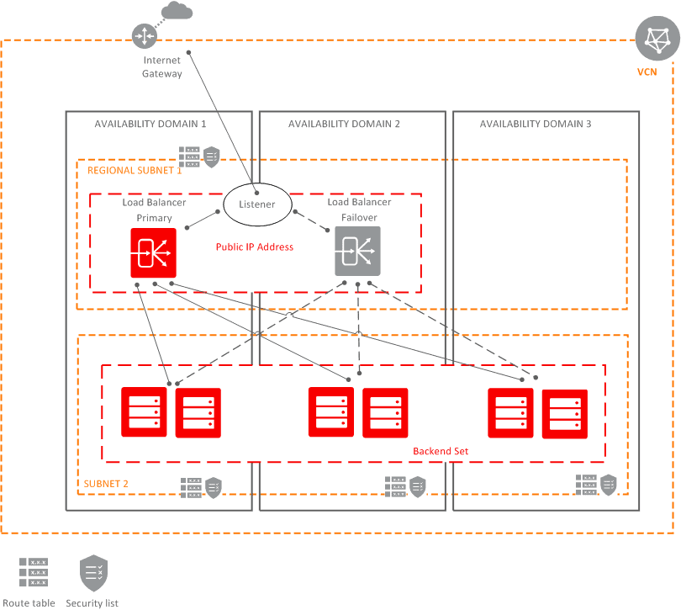

Slide 6
Public LB
The service treats the two LBs as equivalent & you cannot specify which one is primary.
Whether you use regional or AD-specific subnets, each LB requires one private IP from its host subnet.
The Load Balancing service supplies a floating public IP to the primary LB.
The floating public IP does not come from your backend subnets.
If your region includes only one AD, the service requires just 1 subnet, either regional or AD-specific, to host both the primary & standby LBs.
The primary & standby LBs each require a private IP from the host subnet, in addition to the assigned floating public IP.
If there is an AD outage, the LB has no failover.
You cannot specify a private subnet for your public LB.

Slide 7
Private LB
To isolate your LB from the internet & simplify your security posture, you can create a private LB.
The Load Balancing service assigns it a private IP that serves as the entry point for incoming traffic.
When you create a private LB, the service requires only 1 subnet to host both the primary & standby load balancers.
The LB can be regional or AD-specific, depending on the scope of the host subnet.

Slide 8
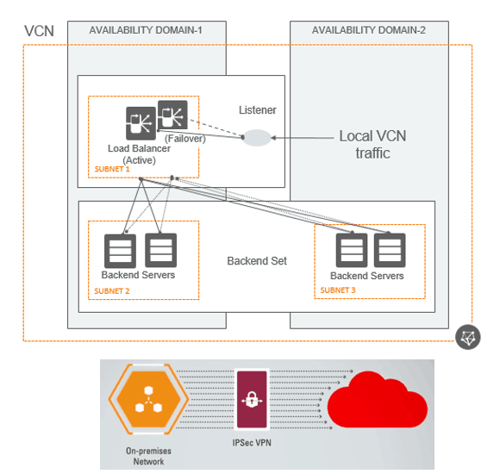

Slide 9
Private LB
The LB is accessible only from within the VCN that contains the host subnet, or as further restricted by your security rules.
The assigned floating private IP is local to the host subnet.
The primary & standby LBs each require an extra private IP from the host subnet.
If there is an AD outage:
A private LB created in a regional subnet in a multi-AD region provides failover.
A private LB created in an AD-specific subnet, or in a regional subnet in a single AD region, has no failover.

Slide 10
All LBs
Your LB has a backend set to route incoming traffic to your Compute instances.
The backend set is a logical entity that includes:
A list of backend servers.
A load balancing policy.
A health check policy.
Optional SSL handling.
Optional session persistence configuration.
The backend servers (Compute instances) associated with a backend set can exist anywhere, as long as the associated NSGs, security lists, & route tables allow the intended traffic flow.

Slide 11
All LBs
If your VCN uses NSGs, you can associate your LB with an NSG.
If you prefer to use security lists, the Load Balancing service can suggest appropriate security list rules.
Oracle recommends that you create your LB in a regional subnet.
Oracle recommends that you distribute your backend servers across all ADs within the region.

Slide 12
Load Balancing Concepts
Backend Server
Backend Set
Certificates
Health Check
Health Status
Listener
Load Balancing Policy
Path Route Set
Session Persistence
Shape
SSL
Virtual Hostname

Slide 13
Load Balancing Limits
You cannot dynamically change the LB shape to handle more incoming traffic.
You cannot convert an AD-specific LB to a regional LB or vice-versa.
Max concurrent connections are limited when you use stateful security rules for your LB subnets.
To accommodate high-volume traffic, use stateless security rules for your LB subnets.
Each LB has the following configuration limits:
1 IP
16 backend sets
512 backend servers per backend set
1024 backend servers total
16 listeners

Slide 14
How Load Balancing Policies Work
A TCP LB considers policy & weightage to direct an initial incoming request to a backend server.
All subsequent packets on this connection go to the same endpoint.
An HTTP LB configured for cookie-based session persistence forwards requests to the backend server specified by the cookie’s session information.
For non-sticky HTTP requests, the LB applies policy & weightage to every incoming request & determines an appropriate backend server.
Multiple requests from the same client could be directed to different servers.

Slide 15
Round Robin
Round Robin is the default LB policy.
This policy distributes incoming traffic sequentially to each server in a backend set list.
After each server has received a connection, the load balancer repeats the list in the same order.
Round Robin is a simple load balancing algorithm.
It works best when all the backend servers have similar capacity & the processing load required by each request does not vary significantly.

Slide 16
Least Connections
The Least Connections policy routes incoming non-sticky request traffic to the backend server with the fewest active connections.
This policy helps you maintain an equal distribution of active connections with backend servers.
As with the round robin policy, you can assign a weight to each backend server & further control traffic distribution.

Slide 17
IP Hash
The IP Hash policy uses an incoming request’s source IP as a hashing key to route non-sticky traffic to the same backend server.
The LB routes requests from the same client to the same backend server as long as that server is available.
This policy honors server weightage when establishing the initial connection.

Slide 18
IP Hash
IP Hash ensures that requests from a particular client are always directed to the same backend server, as long as it is available.
You cannot add a backend server marked as Backup to a backend set that uses the IP Hash policy.
Multiple clients that connect to an LB through a proxy or NAT router appear to have the same IP. If you apply the IP Hash policy to your backend set, the LB routes traffic based on the incoming IP & sends these proxied client requests to the same backend server. If the proxied client pool is large, the requests could flood a backend server.

Slide 19
Connection Management
LBs support connection multiplexing.
The LB can route many incoming requests from multiple clients to the destination backend server through a few (1 or multiple) backend connections.
After your LB connects a client to a backend server, the connection can be closed due to inactivity.

Slide 20
Connection Management
You can configure LB listeners to control the max idle time allowed during each TCP connection or HTTP request & response pair.
Oracle recommends that you do not allow your backend servers to close connections to the load balancer.

Slide 21
Connection Management
3 timeout settings affect your LB’s behavior:
Keep-alive setting between the LB & backend server.
Keep-alive setting between the LB & the client.
Idle timeout.

Slide 22
HTTP “X-” Headers
The Load Balancing service adds or modifies the following X- headers when it passes requests to your servers:
X-Forwarded-Host X-Forwarded-Port X-Forwarded-Proto X-Real-IP

Slide 23
Create a load balancer using Terraform
resource oci_load_balancer_load_balancer tf_lb {
compartment_id = var.compartment_id
display_name = "tf-lb"
ip_mode = "IPV4"
is_private = "false"
shape = "100Mbps"
subnet_ids = [ "[subnet-ocid]" ]
}

Slide 24
Load balancer backend set
resource oci_load_balancer_backend_set tf_load_balancer_set {
health_checker {
interval_ms = "10000"
port = "80"
protocol = "HTTP"
response_body_regex = ""
retries = "3"
return_code = "403"
timeout_in_millis = "3000"
url_path = "/"
}
load_balancer_id = oci_load_balancer_load_balancer.tf_lb.id
name = "tf_load_balancer_set_LC"
policy = "LEAST_CONNECTIONS"
}

Slide 25
Load balancer backend
resource oci_load_balancer_backend tf_demo_instance_backend {
backendset_name = oci_load_balancer_backend_set.tf_load_balancer_set.name
backup = "false"
drain = "false"
ip_address = "10.0.0.155"
load_balancer_id = oci_load_balancer_load_balancer.tf_lb.id
offline = "false"
port = "80"
weight = "1"
}

Slide 26
Load balancer listener
resource oci_load_balancer_listener tf_lb_listener {
connection_configuration {
backend_tcp_proxy_protocol_version = "0"
idle_timeout_in_seconds = "60"
}
default_backend_set_name = oci_load_balancer_backend_set.tf_load_balancer_set.name
load_balancer_id = oci_load_balancer_load_balancer.tf_lb.id
name = "listener_lb_2022-0408-1500"
port = "80"
protocol = "HTTP"
}

