Slide 1
Terraform
Palani Karthikeyan

Slide 2
Course Agenda
Introduction to IaC
Types of IaC Tools
Terraform Architecture
Install Terraform
Hashi Corp Configuration Language(HCL)
Terraform providers & Resource
Variables
Life Cycle Rules
Data source

Slide 3
Course Agenda
Terraform state file
Terraform Commands
Meta Arguments
Version Constraints
Remote State
Import & Modules
Terraform Functions & Conditional Expression

Slide 4
Course Agenda
Locl_resource & GitHub
Deploying to Oracle Cloud Infrastructure with Terraform
Identity and Access Management
IAM Components
Tenancy & Policy
Virtual Cloud Network
Subnet
Internet Gateway
Dynamic Routing Gateway

Slide 5
Course Agenda
Object Storage
Object Storage Resources
Compute Service
Components for Launching Instances
Block Volume
Load Balancing
File System Concepts

Slide 6
Course Agenda
Configuration Management Tool
Ansible
Ansible Architecture
Inventory Files
Playbook Sections
Roles

Slide 7
Infrastructure as code (IaC)
Infrastructure as code (IaC) is the process of managing and provisioning computer data centers through machine-readable definition file, rather than physical hardware configuration or interactive configuration tools.

Slide 8
IaC

Slide 9
Why IaC ?
Back in the good old days, when you needed to deploy the infrastructure, a group of powerful beings known as sysadmins used to deploy infrastructure manually.
Every server, routers, load balancers, and database configuration was created and managed manually.
There always used to be the fear of accidental misconfiguration, fear of down time, and fear of slow and fragile deployments.
To overcome these type of scenarios or issues, DevOps has come into play where we write code to do things Infrastructure as Code.
The idea behind IAC is to write code to define, provision, and manage your infrastructure.

Slide 10
Types of IAC Tools
Configuration Management
Ansible
puppet
SALTSTACK
Server Templating
docker
packer
Vagrant
Provisioning tools
Terraform
CloudFormation

Slide 11
Provisioning tools
Deploy immutable infrastructure resources Servers, DataBases, Network components etc.,
Terraform
Cloudformation

Slide 12
Terraform
Terraform allows you to write infrastructure as code, that is, whatever tasks you do using a console graphically, you can do using code.
It’s automation of the infrastructure.
Terraform can manage existing and popular service providers as well as custom in-house solutions.
You can keep your infrastructure in a certain state.

Slide 13
Terraform
Terraform enables you to make your infrastructure auditable.
That is, you can upload your source files to version control systems, such as Git.

Slide 14
Terraform
Written in Go
Fast development - releases monthly+
HCL – Hashi Configuration Language and simple markup format JSON interoperable.

Slide 15
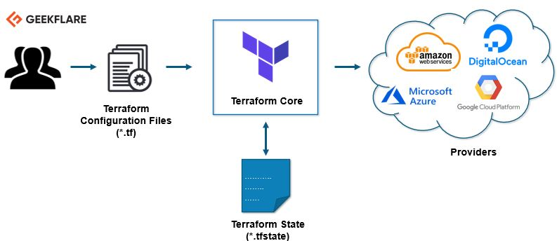
Terraform-Architecture

Slide 16
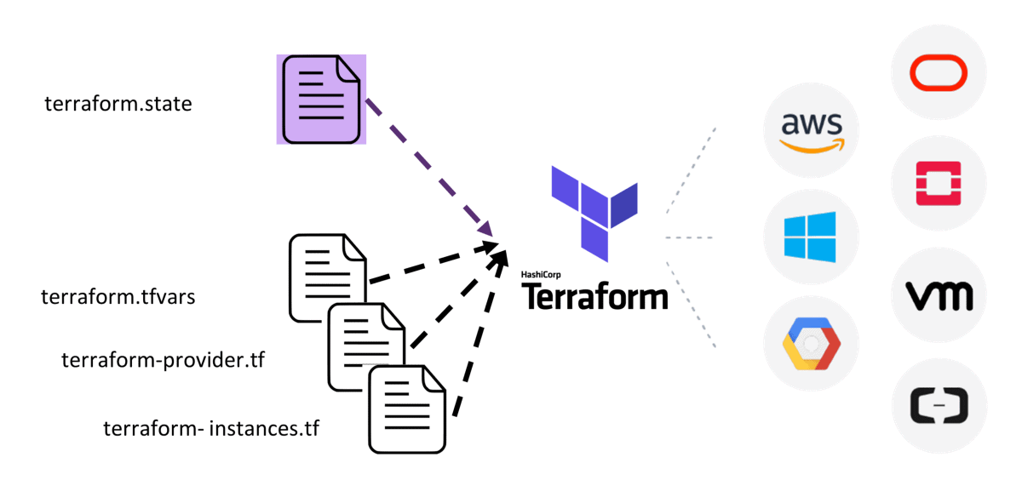
Terraform-Architecture

Slide 17

Terraform Vs Ansible

Slide 18
Mutable and Immutable Infrastructure
Mutable – If you use Ansible to install a new version of OpenSSL, it’ll run the software update on your existing servers and the changes will happen in-place.
– Chef, Puppet, Ansible, and SaltStack are mutable infrastructure.
Immutable – If you’re using a provisioning tool, such as Terraform, to deploy machine images created by Docker or Packer, then every “change” is actually a deployment of a new server (just like every “change” to a variable in functional programming actually returns a new variable).
– Terraform and CloudFormation are immutable infrastructure.

Slide 19
Core Terraform Workflow
The core Terraform workflow has three steps:
1. Write – Author infrastructure as code.
2. Plan – Preview changes before applying.
3. Apply – Provision reproducible infrastructure.
Terraform has a "planning" step where it generates an execution plan.
The execution plan shows what Terraform will do when you call apply.

Slide 20
Terraform Commands
Apply: The terraform apply command is used to apply the changes required to reach the desired state of the configuration, or the predetermined set of actions generated by a terraform execution plan.
Destroy: To destroy the infrastructure, use this command.
init: The terraform init command is used to initialize a working directory containing Terraform configuration files. This is the first command that should be run after writing a new Terraform configuration or cloning an existing one from version control. It is safe to run this command multiple times.
Validate: To validate the syntax of Terraform files, use this command.

Slide 21
Summary
In this lesson, you should have learned to describe:
Infrastructure as Code
Core Terraform Workflow

Slide 22
Terraform Installation
Installing Terraform is similar to all OS but with a slight difference.
You can download the Terraform software (depending on the OS version) from this link:
https://www.terraform.io/downloads.html
We’re going to install it on Linux and Windows.
Download and unzip the package.

Slide 23
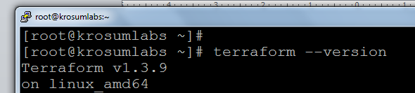
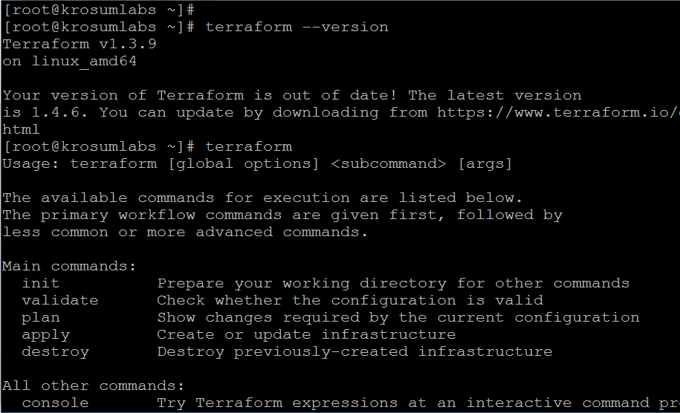
Verifying Terraform

Slide 24
Writing Terraform Configurations
Describe your Oracle Cloud Infrastructure using the HashiCorp Configuration Language format (HCL) in Terraform configuration files.
Configuration files that use the HCL format end with the .tf.
Use Terraform configurations to define your Oracle Cloud Infrastructure resources, variable definitions, data sources, and a great deal more.
Terraform then converts your Oracle Cloud Infrastructure configurations into a set of API calls.

Slide 25
Terraform Configuration Files
Configuration can be in a single file or split across multiple files.
Terraform will merge all files in the current working directory, which ends in .tf or .tf.json.
Subfolders are not included (nonrecursive).
Files are merged in alphabetical order.
Any files with a different extension are ignored.

Slide 26
Terraform Top Level Blocks
Fundamental Block
Terraform block
Provider block
Resource block
Variable Blocks
Input variable block
Output variable block
Local value block
Calling /Referencing Blocks
Data Source Block
Modules Block

Slide 27
Block - Syntax
<BlockType> "<BlockLabel>" .. "<Block Label>" {
# Block body
<identifier> = <expression (or) value>
}
Example
resource “local_file” “f1” {
content=“message”
}

Slide 28
Comments
# single line comment (or) // single line comment
/* Multiline comments */

Slide 29
Terraform Configuration Files: Providers
Providers connect Terraform to the infrastructure you want to manage.
They provide configuration like connection details and authentication credentials.
You can think about them as a wrapper around the services whose infrastructure you want to manage.
To download the providers you’re using in your environment, you need to run the terraform init command to install any required providers.

Slide 30
Terraform Configuration Files: OCI Provider
First, set up a provider.
Providers abstract the APIs from any given third party to create infrastructure. Here is the OCI example:
provider "oci" {
tenancy_ocid = "${var.tenancy_ocid}"
user_ocid = "${var.user_ocid}"
fingerprint = "${var.fingerprint}"
private_key_path = "${var.private_key_path}"
region = "${var.region}"
}

Slide 31
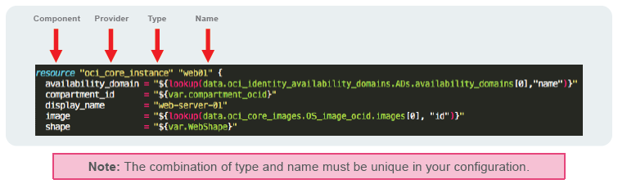
Terraform Configuration Files: Resources
After a provider is configured, you can start using that provider’s resources.
Using the OCI provider, you can start creating instances, block and object storage, networks, and so on.
The following example starts an instance:

Slide 32
Terraform Plan
The plan shows you what will happen.
You can save plans to guarantee what will happen.
Plans show reasons for certain actions (such as re-create).
Prior to Terraform, users had to guess change ordering, parallelization, and rollout effect.
terraform plan

Slide 33
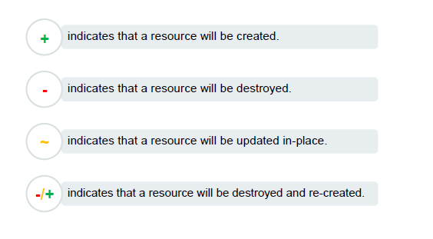
Terraform Plan: Indicators

Slide 34
terraform apply
Executes changes in order based on the resource graph
Parallelizes changes when possible
Handles and recovers transient errors
Updates existing resources when updates are allowed
Re-creates existing resources when updates are not allowed
terraform apply

Slide 35
Terraform State File
Terraform stores the state of your managed infrastructure from the last time Terraform was run.
Terraform uses this state to create plans and make changes to your infrastructure.
It is critical that this state is maintained appropriately so future runs operate as expected.

Slide 36
Terraform Local State File
State is stored locally on a local machine in JSON format.
Because it must exist, it is a frequent source of merge conflicts. It is generally acceptable for individuals and small teams.
Tends not to scale for large teams
Requires a more "mono repo" pattern

Slide 37
Adding a Second Resource
resource "oci_identity_user" "user01" {
name = "user01-TF"
description = "A user managed with Terraform"
}
resource "oci_identity_ui_password" ”user01_password" {
user_id = "${oci_identity_user.user01.id}"
}

Slide 38
Terraform: Outputting Plans
Terraform: Outputting Plans
Terraform has an approach for trying to limit the risk of large-scale destructive changes to the environment.
The plan output enables incremental changes.

Slide 39
Terraform Show
terraform show:
Displays human-friendly state
Can be used to get on-the-fly information
Run terraform show and get the user information you just created.

Slide 40
Terraform Destroy
terraform destroy
Destroys the running infrastructure
Does not touch infrastructure that is not managed by Terraform
Will ask for permission, requiring an explicit yes as input
Without any options, destroys everything

Slide 41
Terraform Variables
Define the parameterization of Terraform configurations
Can have defaults, be provided with a variables file, be asked for at execution, or overridden via the CLI

Slide 42
Terraform Variables
Variables can be defined anywhere, but best practices suggest creating a variables.tf file.
# Choose an Availability Domain
variable "AD" {
default = "1"
}
variable "InstanceShape" {
default = "VM.Standard1.2"
}
variable "InstanceImageDisplayName" {
default = "Oracle-Linux-7.4-2017.10.25-0"
}

Slide 43
Understanding variable block
variables.tf
variable "filename" {
default = "/root/pets.txt"
type = string
description = "the path of local file"
}
variable "content" {
default = "Test"
type = string
}

Slide 44
Variables
| Type | Example
| string| "/root/pets
|------------------
| number| 1
|----------------------
| bool | true/false
|-----------------------
| any | Default Value
|-----------------------
| list | ["d1","d2"]
| map | pet1 = cat
| | pet2 = dog
|-----------------------
| object| complex Data
| | structure
|-----------------------
| tuple | complex data
| | structure
+--------------------------------------------+

Slide 45
Determine the given type ?
variable "environment" { default = "dev" }
variable "shape" {
type = "map"
default = {
dev = "VM.Standard1.2"
test = "VM.Standard1.4"
prod = "BM.Standard1.36"
}
}
resource "oci_core_instance" "app-server" {
image = "${var.image}"
shape = "${lookup(var.instance_type, var.environment)}"
subnet_id = "${var.subnet_id}"
}

Slide 46
Terraform Outputs
Terraform can be directed to display the variables that are generated dynamically as part of the process of creating the infrastructure.
For example, after a run, you might want to see the public IP of the host:

Slide 47
Terraform Outputs
cat outputs.tf
output "InstancePrivateIP"
{value = ["${data.oci_core_vnic.InstanceVnic.private_ip_address}"]}
output "InstancePublicIP" {value =
["${data.oci_core_vnic.InstanceVnic.public_ip_address}"]}
After a terraform apply:
Apply complete! Resources: 4 added, 0 changed, 0 destroyed.
State path:
Outputs:
InstancePrivateIP = [ 10.0.0.10 ]
InstancePublicIP = [ 129.146.3.173]

Slide 48
Terraform Modules
Modules:
Are portable Terraform configurations (packages)
Allow separation of concerns and responsibilities among teams
Are just Terraform configurations inside a folder. There's nothing special about them.
module "users" {
source = "modules/users"
}

Slide 49
Introduction to Terraform state
terraform.tfstate - which contains real word resource configuration file.
complete record of the infrastructure created by TF.
Real World Infra terraform.tfstate
[cpu] [dog] [File]
| | |
| | |________________[File] id=<uniqid>
| |______________________[dog] id=<uniqid>
|_________________________[cpu] id=<uniqid>

Slide 50
TF Commands
terraform validate
terraform fmt
terraform show
terraform show -json
terraform providers
terraform output
terraform output <outputLabel>
terraform refresh
terraform plan
terraform graph

Slide 51
Data Sources
Data sources in Terraform are used to get information about resources external to Terraform, and use them to set up your Terraform resources.
git clone https://github.com/hashicorp/learn-terraform-data-sources-vpc.git

Slide 52
Meta Arguments
depends_on
count
for_each

Slide 53
Debug
export TF_LOG=TRACE
export TF_LOG_PATH=/tmp/terraform.log
To disable log separately
unset TF_LOG_PATH

Slide 54
Terraform import
Terraform import
import external infrastructre resoure to current resource
Syntax:-
terraform import <resource_type>.<resource_name><attribute>
terraform import aws_instance.webservers-2 i-026213be10d5367
resoruce "aws_instance" "webserver-2" {
..
}

Slide 55
Terraform Functions
file() - read data from file
length() - To determine the no.of elements
toset() - Convert list into set

