Slide 1

Intermediate Python programming- DAY2
By Karthikeyan Palani
Timmins Training Consulting

Slide 2
Classes and Objects

Slide 3
Agenda
Class & object
Initializing the Object
Methods
Python (Magic, Special) Methods
Private members

Slide 4
class
classes are used to create new user-defined data structures that contain arbitrary information about object.
We can think class is a blueprint of the object.
class classname:
attributes
class is a keyword, class name is user defined.

Slide 5
Object
While the class is the blueprint, an instance is a copy of the class with actual values, literally an object belonging to a specific class.
An object (instance) is an instantiation of a class.
From single class we can create more than one object.

Slide 6
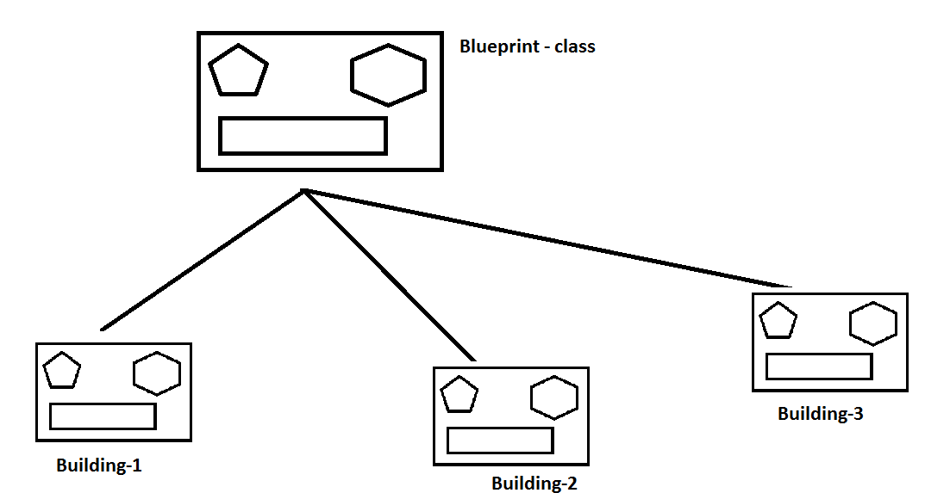
class & object

Slide 7
Class & object
Creating a new class creates a new type of object, allowing new instances of that type to be made.
The class object when invoked like a function creates an object of that class
The object is said to be an instance of the class
Each class instance can have attributes attached to it for maintaining its state.
class box:
pass
obj1=box()
obj2=box()

Slide 8
Activity - 1
step 1 : create an empty Vehicle class
step 2 : initialize two objects (v1,v2) from Vehicle class
step 3 : use type() - determine object types

Slide 9
Activity - 2
Predict the output
class Fax:
faxNo=0
f1=Fax()
f1.faxNo=1234
f2=Fax()
f3=Fax()
f3.faxNo=5678
Fax.faxNo=5555
print( f1.faxNo ) # (A)
print(f2.faxNo ) # (B)
print(f3.faxNo) # (C)

Slide 10
Copy
When an object is assigned to another variable, both variables are pointing to the same copy of the object
Modification through one variable will reflect in the other variable - aliasing
If a copy is required copy module can be used to copy the object.

Slide 11
Shallow copy
A shallow copy creates a new object which stores the reference of the original elements.
A shallow copy doesn't create a copy of nested objects, instead it just copies the reference of nested objects.
import copy
copy.copy(obj)

Slide 12
Deep Copy
A deep copy creates a new object .
import copy
copy.deepcopy(obj)

Slide 13
Activity - 3
class A:
a=10
class B:
b=1.45
objA=A()
objB=B()
import copy
objC=copy.copy(objB)
print(objC.objA.a+objB.b) # (A)
objC.objA.a=100
print(objB.objA.a+objB.b) #(B)

Slide 14
Attributes
An instance can have a named values associated with it.
These named values are called attributes.
These attributes can be accessed using the dot-syntax, that is similar to accessing names in a module.
Assigning a value to the attribute causes the attribute to be created.

Slide 15
Functions Vs Methods
Functions were used to perform operations on the Date object.
These functions accept the date object as argument.
But connection between the class and the function is not obvious.
Methods are functions associated with a particular class

Slide 16
Function/method call with arguments
We can call a function by using the following types of formal arguments :-
Required arguments def f1(a1,a2,…an)
Default arguments def f2(variable=value)
Variable-length arguments def f3(*args)
Keyword arguments def f4(**kwargs)

Slide 17
Activity - identify the errors
Q1. def f1(a1,a2):
print("Hello")
f1(10,20,None)
Q2. def f2(a1,a2,a3=0,a4):
print("Hello")
f2(100,200,300,400)
Q3. def f3(a1,a2,a3=0):
print("Hello")
f3(10)
Q4. def f4(a1,a2=0,*a3,*a4):
print("Hello")
f4(10)
Q5. def f5(**a2,*a3):
print("Hello")
f5()

Slide 18
class cname:
def method1(self):
print(“MethodCall”)
obj1=cname()
obj2=cname()
obj3=cname()
obj1.method1() # method1(obj1)
obj2.method1() # method1(obj2)
obj3.method1() # method1(obj3)

Slide 19
Activity - 4
Write a program
Create a class Employee which allows dynamic object creation.
The Employee class includes empID,empName,empDept as attributes and initialize(),display(),update() as its behaviors.
use Initialize() to accept employee details (empID,empName,empDept) from the user.
Use display() to print the employee details to the console.
Use update() to modify the employee department if necessary.

Slide 20
Initializing the Object
The __init__() method is a special method that gets invoked after the object is instantiated.
It is used to create the initial attributes in the object.
When the object is created by invoking the class, the arguments corresponding to the __init__() method needs to be passed.
>>> class Box:
... def __init__(self):
... print("This is initialization block")
...
>>> Box
<class '__main__.Box'>
>>> Box()
This is initialization block
<__main__.Box object at 0x0000000002289888>

Slide 21
Examples
>>> a=int(10)
>>> b=float(4.5)
>>> c=str('hello')
>>> d=Box(10)

Slide 22
Activity - 5
Modify activity -4
Use __init__() method

Slide 23
Python (Magic, Special) Methods
In Python, special methods are a set of predefined methods we can use python classes.
Special methods are start and end with double underscores.
for example __init__ or __str__.

Slide 24
__str__()
This method returns the string representation of the object.
This method is called when print() or str() function is invoked on an object.
This method must return the String object.
if we don’t implement __str__() function for a class, then built-in object implementation is used that actually calls __repr__() function.

Slide 25
__repr__()
Python __repr__() function returns the object representation.
It could be any valid python expression.

Slide 26
str() Vs repr()
>>> import datetime
>>> datetime.datetime.now()
datetime.datetime(2019, 8, 29, 23, 10, 34, 585663)
>>>
>>> str(datetime.datetime.now())
'2019-08-29 23:10:41.042032‘
>>> repr(datetime.datetime.now())
'datetime.datetime(2019, 8, 29, 23, 10, 47, 298390)'

Slide 27
Activity - 6
create a class named fsinfo
its constructor should take three parameters, the filesystem type,fileindex and file system mount point.
create an instance of the fsinfo class to return each file system details to caller.
Note: use __str__()

Slide 28
Iterator protocol
An iterator is an object that implements:
__iter__ method that returns the object itself.
__next__ method that returns the next item. If all the items have been returned, the method raises a StopIteration exception.

Slide 29
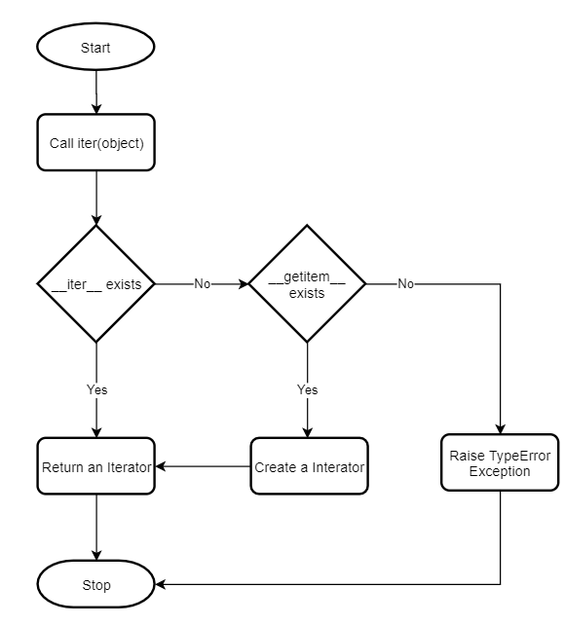

Slide 30
Example
class Box:
def __init__(self):
self.count=0
def __getitem__(self,index):
if isinstance(index,int):
self.count+=1
return self.count
obj=Box()
r=iter(obj)
next(r) # 1
class Box:
def __init__(self):
self.count=0
obj=Box()
r=iter(obj)
next(r) # TypeError: 'Box' object is not iterable

Slide 32
Operator Overloading
>>> a=10
>>> b=20
>>> a.__add__(b)
30
>>> s1='python'
>>> s2='program'
>>> s1.__add__(s2)
'pythonprogram'
>>>

Slide 33
Rich comparison methods
a.__lt__(b)
a.__le__(b)
a.__gt__(b)
a.__ge__(b)
a.__eq__(b)
a.__ne__(b)

Slide 34
Private Members
Python doesn't have any mechanism that effectively restricts access to any instance variable or method.
Python prescribes a convention of prefixing the name of the variable/method with a double underscore to emulate the behavior of private access specifiers.
The double underscore __ prefixed to a variable makes it private.
It gives a strong suggestion not to touch it from outside the class.
Any attempt to do so will result in an Attribute Error

Slide 35
Name Mangling
When a member starts with a double underscore, the name of
the member is mangled by the Python interpreter.
class ABC:
def __init__(self, a, b, c):
self.a = a
self._b = b
self.__c = c
x = ABC(10, 20, 30)
x.a # 10
x._b # 20
x.__c # AttributeError
x._ABC__c # 30

Slide 36
Conclusion

Slide 37
A type specifies what methods are available and the behaviour for those methods.
A user defined type is used to represent data, by grouping data represented using existing data types.
User defined types also specify methods for the newly define type.

Slide 38
User defined types are created using the class keyword.
Instances of the class are created by invoking the class like a function.
Attributes can be assigned to the object, and they pop into existence.
Methods for the object can be defined as part of the class.

Slide 39
THANKYOU
MALAYSIA
Timmins Training Consulting
C-11-01 Komplek Danau Kota, Taman Zeta@Zetapark, 67, Taman Ibu Kota, Setapak 53300 KL
www.consult-timmins.com
Shan.t@consult-timmins.com
INDONESIA
PT Timmins Konsultan Utama
Graha Mampang Lt. 3 Suite 305 Jl. Mampang Prapatan Raya Kav. 100 Jakarta Selatan 12760
www.consult-timmins.com Nadiah.s@consult-timmins.com
CANADA
Timmins Training Consulting Inc.
Suite #1203,
1, Reidmount Avenue, Toronto, Ontario, M1S 4V3
www.consult-timmins.com
info@consult-timmins.com

