Slide 1
MLOps Monitoring Practices with Prometheus & Grafana
Palani Karthikeyan
Sr.Technical Consultant, Krosum Labs
karthikeyan@krosum.com

Slide 2
Agenda
MLOps and Devops
Grafana – Deep dive into Grafana
Prometheus
Mlfow – Case studies

Slide 3
MLOps
Machine Learning Operations for Production, is a collection of defined methods for building, deploying, and governing the lifespan of machine learning models.
MLOps approaches also improve the ML systems’ scalability, security, and reliability, resulting in faster development cycles and more revenues from ML initiatives.

Slide 4
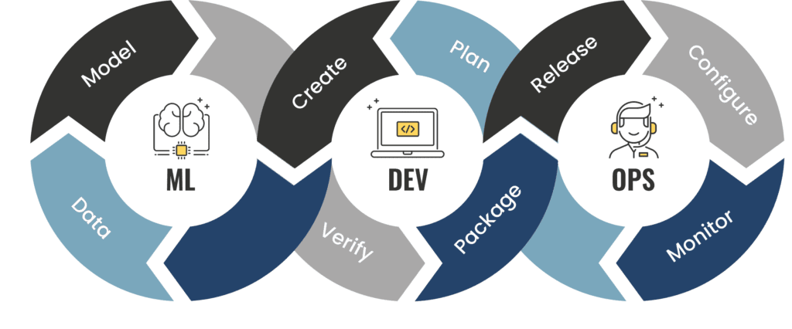
MLOps

Slide 5
MLOps
      MLOps is a methodology of operation that aims to facilitate the process of bringing an experimental Machine Learning model into production and maintaining it efficiently.
      MLOps focus on bringing the methodology of DevOps used in the software industry to the Machine Learning model lifecycle.

Slide 6
Features of a MLOPs project
Data and Model Versioning
Feature Management and Storing
Automation of Pipelines and Processes
CI/CD for Machine Learning
Continuous Monitoring of Models

Slide 7
Grafana
Grafana is an open-source data visualization and analysis tool which allows us to view our data in the form of beautiful graphs.
Grafana designed by Torkel Odegaard in January 2014.

Slide 8
Grafana
It enables us to create a dashboard for collecting, processing, storing, and analyzing data from various different sources.
It allows us to query, visualize, alert on, and understand our metrics.

Slide 9
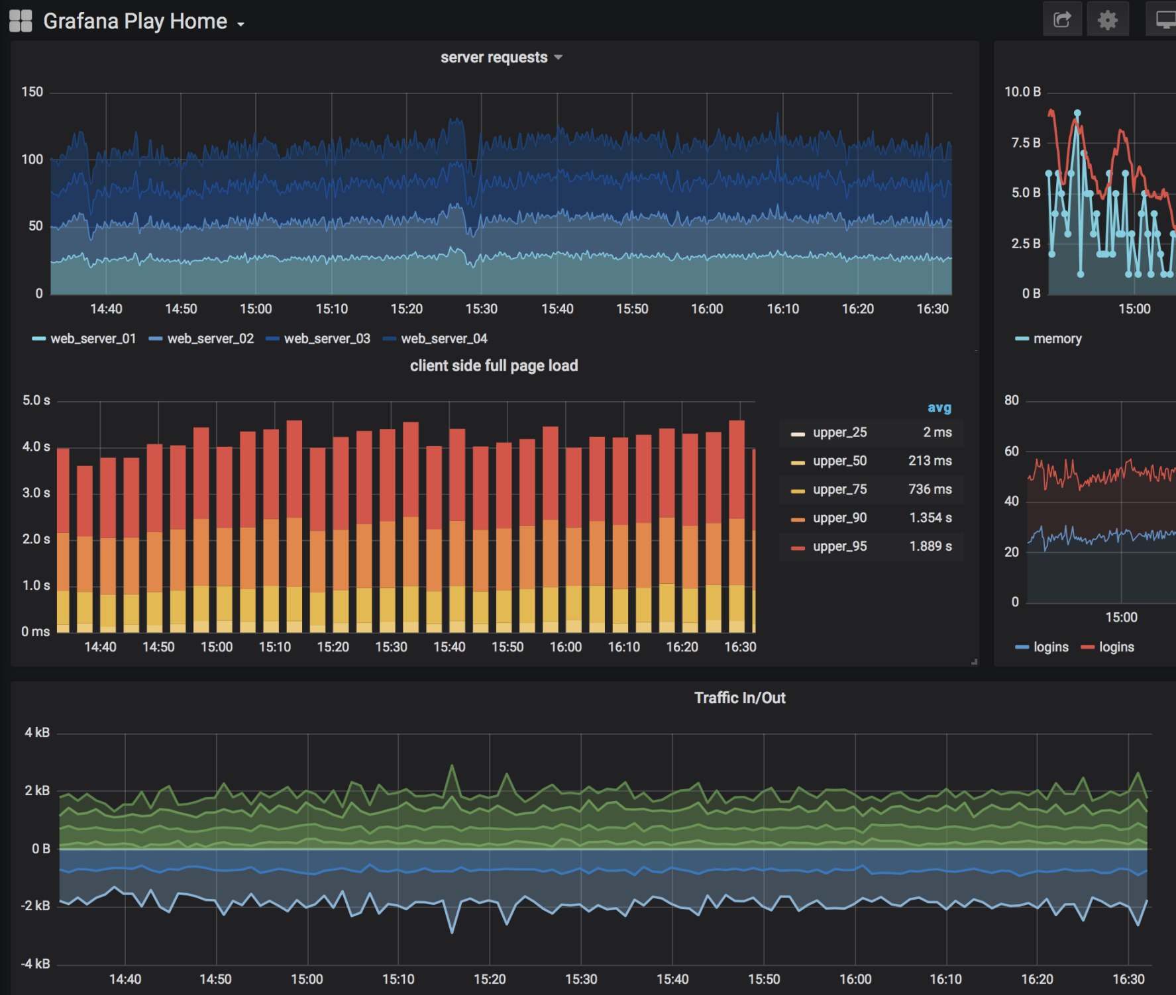

Slide 10
Grafana
It includes a variety of visualization option that helps us to understand our data, beautifully.
Grafana is written in Go and Node.js LTS language with a strong API (Application Programming Interface).

Slide 11
Grafana Dashboard
Grafana Dashboard is used to pull data from various data sources such as Prometheus, Influx DB, Graphite, ElasticSearch, MySQL, PostgreSQL, CloudWatch, Microsoft SQL Server, and many more.
A Grafana Dashboard contains various visualization options such as heat maps, geomaps, histograms, tables, free text panels, and different types of charts & graphs to study and understand business data easily.

Slide 12
Why Grafana?
Easy virtualization
Drag and Drop panels
Flexible to use
Supports different data source
Open source
Multi-platform support

Slide 13
Features of Grafana
Plugins Platform
Transformation
Dynamic Dashboards
Authentication
Explore metrics and Logs
Alerting
Annotations
Mixed data sources

Slide 14
Installing Grafana
To download the latest versions of Grafana, check out https://grafana.com/grafana/download

Slide 15
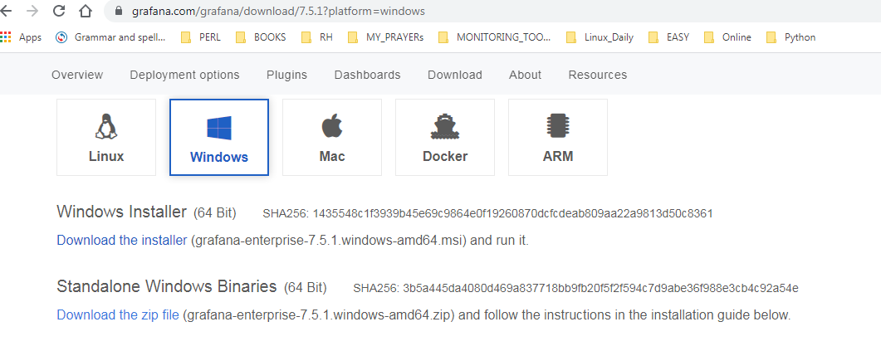
Install Grafana on Windows

Slide 16
Step 1: Go to any web browser, copy-paste the below link, or simply click on the below link.
https://grafana.readthedocs.io/en/latest/sources/installation/windows.html
Step 2: Once the link is opened, the below window appears on the screen, in which click on the grafana.4.4.1.windows-x64.zip.

Slide 17
Connecting to the Grafana server
Once you have installed and launched Grafana, open a browser page to access
the Grafana application. It can be found at http://localhost:3000

Slide 18
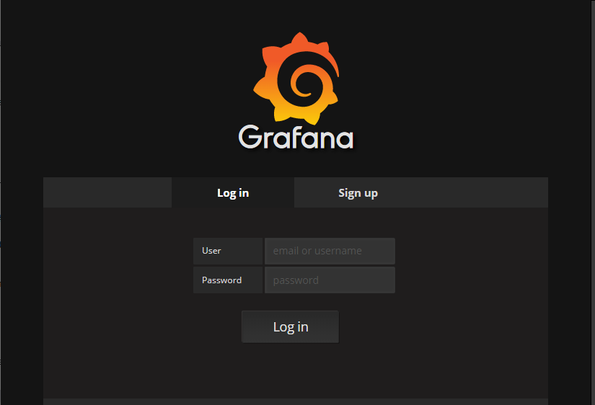
Log in with the admin username and the admin password

Slide 19
Grafana User Interface
The default Home dashboard
The sidebar menu.
Navigation hub, providing both quick access to simple creation pages and links to more complex functions, including data source creation, Explore mode, alert management, and server administration.

Slide 20
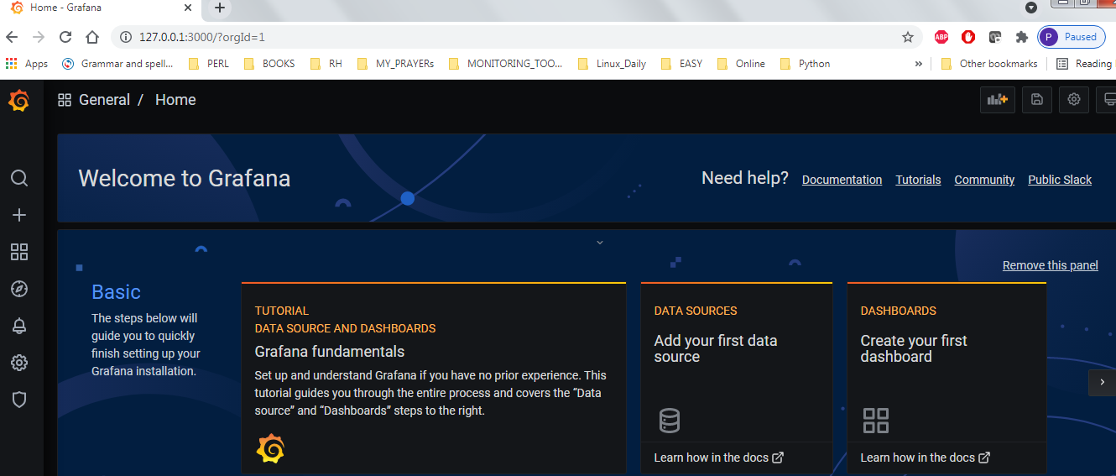

Slide 21
Grafana's left sidebar
To the left of the dashboard itself is the left sidebar.
These icons lead to some of the most powerful of Grafana's impressive features.
Search for dashboards
Create and import dashboards and folders
Find dashboards
Manage dashboards, dashboard playlists, and dashboard snapshots
Explore data sources in a free-form fashion
Manage alert rules and notification channels
Configure data sources, users, and teams, download plugins, set
preferences, and generate API keys
Administer Grafana users and organizations and view the server
settings and stats
Return to the Home dashboard
Set personal preferences
Get help
Notes:
Search for dashboards
Create and import dashboards and folders
Find dashboards
Manage dashboards, dashboard playlists, and dashboard snapshots
Explore data sources in a free-form fashion
Manage alert rules and notification channels
Configure data sources, users, and teams, download plugins, set
preferences, and generate API keys
Administer Grafana users and organizations and view the server
settings and stats
Return to the Home dashboard
Set personal preferences
Get help

Slide 22

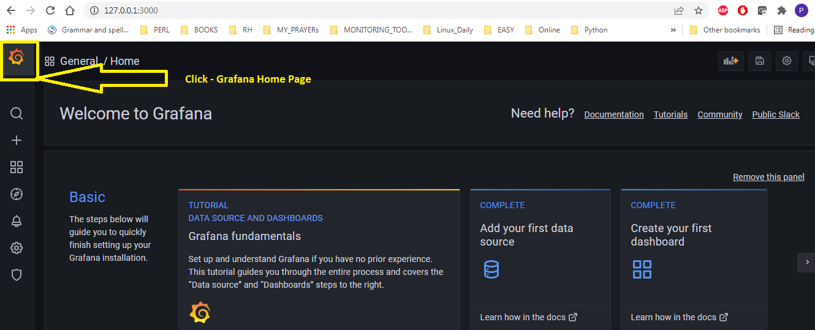
The Grafana logo
1

Slide 23
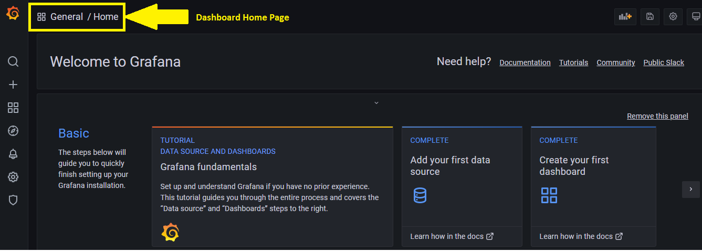
2

Slide 24
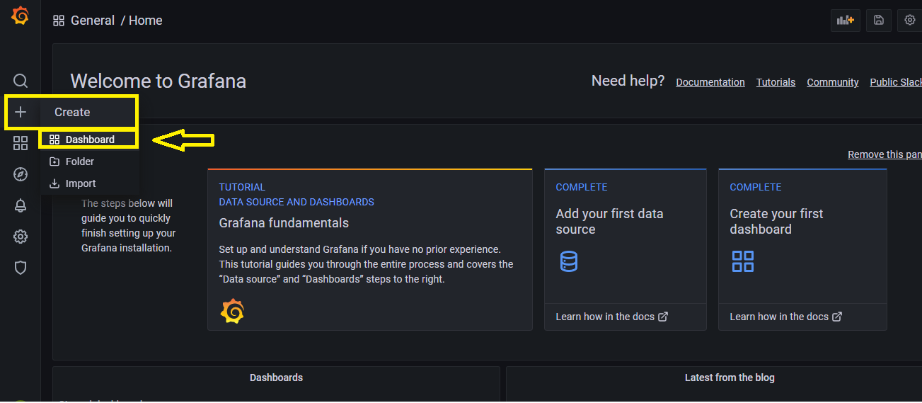
3

Slide 25
The panel's UI
The panel's UI can be broken down into roughly three main functional areas:
1. Panel display: Preview display, and time picker
2. Display settings: Panel visualization type, styles, and links
3. Data configuration: Data query, data transformation, and alerting

Slide 26
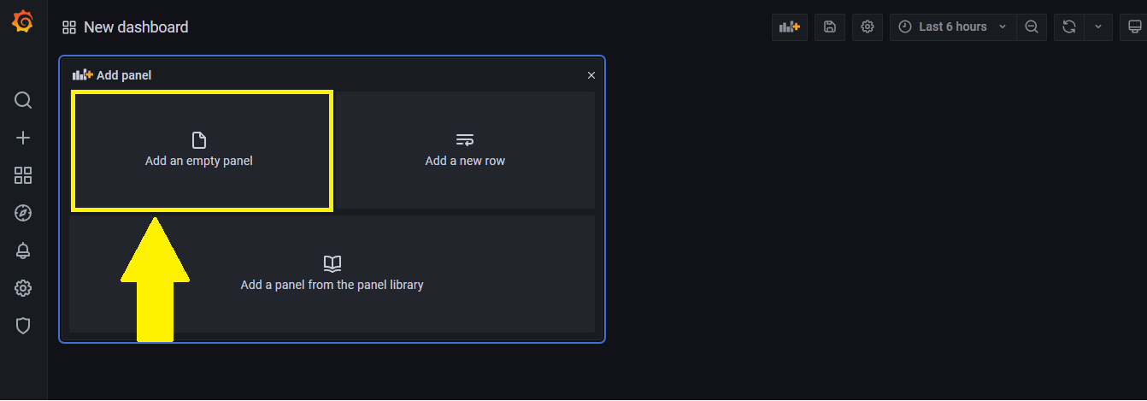
4

Slide 27
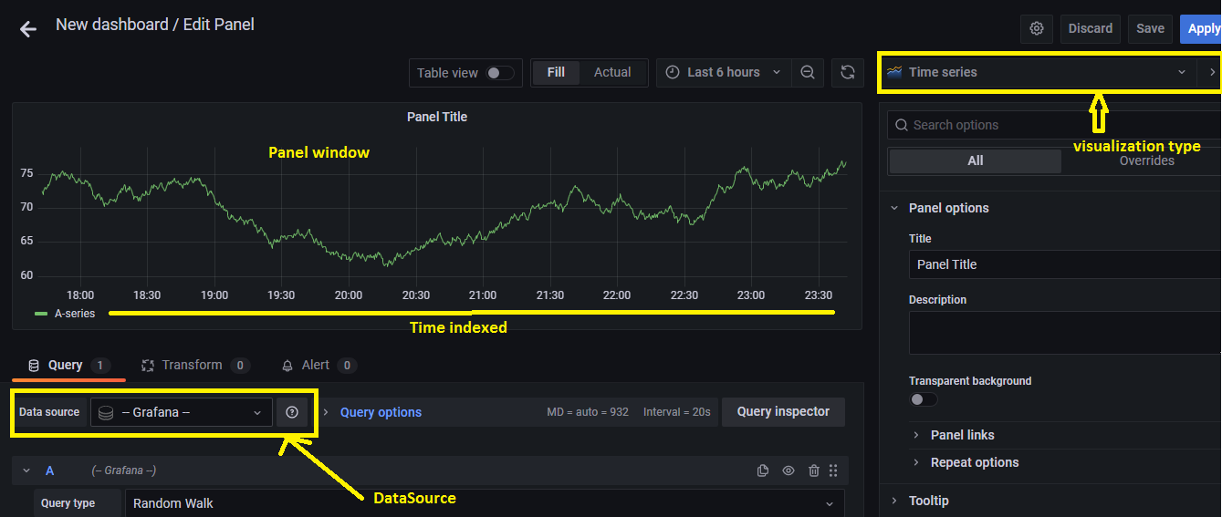
5

Slide 28
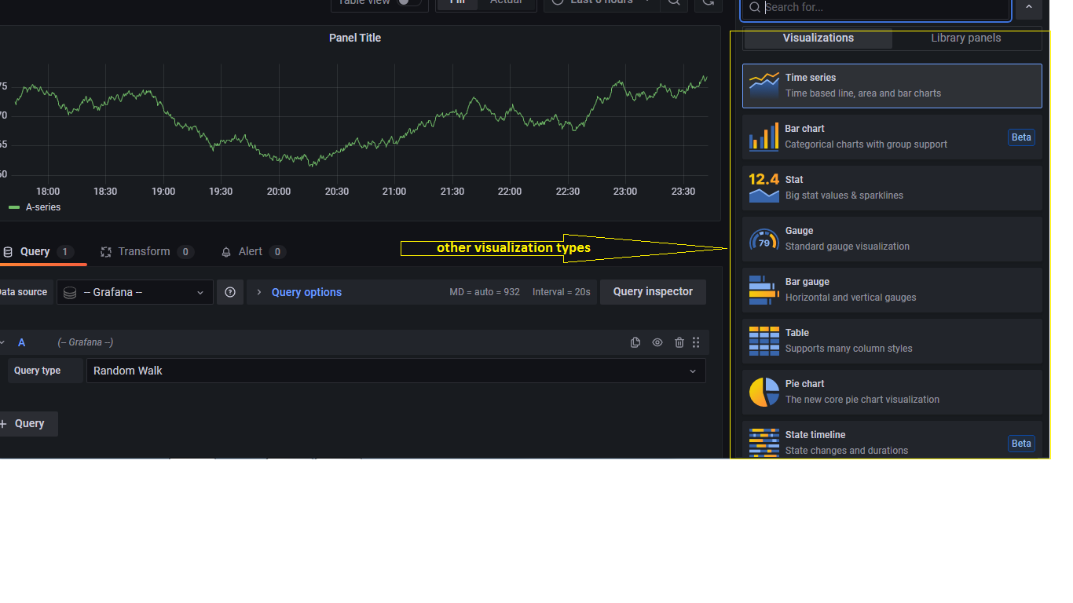
6

Slide 29
Dashboard
A dashboard is a kind of canvas upon which you can display one or more panels in a grid style arrangement.
It also serves as a web page, so you can bookmark or share it with a simple URL.
The entire dashboard can even be imported and exported in JSON text file format, making it easy to share, save, or transfer to another version of Grafana.

Slide 30
Unit (or) service file & Grafana server daemon
Windows: grafana-server.exe
Linux : grafana-server.service file
sudo systemctl daemon-reload
sudo systemctl start grafana-server
sudo systemctl status grafana-server
Configure the Grafana server to start at boot:
sudo systemctl enable grafana-server.service

Slide 31
Data Source
Grafana works with data, which must be stored in a database before it can be accessed by Grafana.
There are several different kinds of databases.
Additionally, some other systems can be used to store data, even though their main purpose is not focused on data storage.
A Grafana data source is any place from which Grafana can pull data.

Slide 32
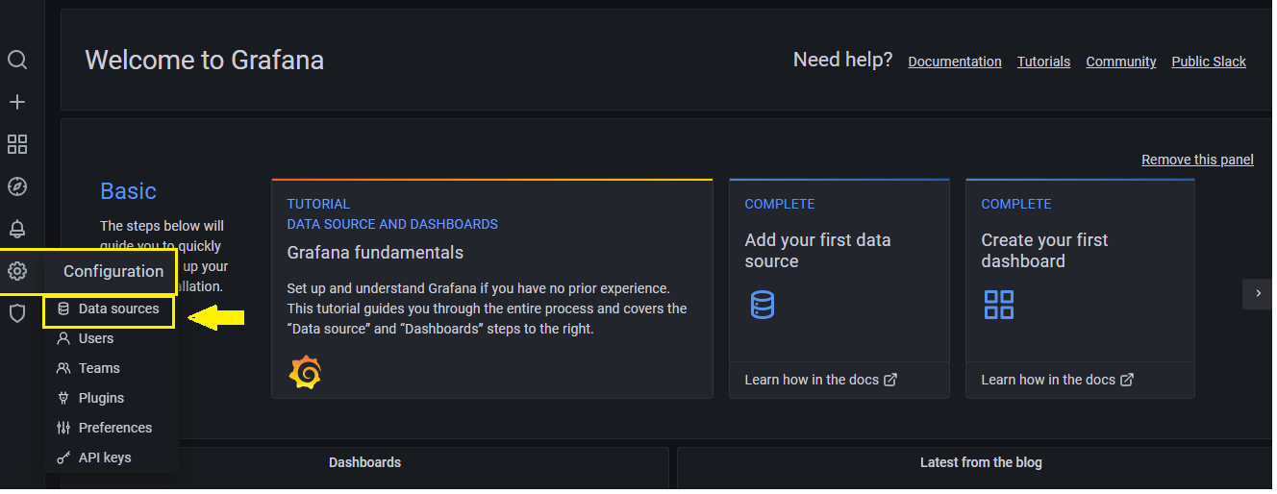
How to add a data source in Grafana

Slide 33
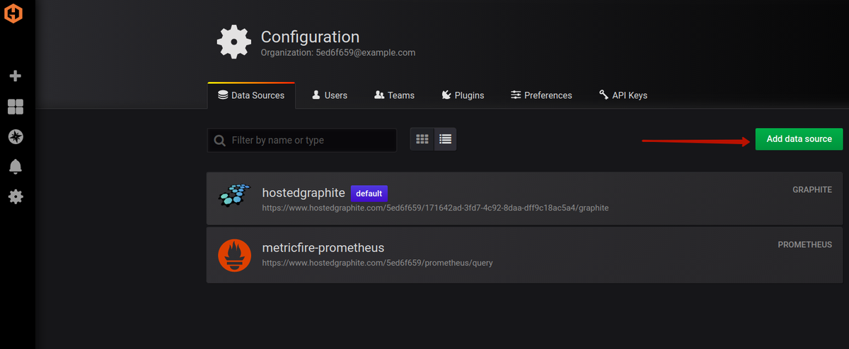
When you click the Add data sources button, you will see the list of officially supported data sources available for connection

Slide 34
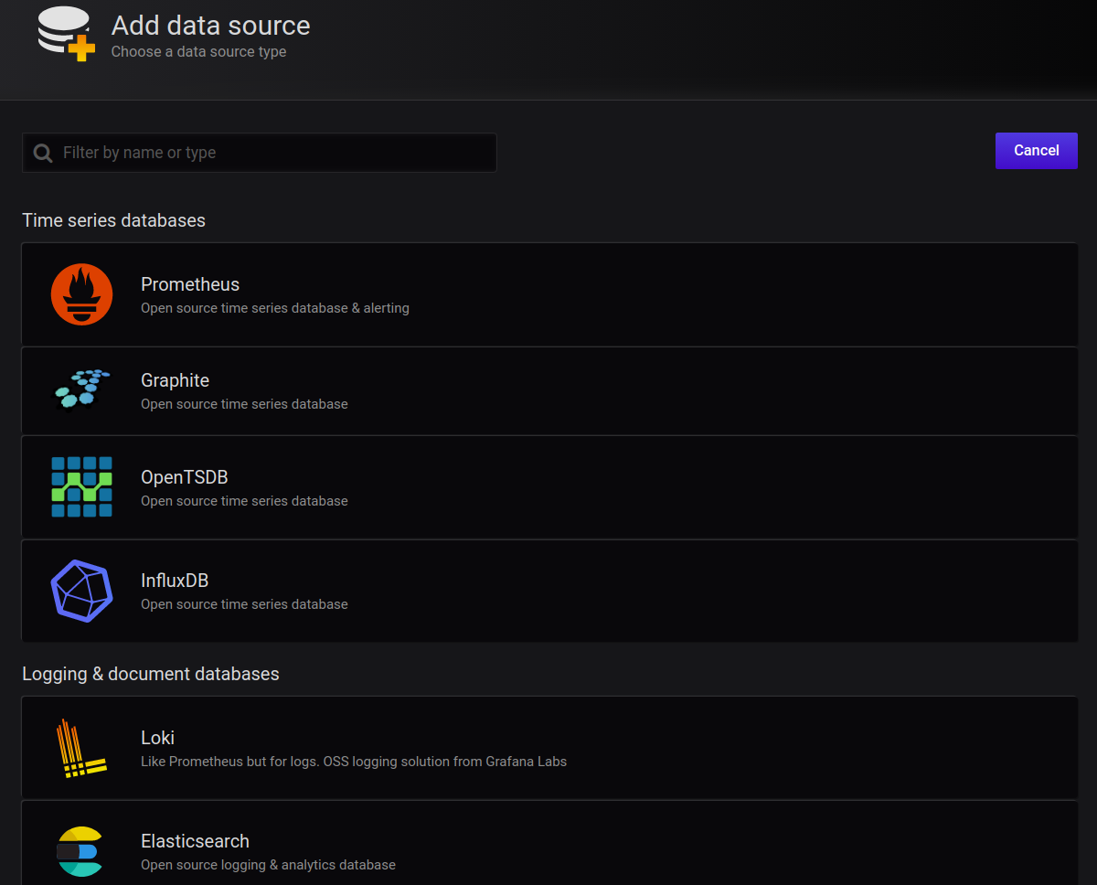

Slide 35
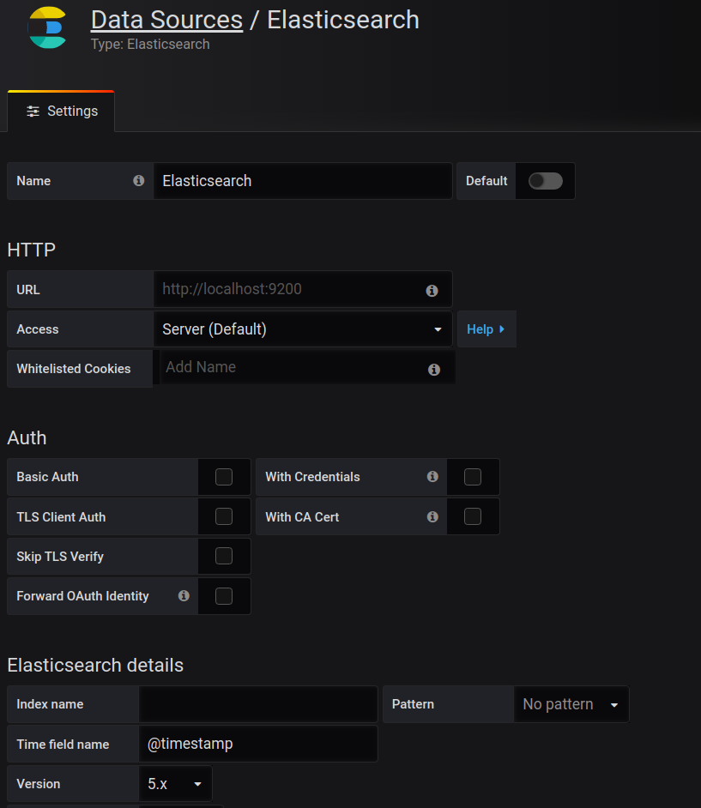

Slide 36
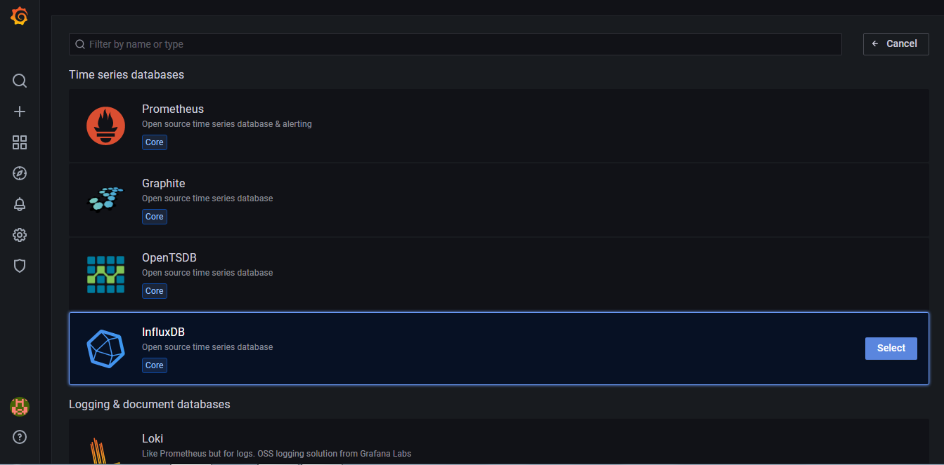
Influx DB with Grafana integration

Slide 37
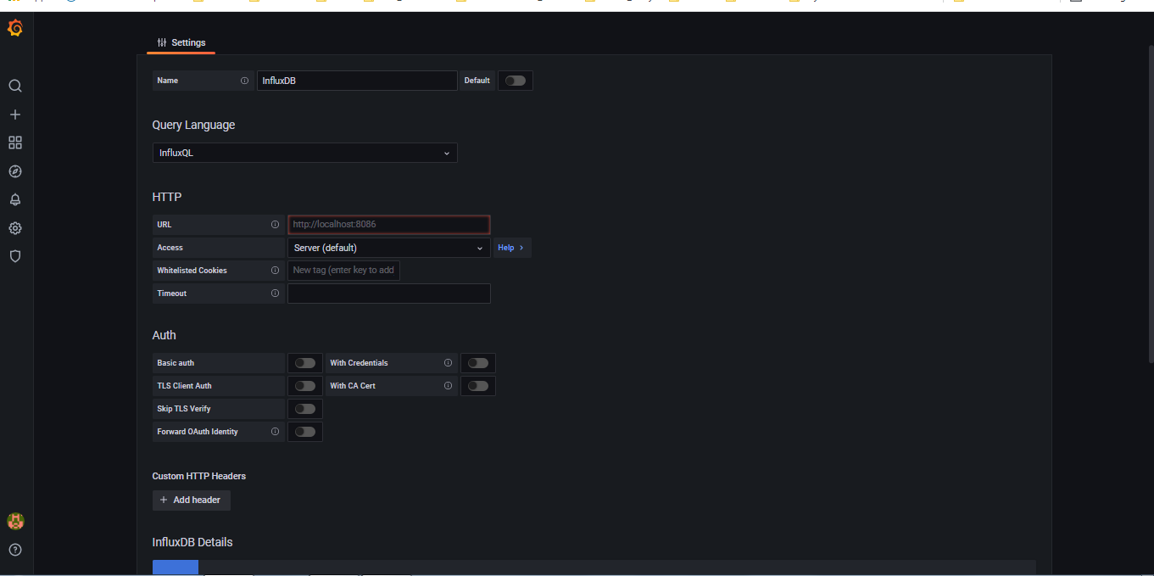

Slide 38
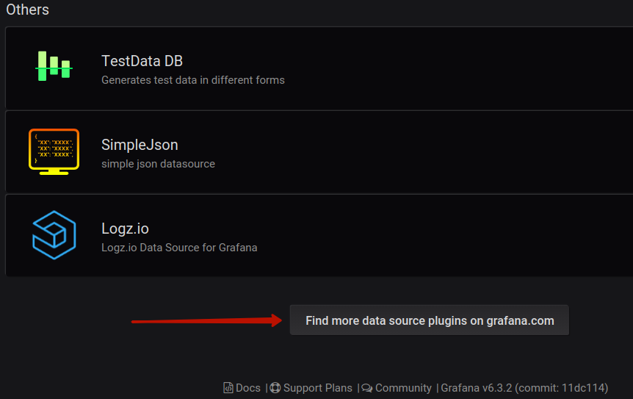
Installing third-party data sources

Slide 39
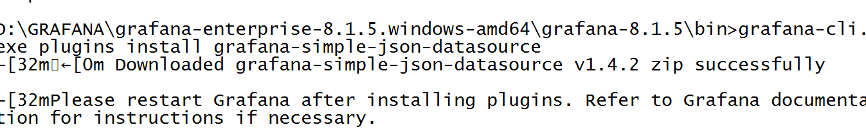
grafana-cli

Slide 40
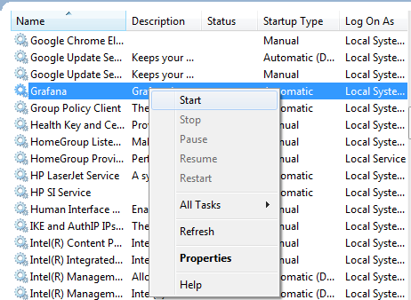

Slide 41
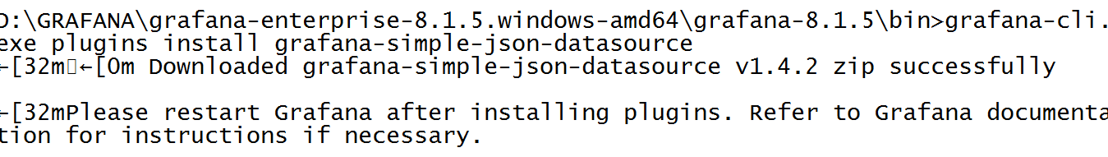

Slide 42
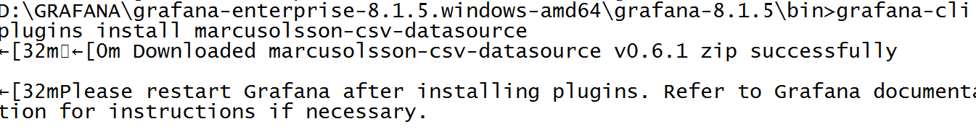

Slide 43
Prometheus
Prometheus is an open source, metrics-based monitoring system.
Prometheus is primarily written in Go and licensed under the Apache 2.0 license.
In 2016 the Prometheus project became the second member of the Cloud Native Computing Foundation (CNCF).

Slide 44
Categories of Monitoring
Receiving a HTTP request
Sending a HTTP 400 response
Entering a function
Reaching the else of an if statement
Leaving a function
A user logging in
Writing data to disk
Reading data from the network
Requesting more memory from the kernel

Slide 45
Prometheus ­ main features
A multi­dimensional data model with time series data identified by metric name and key/value pairs.
A flexible query language to leverage this dimensionality.
No reliance on distributed storage; single server nodes are autonomous.

Slide 46
Prometheus ­ main components
The Prometheus server which scrapes and stores time series data.
Client libraries for instrumenting application code.
The Alert manager.
A push gateway for supporting short ­lived jobs (optional)

Slide 47
Prometheus ­ data model
Prometheus fundamentally stores all data as time series: streams of time stamped values belonging to the same metric and the same set of labeled dimensions.
Besides stored time series, Prometheus may generate temporary derived time series as the result of queries.

Slide 48
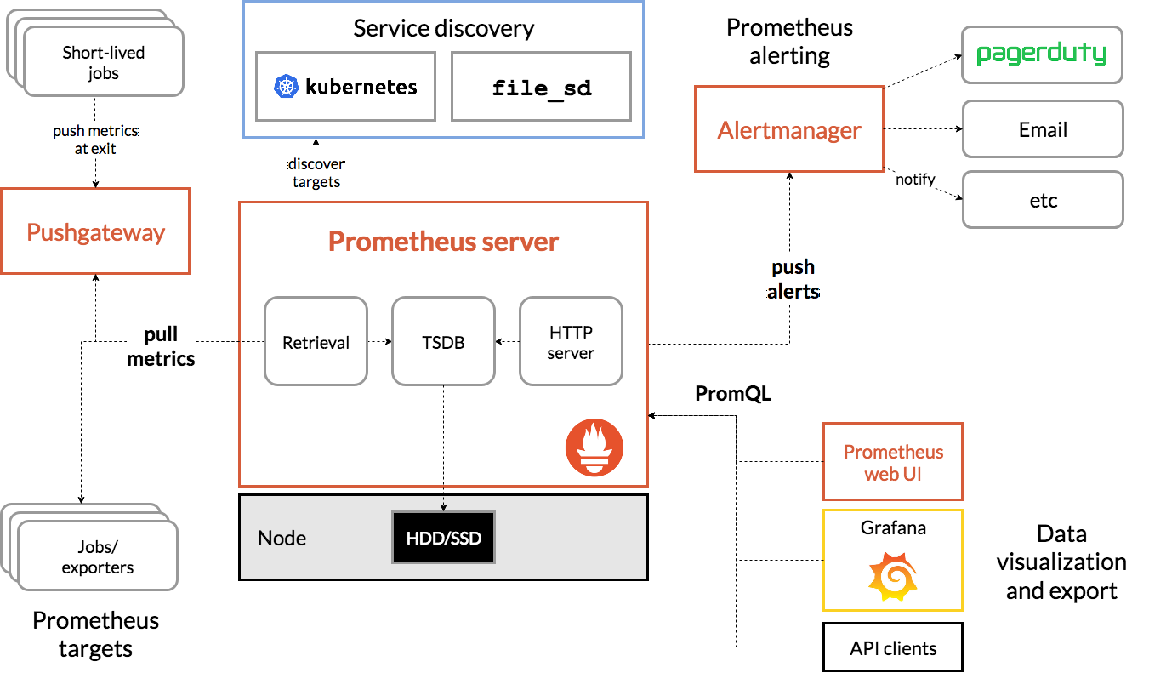
Prometheus Architecture

Slide 49
Prometheus ­ Alert Manager
The Promtheus Alertmanager handles alerts sent by client applications such as the Prometheus server.
It takes care of de­-duplicating, grouping, and routing them to the correct receiver integration such as email, PagerDuty, or OpsGenie.

Slide 50
Prometheus ­ Alert Manager
AlertManager is also capable of silencing and inhibition of alerts.
In this context, inhibition means suppressing notifications for certain alerts if certain other alerts are already firing.

Slide 51
promQL
PrometheusQueryLanguage(promQL)
Provides built in operators and functions
vector-based calculations like Excel
Expressions over time-series vectors

Slide 52
Expression
Instant Vector-set of time series containing
single sample for each time series, all sharing same timestamp.
Examples:-
http_request_count
http_request_count {status = "200"}
http_request_count {status != "200"}

Slide 53
Range Vector - set of time series containing a range of data points over time for each series
http_request_count[5m]
scalar - as a literal and as result of an expression
string - only currently as a literal in an expression

Slide 54
Time Series Selectors
Instant Vector Selectors
num_nodes
num_nodes{role="backend"}
Range Vector Selectors(s,m,h,d,w,y)
num_nodes{role="backend"}[5m]
Offset Modifier
num_nodes{role="backend"}[5m} offset 1w

Slide 55
Prometheus metric types
The four Prometheus metric types
Counters
Gauges
Histograms
Summaries

Slide 56
Node exporter
Set up and configured Node Exporter to collect Linux system metrics like CPU load and disk I/O.
Node Exporter will expose these as Prometheus-style metrics.
Configured Prometheus to scrape Node Exporter metrics and optionally ship them to Grafana Cloud.

Slide 57
Node exporter
Set up a preconfigured and curated set of recording rules to cache frequent queries.
Imported Grafana dashboards to visualize your metrics data.
Set up Prometheus alerting rules to alert on your metrics data.

Slide 58
Installation
Step 1: Setting up Node Exporter
In this step you’ll set up Node Exporter on your Linux machine to collect and expose system metrics.
To begin, log in to your machine and download the relevant Node Exporter binary. In this guide we’ll use linux-amd64 but you should choose the one corresponding to your system’s OS and architecture:
wget https://github.com/prometheus/node_exporter/releases/download/v1.1.1/node_exporter-1.1.1.linux-amd64.tar.gz
https://prometheus.io/docs/guides/node-exporter/

Slide 59
Unzip the tarball and cd into the directory:
tar xvfz node_exporter-*.*-amd64.tar.gz cd node_exporter-*.*-amd64 Run the Node Exporter binary:
./node_exporter
If you see the above output, you successfully ran Node Exporter.
Node Exporter publishes your system metrics in Prometheus format on port 9100.
You can test this using curl. You will need to open a new SSH session or background the Node Exporter process to use curl.
curl http://localhost:9100/metrics

Slide 60
Step 2: Scraping Node Exporter using Prometheus
Node Exporter is up and running on your machine, you can configure a Prometheus scrape job to collect and store Node Exporter metrics.
Add the following scrape job config to the scrape_configs section of your prometheus.yml configuration file:
  - job_name:
  node static_configs:
  - targets:
  ['linux_machine_IP_address:9100']

Slide 61
Prometheus Push gateway
The Prometheus Pushgateway exists to allow ephemeral and batch jobs to expose their metrics to Prometheus.
Since these kinds of jobs may not exist long enough to be scraped, they can instead push their metrics to a Pushgateway.
The Pushgateway then exposes these metrics to Prometheus

Slide 62
pushgateway
The Pushgateway is explicitly not an aggregator or distributed counter but rather a metrics cache.
The metrics pushed are exactly the same as you would present for scraping in a permanently running program.
The Pushgateway is not an event store. While you can use Prometheus as a data source for Grafana annotations, tracking something like release events has to happen with some event-logging framework.

Slide 63
Install Prometheus Push Gateway by executing following commands
sudo useradd -M -r -s /bin/false pushgateway
wget https://github.com/prometheus/pushgateway/releases/download/v1.2.0/pushgateway-1.2.0.linux-amd64.tar.gz
tar xvfz pushgateway-1.2.0.linux-amd64.tar.gz
sudo cp pushgateway-1.2.0.linux-amd64/pushgateway /usr/local/bin/
sudo chown pushgateway:pushgateway /usr/local/bin/pushgateway

Slide 64
/etc/systemd/system/pushgateway.service
Create a systemd unit file named /etc/systemd/system/pushgateway.service with following content:
[Unit]
Description=Prometheus Pushgateway
Wants=network-online.target
After=network-online.target[Service]
User=pushgateway
Group=pushgateway
Type=simple
ExecStart=/usr/local/bin/pushgateway[Install]
WantedBy=multi-user.target

Slide 65
Start PushGateway service by executing following commands:
sudo systemctl enable pushgateway
sudo systemctl start pushgateway
sudo systemctl status pushgateway

Slide 66
To configure Pushgateway as a Scrape Target for Prometheus Server.
Add following lines at the end of /etc/prometheus/prometheus.yml file
- job_name: 'Pushgateway'
honor_labels: true
static_configs:
- targets: ['localhost:9091']

Slide 67
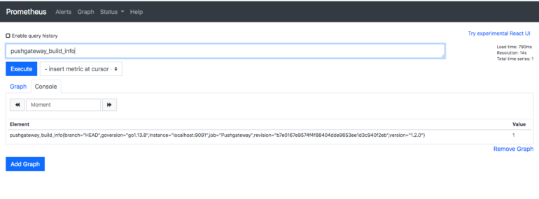
pushgateway_build_info query in Prometheus expression browser.

Slide 68
Service discovery is designed to integrate with the machine and service databases.
Prometheus 2.2.1 has support for Azure, Consul, DNS, EC2, OpenStack, File, Kubernetes, Marathon, Nerve, Serverset, and Triton service discovery in addition to the static discovery you have already seen.

Slide 69
A good service discovery mechanism will provide you with metadata.
Metadata is what you will convert into target labels.

Slide 70
MLflow
MLflow is an open source platform for managing machine learning workflows.
MLflow REST API allows you to create, list, and get experiments and runs, and allows you to log parameters, metrics, and artifacts.
It is used by MLOps teams and data scientists.
It Tracking ML experiments to record and compare model parameters, evaluate performance, and manage artifacts

Slide 71
Components of MLflow
Tracking
Projects
Models
Model Registry

Slide 72
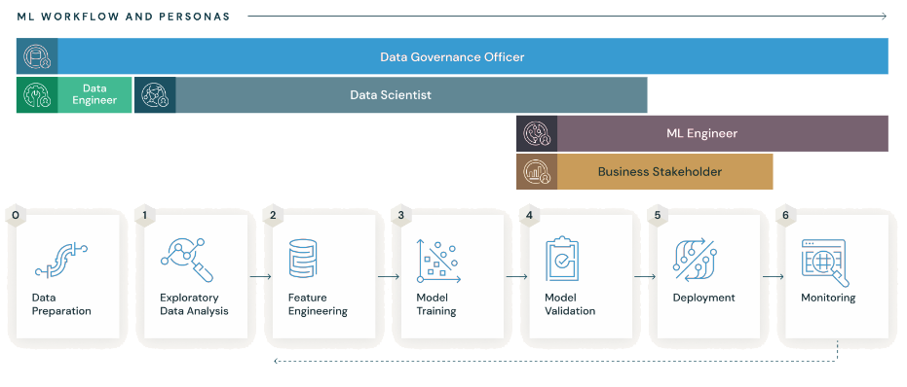
MLflow

Slide 73
Reference
https://grafana.com/docs/
https://prometheus.io/docs/introduction/overview/
https://ml-ops.org/content/mlops-principles
https://docs.h2o.ai/mlops/

Slide 74
Thank you

