Slide 1
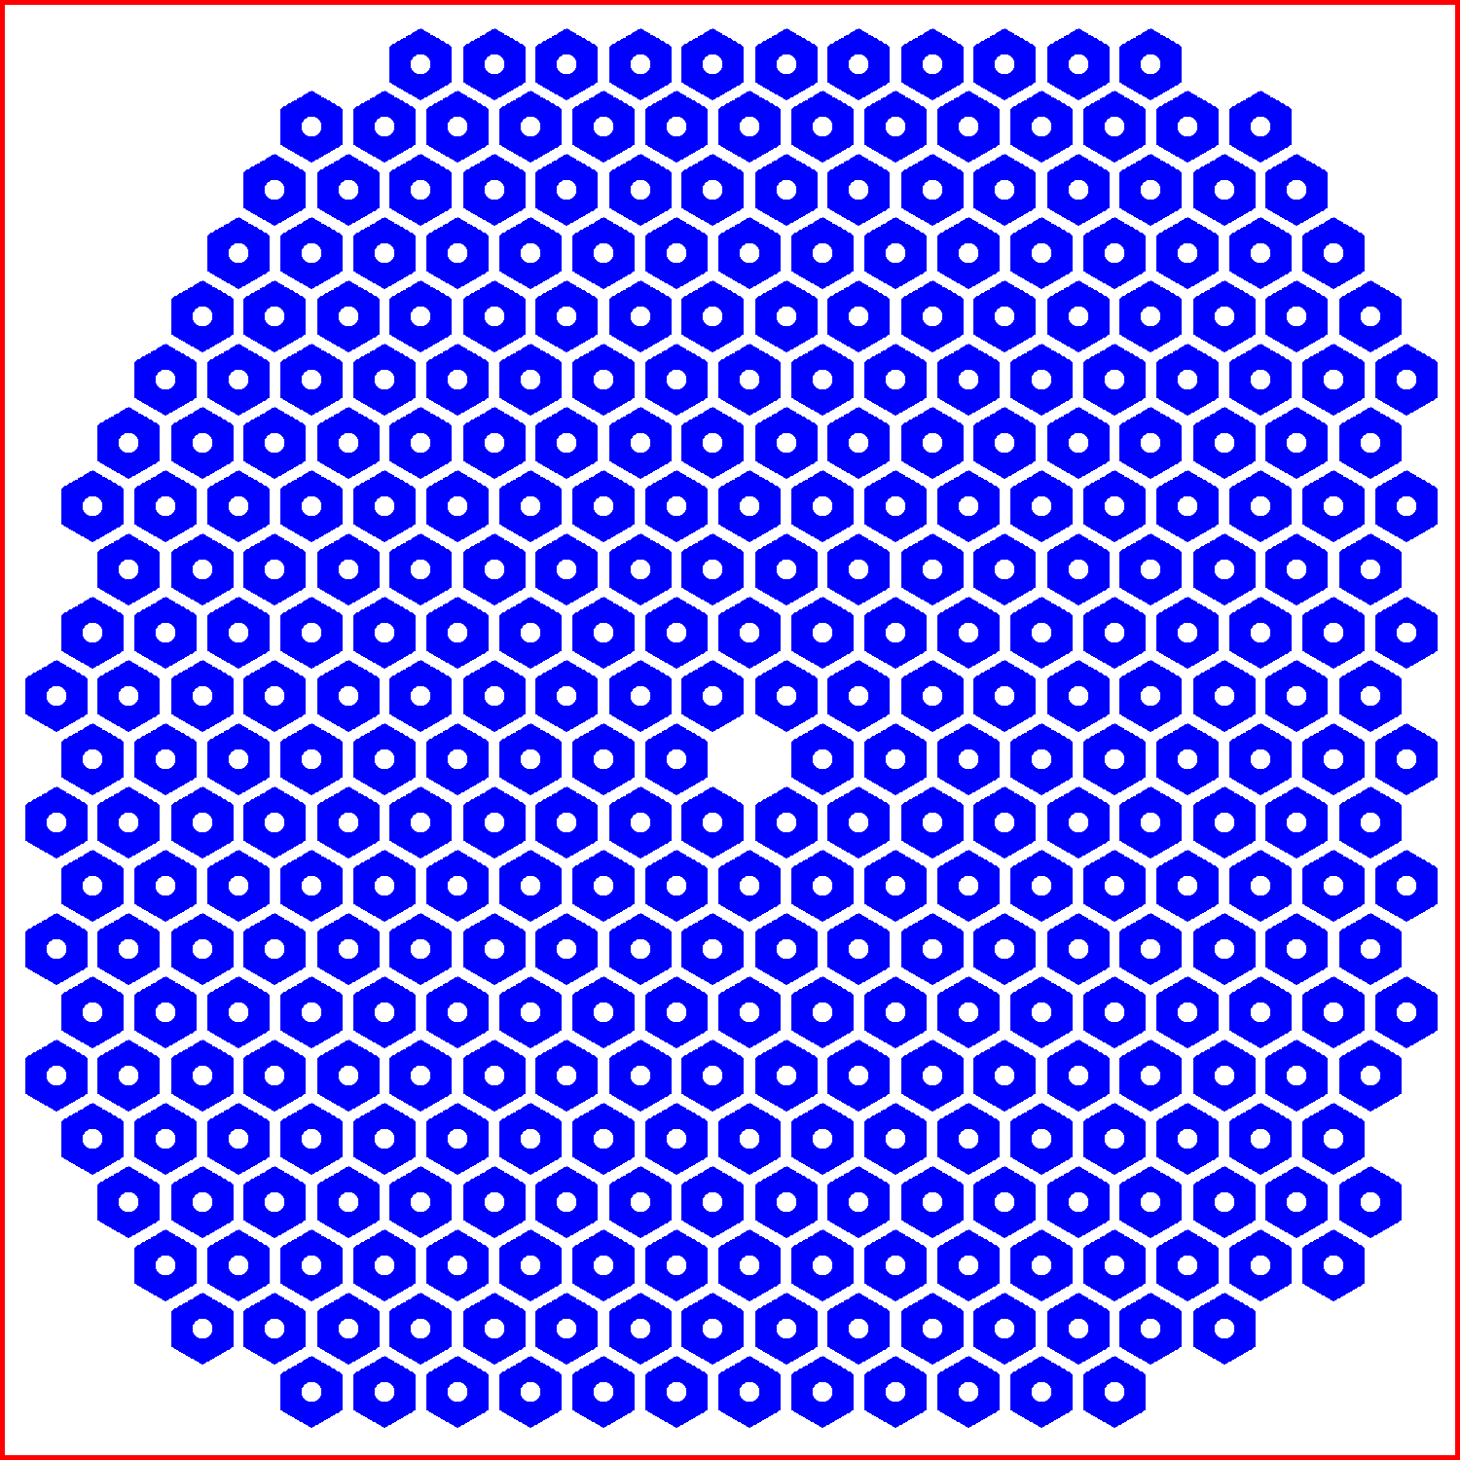
Red box = 2mm x 2mm

