Slide 1
C storage Class

Slide 2
Programming API Perspective: C Storage Classes
A Storage Class (SC) defines the scope, life-time, and physical location of a variable and precedes the variable name, e.g. static int count
  Auto: the default storage class for all local variables
  Static: used to keep a local variable in existence during the life-time of the program (instead of creating and destroying it each time the function is called and exits)
  Extern: used to give a reference of a global variable that is visible to ALL the program files
  Register: used to define local variables that should be stored in a register instead of RAM

Slide 3
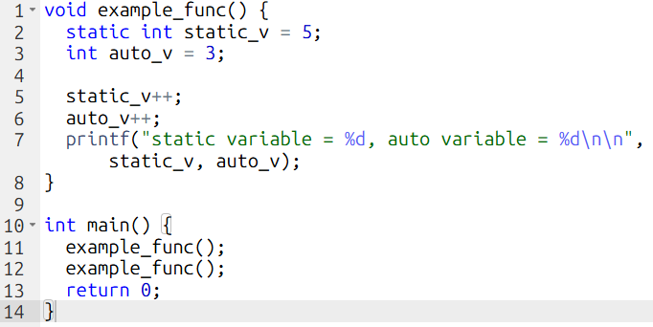
Auto and Static Demonstration
Code

Slide 4

Output
  Note:
  - static variable start at 5
  - auto variable start at 3

Slide 5
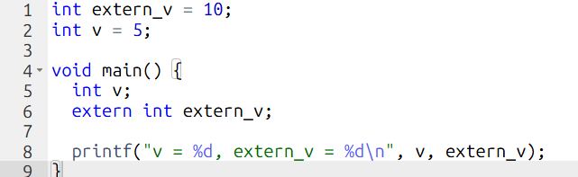
Auto and Extern Demonstration
Code

Slide 6
Output
  v = 25864, extern_v = 10
  Note:
  - V is random since we declare it without initial value.
  - extern_v is become the same as the one initialized before.

Slide 7
Position Independent Executable (PIE)
  - PIE allows an executable to be loaded at a different virtual address each time it runs.
  - Instead of relying heavily on fixed absolute addresses, PIE uses Position-independent / relative addressing using offset from pointer.

