Slide 1
Problem Session 08 Lock Mechanisms
Explore more locks that are not included in the lecture.
It is a group work of up to 6-8 students.
Research the following mechanisms:
  Peterson’s Algorithm
  Load-Linked and Store-Conditional
  One additional mechanism not mentioned in the lecture
Analyze correctness and performance for each locks using metrics discussed in class
Create slides showing the information for each lock.
submit your presentation slides (pdf) and presentation video (link) on LEB2.

Slide 2
Group: OS InW
Template example
ID of student
Name of student
Peterson’s algorithm
ID of student
Name of student
Dekker's algorithm
ID of student
Name of student
X’s algorithm
ID of student
Name of student
Y’s algorithm
Power Point for the Lecture on
4-5 Algorithms of Software based Locks Mechanism
With 3-6 Pages per Algorithm

Slide 3
Test and Set Algorithm
Template example
ID of student
Name of student

Slide 4
Software Test and Set
Template example
A purely software attempt at implementing a lock
typedef struct lock_t { int flag; } lock_t;
void init(lock_t *mutex) {
// 0 -> lock is available, 1 -> held
mutex->flag = 0;
}
void lock(lock_t *mutex) {
while (mutex->flag == 1); // TEST flag and spin-wait
mutex->flag = 1; // now SET it!
}
void unlock(lock_t *mutex) {
mutex->flag = 0;
}
What about Correctness and Performance ???
Notes:
Use a simple flag to indicate whether a thread holds the lock
A thread that wants to enter its critical section will call lock(), which tests whether the flag is equal to 1
If the flag is 0, it sets the flag to 1 to indicate that the thread now holds the lock
On leaving the critical section, the thread calls unlock() and clears the flag, indicating that the lock is no longer held
If another thread happens to call lock() while that first thread is in the critical section, it will simply spin-wait in the while loop for that thread to call unlock() and clear the flag
Once that first thread does so, the waiting thread will fall out of the while loop, set the flag to 1 for itself, and proceed into the critical section

Slide 5
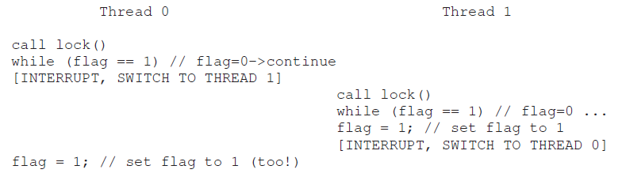
What about Correctness
Template example
Unlikely but possible
Both threads can enter the critical section at the same time – no mutual exclusion

Slide 6
What about Performance
Template example
Spin-waiting wastes time waiting for another thread to release the lock
On a single processor, the thread that holds the lock cannot even run (at least, not until a context switch occurs)!
Thus, as we move forward and develop more sophisticated solutions, we should also consider ways to avoid this kind of waste

