Slide 1
FootballStyle

Slide 2
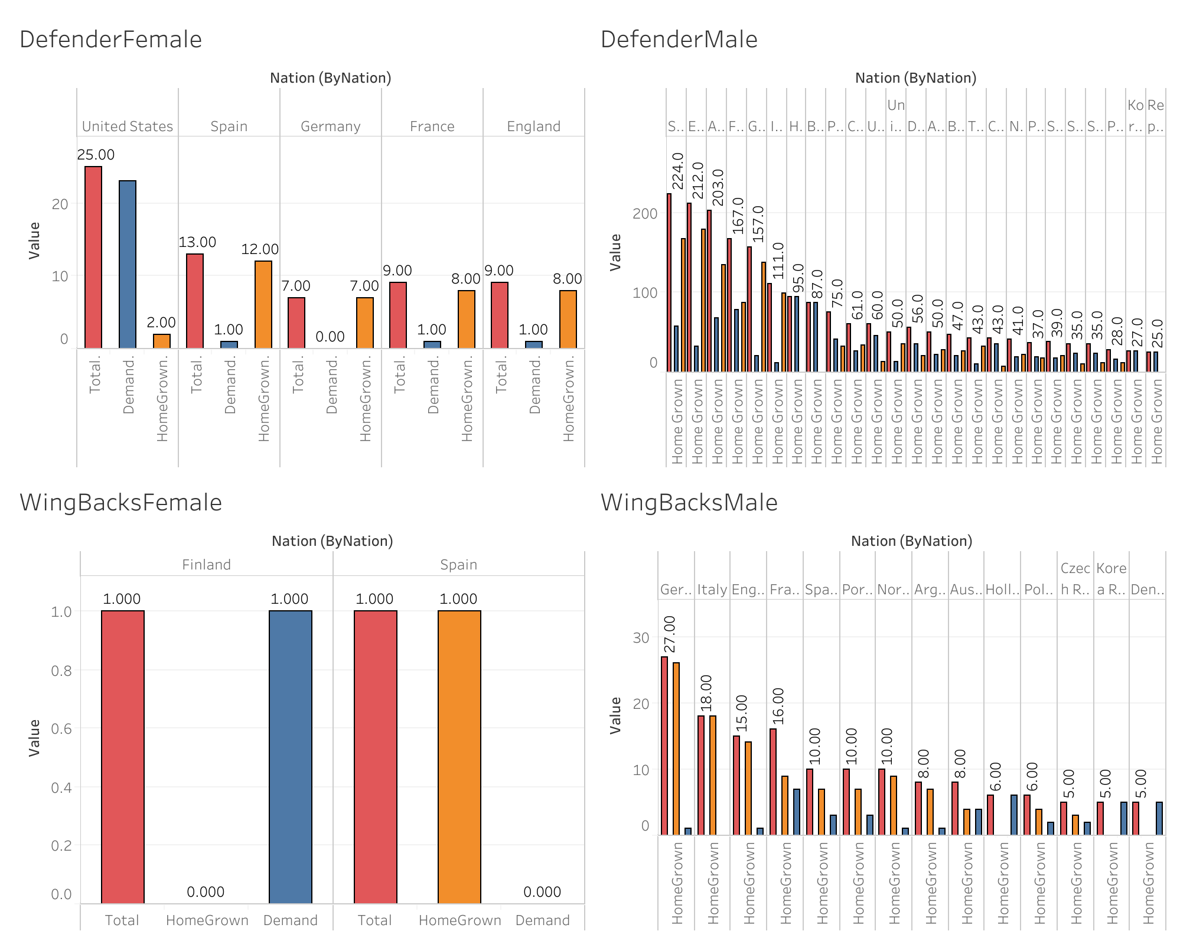
Spain and the US are renowned for producing quality defenders in the men's and women's categories, respectively.
Women defenders from the US tend to play for European clubs more often than those in their home country.
In women's football, there is a scarcity of high-quality wingbacks, resulting in slower adoption compared to men's football.
Germany stands out in the male category for producing a significant number of wingbacks, attributed to the Bundesliga clubs' focus on Gegenpressing.
Competition is fierce more in the women's wingback and defender categories, indicated by higher median values compared to the male category, suggesting a greater level of competition despite fewer players.

Slide 3
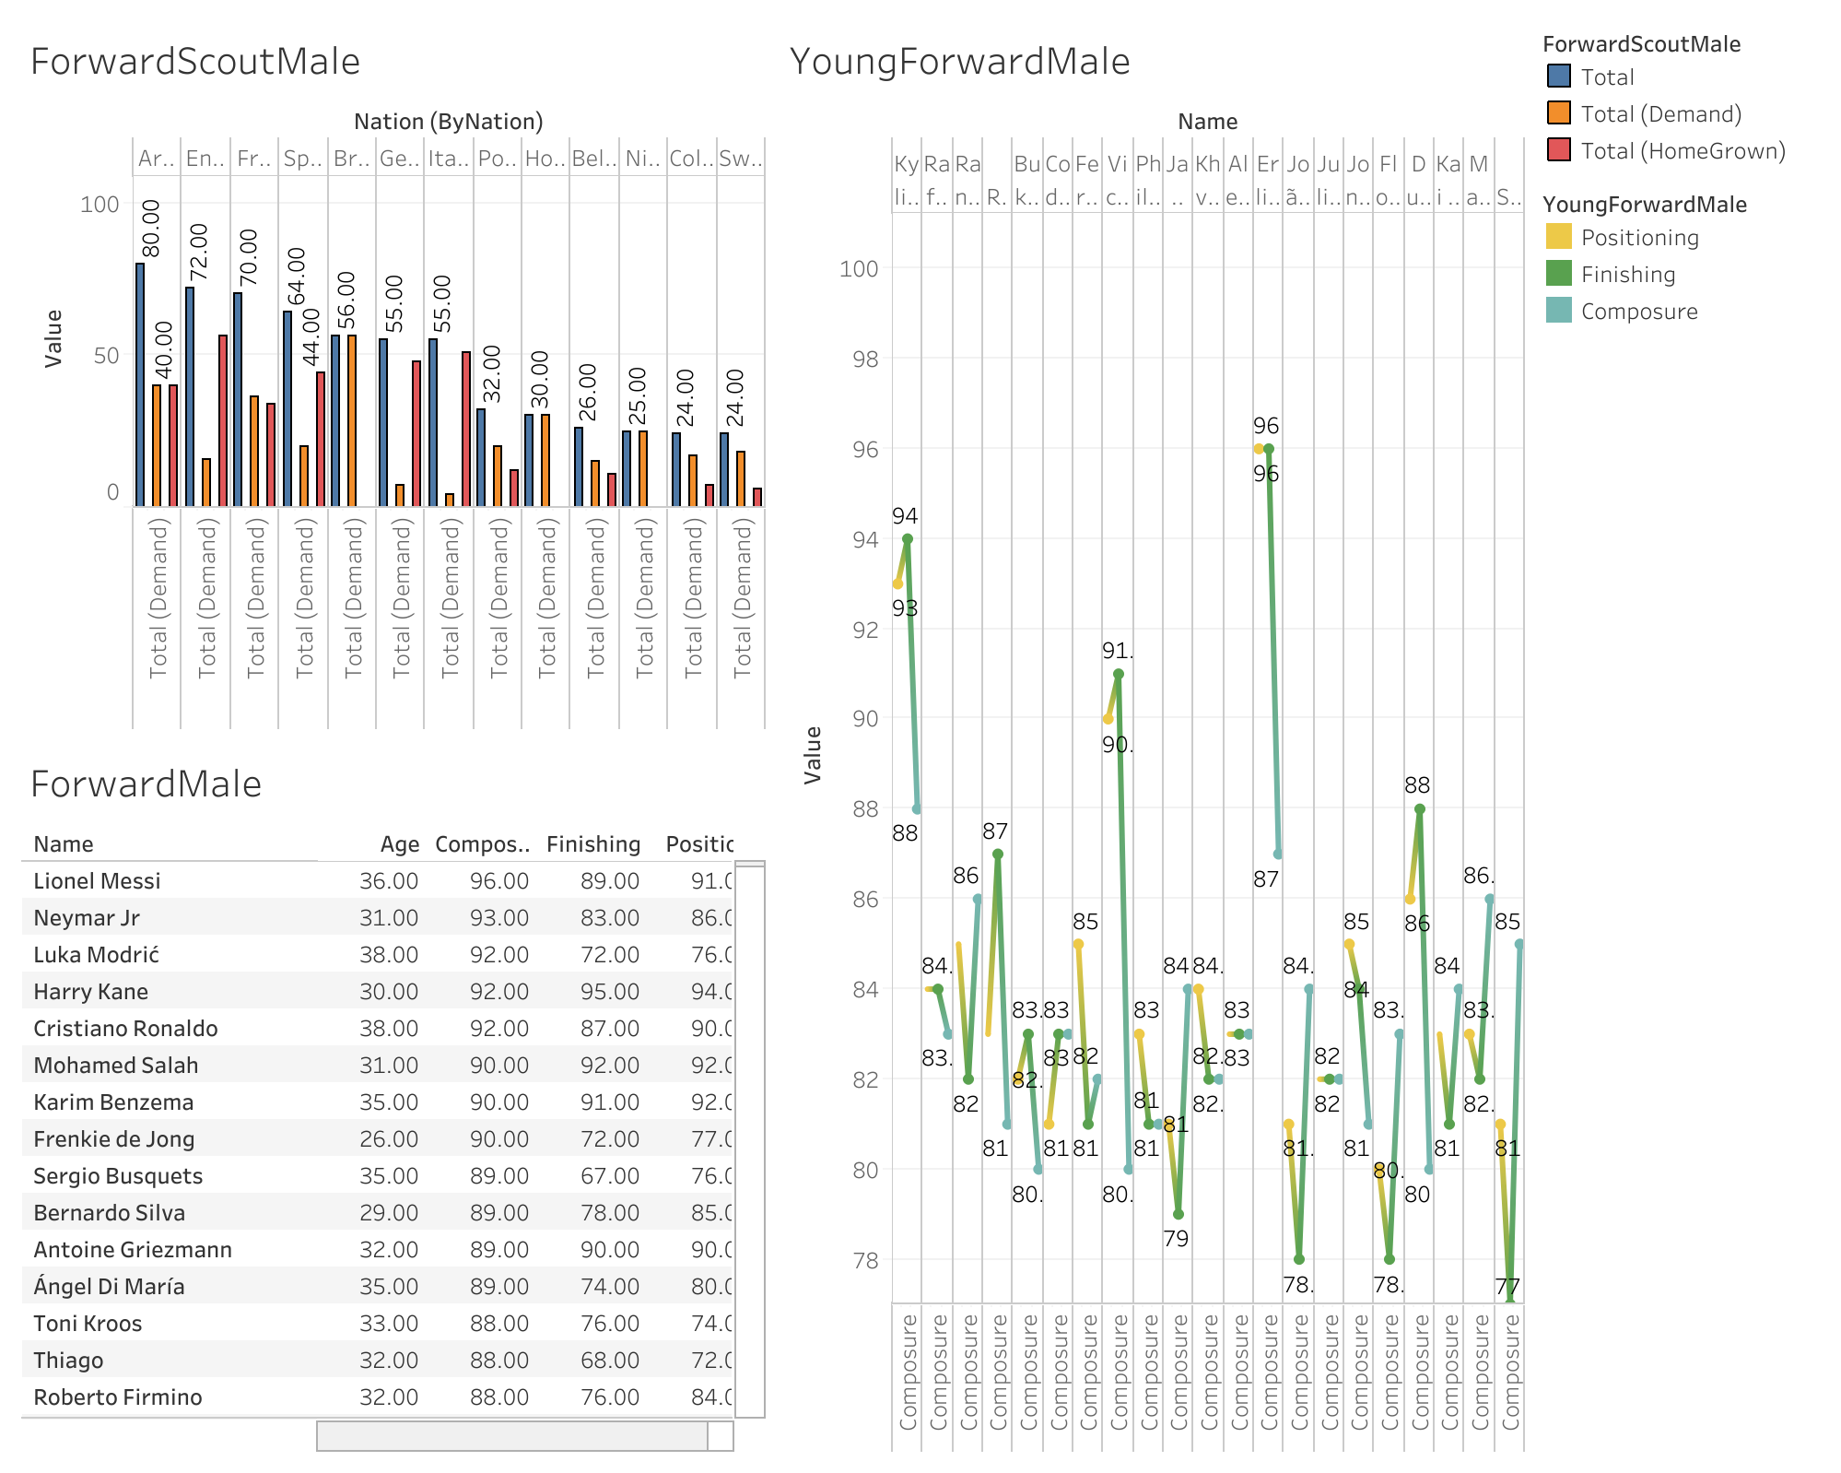
Argentina, England, France, and Spain boast a higher number of male forwards compared to other top footballing nations.
In Brazil, none of the quality forwards currently play for domestic football clubs, indicating their high demand at a more affordable price.
Due to England's emphasis on attacking football, many forwards prefer to showcase their talents in the Premier League.
As players mature, they develop enhanced composure, positioning, and finishing skills. Young players who exhibit these three skills at a level exceeding 80 are in high demand among clubs. This is evidenced by the YoungForwardAnalysis graph, which illustrates the popularity of such players due to these 3 exceptional qualities.

Slide 4
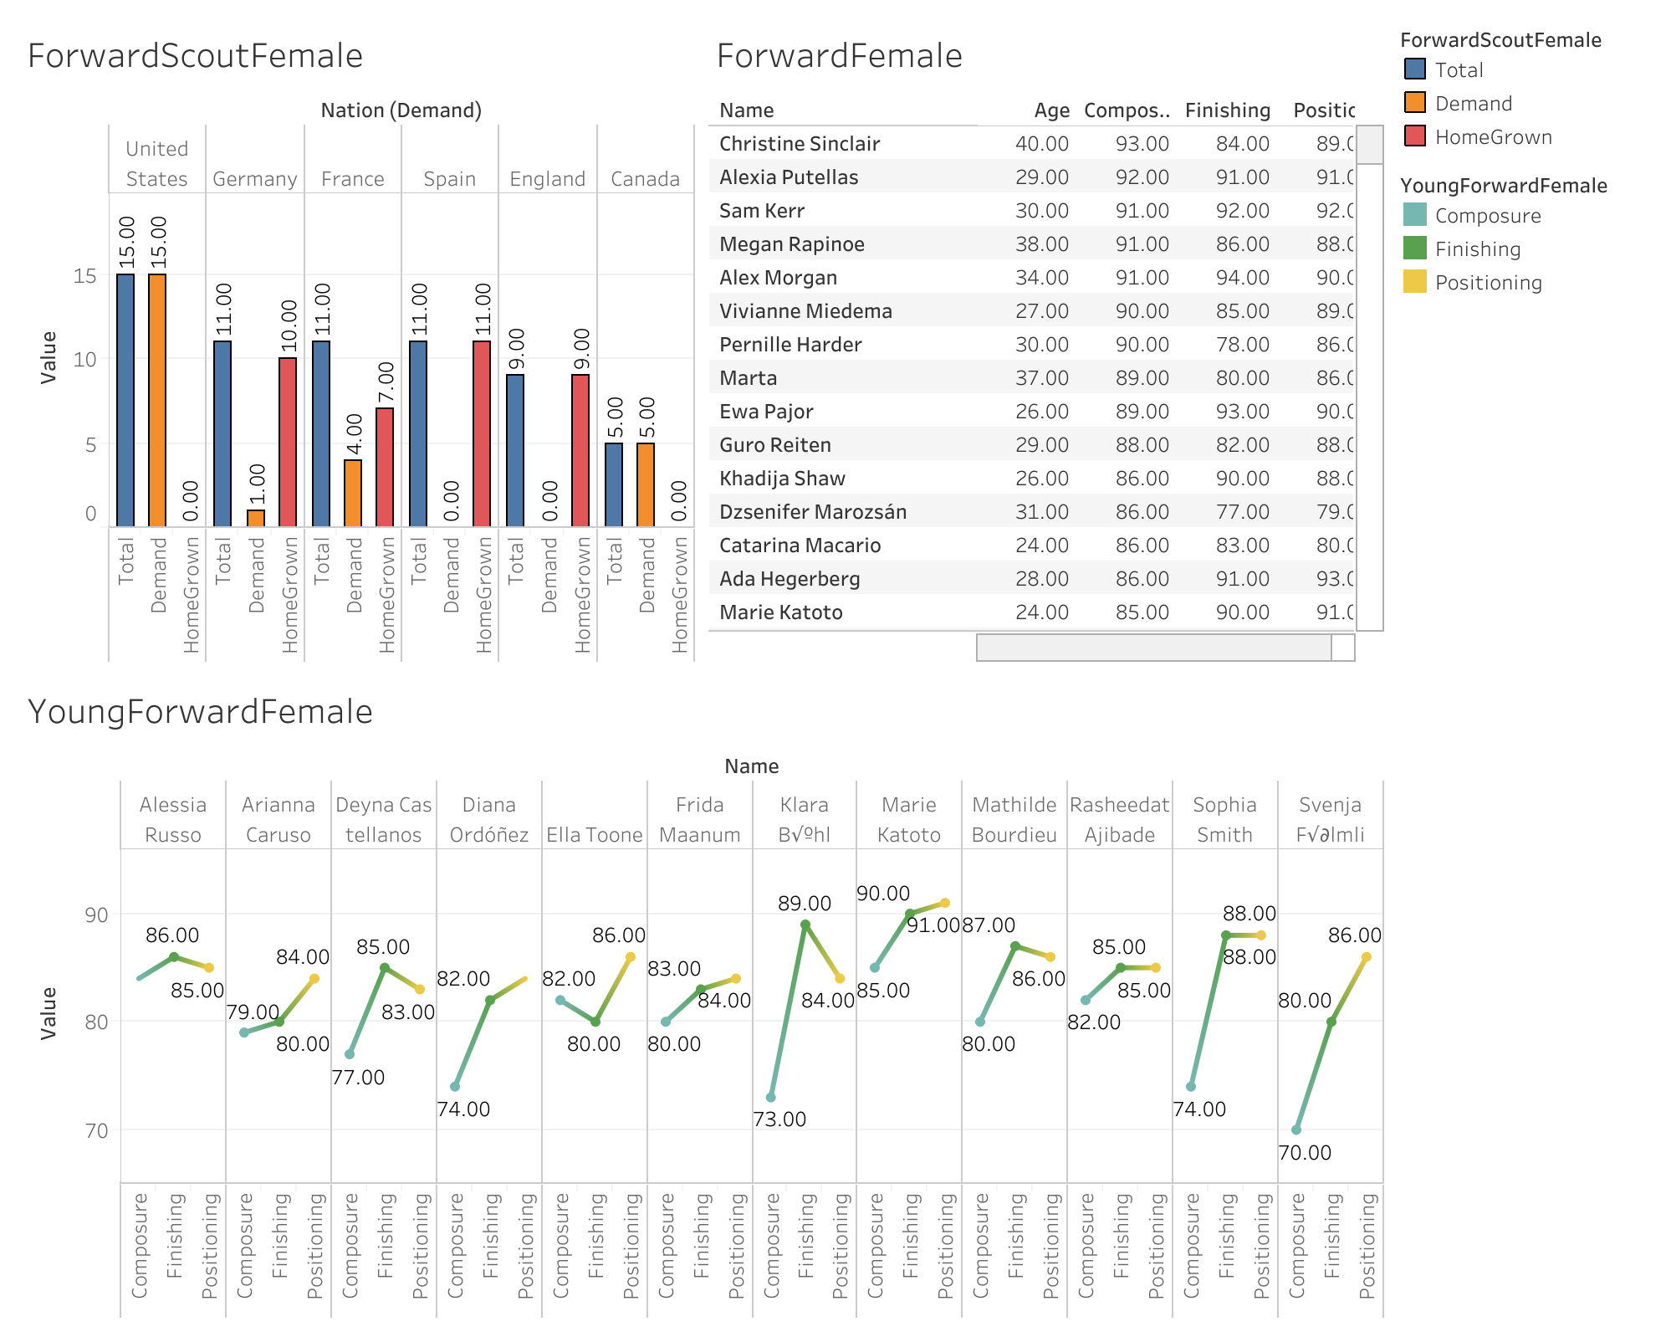
Young female forwards generally exhibit higher minimum attributes in composure, finishing, and positioning compared to their male counterparts.
Once again, the United States is generating a greater number of forwards who are plying their trade in foreign clubs.
Marie Katoto stands out as the top young player with exceptional statistics.
Improved composure not only enhances positioning but also contributes to better finishing.

Slide 5
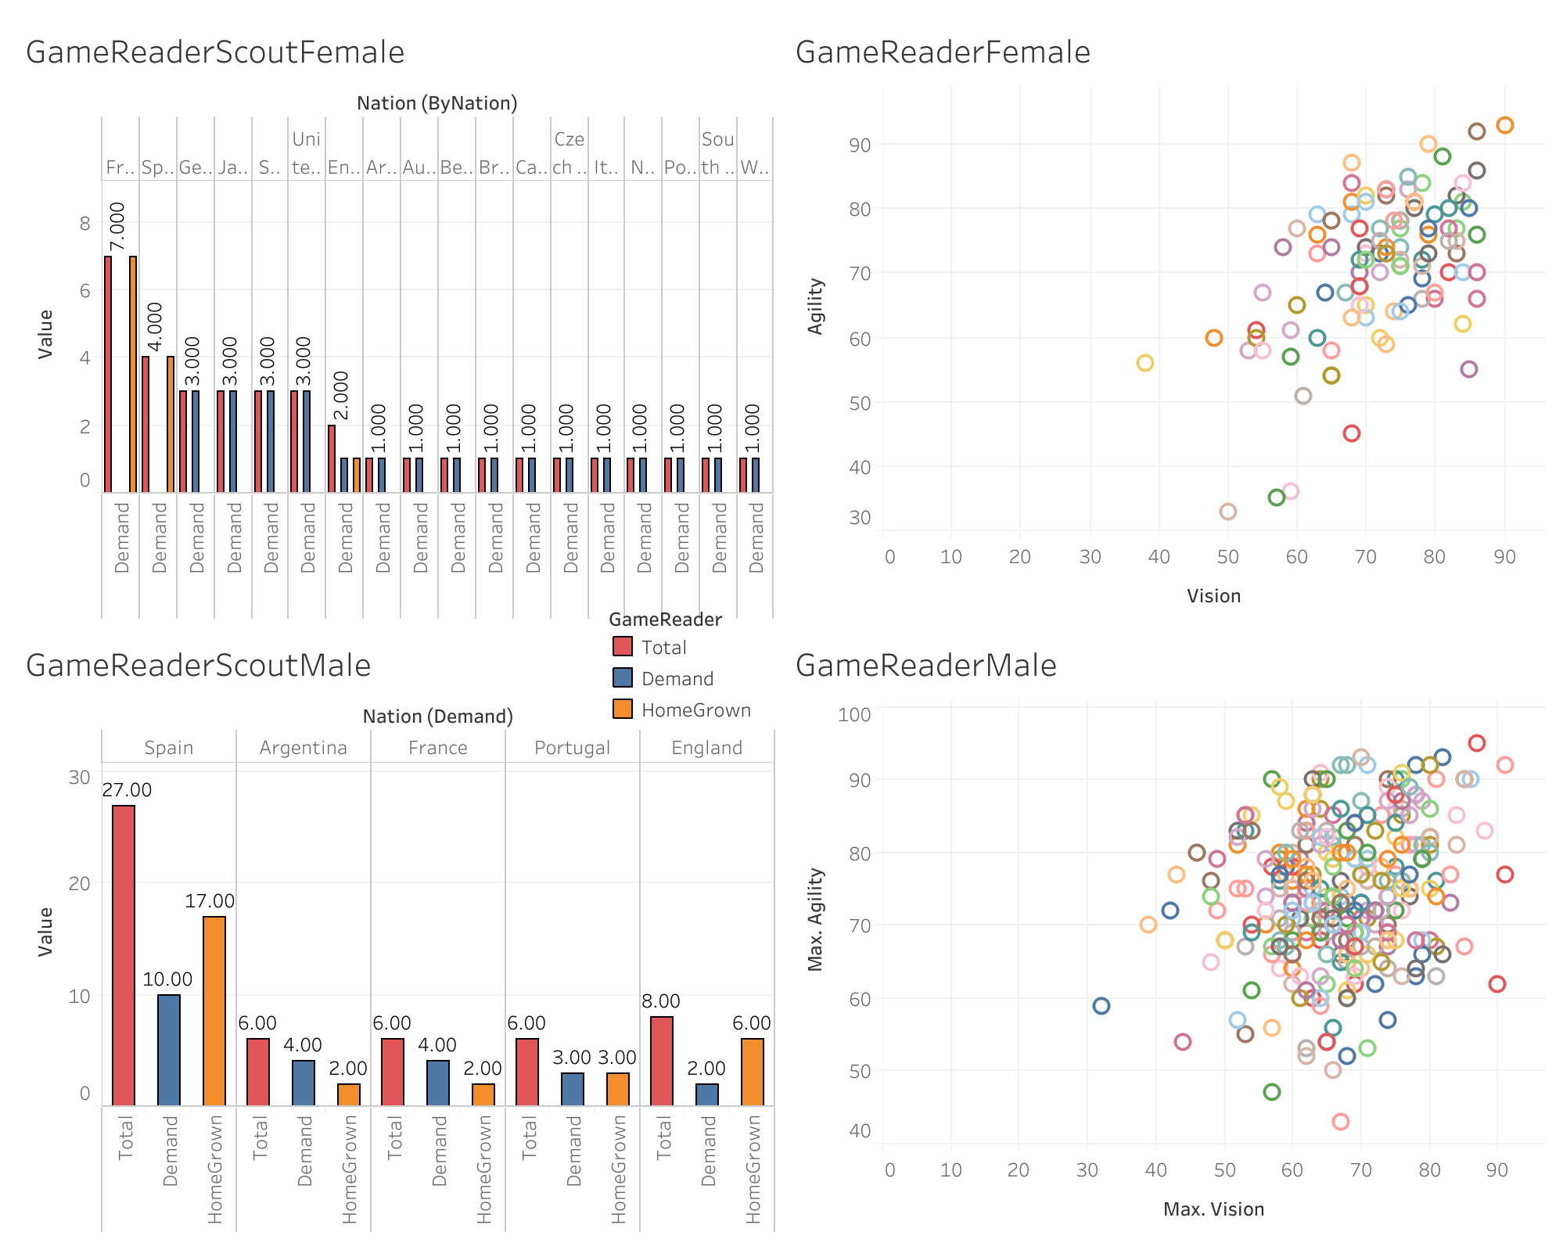
Players who excel in both attacking and defensive phases require superior vision and agility to control the game effectively.
In women's football, France and Spain boast higher-quality players, as evidenced by their performance in the Champions League.
Players from less-developed countries with exceptional qualities often find themselves playing for foreign clubs.
In men's football, Spain is renowned for producing game-savvy players who dictate the flow of play. They also scout talent from other countries to bolster their team.

Slide 6
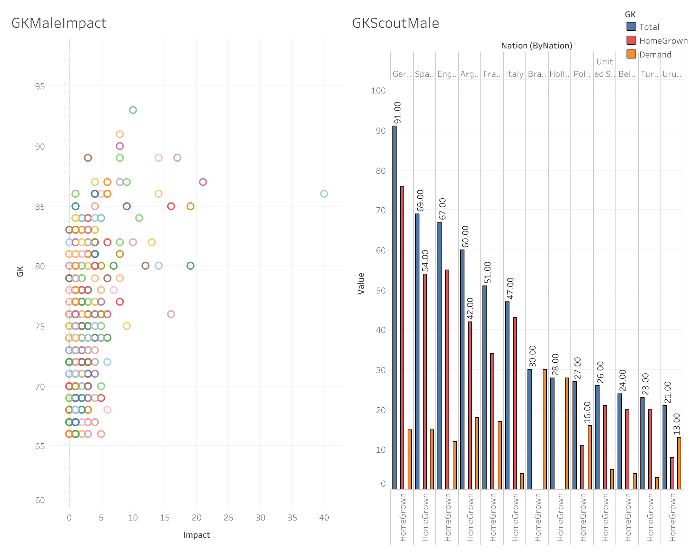
Splitting the data into two categories, goalkeepers from clubs with an impact score of 6 or less tend to adopt a counter-attacking style of play.
Players from clubs with an impact score higher than 6 are typically associated with teams that favor an attacking football approach.
Goalkeepers from Manchester City often have a greater impact on the game, being involved in various aspects beyond shot-stopping, unlike other goalkeepers with an impact score exceeding 6.
The top five European leagues are known for producing top-quality goalkeepers, although French goalkeepers show a preference for playing in leagues other than Ligue 1.

Slide 7
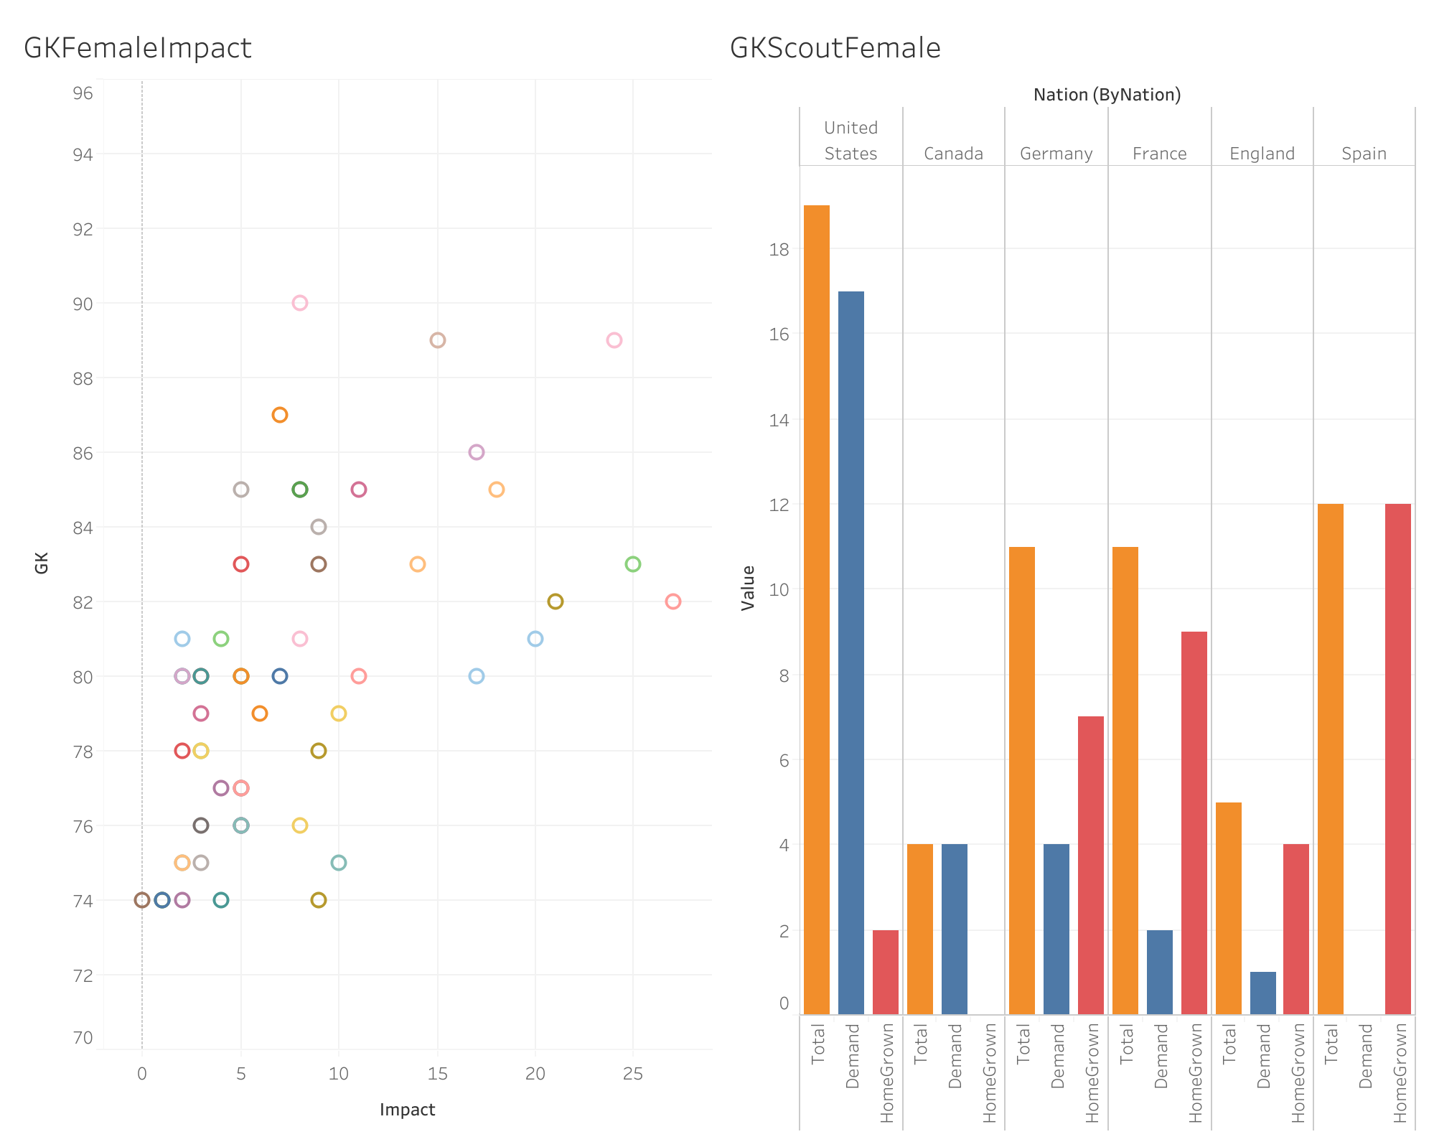
For female Goalkeeper, if the impact is less than 4, the club is playing counter attacking football otherwise attacking football

Slide 8
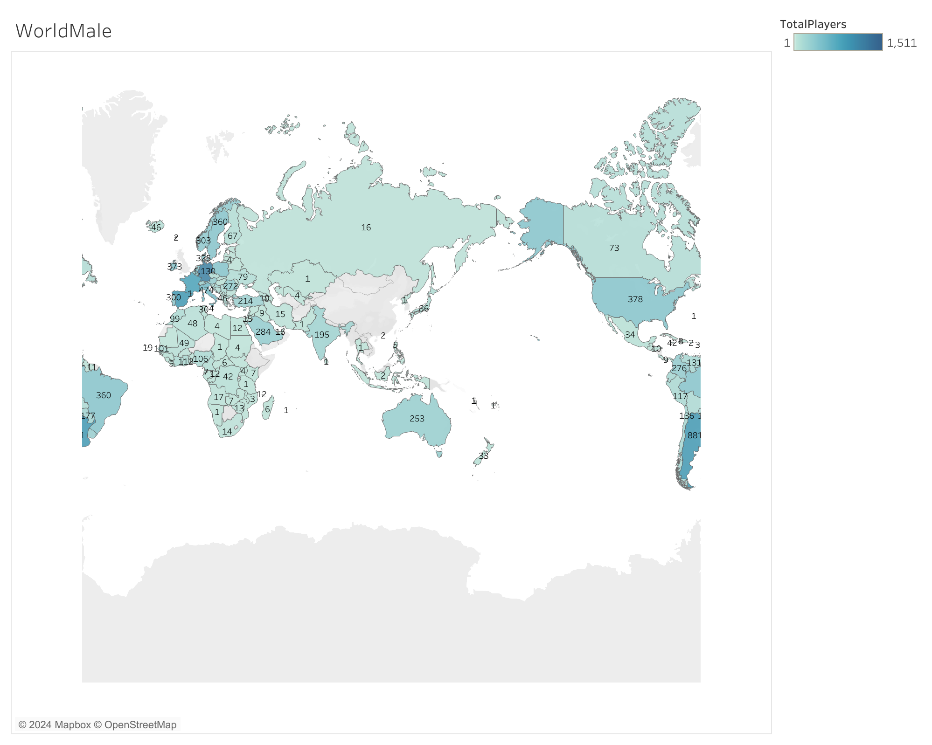
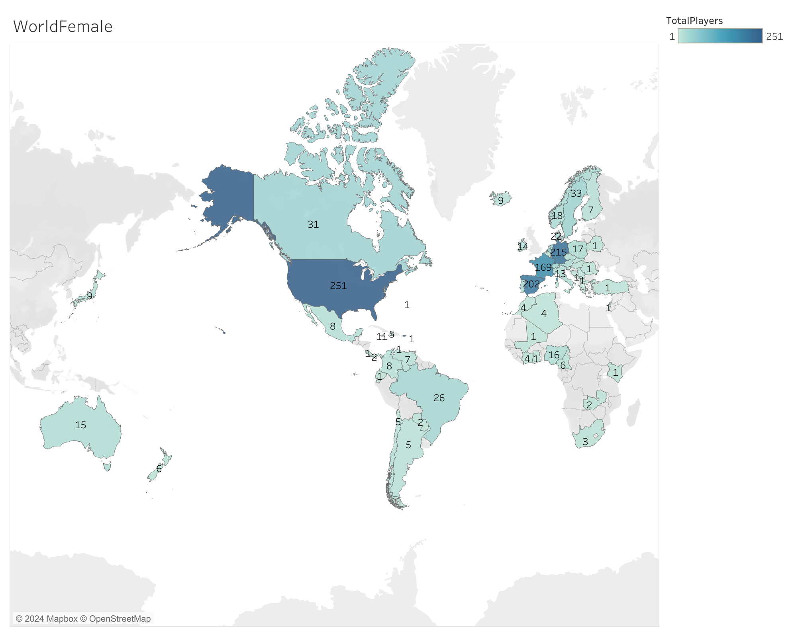
World
Male
In male football, certain countries from Africa and Asia, such as Chad, Tanzania, and Kazakhstan, have only one player reaching exceptional quality. While football is widespread globally for males, the same cannot be said for females. In some countries, there are no women's teams at all, and even in those that do have teams, no players reach exceptional quality.
This situation raises questions about the development of women's football in these regions, particularly in Africa. Many African countries experience frequent civil unrest, limiting opportunities for women in various aspects of life. In such environments, where women's rights and opportunities are often restricted, the growth of women's football faces significant challenges.
Female

