Slide 1
Background
Football is one of the most difficult sports to predict but recently there has been rapid growth in the area of predicting football results through statistical modeling. The most-watched and most profitable football league in the word is the English Premier League. Broadcast to over 643 million homes and to 4.7 billion people, the Premier League is England’s top league with twenty selective spots. This work will attempt to develop a model following a Poisson distribution to predict the results of the 2017-18 Premier League.

Slide 2

Abstract
Tournament:
English premier league
Objective:
1. To predict 2017-18 Premiership league table using the result of 2016-17 league season.
2. To predict 2017-18 EPL table based on the last ten league seasons data (2007- 2017).

Slide 3
Data Source and its form
Data Source-
The data used throughout the report is taken from the website http://www.football-data.co.uk/ & http://www.soccerstats.com/timing.asp?league=england
Form of data table-
. . . . . . .
. . . . . . .
. . . . . . .
Div | Date | Home Team | Away Team | FTHG | FTAG | FTR
EO | 8/8/2015 | Bournemouth | Aston Villa | 0 | 1 | A

Slide 4
Steps taken in the project
Verify whether no. goals per match follows Poisson distribution or not
2nd Step
Fitting Poisson regression model on no. of goals scored by each team per match
3rd Step
1. After estimating the parameters simulate the goal scores from the model
2. Using the scores to predict the league table for the next season
1st Step
4th Step
Simple Exponential smoothing of all the factor variables(by considering last 10 years data) and then repeat the above 3 steps to predict the league table

Slide 5
Observations
Total no of matches in 2015-16 Premiership football season=380
Total no of goals scored in the season=1064
Average no of goals per game= 1064/380 = 2.8
X= total number of goals per game in all 380

Slide 6
Modeling a Poisson process
Let, N(t)= no. of times a specified ‘event’ occurs by time t
N(0) = 0
E.g. finishing score =3-2 =>N(90) = 5.
N(t)-N(s) = number of ‘successes’ in (s; t] for 0<= s < t <1
=> Different time intervals between 0 and t can be viewed as a Poisson process.
0 10 20 30 40 50 60 70 80 90

Slide 7
Modeling a Non homogeneous Poisson process
Divide the 90 minutes match into subintervals each of equal length i.e.10 minutes.
Total no. of goals per match for the interval ti
= x(ti) ~ Poisson(λ(ti) ), for i=1,2,…,9.
λ(ti) =average goals scored in the interval ti.

Slide 8
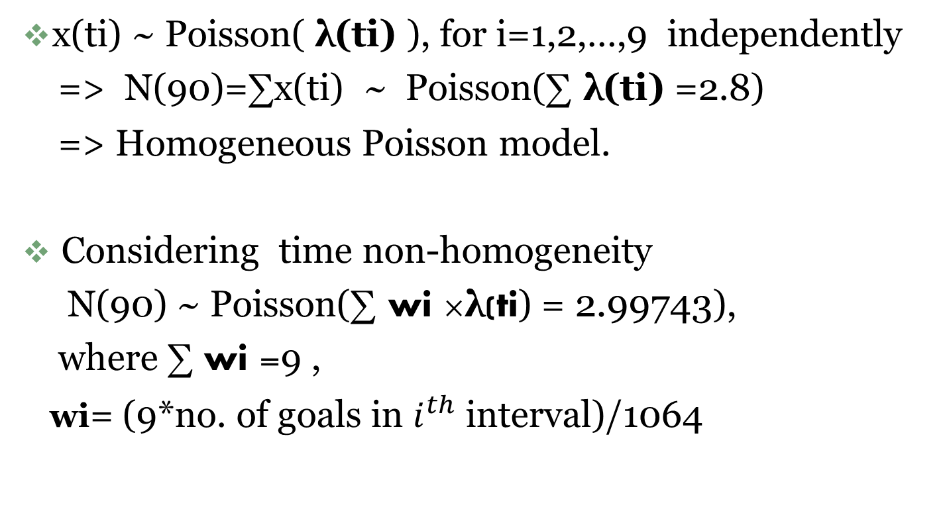
Comparison between the two types of fitting
x(ti) ~ Poisson( λ(ti) ), for i=1,2,…,9 independently
=> N(90)=∑x(ti) ~ Poisson(∑ λ(ti) =2.8)
=> Homogeneous Poisson model.
Considering time non-homogeneity
N(90) ~ Poisson(∑ wi ×λ(ti) = 2.99743),
where ∑ wi =9 ,
wi= (9*no. of goals in $i^{th}$ interval)/1064

Slide 9
Bar plots of Poisson random variables for different subintervals in a game

Slide 10

Goodness of fit
count | observed | fitted (homogeneous Poisson) | Fitted (non homogeneous Poisson)
0 | 27 | 22.588 | 18.967
1 | 59 | 63.7608 | 56.8545
2 | 88 | 89.9901 | 85.2087
3 | 83 | 84.6729 | 85.13579
4 | 73 | 59.752 | 63.797
5 | 27 | 33.733 | 38.245
6 | 13 | 15.8699 | 19.1063
7 | 7 | 6.399 | 8.181
8 | 1 | 2.258 | 3.0654
9 | 2 | 0.708 | 1.437
Chi-squared test for homogeneous and non homogeneous Poisson distribution
X^2 d.f p-value
Homogeneous Poisson 8.0034 9 0.5338
Non homogeneous Poisson 11.996 9 0.216

Slide 11
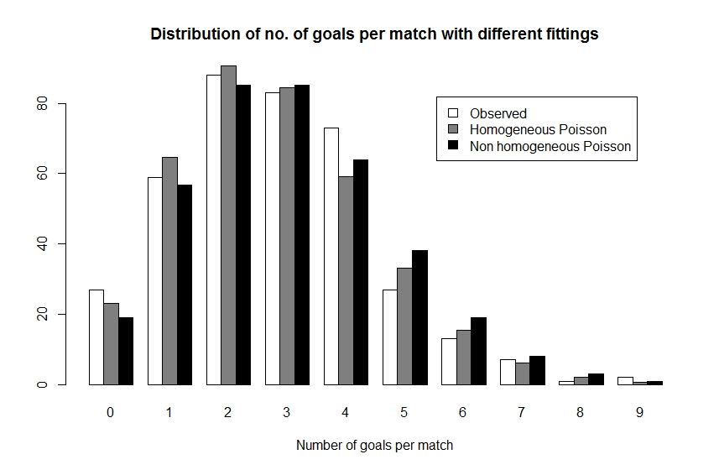
Comparison Plot

Slide 12
Poisson Regression Model
Poisson regression with log link
E(Y|X)= exp(Xß)
V(Y|X)= exp(Xß)
Y'=(i1 y¹ j1 , j1 y¹ i1, i2 y² j2,……………….., i380 y³⁸º j380 ,j380 y³⁸º i380)
where ayⁿb = no. of goals scored by team a versus team b in game n.
Predictors:
X1j=total no. of shots by a team per game
X2j=total no. of shots on target by a team per game
X3j=Fouls Committed by a team per game
X4j=Corners taken by a team per game j=1 for Home Team
X5j=getting yellow cards =2 for Away Team
X6j=getting red cards

Slide 13
Quasi Poisson Regression Model
Quasi Poisson regression with log link
E(Y|X)= exp(Xß)
V(Y|X)= φ exp(Xß)
where φ = dispersion parameter to be estimated from the data
Φ > 1 => Over dispersion
Φ<1 => Under dispersion

Slide 14
Estimating the regression coefficients
Covariate | P-value (Poisson) | P-value (Quasi Poisson)
(Intercept) | 0.1099 | 0.0712
Shots(h) | 0.9729 | 0.9694
Shots(a) | 0.4574 | 0.4013
Shots on target(h) | <<0.001 | <<0.001
Shots on target(a) | <<0.001 | <<0.001
Fouls(h) | 0.9589 | 0.9536
Fouls(a) | 0.2670 | 0.2100
Corners(h) | 0.0745 | 0.0442
Corners(a) | 0.0757 | 0.0451
Y.card(h) | 0.5284 | 0.4764
Y.card(a) | 0.8866 | 0.8720
R.card(h) | 0.9800 | 0.9774
R.card(a) | 0.7945 | 0.7685
Cragg and Uhler's pseudo r-squared: 0.3359
Dispersion parameter of Quasi Poisson family: 0.7829353

Slide 15
Simulating FUTURE Games & League table generation
Simulating One Game From the Parameters:
Y is simulated from Poisson(exp(XßHAT))
Simulation scheme:
To achieve Under dispersion we simulate Yi , by taking median of m sample observations , which are generated from Poisson(exp(xi'βHAT)) instead of taking directly from Poisson(exp(xi'βHAT)) .
After simulation , league table can be generated by using this simulated goal scores per match data.

Slide 16
Simulation of k-seasons
Here we simulate Y from Poisson(exp(XßHAT)) k(=1000)
times , which should cancel out any extreme randomness that occurs.
Now we take mode of those goal scores which are obtained by 1000 simulations.
Then based on that modal value of scores league table can be formed as in the earlier case.

Slide 17
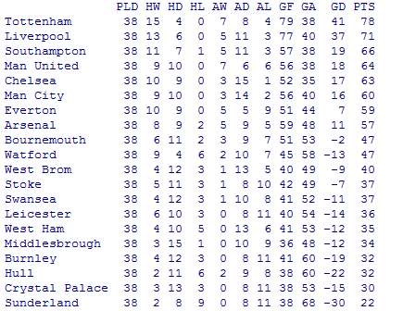
Final predicted league table

Slide 18
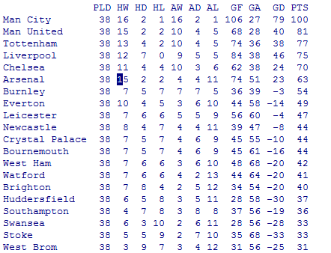
2017-18 EPL league table
League table

Slide 19
Exponential Smoothing
Generalization can be done by using the single Exponential smoothing of the Predictor variables only. Where smoothing is applied on the last ten years data(2007-08 to 2016-17).
Exponential smoothing formula is given by…….
Sijt = α Xijt + (1 - α) Sij(t-1) , i=1,…,6 ,j= 1,2 and t=2,…..10
where, Sij1= Xij1.
The method of least squares is used to determine the value of α for which the sum of square of the quantities ( Xijt- Sij(t-1)) is minimized.
Finally after getting predictor variables Sij10 , i=1,…..,6 j=1,2 ,same regression modeling and simulation is done for the prediction of the league table.

Slide 20
Results of Exponential Smoothing and Regression P-values
Covariate | Optimum α | P-value ( Poisson) | P-value (Quasi Poisson)
Shots(h) | 0.6848 | 0.59221 | 0.47875
Shots(a) | 0.588 | 0.000495 | <<0.001
Shots on target(h) | 0.7126 | <<0.001 | <<0.001
Shots on target(a) | 0.5673 | <<0.001 | <<0.001
Fouls(h) | 0.6769 | 0.21479 | 0.10118
Fouls(a) | 0.6414 | 0.980301 | 0.9739
Corners(h) | 0.4785 | 0.0231 | 0.00279
Corners(a) | 0.4832 | 0.92803 | 0.9049
Y.card(h) | 0.32436 | 0.7437 | 0.66545
Y.card(a) | 0.1336 | 0.00178 | <<0.001
R.card(h) | 0.2128 | 0.58196 | 0.4661
R.card(a) | 0.1774 | 0.11465 | 0.03737

Slide 21
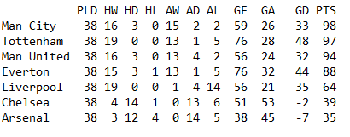
Result of the final prediction
In the last 10 years only 7 teams are consistently played in EPL. That’s why the concept of exponential smoothing is attempt to predict the result of those 7 teams only.
So we consider all the home and away matches of these 7 teams.
i.e. Total home matches + Total away matches
=[(19 x 7)- 7C2] + [(19 x 7)- 7C2] = 224

Slide 22
Model validation
Compare the predicted league table and the actual league table according to the mode of interest viz. team position , points column etc.
Correlation between observed and predicted goal scores can also be taken as a measure of model validation.
0.5421628 (Normal Poisson regression)
0.6636259 (After application of exponential smoothing)

Slide 23
Conclusion
Initial method of regression can be extended by considering some important factors like player transfer, change of manager , player injuries within season etc .
This can be done by updating the model dynamically.
Non homogeneous Poisson regression model can be expected to lead to better prediction but has more demanding data requirements.
In the exponential smoothing part, it is assumed that all the other 13 teams are playing in similar way, So that relaxation can be improved by collecting last 10 year data of the rest of the 13 teams.

