Slide 1
SDLC
By Palash shah

Slide 2
What is SDLC?
Software development life cycle (SDLC) is a structured process that is used to design, develop, and test good-quality software.
The goal of the SDLC life cycle model is to deliver high-quality, maintainable software that meets the user’s requirements.
SDLC consists of a precise plan that describes how to develop, maintain, replace, and enhance specific software.
The life cycle defines a method for improving the quality of software and the all-around development process.

Slide 3
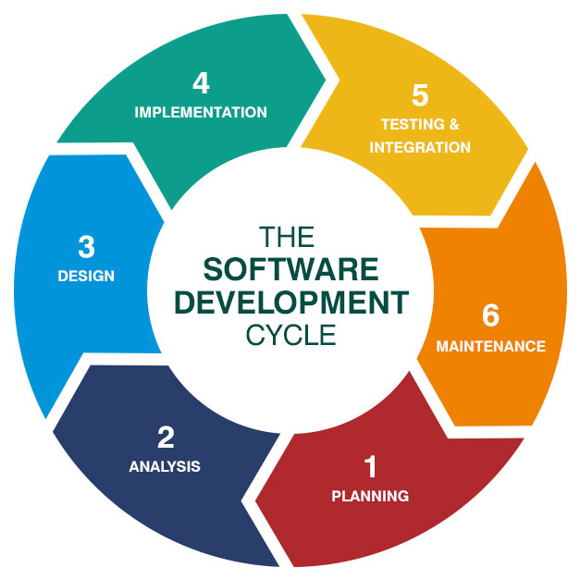
SDLC Phases

Slide 4
Types of Models
1) Waterfall Model
2) Iterative Model
3) Spiral Model
4) V-Model

Slide 5
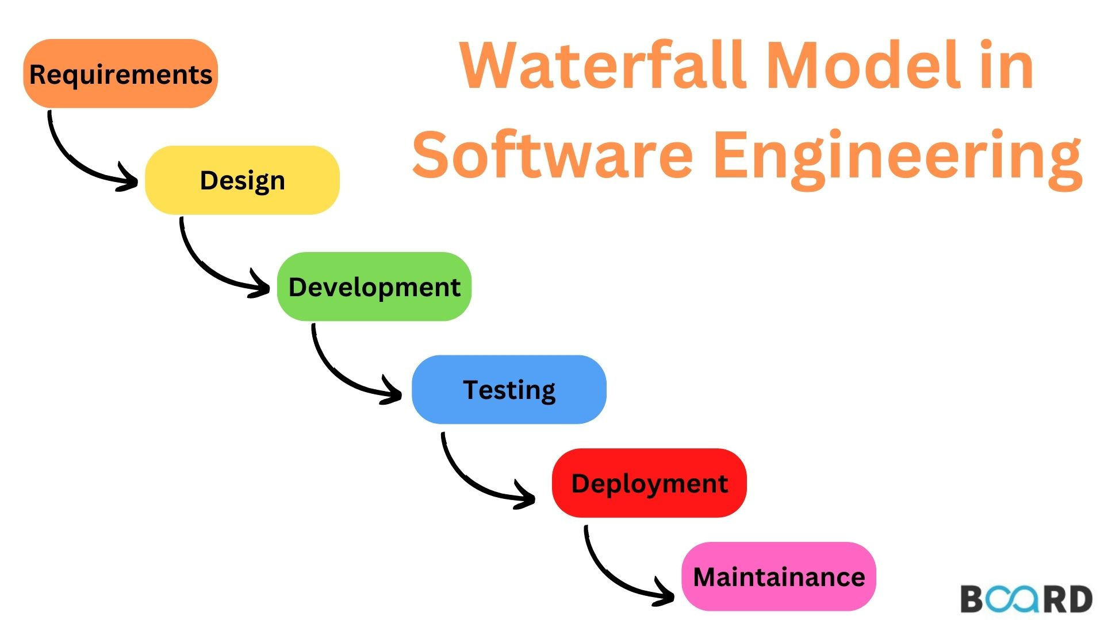
Waterfall Model
Linear Sequential model.
Very simple to understand and use.

Slide 6
Advantages of Waterfall:-
Simple, clear, and convenient to use.
It is simple to maintain since the stages are strict and exact.
Produces the desired outcomes for smaller projects
Disadvantages of Waterfall:-
Unable to embrace the necessary adjustments.
It becomes quite difficult to return to the phase.
Not suitable for larger and more complicate
Difficult to design a risk mitigation strategy.

Slide 7
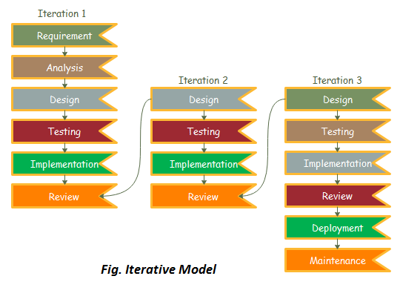
Iterative Model
A method of breaking down the software development of a massive program into smaller components.
Very simple to understand and use.
Flexible enough to incorporate customer feedback in every iteration.

Slide 8
Advantages of Iterative:-
It is easily adaptable to the ever changing needs of the project as well as the client.
Parallel development can be planned.
Risks are identified and resolved during iteration.
We can get reliable user feedback.
Disadvantages of Iterative:-
It is not suitable for smaller projects.
More resources may be required.
More management attention is required.
Difficult to design a risk mitigation strategy.

Slide 9
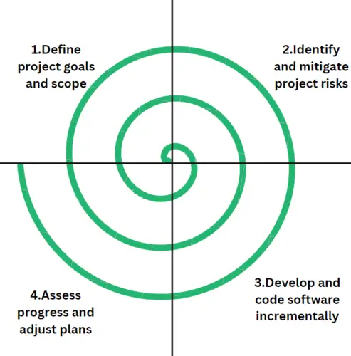
Spiral Model
Provides a systematic and iterative approach to software development
The software is developed in a series of incremental releases.
Flexible enough to incorporate customer feedback in every iteration.

Slide 10
Advantages of Spiral:-
Risk analysis and mitigation.
Good for large and complex projects.
Good for customer satisfaction.
We can easily change requirements at later phases.
It is suitable for high risk projects, where business needs may be unstable.
Disadvantages of Spiral:-
It is much more complex than other SDLC models.
Not suitable for small projects as it is expensive.
Spiral may go on indefinitely.
Project’s success is highly dependent on the risk analysis phase.

Slide 11
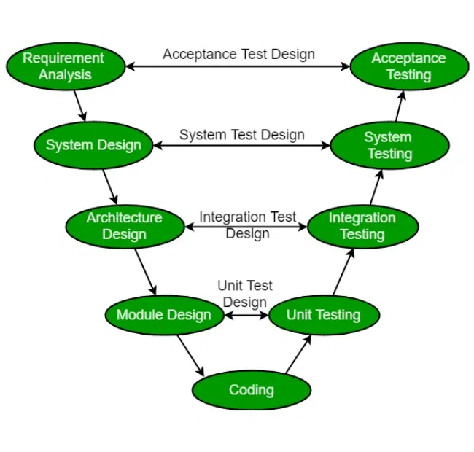
V-Model
Process executes sequentially in a V-shape
Known as the Verification and Validation model.
Development of each step is directly associated with the testing phase.

Slide 12
Advantages of V-model:-
Simple and easy to use.
Defects are found at early stage.
Testing activities like planning, test designing happens well before coding.
Works well for small projects where requirements are easily understood.
It is suitable for high risk projects, where business needs may be unstable.
Disadvantages of Iterative:-
Very rigid and least flexible.
Software is developed during the implementation phase, so no early prototypes of the software are produced.
If any changes happen in midway, then the test documents along with requirement documents has to be updated.

Slide 13
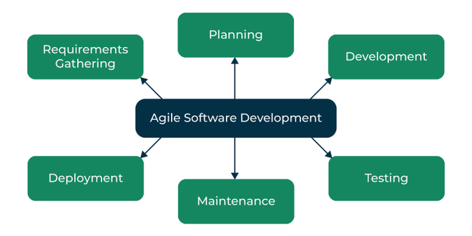
Agile
Agile software development is an iterative and incremental approach to software development.
It emphasizes collaboration between the development team and the customer
Flexibility, and adaptability in the face of changing requirements, and the delivery of working software in short iterations.

