Slide 1

{PREP} (Packages fRom tEmPlates)
Streamline Development of Shiny Apps and R Packages J. Kyle Wathen, Jeremy Wildfire, and Nan Chen

Slide 2
In pharma company – clinical trial statisticians typically focus on trials and not software development and often contribute to internal R functions, Shiny development for new methods
“Common” Practice
Single R script file with many functions and very long (1000s of line)
Computations with little testing and when it was done all testing was manual
Shiny apps in single files with 20k-60k lines with inconsistent themes within groups
Often files mixing UI and computation
Background

Slide 3


{testthat}
https://testthat.r-lib.org/
Package for creating tests/unit test like many other languages
“Testing your code can be painful and tedious, but it greatly increases the quality of your code”
Makes testing “fun”
{golem}
https://thinkr-open.github.io/golem/
“{golem} is an opinionated framework for building production-grade shiny applications”
Creates a Shiny app as a package
Can require a fair amount of configuration
Becomes a dependency of your application
Start with a basic Shiny app
Useful Packages

Slide 4
Application
Computation Package
(with testing)
Shiny UI
Goals

Slide 5
{PREP} – Packages fRom tEmPlates
Shiny
Within an organization/group develop consistent apps
Similar layout
Theme switching
Allow custom templates
Move away from long app.r/server.r files → Modules
Available common use modules or tab
App as package
Functionality to add new “tabs” or modules
R Package
Setup with testing via testthat
Add new function to package
Create file with default/custom header and function stub
Create test file with default/custom header and example
Goals

Slide 6
{PREP} - Shiny as a Package
R Package with modules in the R directory
Default tabs
Key functions – AddTab/AddModule
{PREP} – Package
Key function – AddFunctionToPkg
{PREP} - Shiny App
Project Types

Slide 7
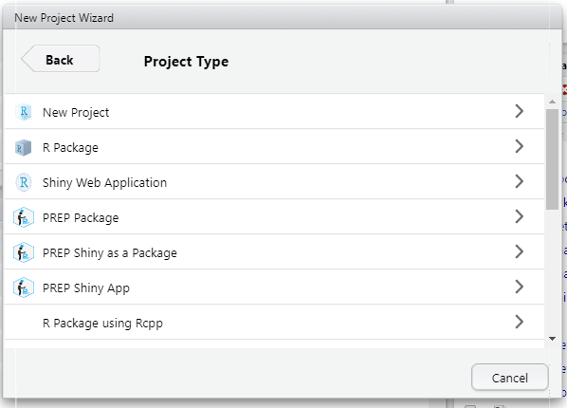
Project Setup

Slide 8
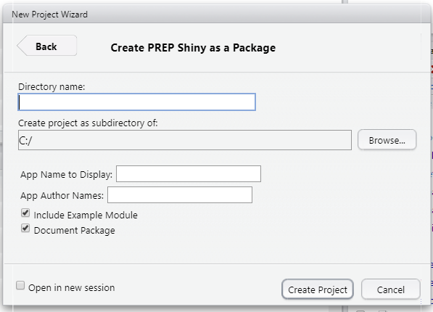
Shiny as a Package

Slide 9
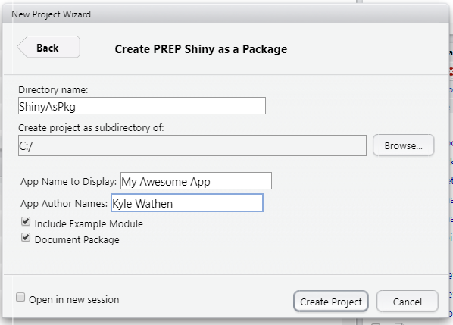
{PREP} Shiny Package Setup

Slide 10
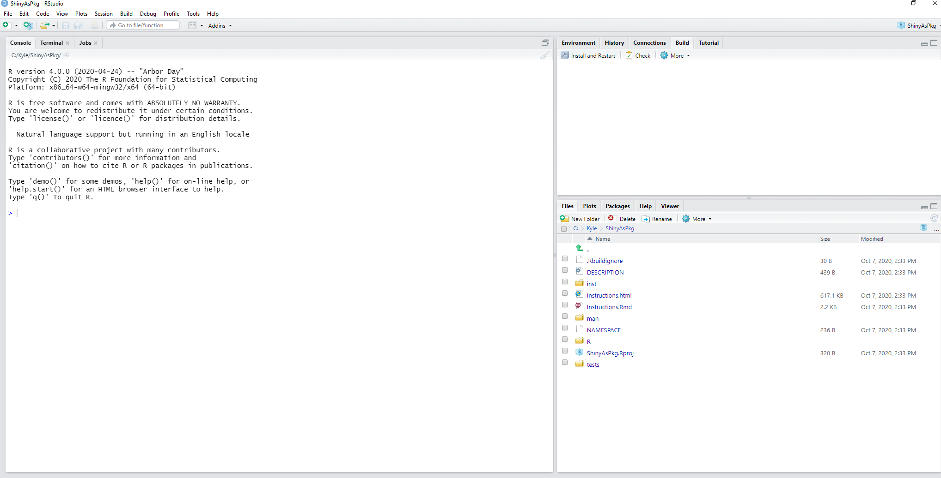

Slide 11
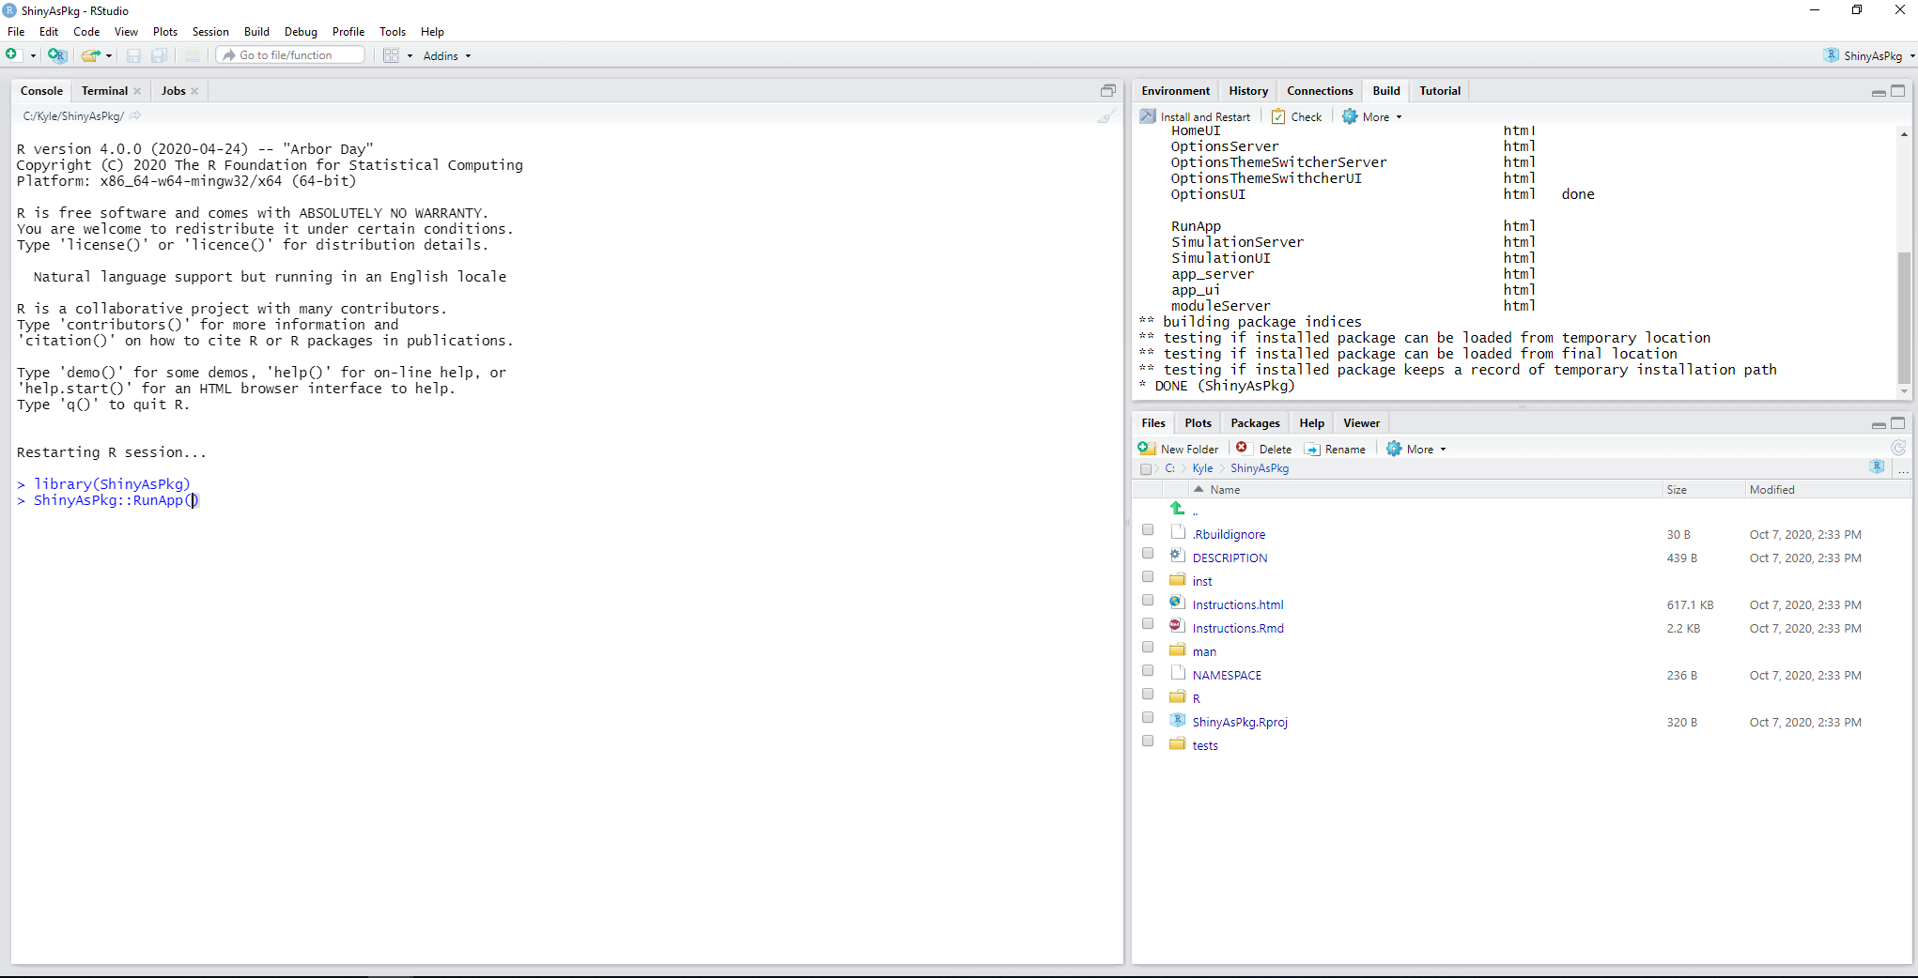

Slide 12
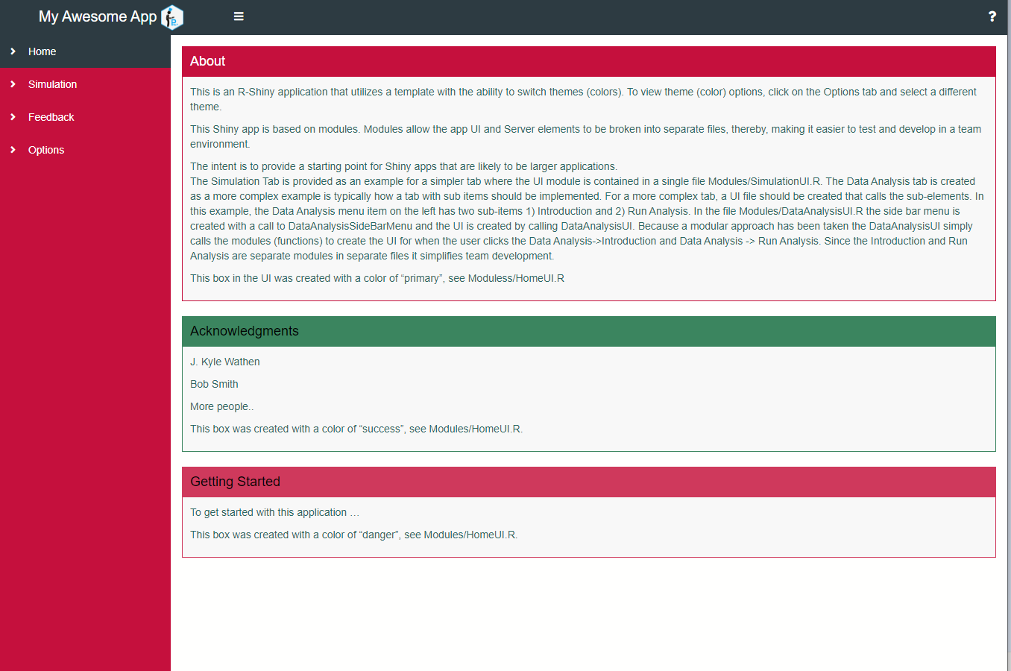
Example Module

Slide 13
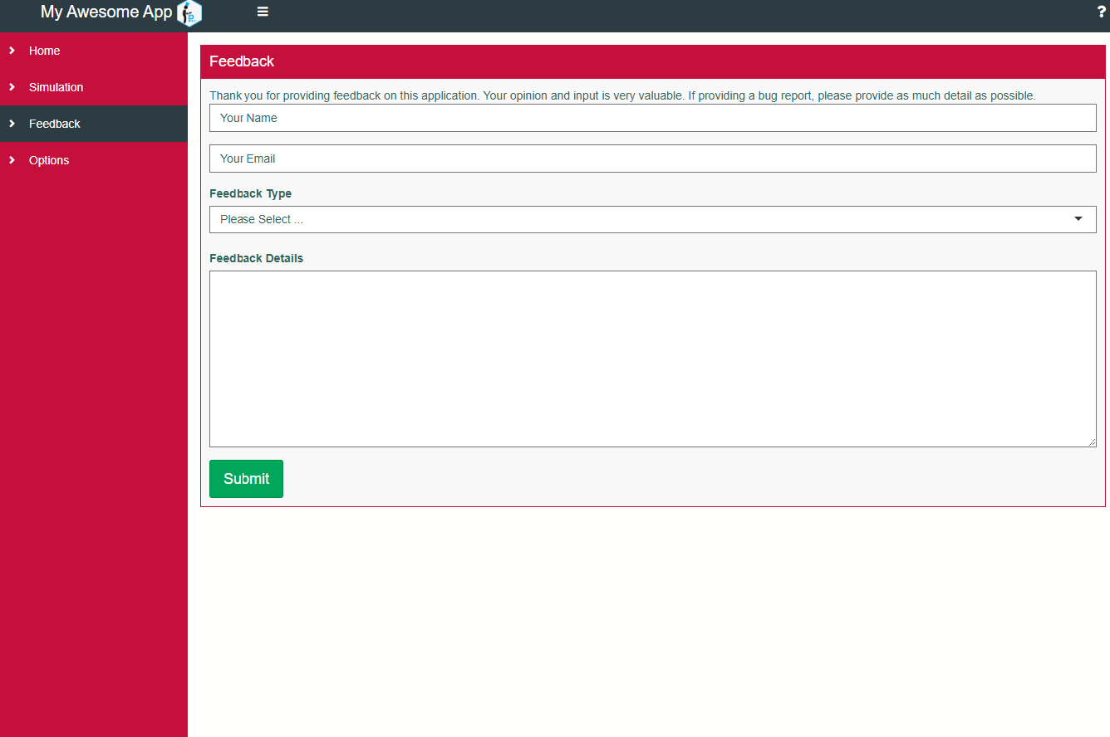

Slide 14
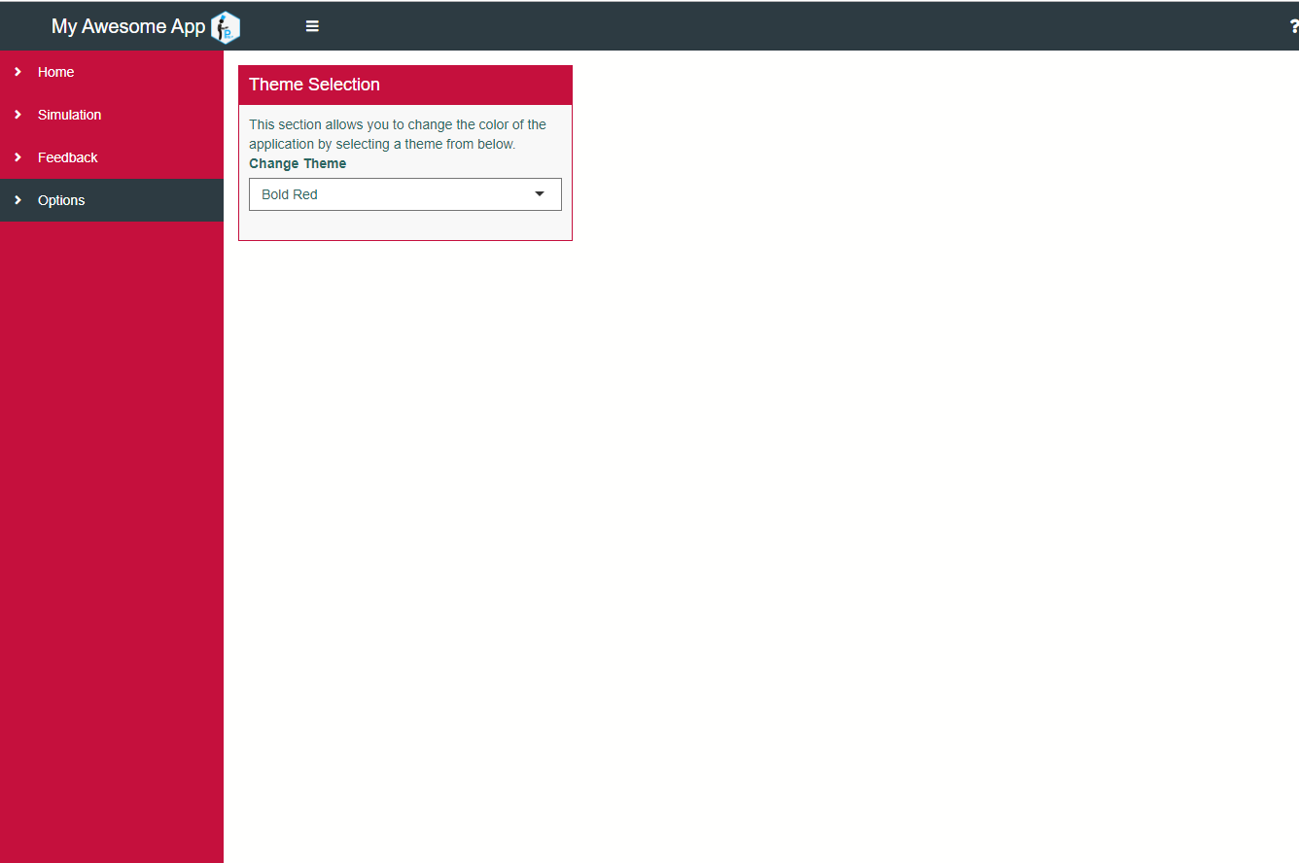

Slide 15
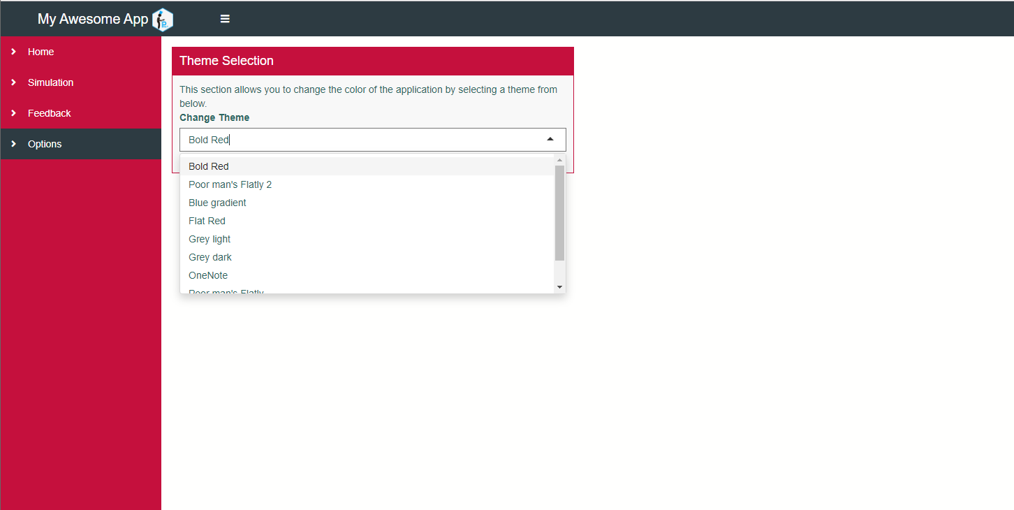

Slide 16
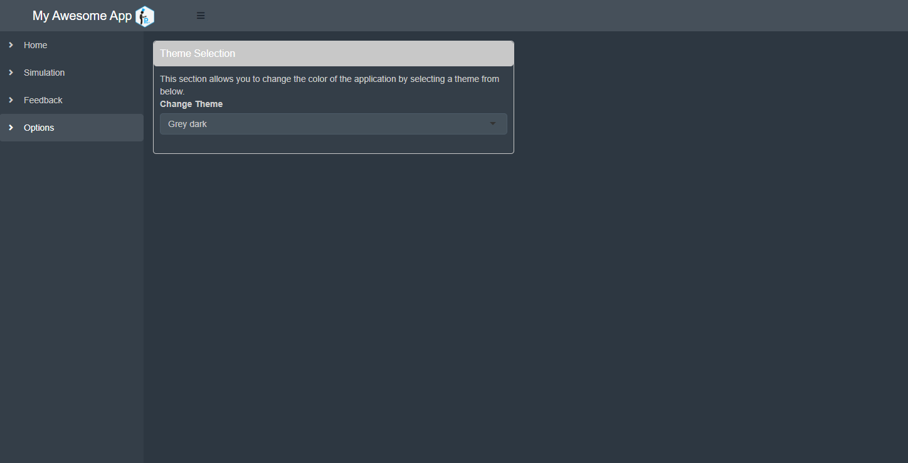

Slide 17
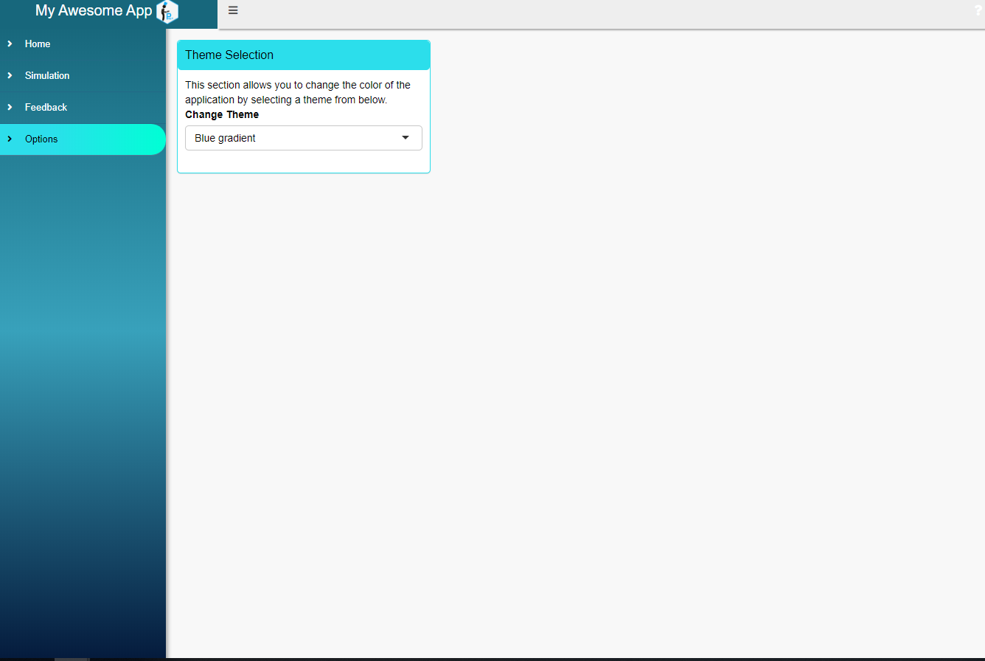

Slide 18
Need to add tabs for Analysis and would like to have sub-tabs for
Primary Analysis
Secondary Analysis
Safety
Using {PREP}
Add New Tab/Subtabs
PREP::AddTab("Analysis",
vSubtabIDs = c("Primary Analysis",
"Secondary Analysis",
"Safety"))

Slide 19
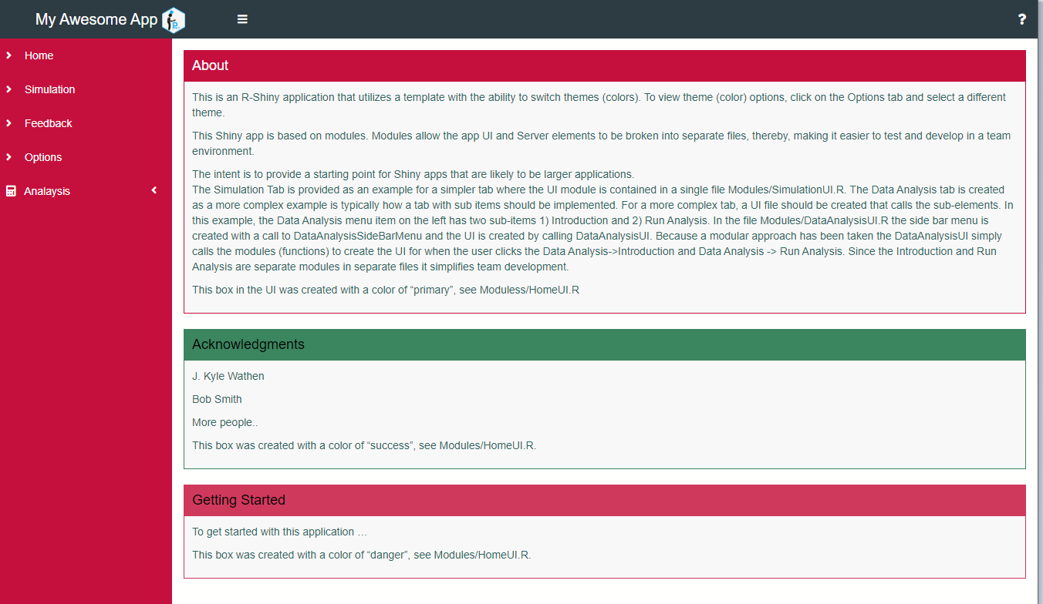

Slide 20
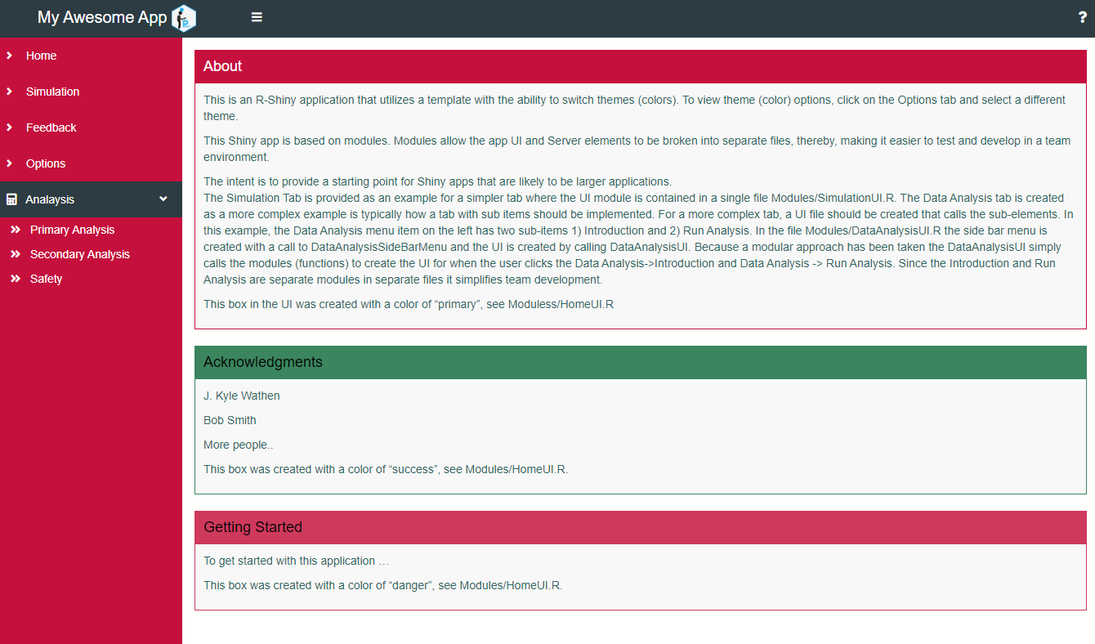

Slide 21
Project Setup

Slide 22
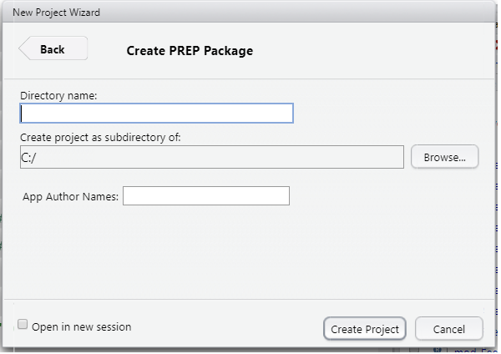
{PREP} Package

Slide 23
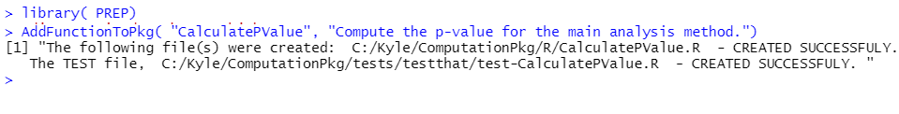
{PREP} - AddFunctionToPkg

Slide 24
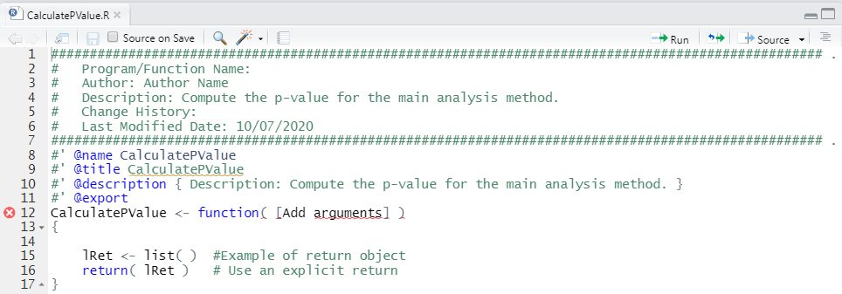
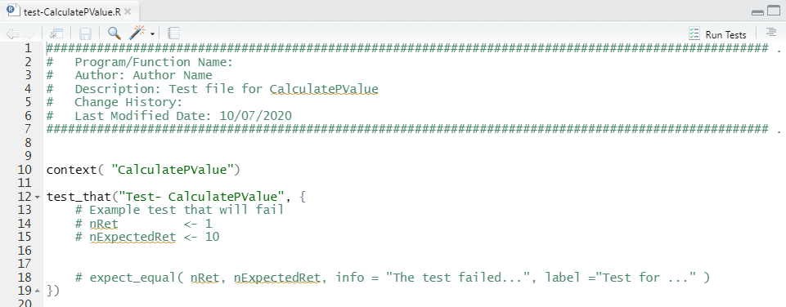
Main File
CalcualtePValue.R
Test File
test-CalcualtePValue.R

Slide 25
Application
Computation Package
Consistent
Shiny UI
{PREP}
Summary
Key Functions
Shiny
1) CreateAppPacakge, CreateAppStandalone
2) AddTab, AddModules
Calculation Package
CreatePackage
AddFunctionToPkg

Slide 26
Main Developers: J. Kyle Wathen, Jeremy Wildfire, and Nan Chen
Package was created as part of the BioPharmSoft Working Group
http://biopharmnet.com/biopharmsoft/
https://community.amstat.org/biop/workinggroups/biopharmsoft/biopharmsoft-home
GitHub Page {PREP}
https://BioPharmSoftGrp.github.io/PREP/
Contact Kyle Wathen, Kyle.Wathen@Gilead.com
Thank You!
References

