Slide 1
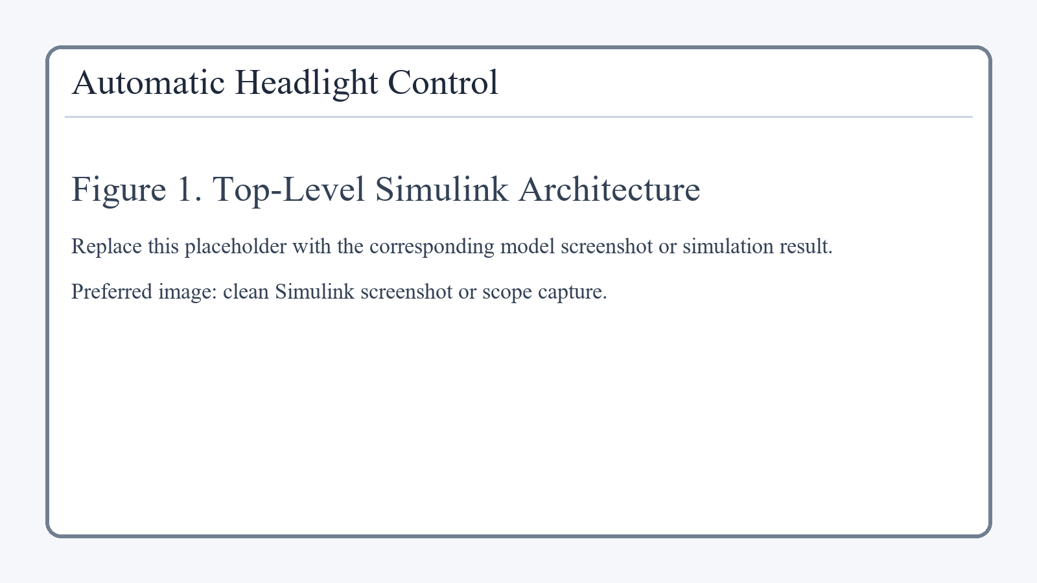
Automatic Headlight Control System
Model-Based Design using Simulink & Stateflow
Submitted by: [Your Name]
PRN: [Your PRN]
Department: Electronics and Telecommunication Engineering
Top-Level Simulink Architecture
Core Flow
Input Subsystem -> Logic Subsystem -> Stateflow Controller -> Output Subsystem
Automatic Headlight Control System | Simulink + Stateflow

Slide 2
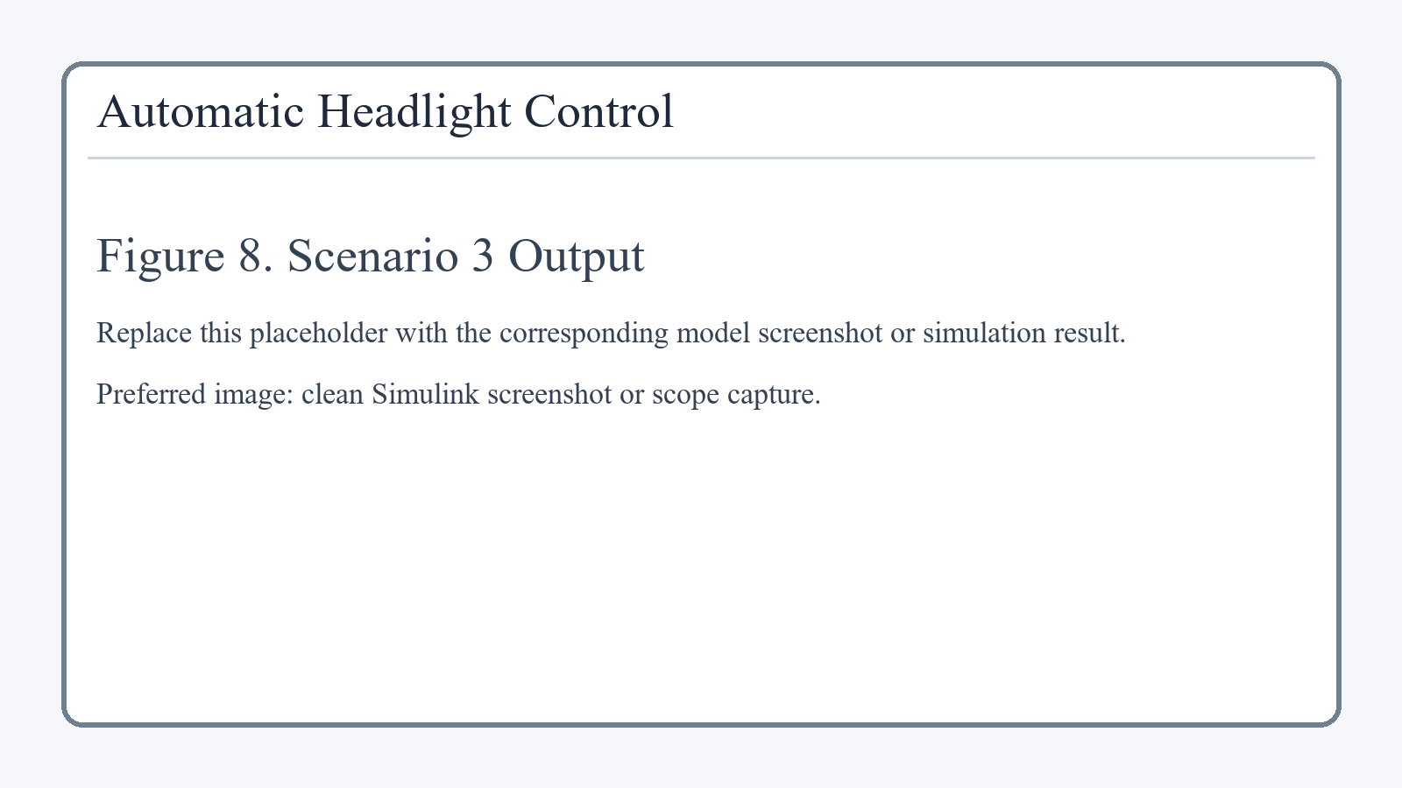
Introduction and Problem Statement
01
Automatic headlight control improves safety by switching headlights according to environmental brightness.
The controller must react correctly during day driving, night driving, tunnel entry, and stopped-at-night conditions.
The system also includes manual override and a fault input for supervisory behavior.
The final output is headlamp_cmd where 0 = OFF and 1 = ON.
Objective
Novelty Feature
Simulation Type
Build and simulate a modular automotive headlight controller.
Manual override takes priority over automatic behavior.
Discrete-time model, fixed step 0.1 s, stop time 40 s.
Tunnel-entry simulation placeholder
Automatic Headlight Control System | Simulink + Stateflow

Slide 3
System Architecture
02
Input Subsystem generates AmbientLux, VehicleSpeed, ManualOverride, and Fault.
Logic Subsystem converts raw values into lux_status and speed_status using hysteresis.
Stateflow Controller applies OFF, ON, HOLD, and MANUAL states.
Output Subsystem displays, plots, and logs headlamp_cmd.
Key Flow
Signal conditioning is separated from final state-based decision making.
Overall Simulink model
Automatic Headlight Control System | Simulink + Stateflow

Slide 4
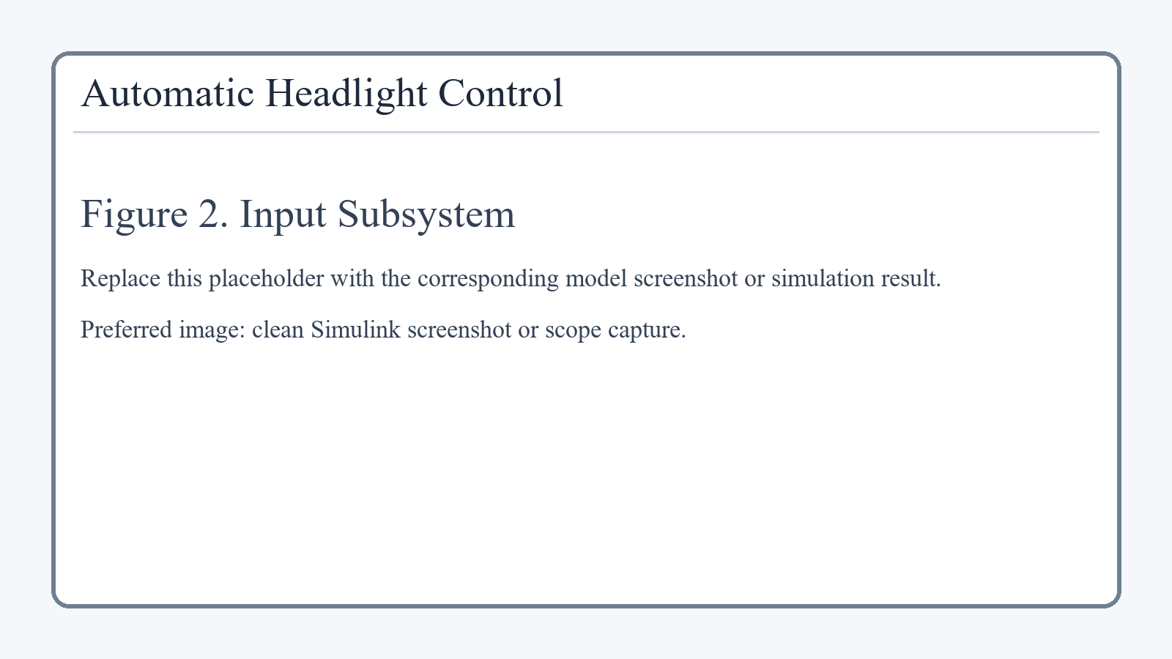

Input and Logic Subsystems
03
Scenario 1: Day + Moving -> AmbientLux = 800, VehicleSpeed = 60
Scenario 2: Night + Moving -> AmbientLux = 100, VehicleSpeed = 60
Scenario 3: Tunnel Entry -> 800 -> 100 -> 800 lux with vehicle moving
Scenario 4: Night + Stopped -> AmbientLux = 100, VehicleSpeed = 0
Logic uses AmbientLux < 300 and AmbientLux > 500 to implement hysteresis.
Unit Delay + NOT + AND + OR create lux_status memory and prevent flicker.
Input Subsystem
Logic Subsystem
Automatic Headlight Control System | Simulink + Stateflow

Slide 5

Stateflow Controller
04
OFF
ON
Active in bright conditions. Output: headlamp_cmd = 0
Active when dark and moving. Output: headlamp_cmd = 1
HOLD
MANUAL
Dark and stopped. Lamps remain ON for safety.
Override active. Highest-priority state, lamps forced ON.
If override = 1 -> MANUAL
Else if lux_status = 0 -> OFF
Else if lux_status = 1 and speed_status = 1 -> ON
Else if lux_status = 1 and speed_status = 0 -> HOLD
Stateflow Controller
Automatic Headlight Control System | Simulink + Stateflow

Slide 6
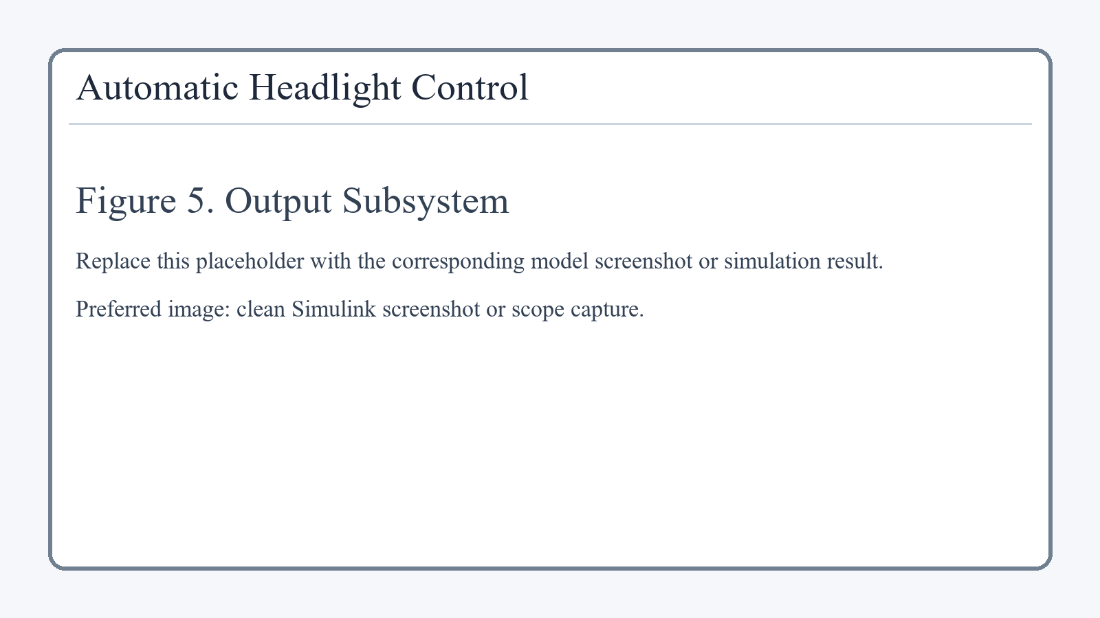
Output Subsystem and Simulation Scenarios
05
Headlamp_Display shows the current logical value of headlamp_cmd.
Headlamp_Scope plots output over time, especially useful for tunnel entry.
Headlamp_ToWorkspace logs out.headlamp_cmd_ts for verification.
Output Subsystem
Scenario | Condition | Expected Output
1 | Day + Moving | 0
2 | Night + Moving | 1
3 | Tunnel Entry | 0 -> 1 -> 0
4 | Night + Stopped | 1
Automatic Headlight Control System | Simulink + Stateflow

Slide 7
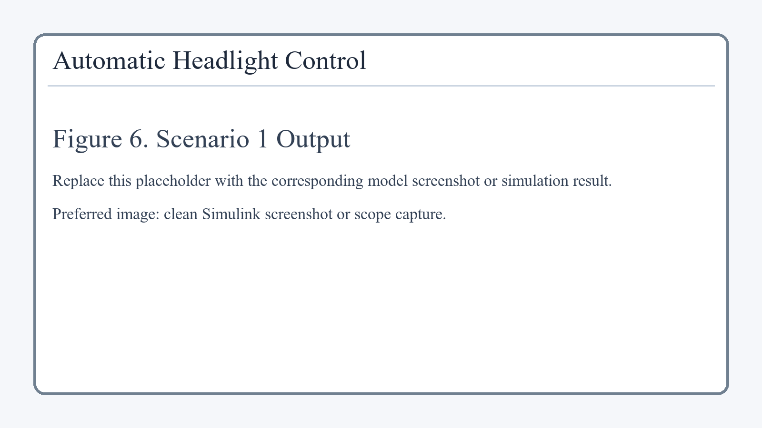


Simulation Results
06
Scenario 1 Output
Scenario 2 Output
Scenario 3 Output
Scenario 4 Output
Scenario 1
Scenario 2
Scenario 3
Scenario 4
Day + Moving -> output remains 0 because brightness is high.
Night + Moving -> output remains 1 because the environment is dark.
Tunnel Entry -> output changes 0 -> 1 -> 0 as lux drops and recovers.
Night + Stopped -> HOLD state keeps output at 1.
Observation
The results confirm correct hysteresis-based signal conditioning and correct state transitions across all four scenarios.
Automatic Headlight Control System | Simulink + Stateflow

Slide 8
Conclusion
07
The model uses a clean modular structure: Input -> Logic -> Stateflow -> Output.
Hysteresis with 300 lux and 500 lux thresholds prevents rapid switching near the decision boundary.
Stateflow clearly represents OFF, ON, HOLD, and MANUAL operating modes.
The model is validated for day, night, tunnel, and stopped-at-night conditions.
Manual override provides direct driver priority over automatic behavior.
Final Line for Viva
This model senses, decides, controls, and verifies automatic headlight behavior using Simulink and Stateflow.
Replace Before Submission
Swap placeholders with final Simulink screenshots and scope captures.
Submitted By
[Your Name] | [Your PRN]
Automatic Headlight Control System | Simulink + Stateflow

