Slide 1

BDAT 1004 – Data Programming
FINAL PROJECT

Slide 2
Meet the team (Group 1)
Palash Pinakin Patel
Developer
Abeesh Thampi Krishnapillai Janardhananpillai
Project Manager
Shivraj Suryakant Dhumal
Business Analyst
Hardik Singh
Data Analyst
Shaun George Dcunha
Data Analyst

Slide 3

Agenda
Project description
Data retrieval and storage
Data retrieval script execution
MongoDB Database Class File
Data Analysis Jupyter Notebook
Data Visualization to answer client questions

Slide 4
Project description
Given the Youtube and Spotify Dataset stored on a remote location in a CSV file, XYZ Corporation would like to know the top 5 artists with Most Views, Likes and Comments at any given point of time.
The client would also like to know what parameters are highly correlated with each other.
The remote CSV file can be updated to reflect the latest data by a third-party system.
To comply with the client requirements, we have developed the project with the following processes:
A python script to fetch data from a CSV file from a remote server and store the latest data into the MongoDB database
The script is set to run at regular intervals to be able to store the latest data so any changes in the remote CSV file will be reflected in the database
Jupyter notebook can then be executed on demand to read and analyze the data from the MongoDB database and generate visualizations to answer the client’s questions.

Slide 5
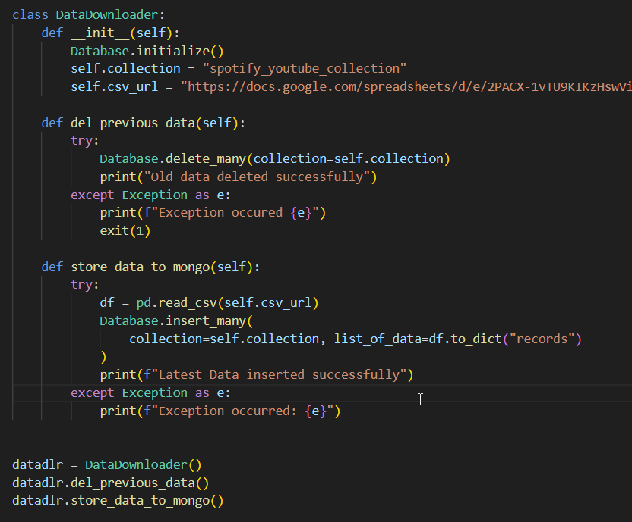
Data retrieval and storage
A python script named ‘download.py’ which can be scheduled to run at specific intervals.
The script reads data from the remote CSV, deletes the existing data from the MongoDB collection and inserts latest data in the collection

Slide 6
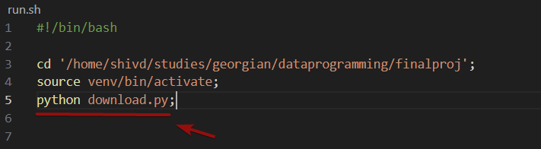
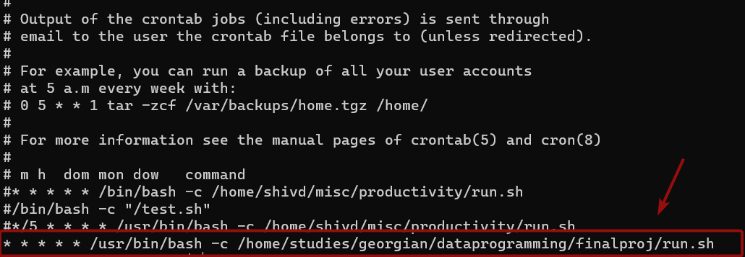
Data retrieval script execution
The ‘download.py’ script is executed through the ‘run.sh’ bash shell script at every 1 minute in the crontab.
The frequency of the execution can be changed depending on the client’s need.

Slide 7
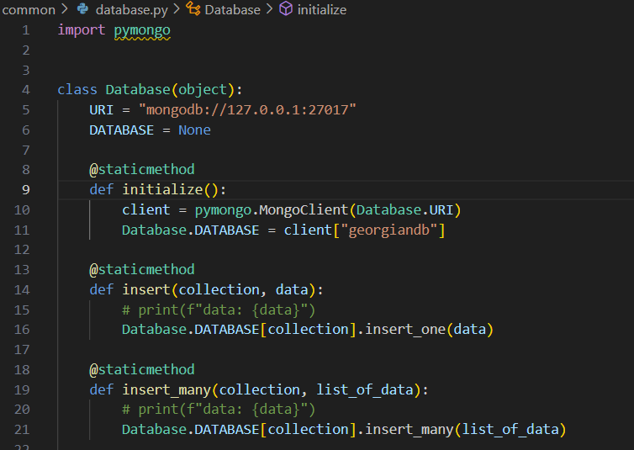
MONGODB DATABASE CLASS FILE
The database.py class file contains all the methods for reusing the MongoDB database CRUD operations
The URI string in the class file can be updated depending on the database connection details.
In the given example, the connection is on the localhost at port 27017.
The database initialize method will need to be called before performing the CRUD operations on the MongoDB collection

Slide 8
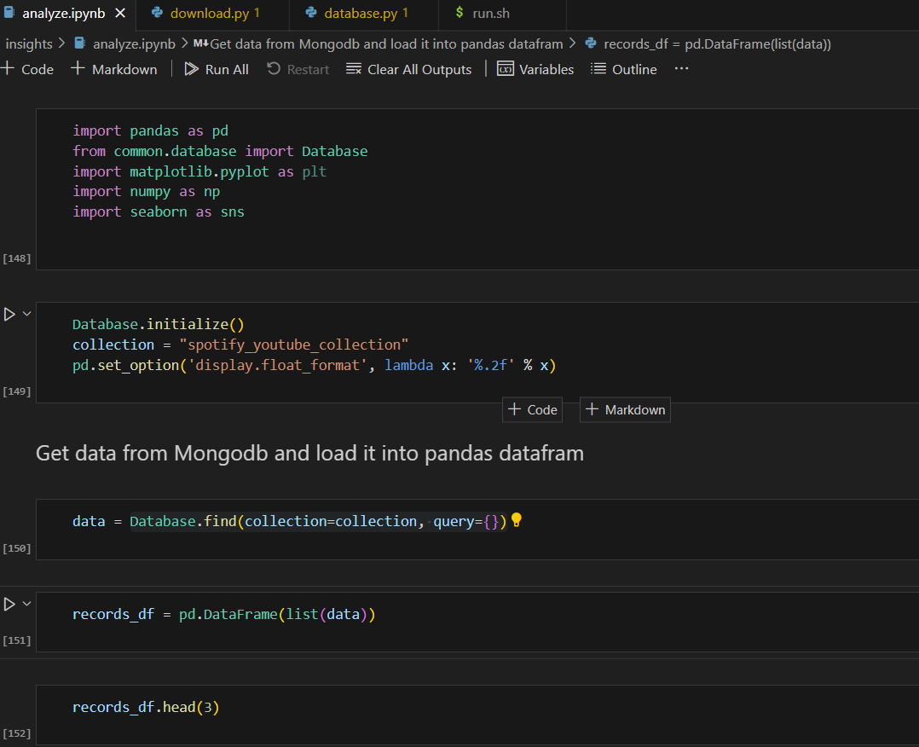
Data analysis jupyter notebook
The analyze.ipynb jupyter notebook file can be executed on demand.
The notebook retrieves data from the mongodb database, and creates visualizations to answer the client’s answers.

Slide 9

Answering the client’s questions

Slide 10
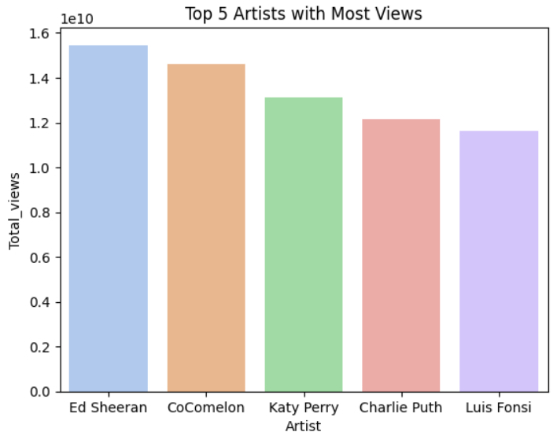
Top 5 artists with most Views

Slide 11
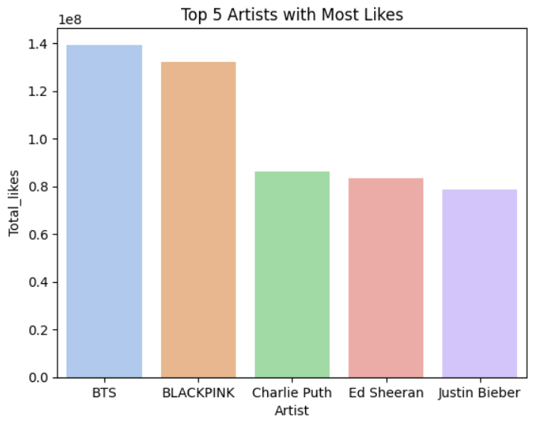
Top 5 artists with most Likes

Slide 12
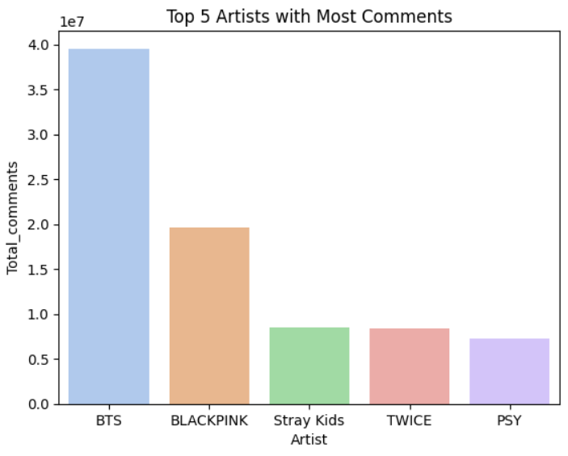
Top 5 artists with most COMMENTS

Slide 13
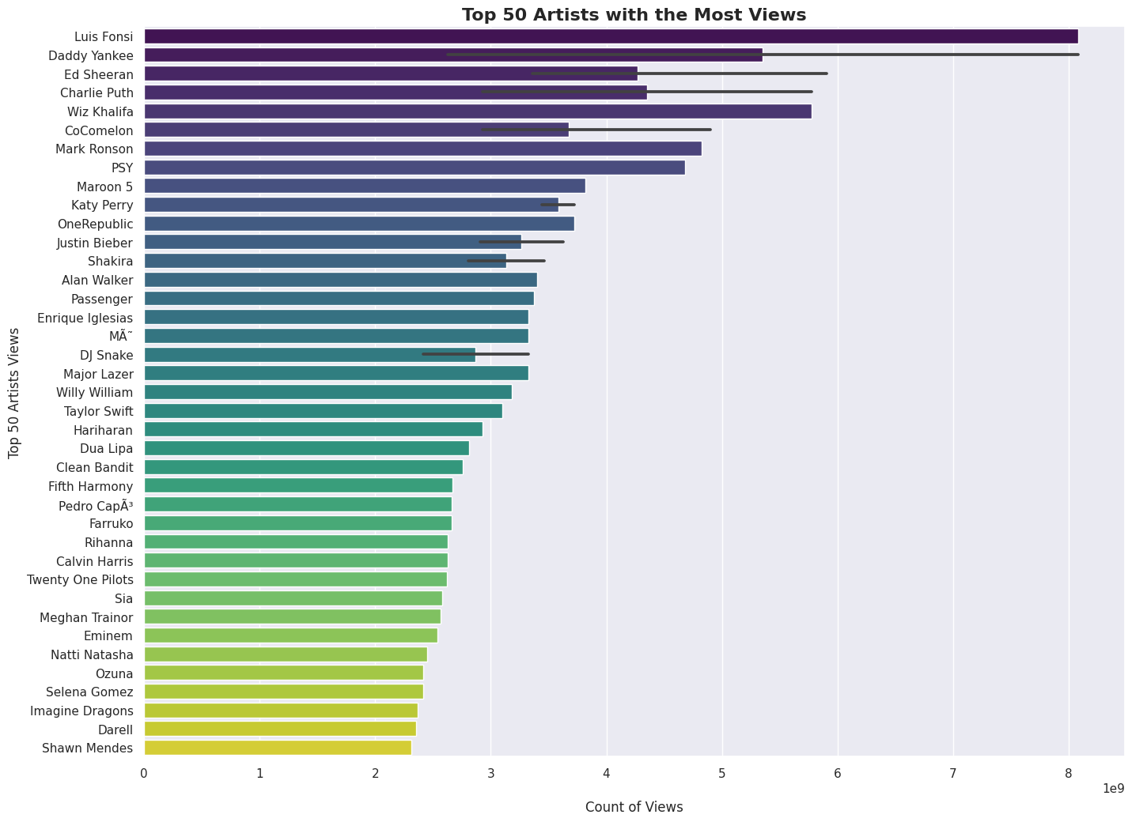
Top 5 artists with most Views

Slide 14
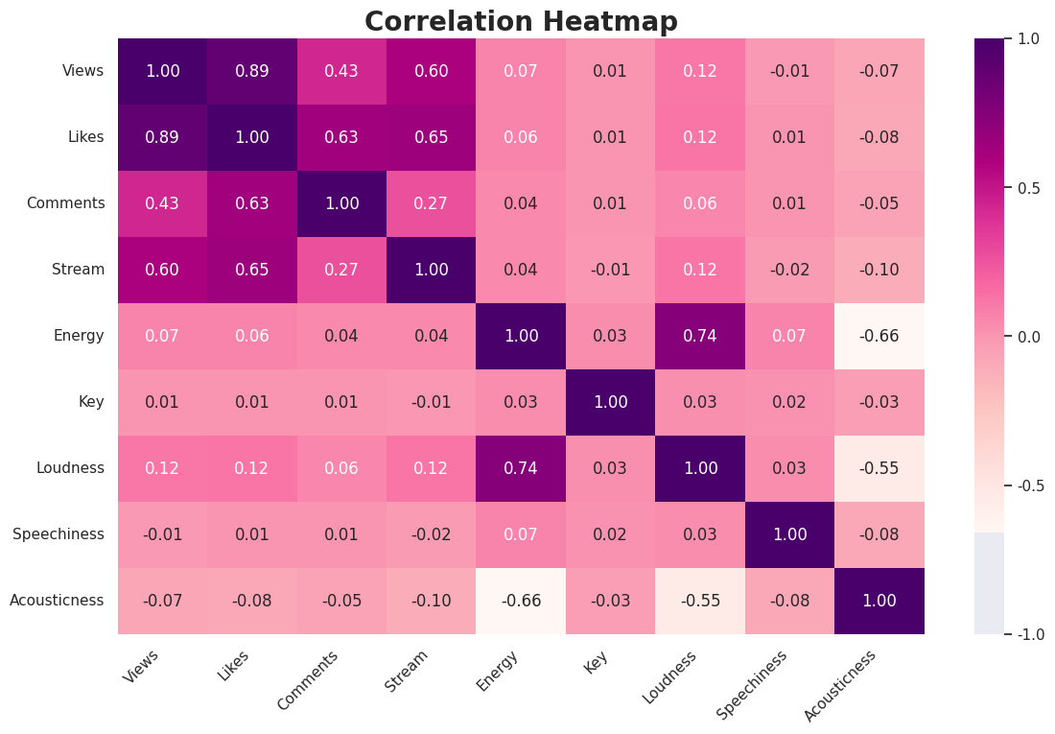
Heatmap showing correlation between various parameters

Slide 15

SUMMARY
From our analysis we can see that:
BTS band is in the top 5 artists in both the lists: most likes and comments
From the correlation matrix we can see that the Likes and Views parameters are highly correlated

Slide 16
THANK YOU

