Slide 1
EMPLOYEE SALARY PREDICTION USING MACHINE LEARNING ALGORITHMS
CAPSTONE PROJECT
Presented By:
Student Name- PALASH PATRA
College Name- INTERNATIONAL INSTITUTE OF PROFESSIONAL STUDIES(IIPS),DAVV,INDORE
Department- INFORMATION TECHNOLOGY
AICTE INTERNSHIP STUDENT REGISTRATION ID : STU68341e1c9af751748246044

Slide 2
OUTLINE
Problem Statement
System Development Approach
Algorithm & Deployment (Step by Step Procedure)
Result
Conclusion
Future Scope
References

Slide 3
Problem Statement
Predicting fair salaries to ensure equitable compensation and boost employee satisfaction across the company.
Identifying underpaid employees to proactively reduce turnover and retain our top talent.
Forecasting salary needs for new hires to make competitive offers that attract the best candidates.
Understanding how investing in skills training impacts our employees' future earning potential and overall company value

Slide 4
System Approach
The Challenge: Strategic Compensation & Talent Management Problem Predicting fair salaries to ensure equitable compensation and boost employee satisfaction across the company, while also identifying underpaid employees to proactively reduce turnover and retain our top talent.
Company Goals: Optimize salary offers for new hires to attract the best candidates. Understand how investing in skills training impacts our employees' future earning potential and overall company value.
Create a tool to accurately predict and plan for future workforce salary costs, optimizing our budget allocation.

Slide 5
System Approach
Our Solution: A Systematic Approach to Salary Prediction
Phase 1: Data Foundation Gather comprehensive internal (e.g., historical salaries, performance, demographics) and external (e.g., market benchmarks) data. Crucial step: Data cleaning, feature engineering, and proactive bias audit to ensure fairness. Transform data (e.g., Label Encoding for categories) to prepare for modelling.
Phase 2: Model Development Explore and select robust machine learning algorithms Train and fine-tune models to achieve high accuracy and reliable predictions. Integrate bias mitigation techniques directly into the modeling process.
Phase 3: Deployment & Continuous Improvement. Deploy the best-performing model (e.g., via a user-friendly Streamlet application).Seamless integration with existing HR/Compensation systems. Ongoing monitoring for performance drift, regular retraining with new data, and continuous ethical review to maintain fairness and accuracy.

Slide 6
System Approach
Key Libraries Used:
Data Manipulation & Analysis : pandas, numpy
Data Visualization: matplotlib.pyplot, seaborn
Machine Learning (Scikit-learn): LabelEncoder (for categorical encoding) StandardScaler (for numerical scaling), train_test_split (for data partitioning) accuracy_score, classification_report (for model evaluation) LogisticRegression, RandomForestClassifier, KNeighborsClassifierSVC (Support Vector Classifier) Pipeline (for streamlining preprocessing and modeling)
Model Persistence: joblib (for saving/loading models)
Web Application Framework: streamlit

Slide 7
Algorithm & Deployment
1.Data Preparation Pipeline:
Fueling Accurate Predictions Initial Data Assessment & Cleaning
Used pandas to load and inspect raw employee data.
Identified and handled missing values (e.g., '?' in work class, occupation) through replacement or removal.
Outlier Detection (using Box Plots):Visualized distributions of numerical features like age, capital-gain, educational-num, and hours-per-week using matplotlib.pyplot box plots.
Box plots helped us identify extreme values (outliers) that could skew model training. For instance, we observed and handled outliers in age (e.g., restricting to 17-75) and educational-num (e.g., restricting to 5-16) to ensure a more robust dataset.

Slide 8
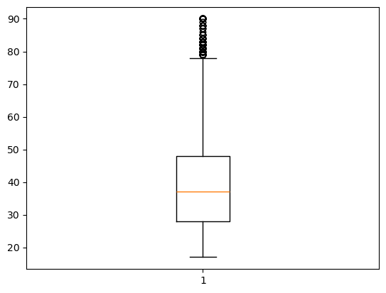
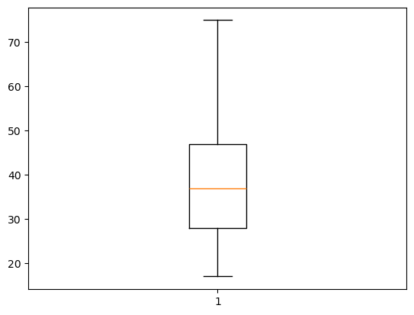
BOX PLOT FOR AGE FIELD
BOX PLOT BEFORE REMOVAL OF OUTLIERS
BOX PLOT AFTER REMOVAL OF OUTLIERS

Slide 9
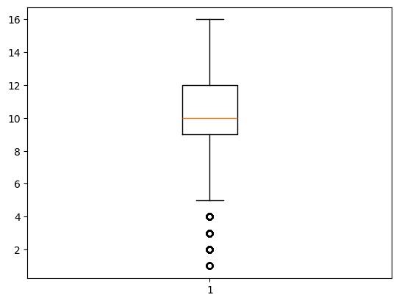
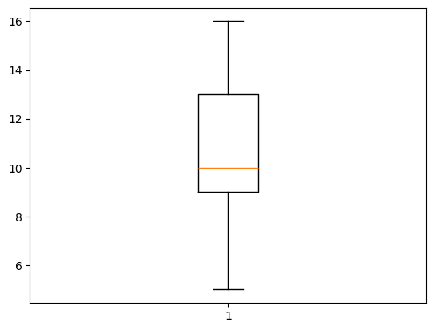
BOX PLOT FOR EDUCATION FIELD
BOX PLOT BEFORE REMOVAL OF OUTLIERS
BOX PLOT AFTER REMOVAL OF OUTLIERS

Slide 10
Algorithm & Deployment
2.Feature Engineering & Selection
Removed redundant features (e.g., 'education' as 'educational-num' was more granular).Retained key features like age, work class, fnlwgt, educational-num, marital-status, occupation, relationship, race, gender, capital-gain, capital-loss, hours-per-week, native-country.
Data Transformation (scikit-learn):Categorical Encoding: Applied LabelEncoder to convert string-based categorical features (e.g., work class, gender) into numerical representations. Numerical Scaling: Utilized StandardScaler to normalize numerical features, integrated into a Pipeline for consistent preprocessing.

Slide 11
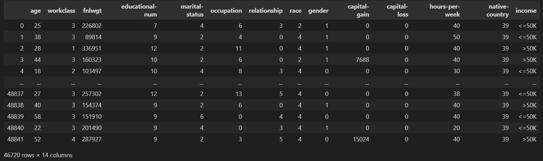
DATSET AFTER PREPROCESSING AND FEATURE SELECTION

Slide 12
Algorithm & Deployment
3.Machine Learning Algorithms:
Logistic Regression: A foundational linear model for binary classification.
Random Forest Classifier: An ensemble method using multiple decision trees for robustness.
K-Nearest Neighbors (KNN): Classifies based on the majority class of its 'k' nearest neighbors.
Data was split into Training and Testing part using train_test_split to evaluate generalization performance.

Slide 13
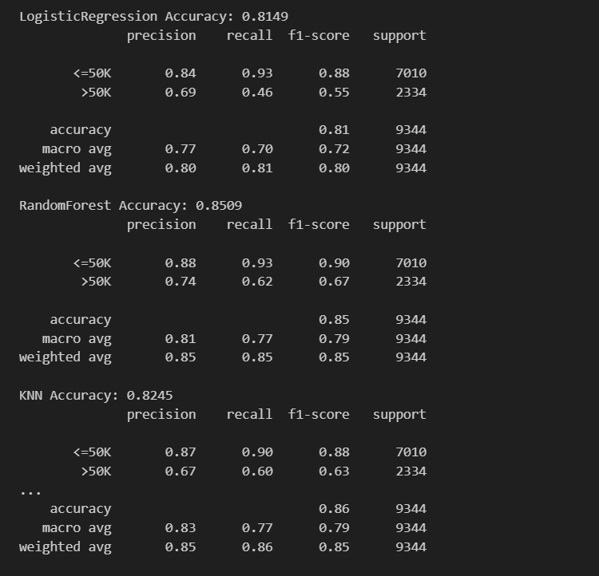
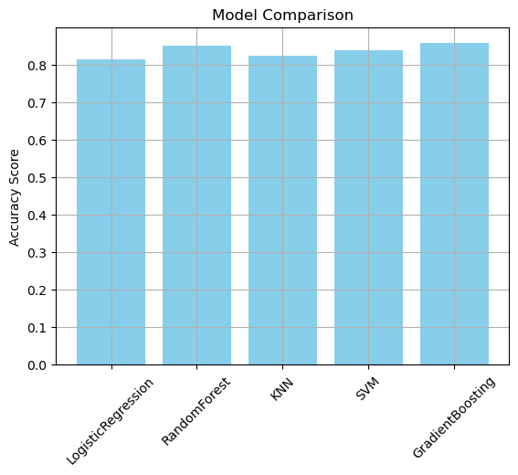
ACCURACY OF MACHINE LEARNING ALGORITHMS

Slide 14
Algorithm & Deployment
4.Model Deployment:
Step 1: Model Persistence (joblib):The entire machine learning pipeline (including StandardScaler and GradientBoostingClassifier) is saved to best_model.pkl using joblib. This ensures the exact state of the trained model and its preprocessing steps can be loaded efficiently.
Step 2: Web Application Development (streamlit):A user-friendly web interface (app.py) is developed using streamlit, a Python library for creating interactive web apps.The app.py loads the best_model.pkl file, making the trained model immediately available for predictions.
Step 3: Real-time Prediction Interface:The Streamlit app provides interactive input widgets (sliders, select boxes) for users (e.g., HR personnel) to enter individual employee details.

Slide 15
Algorithm & Deployment
4.Model Deployment:
Step 1: Model Persistence (joblib):The entire machine learning pipeline (including StandardScaler and GradientBoostingClassifier) is saved to best_model.pkl using joblib. This ensures the exact state of the trained model and its preprocessing steps can be loaded efficiently.
Step 2: Web Application Development (streamlit):A user-friendly web interface (app.py) is developed using streamlit, a Python library for creating interactive web apps.The app.py loads the best_model.pkl file, making the trained model immediately available for predictions.
Step 3: Real-time Prediction Interface:The Streamlit app provides interactive input widgets (sliders, select boxes) for users (e.g., HR personnel) to enter individual employee details.

Slide 16
RESULTS
Model Performance Achieved:
Best Model: Gradient Boosting Classifier Accuracy: 0.8571Demonstrated robust predictive capability across diverse employee profiles.
Key Insights from Data Analysis: Identified and addressed outliers in crucial numerical features like age and educational attainment, leading to a cleaner, more reliable dataset. Successfully transformed various categorical attributes into a format suitable for machine learning, preserving their predictive power.
Enhanced Fairness: Provides a data-driven basis for equitable salary decisions, working towards reducing pay gaps.
Improved Talent Strategy: Supports proactive identification of underpaid high-performers for retention and facilitates competitive new-hire offers.
Optimized Resource Allocation: Enables more accurate forecasting of future salary costs for better budget planning.
Operational Efficiency: The Streamlit application streamlines the prediction process, making it accessible and efficient for HR and management.

Slide 17
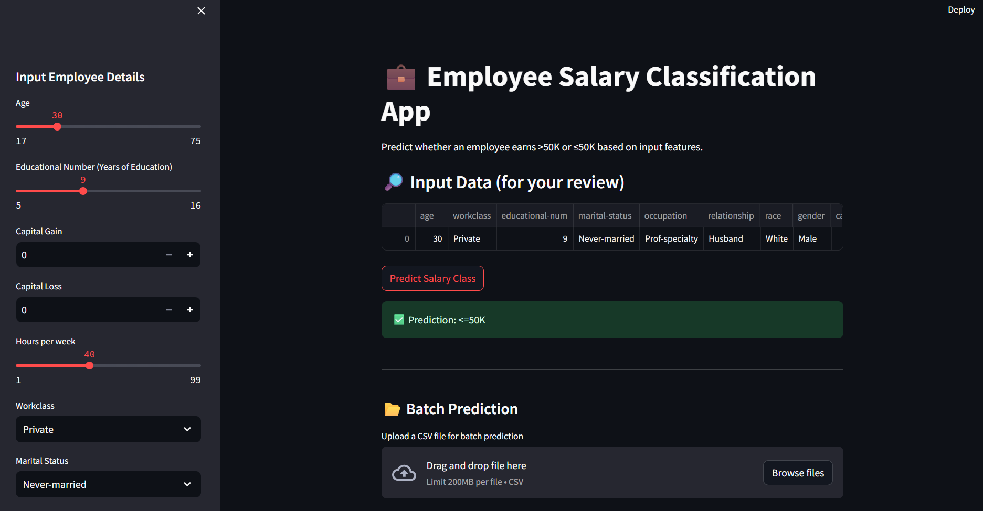
ResultS

Slide 18
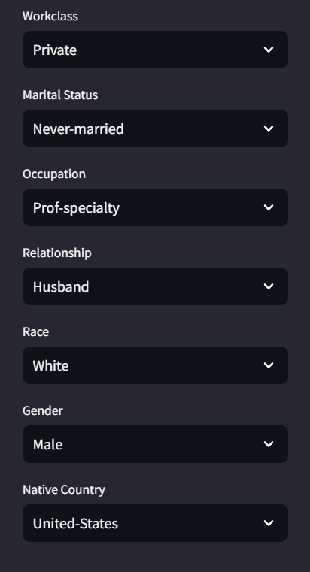
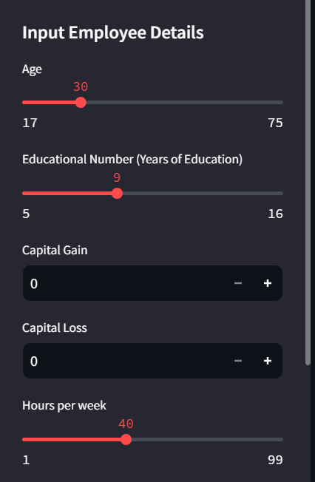
IMPLEMENTED ALL THE FEATUERS FOR PREDICTION

Slide 19
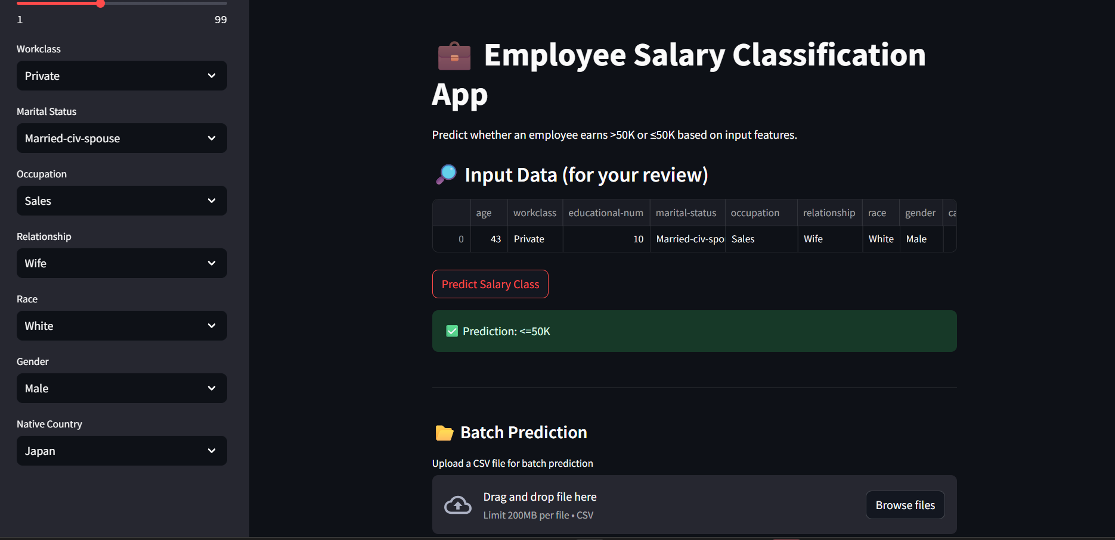
Result FOR ANOTHER PREDICTION

Slide 20
Conclusion
Driving Data-Led Compensation Excellence
Fair & Strategic Pay: System predicts equitable salaries, boosting satisfaction and aiding talent management.
Actionable Benefits: Identifies underpaid talent, optimizes offers, forecasts costs for clear gains.
Continuous Improvement: Designed for ongoing monitoring, retraining, and ethical review.
HR Innovation: A foundation for proactive, intelligent HR and strategic workforce planning.
Ready for Impact: Empowers smarter, data-informed compensation decisions for company and employees.

Slide 21
Future scope
Better Performance Linking: Connect salary predictions directly to how well an employee performs.
Preventing People Leaving: Predict if someone might leave because of pay and suggest how to keep them.
Pay for Skills: Figure out how much new skills (like learning a new software) should increase someone's salary.
Real-time Market Check: Use live market data to keep salaries competitive and fair.
"What If" Scenarios: Let HR test different pay plans to see how they affect the budget.
Clearer Explanations: Make the model explain why it suggests a certain salary, so everyone understands.
Automatic Warnings: Get alerts if salaries start looking unfair for some groups.

Slide 22
References
Academic Papers & Related Work:
Nalawade, V.D., Tingare, S.M., Lokare, R.R., Jadhav, P.D., Salunkhe, M.Y., & Thombare, A.R. (2025). PREDICTING EMPLOYEE SALARIES USING MACHINE LEARNING: A DATA-DRIVEN APPROACH. International Research Journal of Modernization in Engineering Technology and Science, 07(02).
IEEE Xplore Document (ID: 9943146).

Slide 23
THANK YOU

