Slide 1

Insurance Charge Analysis
Key factors influencing medical insurance charges
Paul O. Bankole
Junior Data Analyst
Aim: identify which customer factors drive insurance charges, to guide pricing and customer advice.
Notes:
Introduce yourself and the aim: find out which customer factors drive medical insurance charges, so the company can price policies and advise customers better.
1

Slide 2
Dataset overview
1,338
7
0
customer records
columns: 6 features + charges
missing values
age age of the insured person (18–64)
sex female / male
bmi Body Mass Index (weight relative to height)
children number of dependants covered (0–5)
smoker yes / no
region northeast, northwest, southeast, southwest
charges medical insurance cost billed (the target)
Business question: which factors influence charges the most, so pricing and customer advice can be based on evidence?
2
Notes:
2

Slide 3

Data preparation
Notes:
3

Slide 4
Analysis approach
1
Inspect
Loaded the CSV with Pandas; used .head(), .info(), .shape, .describe()
2
Clean
Checked missing values and duplicates; fixed data types
3
Explore
Average, median, min and max charges; groupby by smoker, sex, region, children
4
Transform
Created bmi_category and age_group with pd.cut()
5
Matplotlib
Bar (region), line (age) and pie (smokers) charts
6
Seaborn
Histogram, boxplot, scatter plot and correlation heatmap
7
Insights
Summarised the main drivers and turned them into recommendations
6
Notes:
6

Slide 5
Data cleaning: results
0
1
missing values in any column, so no imputation needed
exact duplicate row found and removed
1,337
3
clean rows used for the analysis
text columns (sex, smoker, region) converted to category
The duplicate: a 19-year-old male non-smoker in the northwest (BMI 30.59, $1,639.56) appeared twice. Numeric columns were already the correct types.
4
Notes:
4

Slide 6
New columns created
bmi_category
age_group
Category | BMI | Count | Avg charge
Underweight | < 18.5 | 20 | $8,852
Normal | 18.5–24.9 | 225 | $10,409
Overweight | 25–29.9 | 386 | $10,988
Obese | 30+ | 706 | $15,572
Group | Ages | Count | Avg charge
Young | 18–34 | 548 | $9,688
Middle-aged | 35–49 | 404 | $13,744
Senior | 50–64 | 385 | $17,903
Why these cut-offs: BMI uses the standard WHO bands. Age groups split the 18–64 range into three similar-sized groups, so each average is based on enough customers.
What they show: over half of customers (53%) are obese, and the average charge nearly doubles from the youngest to the oldest group.
5
Notes:
5

Slide 7
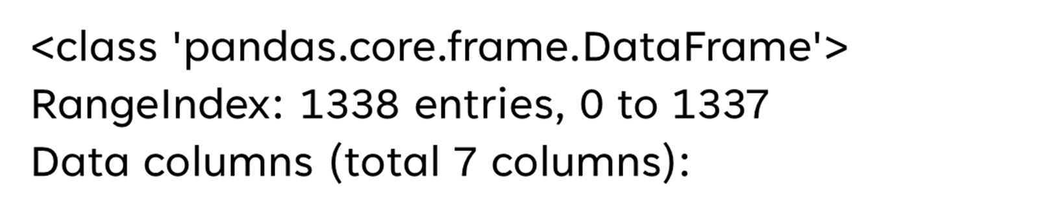
View the first 5 rows
 | age | sex | bmi | children | smoker | region | charges
0 | 19 | female | 27.900 | 0 | yes | southwest | 16884.92400
1 | 18 | male | 33.770 | 1 | no | southeast | 1725.55230
2 | 28 | male | 33.000 | 3 | no | southeast | 4449.46200
3 | 33 | male | 22.705 | 0 | no | northwest | 21984.47061
4 | 32 | male | 28.880 | 0 | no | northwest | 3866.85520
Each row is one customer: three numeric features (age, bmi, children), three categorical features (sex, smoker, region) and the target, charges.
7
Notes:
7

Slide 8
Check data types and non-null counts
# | Column | Non-Null | Count | Dtype
0 | age | 1338 | non-null | int64
1 | sex | 1338 | non-null | object
2 | bmi | 1338 | non-null | float64
3 | children | 1338 | non-null | int64
4 | smoker | 1338 | non-null | object
5 | region | 1338 | non-null | object
6 | charges | 1338 | non-null | float64
What this tells us
1,338 rows × 7 columns, all fully populated.
4 numeric columns (int64 / float64) and 3 text columns (object).
Fix applied: sex, smoker and region converted to category type after cleaning.
Notes:
8

Slide 9
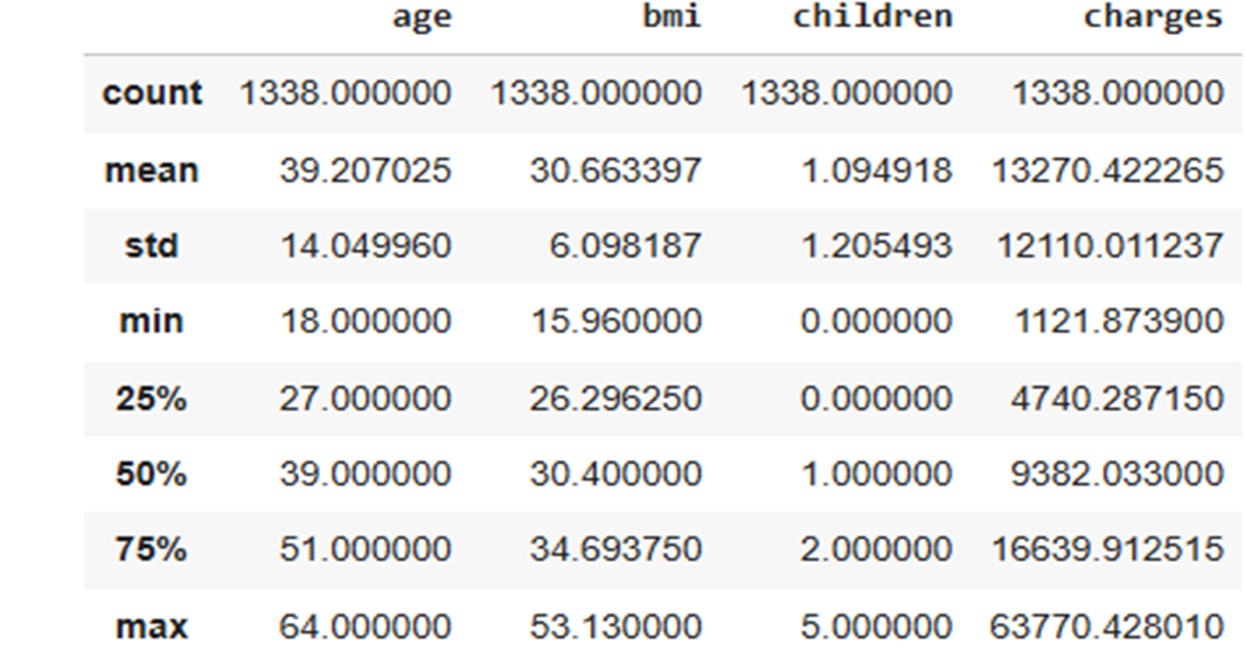
View summary statistics
Key point: charges are right-skewed. The mean ($13,270) is well above the median ($9,382), because a minority of very high bills pulls the average up.
Notes:
9

Slide 10
Charges at a glance
$13,279
$9,386
$63,770
average charge
median (typical) charge
highest charge (lowest: $1,122)
1,063
274
3.8×
non-smokers (79.5%)
smokers (20.5%)
smokers’ average charge vs non-smokers’
Smokers average $32,050 against $8,441 for non-smokers. They make up a fifth of customers but account for 49% of all charges.
10

Slide 11
Charges by gender and region
Gender | Customers | Avg charge | % smokers
Male | 675 | $13,975 | 23.6%
Female | 662 | $12,570 | 17.4%
Region | Customers | Avg charge | % smokers
Southeast | 364 | $14,735 | 25.0%
Northeast | 324 | $13,406 | 20.7%
Northwest | 324 | $12,451 | 17.9%
Southwest | 325 | $12,347 | 17.8%
Takeaway: men and the Southeast pay more on average, but they also have the most smokers. Smoking, rather than gender or region, is the likely reason for the gap.
11

Slide 12
Charges by number of children
Children | Customers | Avg charge | % smokers
0 | 573 | $12,385 | 20.1%
1 | 324 | $12,731 | 18.8%
2 | 240 | $15,074 | 22.9%
3 | 157 | $15,355 | 24.8%
4 | 25 | $13,851 | 12.0%
5 | 18 | $8,786 | 5.6%
Takeaway: there is no clear pattern (correlation r = 0.07). The low averages for 4–5 children are based on only 25 and 18 customers, who are also mostly non-smokers, so they are not reliable.
12

Slide 13
visualizations
Notes:
13

Slide 14
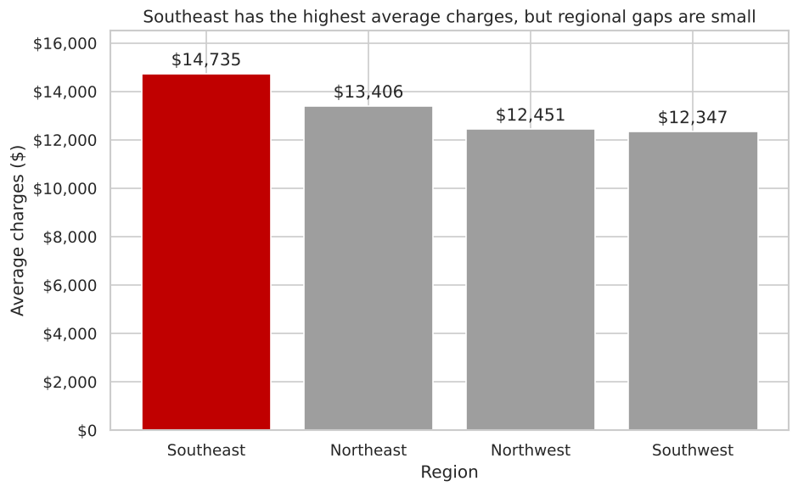
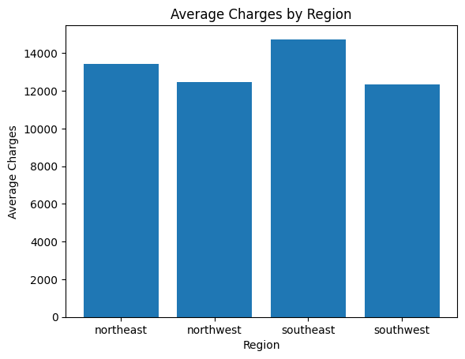
Region has little effect on charges
$2,388
gap between the highest and lowest region
The Southeast averages $14,735; the other regions sit between $12,300 and $13,400.
The Southeast also has the most smokers (25%) and the highest average BMI (33.4).
Matplotlib · bar chart
14
Notes:
Bars are sorted from highest to lowest. The regional gap is small compared with the smoking gap, and the Southeast has more smokers and higher BMI, which likely explains its higher average.

Slide 15
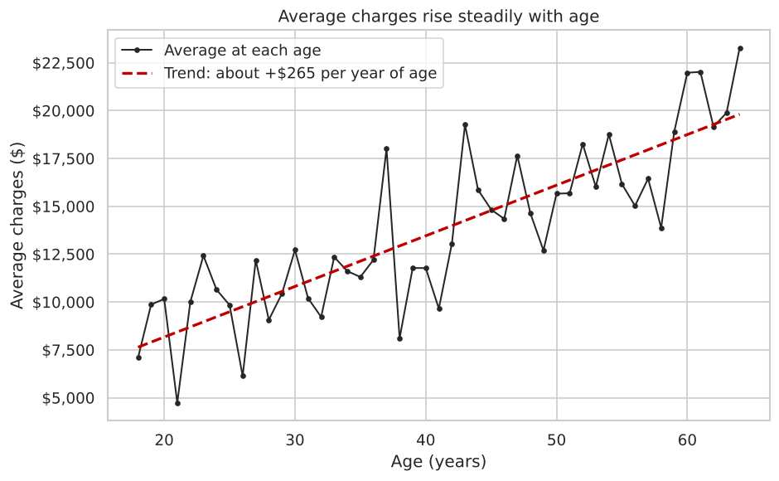
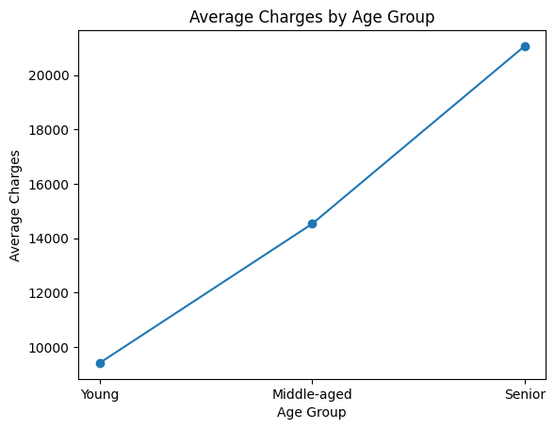
Charges rise steadily with age
+$265
average increase per year of age
The average charge climbs from about $7,100 at 18 to $23,300 at 64.
The zig-zags come from how many smokers there are at each age.
Matplotlib · line chart
15
Notes:
This line shows the average charge at every age from 18 to 64, with a straight-line trend in red. Older customers cost more because health problems become more common with age.

Slide 16
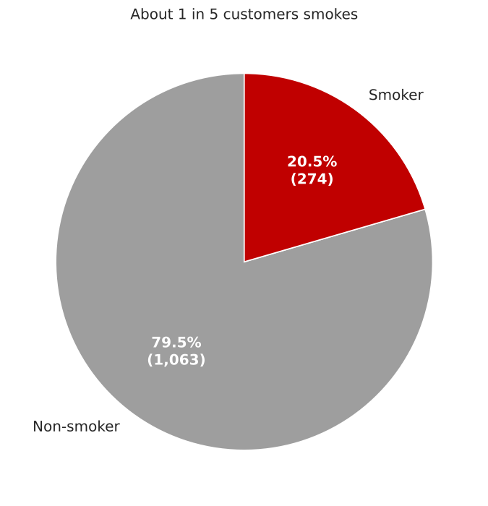
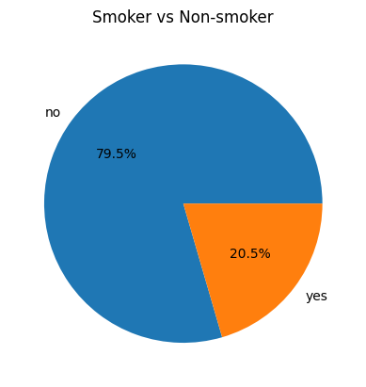
About 1 in 5 customers smokes
49%
of all charges come from smokers
Smokers are only 20.5% of customers (274 of 1,337), yet they generate almost half of the total amount billed.
Matplotlib · pie chart
16
Notes:
The pie shows the share of customers. The key point is the contrast: a fifth of customers account for roughly half of all charges.

Slide 17
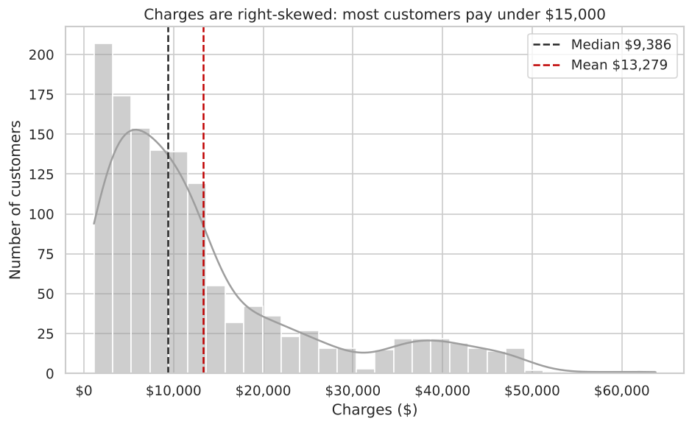
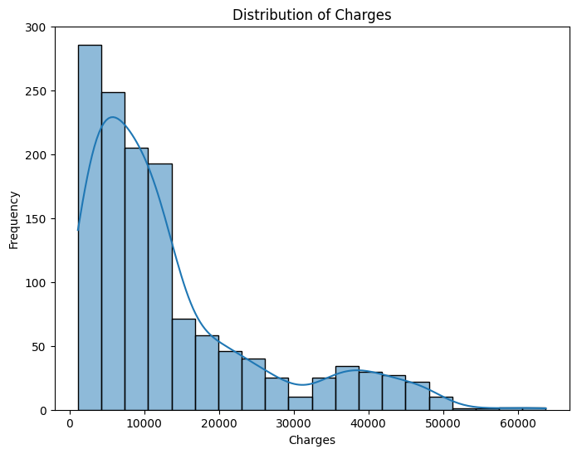
Most customers pay under $15,000
73%
of customers are billed under $15,000
Charges are right-skewed: a long tail of high bills, mostly from smokers, pulls the mean ($13,279) above the median ($9,386).
So the median is the fairer “typical” charge.
Seaborn · histogram
17
Notes:
Most customers sit on the left of the chart. The second bump around $35,000–$45,000 is mainly smokers.

Slide 18
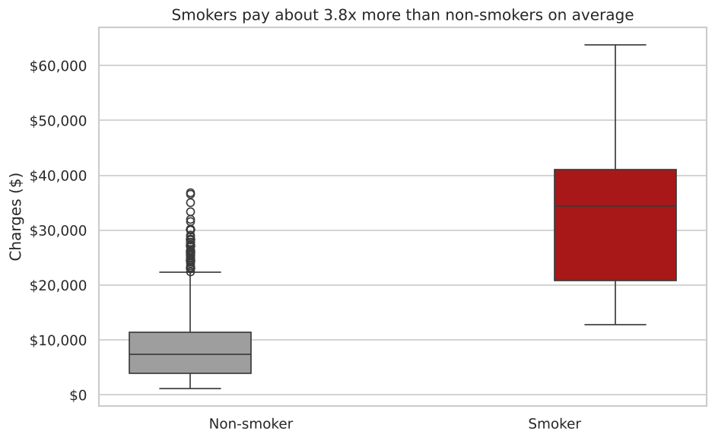
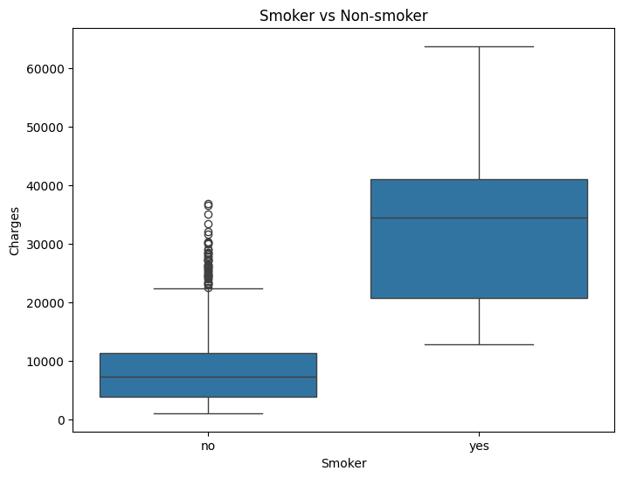
Smokers pay 3.8× more
3.8×
higher average charge for smokers
$32,050 vs $8,441 on average.
Three-quarters of smokers pay over $20,800, while three-quarters of non-smokers pay under $11,400.
Seaborn · boxplot
18
Notes:
The two boxes barely overlap, so smoking separates high-cost and low-cost customers more clearly than any other factor.

Slide 19
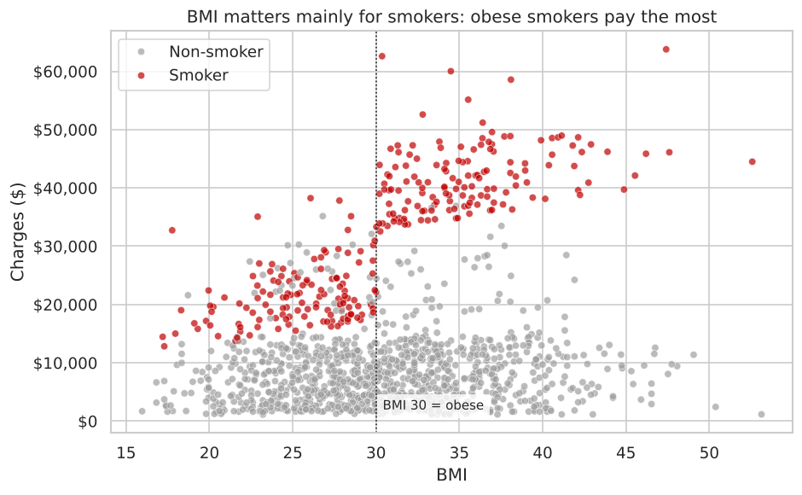
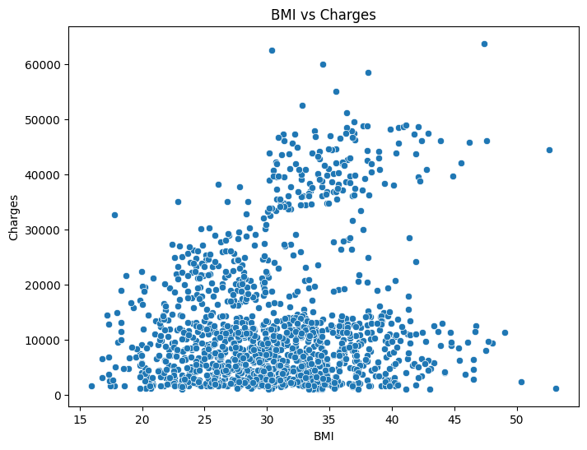
BMI raises costs mainly for smokers
$41,558
average for smokers with BMI 30+
Nearly double the average for smokers below BMI 30 ($21,363).
For non-smokers BMI makes little difference ($7,977 vs $8,856).
Seaborn · scatter plot
19
Notes:
Colouring the points by smoking status reveals two groups among smokers, split at BMI 30. Smoking and obesity together produce the highest charges.

Slide 20
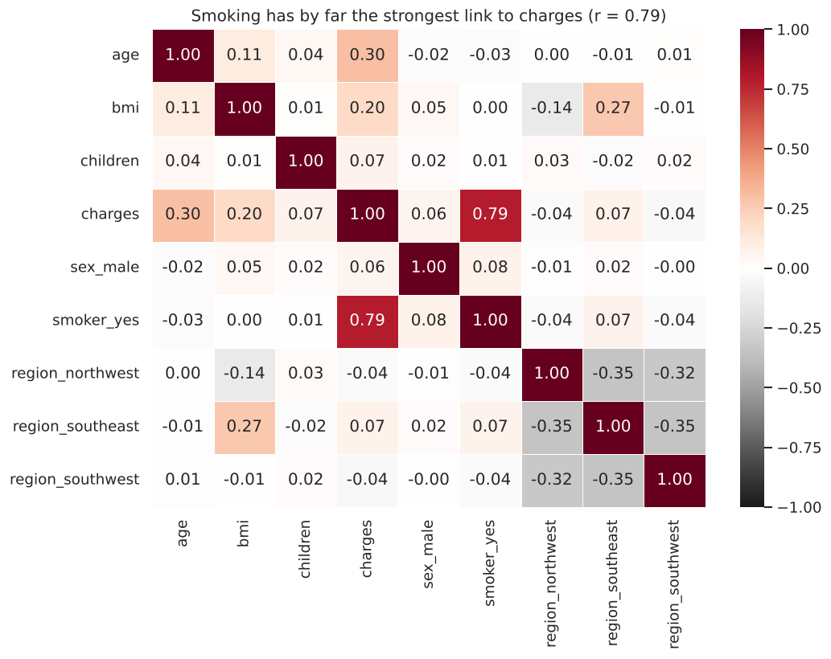
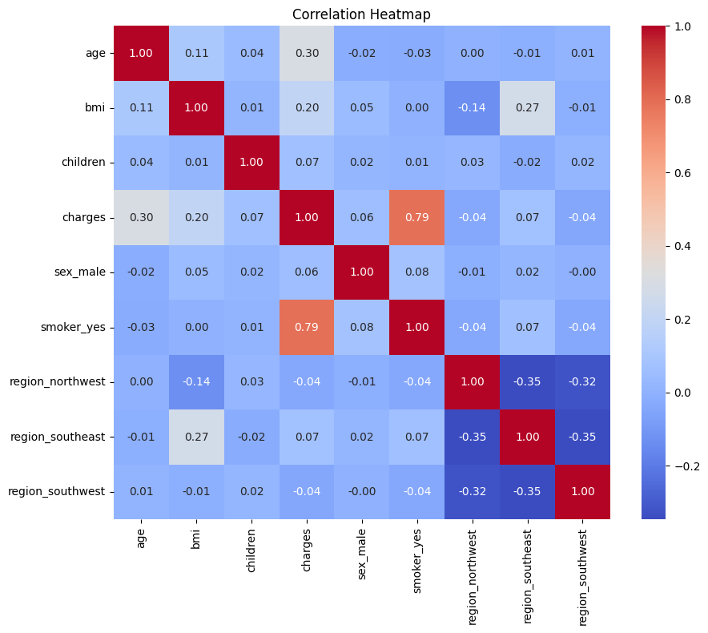
Smoking dominates the correlations
r = 0.79
correlation between smoking and charges
Age 0.30 BMI 0.20
Children 0.07 Sex 0.06
Region all below 0.07
Correlation shows a link, not proof of cause.
Seaborn · correlation heatmap
20
Notes:
Read the charges row: smoking is by far the strongest, followed by age and BMI. Sex, children and region have almost no linear relationship with charges.

Slide 21
Key insights
Smokers vs non-smokers
BMI effect
3.8×
$41.6k
Smokers average $32,050 vs $8,441, the largest gap in the data.
Obese smokers pay the most; BMI barely matters for non-smokers.
Age impact
Regional differences
+$265/yr
≤ $2.4k
Average charges rise from $9.7k (18–34) to $17.9k (50–64).
Small gaps that are largely explained by smoking and BMI.
21
Notes:
21

Slide 22
Business recommendations
Price mainly on smoking status, and verify it
1
Smoking is the strongest driver (r = 0.79, 3.8× higher charges). Confirm declarations with a medical questionnaire or test to prevent under-reporting.
Target support at smokers with BMI 30+
2
This group averages $41.6k a year. Stop-smoking and weight-management programmes aimed at them could reduce claims far more than programmes aimed at everyone.
Use age bands; avoid pricing on region or gender
3
Age adds about $265 a year, a steady and predictable effect. Region and gender gaps are small and largely explained by smoking and BMI.
23
Notes:
23

Slide 23

Closing & Reflection
Recap: cleaned 1,337 records, explored them with Pandas, built 7 charts and identified three main drivers.
Reflection: the three strongest drivers
1
Smoking status (r = 0.79)
Smokers pay 3.8× more; smoking causes costly chronic disease.
2
Age (r = 0.30)
Charges rise about $265 a year as health problems become more common.
3
BMI (r = 0.20)
Linked to diabetes and heart disease; strongest when combined with smoking.
Sex, region and number of children have only weak links (|r| < 0.07).
24
Notes:
24

Slide 24
THANK YOU
25
Notes:
25

