Slide 2

WannaCry: The Ransomware Worm That Shook the World
Cyber Security — Assignment 3 | Group 27 | Section C
IIB2024028-Chauhan Palchhin Kamleshkumar

Slide 3
WannaCry at a Glance
Type: Ransomware + worm-like propagation
Platform: Microsoft Windows
Exploited: SMBv1 vulnerabilities
Exploit used for spreading: EternalBlue
📅 12 May 2017
🌍 150+ Countries
Major global outbreak begins
Affected worldwide
WannaCry combined ransomware with worm-like network propagation, making it particularly dangerous.
🪱 Worm + Ransomware
Dual-threat propagation

Slide 4


Why Was WannaCry So Dangerous?
The Worm Difference
Traditional ransomware requires a user to make a mistake — clicking a link, opening an attachment. WannaCry changed the equation entirely.
WannaCry could exploit vulnerable Windows systems through SMB and propagate across networks automatically. Instead of one compromised computer remaining isolated, infection could move from machine to machine without any further human interaction.
Traditional Ransomware
Propagation Effect
WannaCry (Worm)
User click → Infection → Encryption → Ransom
Vulnerable system → Exploit → Infection → Automatic spread
Infects more systems → Rapid network-wide encryption
No user interaction required — a single vulnerable machine on a network was enough.

Slide 5
The Timeline
14 March 2017
1
Microsoft releases MS17-010 — the patch addressing SMB vulnerabilities
2
14 April 2017
EternalBlue publicly released by Shadow Brokers
12 May 2017
3
WannaCry outbreak begins — global spread and disruption
4
12–13 May 2017
Kill-switch domain registered — spread of original variant dramatically reduced
Microsoft had released a security update addressing the relevant SMB vulnerabilities on March 14, 2017. The WannaCry outbreak occurred almost two months later — a critical lesson in patch management.

Slide 6
What Vulnerability Did WannaCry Exploit?
The Vulnerability
A vulnerable computer running SMBv1 could receive specially crafted network traffic that caused code to execute on the target system — with no authentication required.
Vulnerability Class: Software / Operating System Vulnerability
Specifically: Windows SMBv1 Remote Code Execution vulnerabilities
Microsoft Security Bulletin: MS17-010
Protocol: SMBv1
Attack capability: Remote Code Execution
Exploit used for propagation: EternalBlue

Slide 7
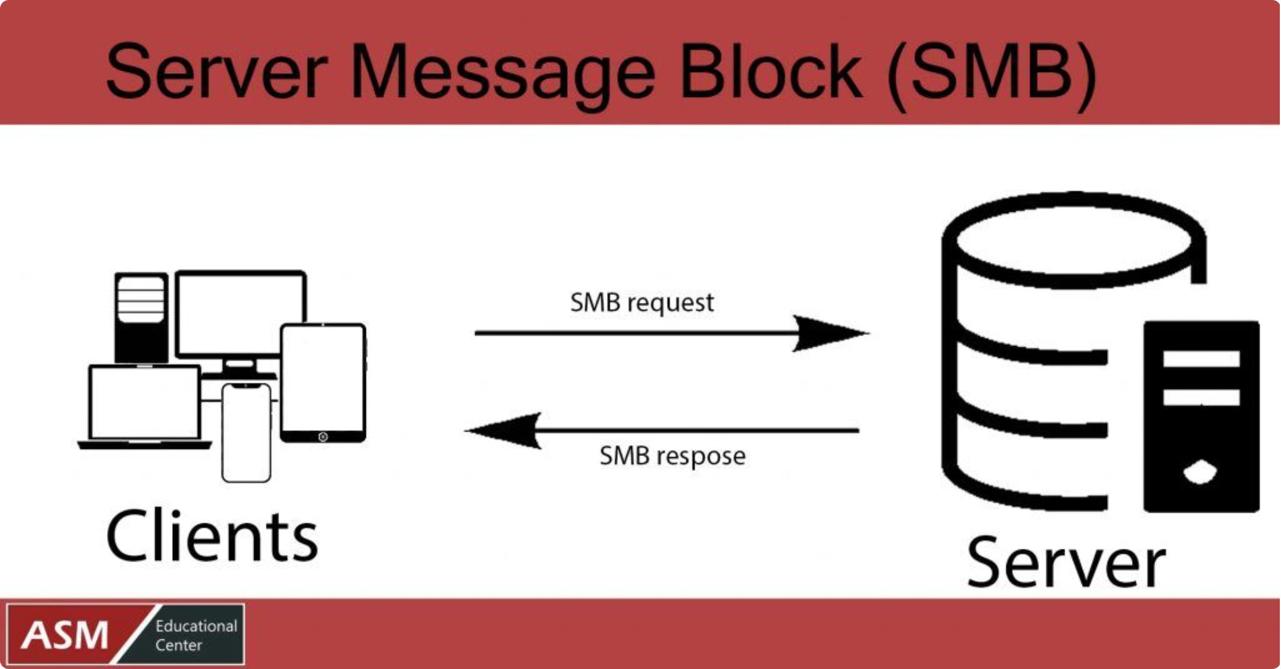
What Is SMB?
Server Message Block
SMB is a network communication protocol used for sharing files, printers, and other resources between Windows systems on a network.
SMB itself is completely legitimate functionality. The problem was not that SMB was malicious — the problem was the older SMBv1 implementation.
✅ Legitimate Uses
⚠️ The Problem
File sharing, printer sharing, accessing network resources
The older SMBv1 implementation contained vulnerabilities exploitable remotely

Slide 8





MS17-010 vs EternalBlue vs WannaCry
SMBv1 Vulnerabilities
MS17-010
The underlying flaw in Windows SMB protocol
Patch / Fix — Microsoft's security bulletin and update
EternalBlue
WannaCry
Exploit — took advantage of the SMB vulnerability
Malware — used EternalBlue as its propagation mechanism
Remember: Vulnerability → Patch → Exploit → Malware. These terms are easy to confuse but are not the same thing.

Slide 9
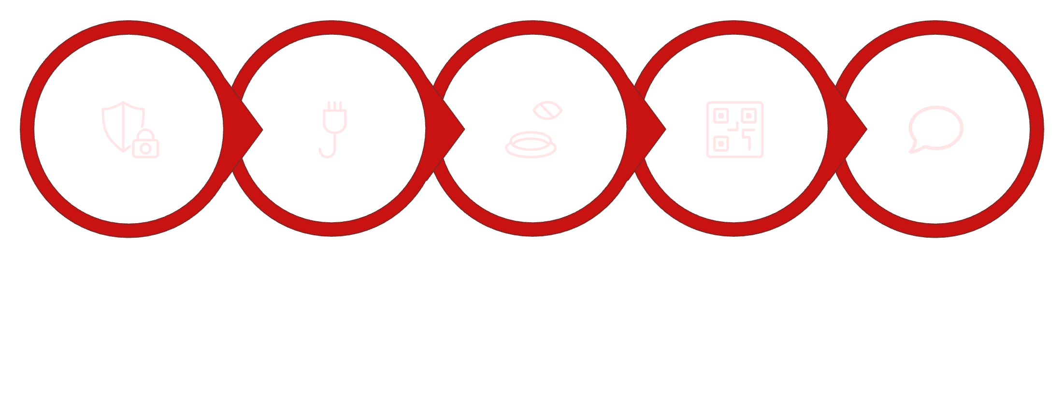
Complete Exploit Chain
01
Vulnerable Windows System
SMBv1 service provides attack surface
02
EternalBlue Exploits
Remote Code Execution achieved on target
03
WannaCry Executes
Network/System Discovery begins
Vulnerable Windows
SMBv1 Attack
EternalBlue
Remote Code Exec
WannaCry Executes
04
SMB Propagation
Other vulnerable systems become infected
05
Encryption + Ransom
Files encrypted, ransom demand presented

Slide 10


Stage 1: Initial Access
What We Know — and What We Don't
Possible Scenario 1
Microsoft stated that it did not have evidence establishing the exact initial entry vector. What is much more firmly established is what happened once the malware had access to vulnerable systems.
Direct infection through a vulnerable SMB port exposed to the internet
Possible Scenario 2
"The precise initial vector remains uncertain; SMB exploitation was central to its subsequent propagation."
Social engineering / email followed by activation of the worm capability

Slide 11

Stage 2: Exploitation
1
Target system identified
SMBv1 service located on the network
2
Specially crafted packet sent
Unauthenticated network request exploits the vulnerability
3
Remote Code Execution achieved
Attacker gains ability to execute code on the target
4
WannaCry runs on target
Network vulnerability becomes a propagation mechanism
An unauthenticated attacker could send a specially crafted packet to a targeted SMBv1 server. Successful exploitation gave the attacker the ability to execute code on the target, allowing the malware to turn a network vulnerability into a mechanism for propagation.

Slide 12
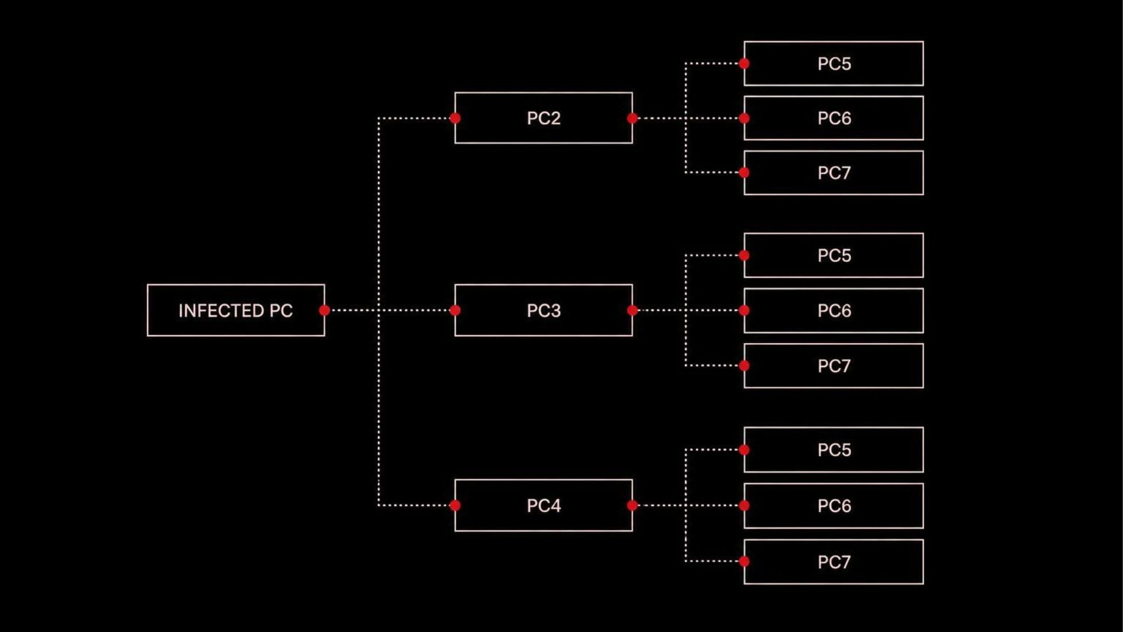
Stage 3: Propagation
Unlike traditional ransomware that requires user interaction, WannaCry automatically discovers vulnerable systems on the network and infects them without any human involvement. Each newly infected system becomes a new propagation point, creating exponential spread across the network.
THIS IS WHY IT WAS A WORM

Slide 13
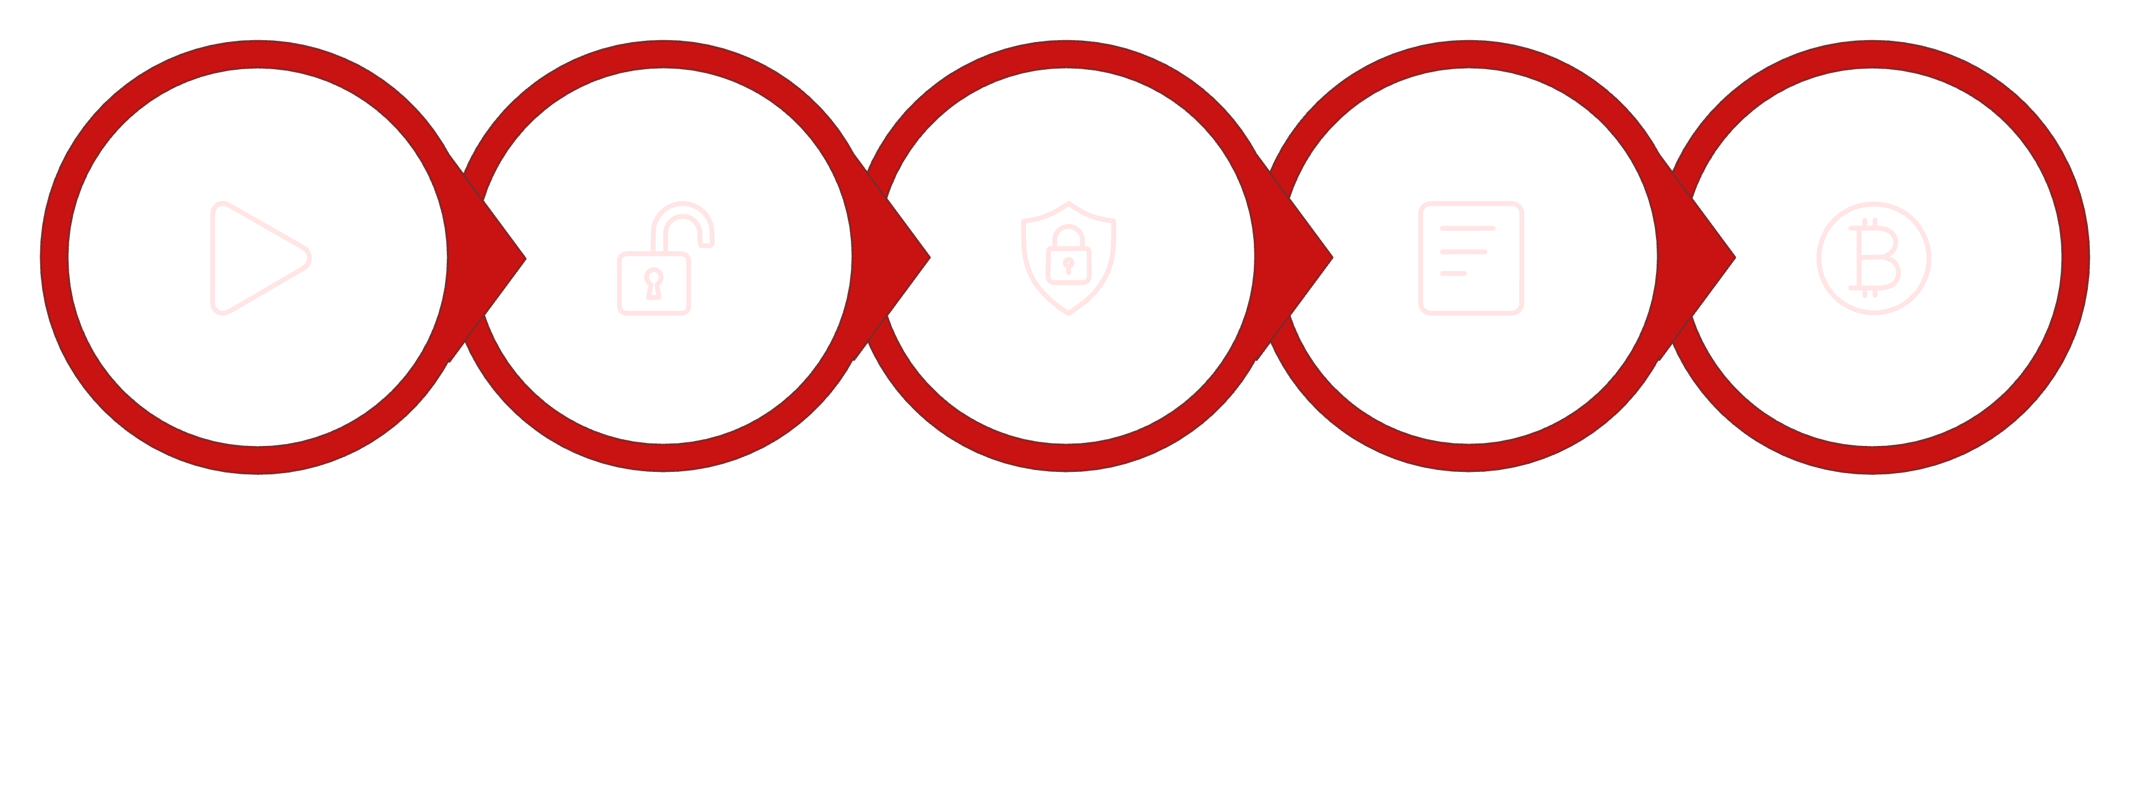
Stage 4: Ransomware Payload
Once WannaCry successfully exploits a vulnerable system, it proceeds to execute its ransomware payload, initiating a sequence of actions designed to encrypt files and demand payment.
Inaccessible
Ransom Note
Payment Demand
Execute
Encrypted

Slide 14
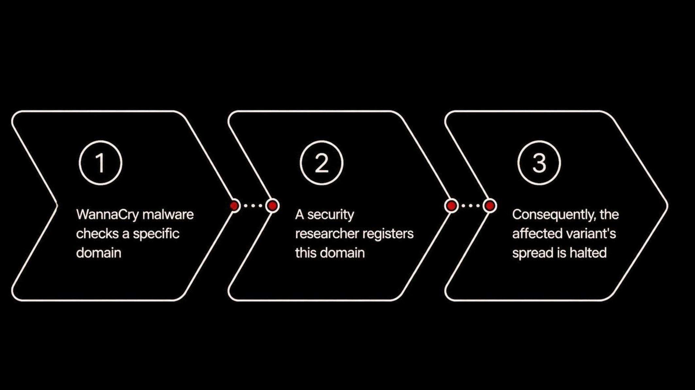

The Kill Switch
While the kill switch stopped the worm from spreading, it did NOT decrypt files that were already encrypted. Victims' data remained locked even after the spread was halted.
Kill switch ≠ decryption

Slide 15
Attacker Objective
Financial Gain 💰
The primary and sole objective behind the WannaCry attack was financial gain. The attackers aimed to extract money from victims through a sophisticated extortion scheme.
1
Encrypt Victim Data
2
Demand Ransom
WannaCry's core function was to encrypt a wide range of files on infected systems, rendering them inaccessible to users and organizations.
After encryption, a ransom note was displayed, demanding payment, typically in Bitcoin, in exchange for a decryption key.
3
Request Bitcoin Payment
4
Attempt to Monetize Infections
Bitcoin was chosen due to its perceived anonymity and the irreversibility of transactions, making it difficult for law enforcement to trace and recover funds.
The worm's rapid, automated spread was designed to maximize the number of infections, increasing the potential pool of victims willing to pay the ransom.

Slide 16
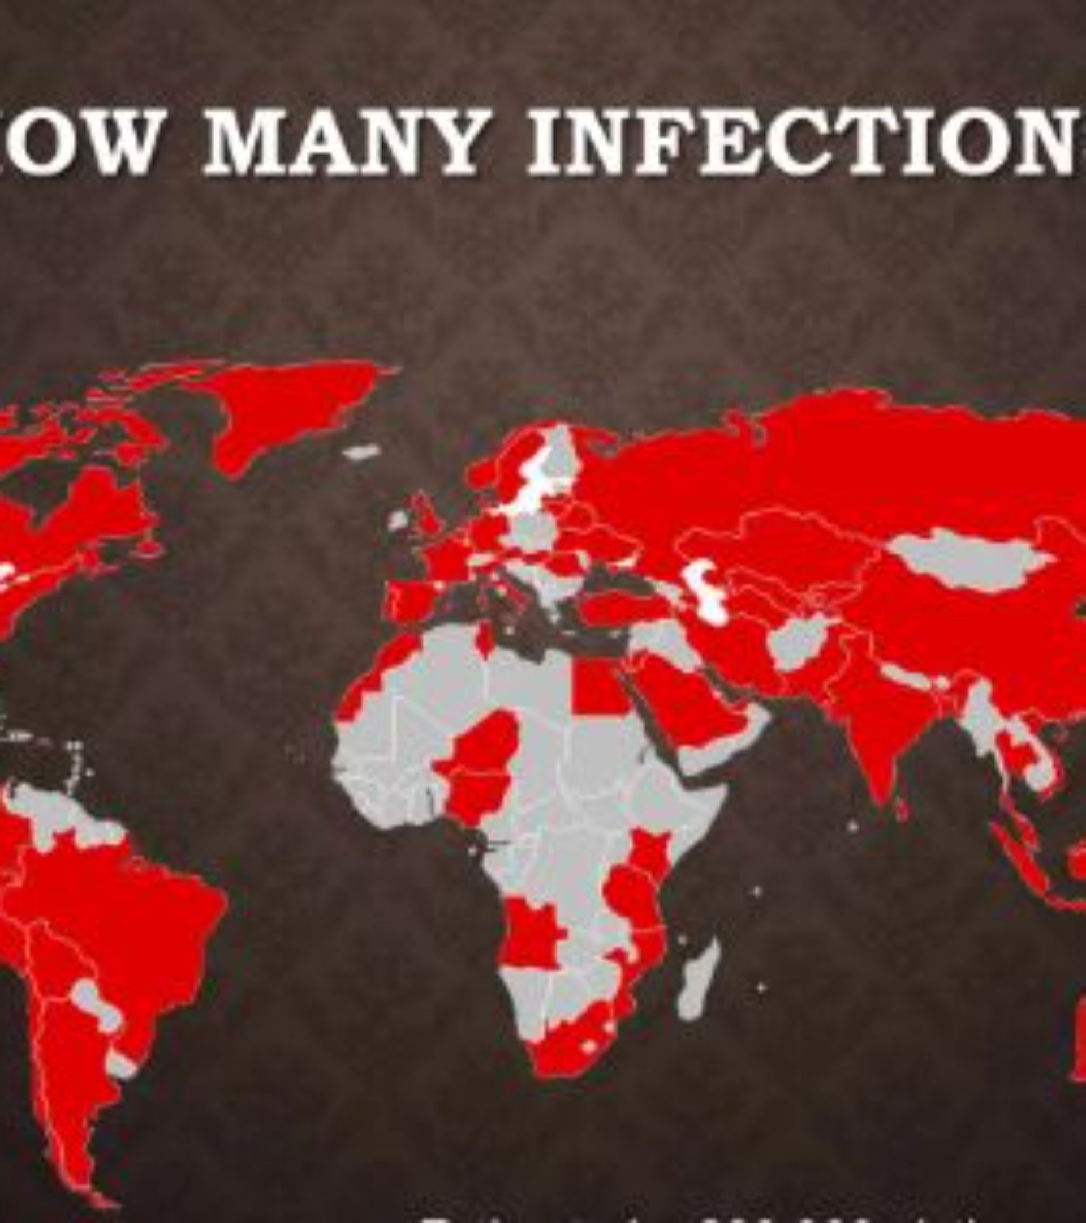
Global Impact + NHS
🌍 Global Impact
NHS Impact (UK National Health Service)
150+ countries affected
Hundreds of thousands of systems infected
47 NHS trusts and Foundation Trusts affected
Ambulances diverted
Operations cancelled
Patient services disrupted

Slide 17
How Could We Have Stopped It?
Preventative measures and defenses against WannaCry focused on mitigating known vulnerabilities and improving incident response capabilities.
Weakness | Defense
Unpatched SMB vulnerability | Apply MS17-010
SMBv1 | Disable where possible
Network exposure | Restrict unnecessary SMB access
Vulnerable legacy systems | Upgrade/isolate
Worm propagation | Network segmentation
Ransomware | Offline/isolated backups
Malware | Updated endpoint protection
Poor visibility | Monitoring + incident response

Slide 18






Final Verdict
WannaCry Was More Than Ransomware
Known vulnerability
Remote exploitation
Worm-like propagation
File encryption
Ransom demand
Global disruption

Slide 19
Sources
Microsoft — MS17-010 Security Bulletin Microsoft MS17-010
Microsoft Security Blog — WannaCrypt ransomware worm Microsoft WannaCrypt analysis
MITRE ATT&CK — WannaCry S0366 MITRE ATT&CK WannaCry
UK NCSC — WannaCry guidance NCSC WannaCry guidance
UK NCSC — 2017 Annual Review NCSC 2017 Annual Review

Slide 20
Thank You

