Slide 1


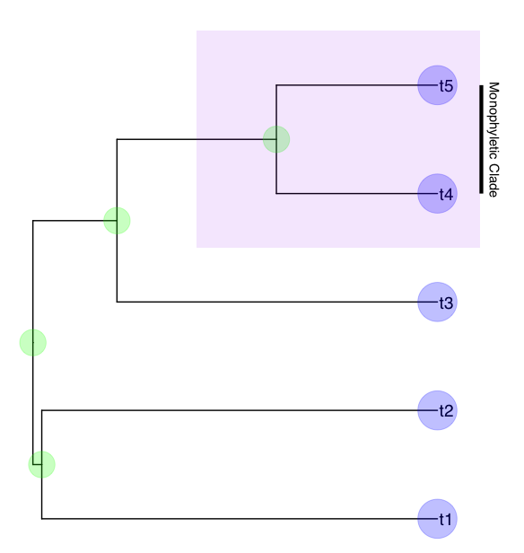
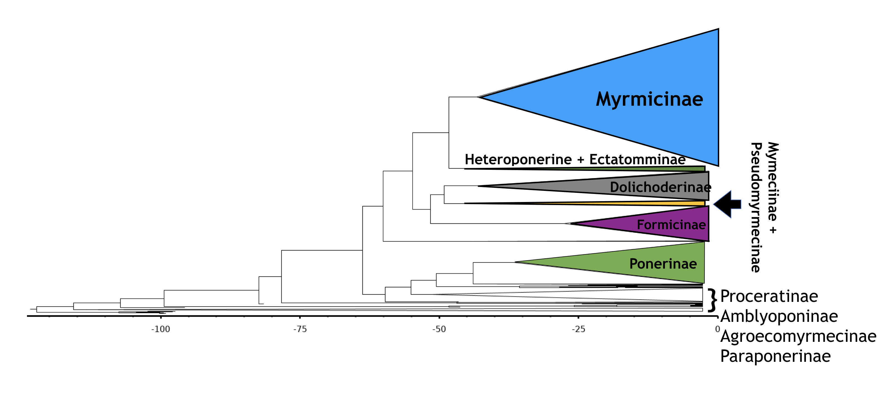


Unifying Phenotypic and Molecular Data for Phylogenetic Estimation
Tyler Tran, Christina Kolbmann, Courtney Grigsby, April Wright PhD
Department of Biological Science,
Southeastern Louisiana University
Node: Shows most
recent common
ancestor of subtending lineage
Our Dataset
There are over 15,000 described species of ants. Though it may not appear so, ants actually form a test case for medical phylogenetics. Much as a viral outbreak will have periods of high diversification (such as during an outbreak), there are intervals in the fossil record of high ant diversity. In viral phylogenetics, multiple samples may have been taken during the evolutionary history of the virus. We also have this in ants, via the fossil record.
This is one of the largest datasets ever used, with 750 ant samples, including 85 fossils.
Dating Phylogenetic Trees
This Bayesian “total evidence” phylogenetic analysis of extant and fossils species, combines morphological and molecular data as well as stratigraphic ranges. Primary parameters for this model are extinction rate, speciation rate, fossilization rate, origin time, and sampling probability.
Because these models enable researchers to make more complete use of the data, we expect they will result in more robust inferences about node ages and evolutionary
dynamics.
Clade: A most
recent common
and its descendants
Branch: Connects a
tip to node.
Tip: the objects
we want to know the
relationships between
What is a Phylogeny?
Phylogenetics is the study of evolutionary relationships among biological entities including species, individuals, and genes. Statistical functions model the evolutionary process that generated the data. Historically, phenotypic and molecular data have been modeled separately. Our study co-estimates a tree from these two data sources
The Ant Tree of life
Tips grouped into major subfamilies
Origin time consistent with prior work
Phylogenies in Medicine
Fossilized birth-death models show great promise in biomedical research for real-time modeling of evolutionary dynamics in disease-bearing organisms. These models may be used to estimate how fast mutations are arising in populations, and if new lineages are forming. Our explorations into how fossilized birth-death methods can be used to date phylogenetic trees provides the basic science required for these advanced applications
Acknowledgements
Citations:
Volz EM, Koelle K, Bedford T (2013) Viral Phylodynamics. PLoS Comput Biol 9(3): e1002947. Frost , Simon D. W, and Erik M. Volz. 2013 “Modelling Tree Shape and Structure in Viral Phylodynamics.” Philosophical Transactions of the Royal Society B: Biological Sciences, Royal Society, 1

Slide 2
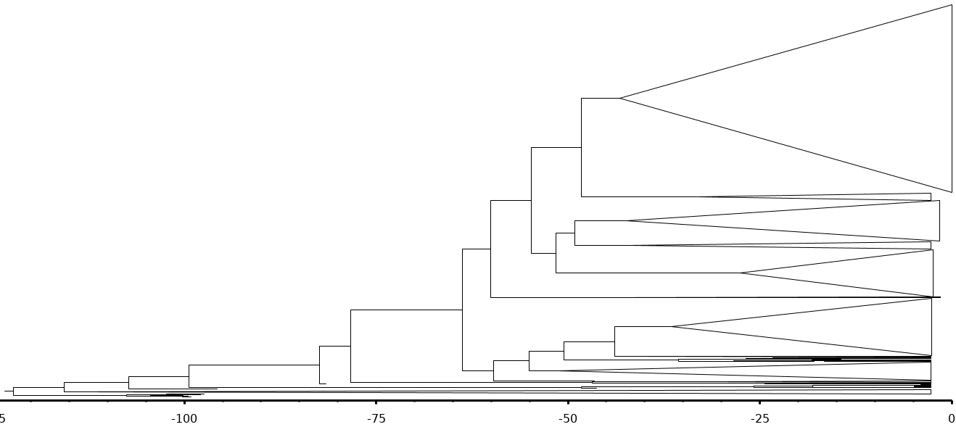
Myrmicinae
Heteroponerine + Ectatomminae
Dolichoderinae
Formicinae
Ponerinae
}
Proceratinae
Amblyoponinae
Agroecomyrmecinae
Paraponerinae
Mymeciinae +
Pseudomyrmecinae

