Slide 1
Implementing the Dirichlet Process to Improve Computational Efficiency of Partitions of Big Data Sets
Tyler Tran, Dr. April Wright, Christina Kolbmann, Courtney Grigsby
Southeastern Louisiana University,
Department of Biological Sciences

Slide 2
Table of Contents
What is a phylogeny
Why we chose ants
The fossilized Birth-Death Model
Implementing the Dirichlet Process

Slide 3
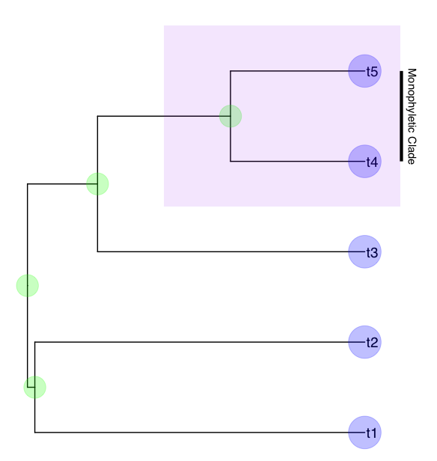
What is a Phylogeny
Root
Nodes
Tips
Clade
Time scale
Phylogeny- used to represent the evolutionary relationships between different species as they diversify overtime

Slide 4
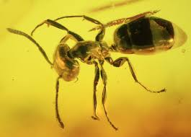
Why Ants
Over 12.500 currently described species
Ecological Importance as decomposers
Significant interactions between animal species as well as flora
Previous studies collected large amounts of molecular and morphological data on ants
Genetic data of fossilized ants has been harvested from amber
Perfect basis to test phylogenetic methods
Provide insight on evolutionary processes of ants

Slide 5
The Fossilized Birth-Death Model
The Fossilized Birth-Death Model is a Bayesian “total evidence” phylogenetic analysis that jointly models extant and fossils species, combining morphological and molecular data as well as stratigraphic ranges
Birth refers to a speciation event in the lineage
Death refers to the lineages that have gone extinct
This model is a more complete representation than using just molecular data or morphological data

Slide 6
Our Phylogeny
Data
-700 ant samples
-14 fossils
Parameter
-The model is calibrated based on a constant diversification rate
-The time scale is continuously stratified
Function ran using RevBayes software

Slide 7
Our Phylogeny Results
Suggested origin time
Maybe talk about sub families
Vastness explained

Slide 8
Implementing the Dirchlet Process
Problem
Working with ants often requires using large genetic data sets. Many test require running the same model numerous times. Ours was run nearly 100 times. Even when using a computer to calculate results, its can be very time consuming.
Solution
The Dirichlet process (solid simple answer)
Expected Results
Finding the true clock of the model with out the Dirichlet Process implemented will be compared to the true clock of the model with the Dirichlet Implemented

Slide 9



Acknowledgments

