Slide 1


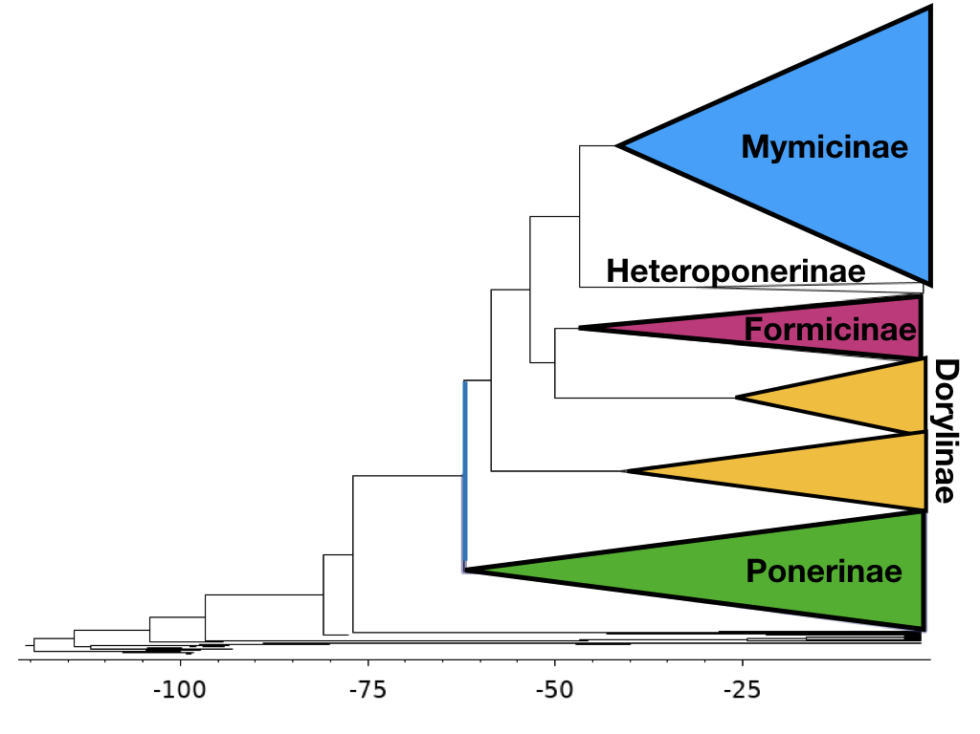


Unifying Phenotypic and Molecular Data for Phylogenetic Estimation
Tyler Tran and April Wright PhD,
Department of Biological Science,
Southeastern Louisiana University
What is a Phylogeny ?
Phylogenetic is the study of evolutionary relationships among biological entities including species, individuals, and genes. To model these evolutionary relationships statistical functions can derived that mirror the natural processes. Running these complex statistical functions requires high processing computer-based software such as RevBayes.
Methods
In our experiment, we’d like to better understand the phylogenetic tree of Formicidae as provides much insight on the evolutionary processes that affect not just ants, but any closely interacting species. This Baysian “total evidence” phylogenetic analysis of extant and fossils species, combining morphological and molecular data as well as stratigraphic ranges from the fossil samples is called the Fossilized Birth-Death Model. The FBD function is ran using RevBayes.
Why Use Ants?
On earth are nearly 12,000 currently described ant species. These ants are major parts of every ecosystem they inhabit as they aid tremendously in the decomposition. Interactions with other species on the food webs is very dynamic. Their incredible current diversity in conjunction to their available data records provides astounding amounts of data for phylogenetic testing and analysis.
Expected Results
From the phylogeny produced, insight on the evolutionary forces that affect ants and their diversification can expected to be seen. Verification of the Fossilized Birth-Death Model as an appropriate function to model evolutionary processes can be compared to known phylogenies.
Acknowledgements

