Slide 1


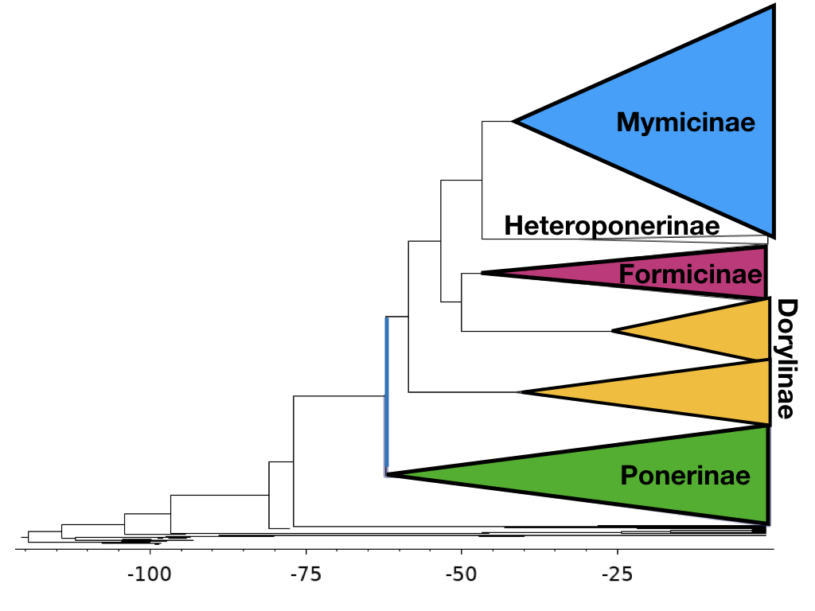


Unifying Phenotypic and Molecular Data for Phylogenetic Estimation
Tyler Tran, Christina Kolbmann, Courtney Grigsby, April Wright PhD
Department of Biological Science,
Southeastern Louisiana University
What is a Phylogeny ?
Phylogenetics is the study of evolutionary relationships among biological entities including species, individuals, and genes. To model these evolutionary relationships statistical functions can be derived that mirror the evolutionary processes. Running these complex statistical functions requires high processing computer software such as RevBayes.
Why Use Ants?
In our experiment, we’d like to better understand the phylogenetic tree of Formicidae as it provides much insight on the evolutionary processes that affect not just ants, but any closely interacting species. On earth, are nearly 12,000 currently described ant species. These ants are major parts of every ecosystem they inhabit as they aid tremendously in decomposition. Interactions with other species on the food webs are very dynamic. Their incredible current diversity in conjunction to their available data records provides a well-rounded basis for phylogenetic testing and analysis.
Methods
This Bayesian “total evidence” phylogenetic analysis of extant and fossils species, combining morphological and molecular data as well as stratigraphic ranges from the fossil samples is called the Fossilized Birth-Death Model. Primary parameters are a constant diversification rate and a continuously stratified time scale. MCMC testing for convergence for the phylogeny, due to orientation of different nestings of the subfamily, Dorylinae.
Results and Conclusion
The phylogeny is composed of 750 ant samples with 85 being fossils. Most of tips are grouped into their major subfamilies. The phylogeny suggest an origin time of approximately 125 millions year ago. Indicated at the blue bar is the crown group of ants.
Future Goals
Computing large data sets common with ant specimen can be incredibly time consuming. Implementation of the Dirichlet Process to our current model to hopefully improve computational efficiency of the partitions of big data sets.
Acknowledgements

