Slide 1
DR.K.V.SUBBA REDDY COLLEGE OF ENGINEERING FOR WOMEN - KURNOOL PROJECT ON SMS SPAM DETECTION
PROJECT GUIDE
T.MURALI KRISHNA - Asst Professor,
MCA,M.Phil,M.Tech(PhD)
SUBMITTED BY:
JYOTHSNA.P - 182T1A0582

Slide 2
Contents
Abstract
Introduction
Existing System
Proposed System
Architecture
Requirements
References

Slide 3
Abstract
Spam SMSes are unsolicited messages to users,which are disturbing and harmful.
The efficient spam detection help people to classify whether it is a spam SMS or not.
SMS Spam Detection uses smart technique called Natural Language Process(NLP).
Multinomial Naive Bayes gives high accuracy score.

Slide 4
Introduction
SMS Spam Detection:
The spam detection is a big issue in mobile message communication due to which mobile message communication is insecure.Inorder to tackle this problem ,an accurate and precise method is needed to detect the spam in mobile message communication.

Slide 5
Existing System:
To avoid Spam SMS people use White and Black list of numbers,but this technique is not completely avoid Spam SMS.
Detecting bulk amount of spam messages takes time .
To tackle this problem needs smart technique.

Slide 6
Disadvantages
Users need to select features manually.
Complex implementation.
No classification algorithm is used.

Slide 7
Proposed System
Natural language processing technique is useful for SMS Spam identification.It analyses text content and finds patterns which are used to identify Spam or Non-Spam.
Multinomial Naive Bayes used to calculate a probability that an email is or not spam.
Compared to other algorithms Multinomial Naive Bayes gives high accuracy score

Slide 8
Advantages
Help to keep garbage out of email inboxes.
Naive Bayes is more feasible for mobile applications.
Lower memory usage.
Fast to execute,high efficiency

Slide 9
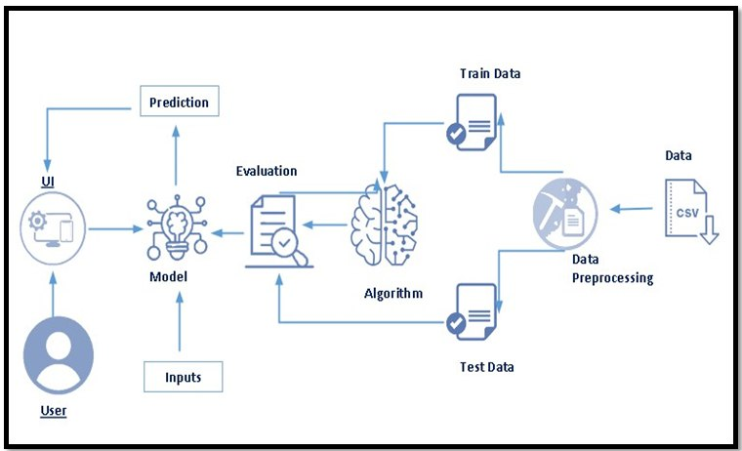
Architecture:

Slide 10
System Requirements
Hardware
RAM : 8 GB
Processor: Intel Core i5
Hard Disk:40 GB

Slide 11
Software
Operating system : Windows XP/7/10/11.
Coding Language : Python 3.6.8
IDE : JUPYTER and SPYDER
Database : EXCEL

Slide 12
References
N.Jindal and B.Liu,”Review spam detection”, in Proc. Of the 16th International Conference on World Wide Web,2007.
T.A.Almedia ,J.M.G.Hidalgo and T.P.Silva, ”Towards SMS spam filtering: Results under a new dataset, ”International Journal of Information Security Science.

Slide 13



