Slide 1
OpenCL
(Open Computing Language)

Slide 2
What is OpenCL..?
Open Computing Language (OpenCL) is a framework for writing programs that execute across heterogeneous platforms consisting of CPUs, GPUs, DSPs, FPGAs and other processors or hardware accelerators.
History
It was initially developed by APPLE inc. ( collaboration with AMD, IBM, Qualcomm, NVIDIA, and intel)
Khronos group in 2008.

Slide 3
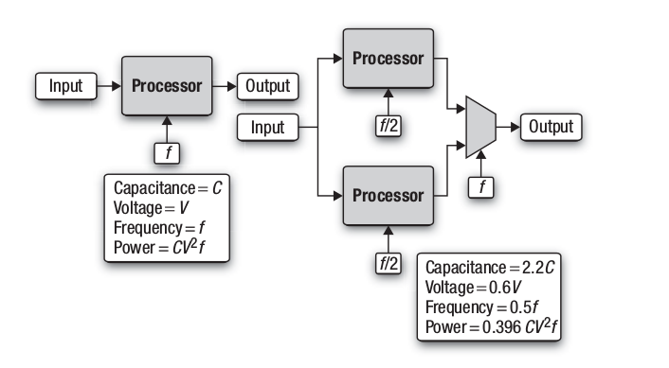
Why OpenCL:

Slide 4
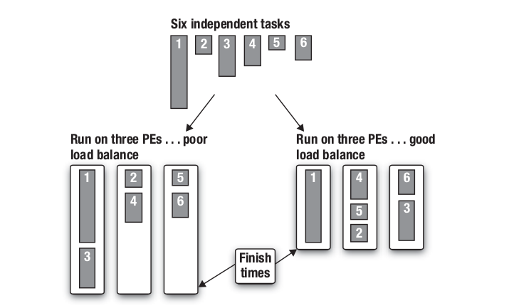
Continue:

Slide 5
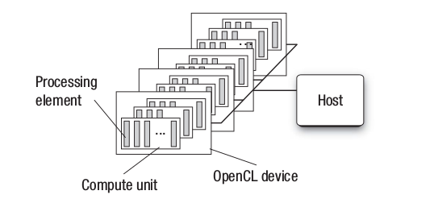
Blocks:

Slide 6
What OpenCL do?
--> Programming and providing API’s for devices like CPU, GPU, DSP, FPGA...etc
--> The above can be done by using Threading(Task), and data-based parallelism.
--> It defines c-like language for writing Programs

Slide 7
Definitions:
--> File name ends with .cl
--> kernels: Function executed on an openCL device.
--> PE’s: Processing Elements
--> Single kernel can run on many PE’s
--> OpenCL programs intended to be compiled at run time (Portable b/w implementations for various host devices)

Slide 8
Memory Hierarchy:
Host Memory : Is directly available to host
Device Memory : Is directly avilable to kernel
Global Memory : shared by pe’s (__global) latency low
Constant Memory : smaller, fast. Writable by host but not compute dev
(__constant)
Local Memory : shared by a group of PE’s (__local)
Private Memory : (__private)

Slide 9
OpenCL C-lang:
--> Follows C99 standard
--> __kernel Marked functions are entry point into the program to be called from host
--> Functions pointers, bit field’s, Var-length array are omitted
--> Recursion is forbidden
--> C’ standard lib is replaced by custom set of standard functions

Slide 10
Hello world Program:
__kernel void hello(__global char* string){
string[0] = 'H';
string[1] = 'e';
string[2] = 'l';
string[3] = 'l';
string[4] = 'o';
String[5] = ',';
String[6] = ' ';
string[7] = 'W';
string[8] = 'o';
string[9] = 'r';
string[10] = 'l';
string[11] = 'd';
String[12] = '!';
String[13] = '\0';
}

Slide 11
Applicatons:
--> Auto-Desk(Maya)
--> Adobe Photoshop
--> Pathfinder
--> Web application (Chrome, Mozilla)

Slide 12
Thank you.......!

