Slide 1
Project 2 – Predicting Credit Card Fraud
Mark Webb
September 17, 2021

Slide 2
Credit Card Fraud Data
The data set contains credit card data from September 2013.
The data was captured over a period of 2 days
It’s unbalanced due to the low rate of fraud transactions compared to non-fraud.
Most of the features have already gone through PCA processing in order to protect private information.
Fraud is indicated through the Class column as 1 for fraud and 0 non-fraud.

Slide 3
Credit Card Fraud Data
Most of the focus for the ML model will be on the Time, Amount, and Class columns.
  Class – contains fraud or non-fraud indicators.
  Time – in seconds between when transactions took place.
  Amount – amount of the transaction
  V1 - V28 – data elements will be used for the model, but have been safe guarded for privacy concerns through PCA

Slide 4
Data Cleaning Process
Reviewed the data for missing values, duplicates, inconsistencies, and converted data for evaluation.
Reviewed data to determine if all data was relevant to the model.
Columns containing the PCA data were checked for null values. However, due to the data being already converted columns V-1 through V-28 were kept as provided outside of null values and duplicates.

Slide 5
The following are the results of the data discovery process that required cleaning:
Null values found in V-16 through V-28, Amount, and Class all in the same row. Fraud_data.dropna(inplace=True) used to remove null values. Since this removed only one row, the data was not negatively impacted.
489 duplicates found. Used fraud_data.drop_duplicates(keep='first', inplace=True) to eliminate duplicates.
Fraud indicators were floats. Changed to int to eliminate confusion. Used fraud_data['Class'] = fraud_data['Class'].astype(int).
Remaining data did not need further cleaning.

Slide 6
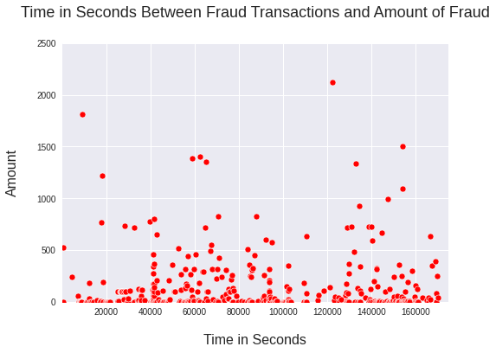
Data Evaluation
The scatter plot shows the time in seconds between each true fraud transaction and the amount of monetary value of said transaction. It helps visualize the pattern of fraud transactions within the time frame of the data.

Slide 7
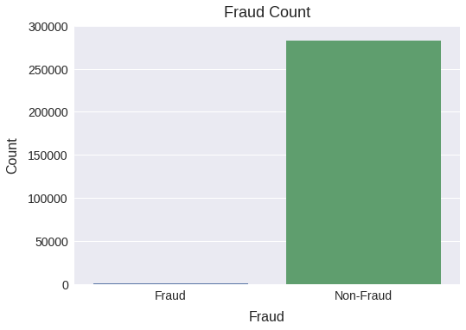
Data Evaluation
Demonstrated in the bar graph, we can see the number of fraud cases is extremely low compared to non-fraud cases. The data is imbalanced but expected considering the preventative measures seen by financial institutions to prevent fraud.

Slide 8
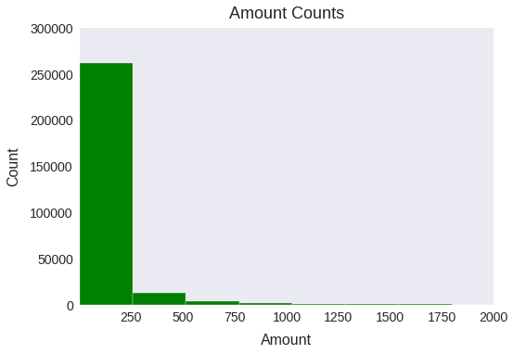
Data Evaluation
As shown in the histogram, we can see the different amounts of the fraud transactions and the frequency of their occurrence. More fraud was seen between 0 and 250.

Slide 9
Challenges within the Data Set
The data set used to evaluate the fraud transactions was rather clean and did not need much alterations for evaluation purposes. However, due the the data being imbalanced, it will be important to consider during the model creation for data prediction. Furthermore, since the majority of the features have been already processed using PCA for privacy and security reasons, we have less of an ability to dive deep into the features and how each one may impact the predictive model results. As far as the cleaning process, it was not difficult and did not require a lot of transformation to make the data ready for the machine learning development.

