Slide 1
Project 2 – Predicting Credit Card Fraud
Mark Webb
October 3, 2021

Slide 2
Credit Card Fraud Data
The data set contains credit card data from September 2013.
The data was captured over a period of 2 days
It’s unbalanced due to the low rate of fraud transactions compared to non-fraud.

Slide 3
Credit Card Fraud Data
Most of the features have already gone through Principal Component Analysis (PCA) processing. It’s a process used to reduce input variables.
PCA makes understanding the data of each feature more difficult but is required for privacy concerns.
Fraud is indicated through the Class column as 1 for fraud and 0 for non-fraud.

Slide 4
Credit Card Fraud Data
Most of the focus for the ML model will be on the Time, Amount, and Class columns.
  Class – contains fraud or non-fraud indicators.
  Time – in seconds between when transactions took place.
  Amount – amount of the transaction
  V1 - V28 – data elements will be used for the model, but have been safe guarded for privacy concerns through PCA

Slide 5
Data Cleaning Process
Reviewed the data for missing values, duplicates, inconsistencies, and converted data for evaluation.
Reviewed data to determine if all data was relevant to the model.
Columns containing the PCA data were checked for null values. However, due to the data being already converted columns V-1 through V-28 were kept as provided outside of null values and duplicates.

Slide 6
Model Used for Prediction
The model chosen is Random Forest Classifier.
The model presented the best performance in classifying fraudulent transactions.
Demonstrated in the next slides we can see some of the data analysis taken into consideration when building the model.
Since the number of non-fraud transactions were the majority, the data had to be balanced using a method called SMOTE to provide more effective model training.

Slide 7
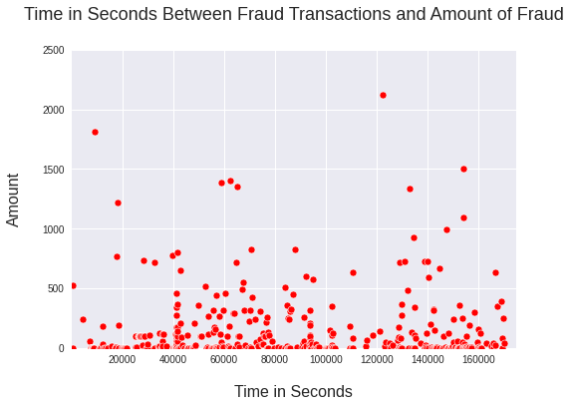
Data Evaluation
The scatter plot shows the time in seconds between each true fraud transaction and the amount of monetary value of said transaction. It helps visualize the pattern of fraud transactions within the time frame of the data. We can see most fraud occurring between the amount of 0 and 500 with relative consistency in regard to time.

Slide 8
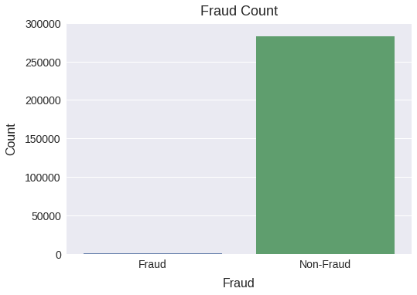
Data Evaluation
Demonstrated in the bar graph, we can see the number of fraud cases is extremely low compared to non-fraud cases. The data is imbalanced but expected considering the preventative measures seen by financial institutions to prevent fraud.

Slide 9
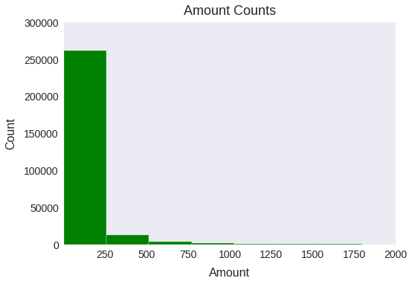
Data Evaluation
As shown in the histogram, we can see the different amounts of the fraud transactions and the frequency of their occurrence. More fraud was seen between 0 and 250.

Slide 10
Recommendation
Using the model created can find fraudulent transactions to eliminate further fraud from occurring on the account.
The implementation can provide insight with capturing more fraud with less errors in regard to false positive and false negative. The model provides a better balance in identifying true fraud.

