Slide 1
Sales Predictions - Project Final
Mark Webb
8/29/2020

Slide 2
Sales Predictions – Data Prep
Cleaning data
  Removing and replacing null values
  Handling duplicated values
  Ensuring value label consistency
  Sorting and filtering data

Slide 3
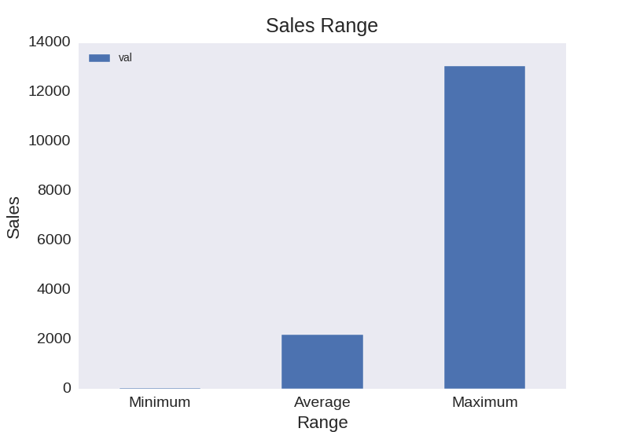
Sales Range
Min – 33
Max – 13,087
Average – 2,181

Slide 4
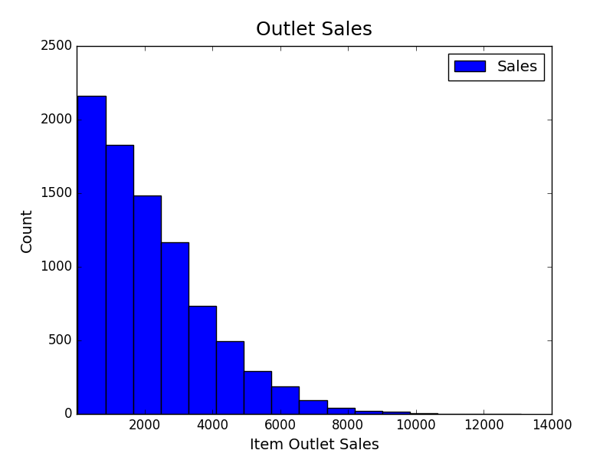
Outlet Sales Frequency
Demonstrated in the graph, there are fewer higher outlet sales results than lower outlet sales results.

Slide 5
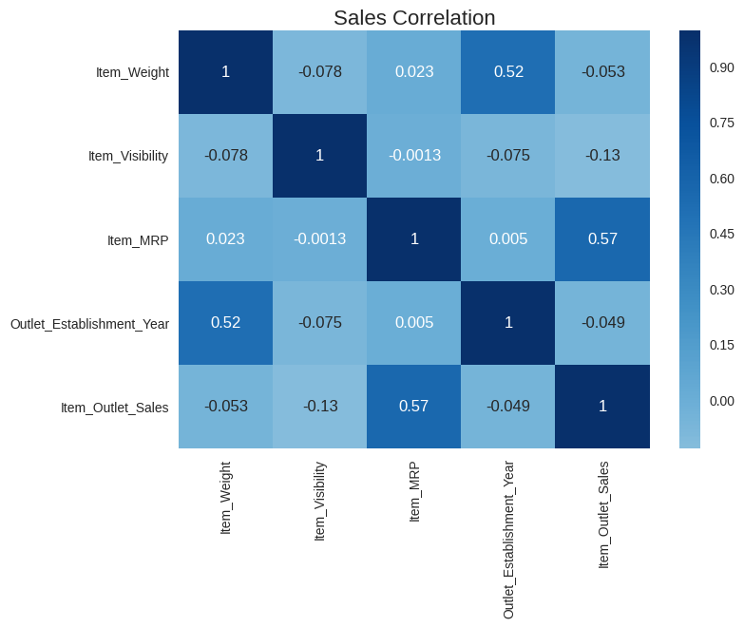
Sales Correlations
As seen in the heat map, one of the stronger correlations with item outlet sales is item MRP.

Slide 6
Data Predictions
Models Used for Sales Predictions
Linear Regression
Regression Tree
Bagged Tree
Random Forest

Slide 7
Linear Regression
R^2 - training score 0.56
R^2 - testing score 0.57
RMSE – training score 1139
RMSE – testing score 1093

Slide 8
Regression Tree
R^2 - training score 0.58
R^2 - testing score 0.57
RMSE – training score 1116
RMSE – testing score 1082

Slide 9
Bagged Tree
R^2 - training score 0.59
R^2 - testing score 0.56
RMSE – training score 1099
RMSE – testing score 1099

Slide 10
Random Forest
R^2 - training score 0.60
R^2 - testing score 0.60
RMSE – training score 1081
RMSE – testing score 1050

Slide 11
Best Model Results
Reviewing the different results between the models we can conclude the random forest is the better fit model for predictions.
  60% of the variability of the model is explained by the the inputs provided to the model
  Lower variance more balanced
  Train and test results are better performers over other models

Slide 12
Recommendations
With the data gathered through the project, we can see items with a higher MRP may outperform lower MRP items even with lowers sales if they are in demand. For example, seafood has a coefficient of 328 and has a higher visibility rate. The coefficient is the change in mean response per unit change. Other variables can include size of outlet and location. However, looking at improving product type and driving sales with these items can have a positive impact, with less impact on expenses, on driving up outlet item sales.

Slide 13
Conclusion
Cleaned data for better data evaluation
Performed data analysis
Completed with different models for best fit
Determined random forest to fit the best
Looking into selling items with a higher coefficient can increase sales

