Slide 1

cv
NEUROLOGICAL DIAGNOSIS OF BRAIN TUMOR
Team Members
Palguni R H (1DS19CS108)
Pavan (1DS19CS110)
P Ishwarya (1DS19CS112)
Rohith M V (1DS19CS131)
Under the Guidance of
Prof. Keerthi S Saurabh Sen
Assistant Professor Software Engineer
Dept of Computer Science and Engineering Infrrd
Department of Computer Science & Engineering, DSCE

Slide 2
cv
TABLE OF CONTENTS
CONTENT | PAGE NO.
Abstract | 1
Introduction | 2
Individual Contribution | 3
Existing System | 4
System Design - Proposed Architecture | 5
Modules | 6-8
Input | 9
Algorithm | 10-11
Output | 12-15
Co guide Details | 16
Project Tool Snapshot | 17
Department of Computer Science & Engineering, DSCE

Slide 3
cv
ABSTRACT
This project presents a novel approach for brain tumor identification and classification using MRI images. It involves preprocessing the images, segmenting the tumor region, and extracting shape, texture, and intensity features. A machine learning algorithm is trained to classify tumors into different types. The method is evaluated and compared with existing techniques, demonstrating its effectiveness in accurately identifying and classifying brain tumors . The developed system has the potential to improve brain tumor diagnosis and treatment planning for patients.
Department of Computer Science & Engineering, DSCE

Slide 4
cv
INTRODUCTION
Diagnosis of a brain tumor is a repetitive and extensive task. Earlier diagnosis means earlier treatment which may have positive impact on patient quality of life, and even survival. Building an automated segmentation method for the exact segmentation of pathological and healthy tissues that comprise the MRI image with the optimised accuracy is the need of the day.
Department of Computer Science & Engineering, DSCE

Slide 5
cv
INDIVIDUAL CONTRIBUTION
Palguni R H – Flask (Web Integration) | Pavan – Flask (Web Integration)
P Ishwarya – Deep Learning Model | Rohith M V – Deep Learning Model
Department of Computer Science & Engineering, DSCE

Slide 6
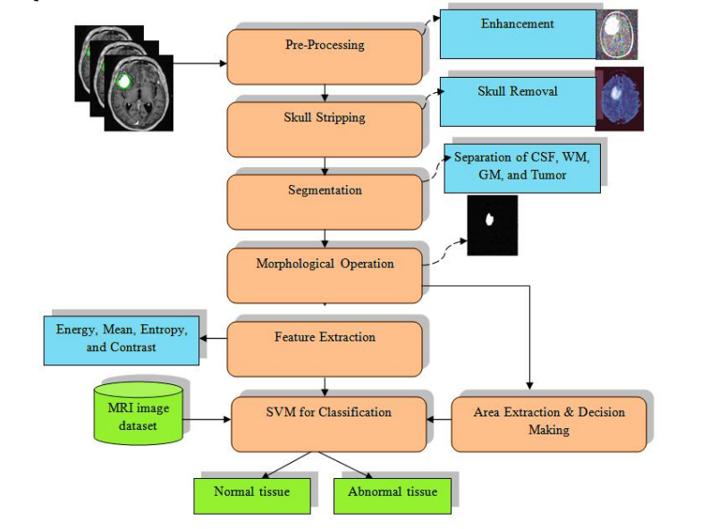
cv
Existing system
Drawbacks
SVM algorithm is used for classification
SVM’s are not well suited for handling large datasets.
SVM do not provide direct probabilistic outputs.
Datasets have to be properly divided in order for to work.
Architecture
Department of Computer Science & Engineering, DSCE

Slide 7
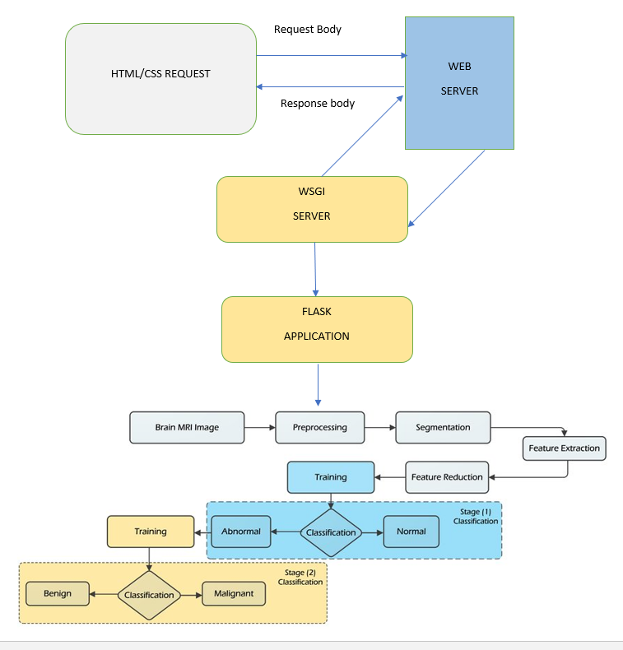
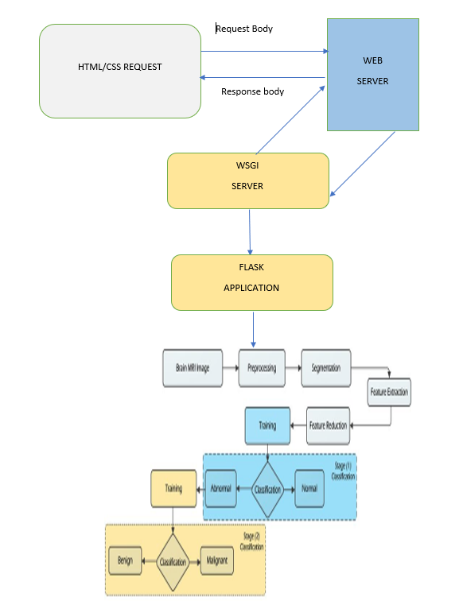
cv
SYSTEM DIAGRAM / proposed ARCHITECTURE
Department of Computer Science & Engineering, DSCE

Slide 8
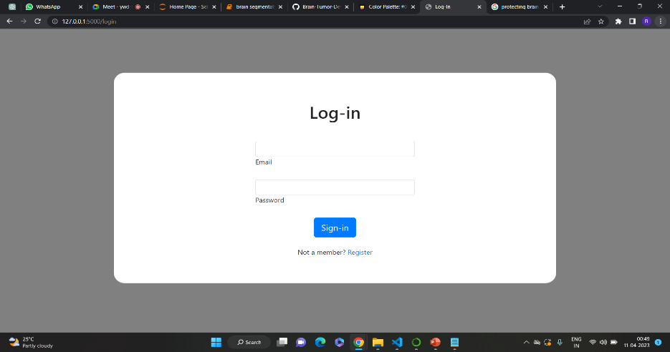
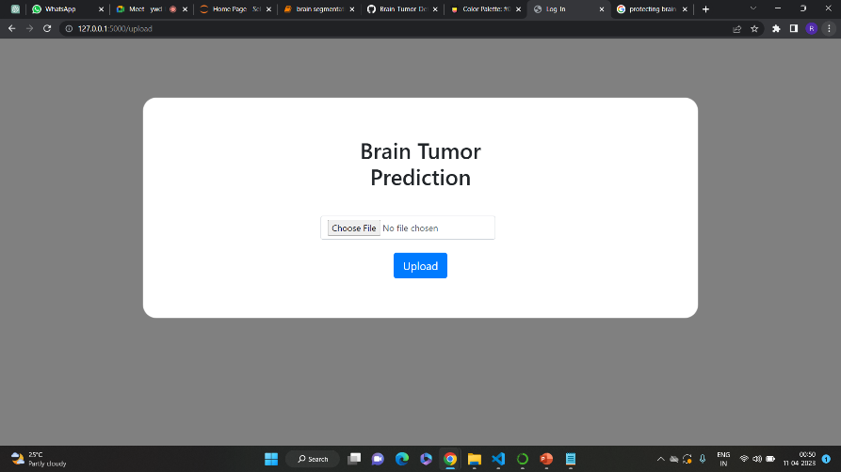
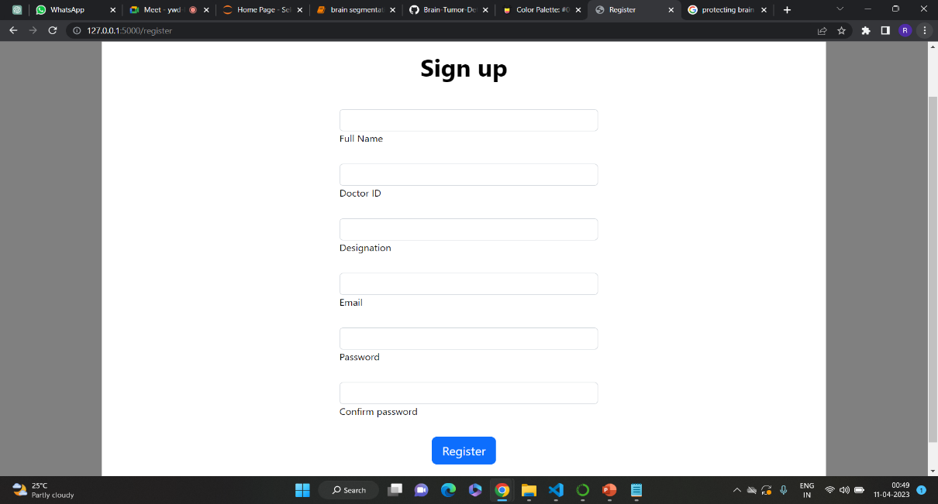
cv
MODULES
1. Image input from webapp
Department of Computer Science & Engineering, DSCE

Slide 9
cv
MODULES
2. Data PreProcessing
Data is fetched from directories and fed to imageDataGenerator(), where required size and shape of the images are achieved
3. Defining required functions
Functions for model enhancements like callback(), functions to display confusion matrix and graphs etc. are defined
4. Constructing the model
Along with the EfficientnetB3 pre-trained model, extra layers have been added for tumor prediction
Department of Computer Science & Engineering, DSCE

Slide 10
cv
MODULES
5. Evaluating the Accuracy of the model
Model is evaluated using test data set and confusion matrix is shown along with the classification report
6. Showing the prediction through Flask
The output of the model is showed to the user using flask application
Department of Computer Science & Engineering, DSCE

Slide 11
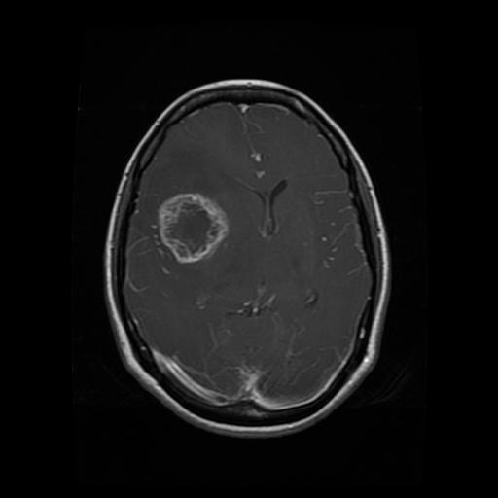
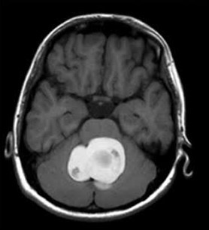
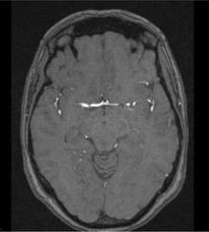
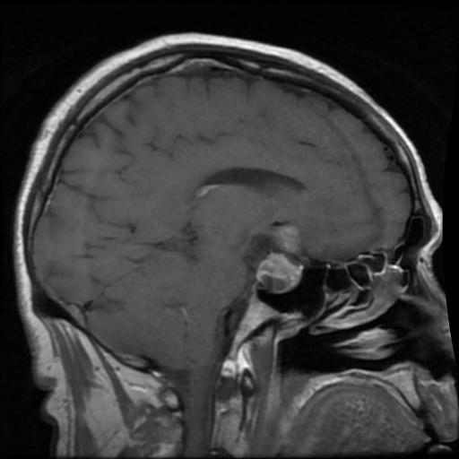
cv
INPUT
GLIOMA
MENINGIOMA
NO TUMOR
PITUITARY
Department of Computer Science & Engineering, DSCE

Slide 12
cv
ALGORITHM
Manual diagnosis by doctors is a very time-consuming and repetitive task.
Pre-processing
ImageDataGenerator is used to generate image data.
Classification
Input dataset consists of 4 classes glioma, meningioma, no tumor and pituitary.
MLP(Multi layer Perceptron) is the deep learning model used for classification.
Department of Computer Science & Engineering, DSCE

Slide 13
cv
EfficientNetB3 is the pre-trained model used, with which scaling is possible to a highly effective coefficient.
ReLU and Softmax are the activation functions used to decide whether the neurons should be activated or not.
Accuracy Evaluation
Model’s performance is evaluated based on how well the model performs in training, validation and testing.
Confusion matrix and Classification report are the metrics used for reporting the accuracy of model.
Department of Computer Science & Engineering, DSCE

Slide 14
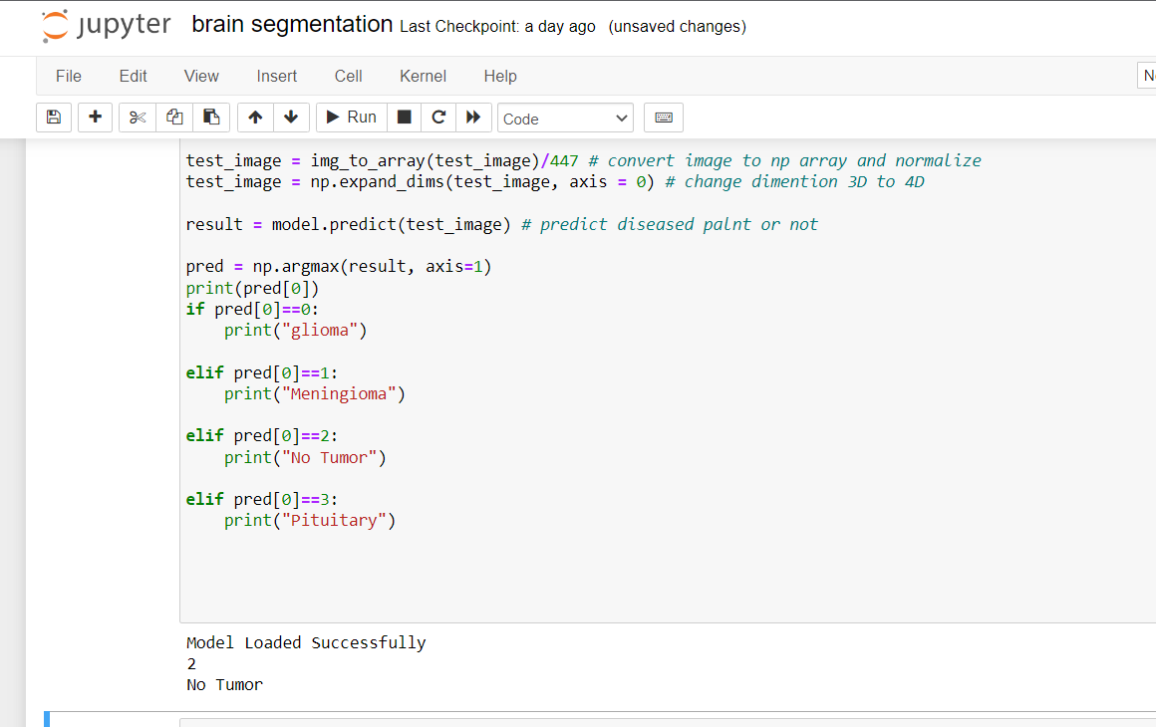
cv
OUTPUT
Department of Computer Science & Engineering, DSCE

Slide 15
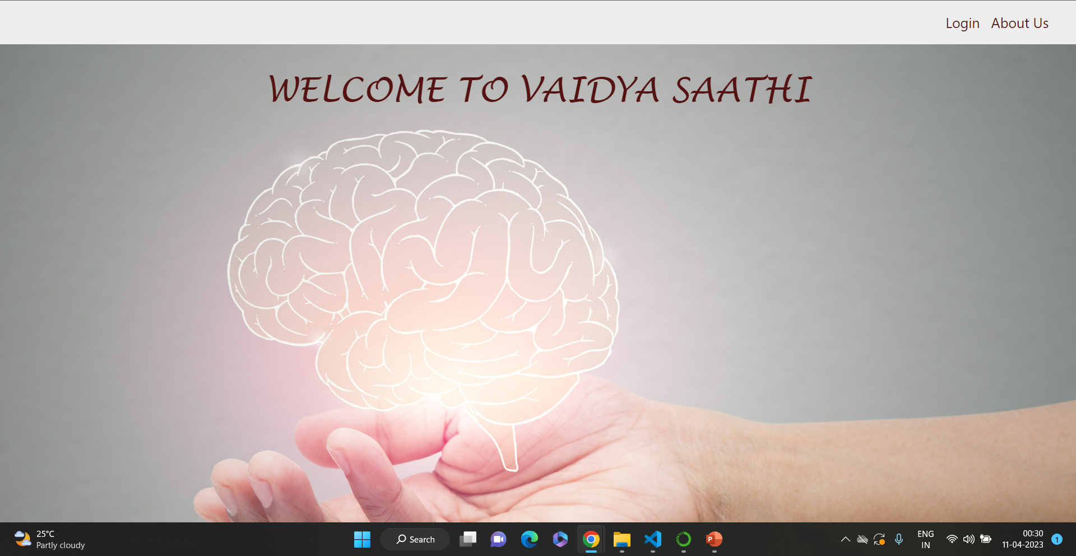
cv
OUTPUT
Department of Computer Science & Engineering, DSCE

Slide 16
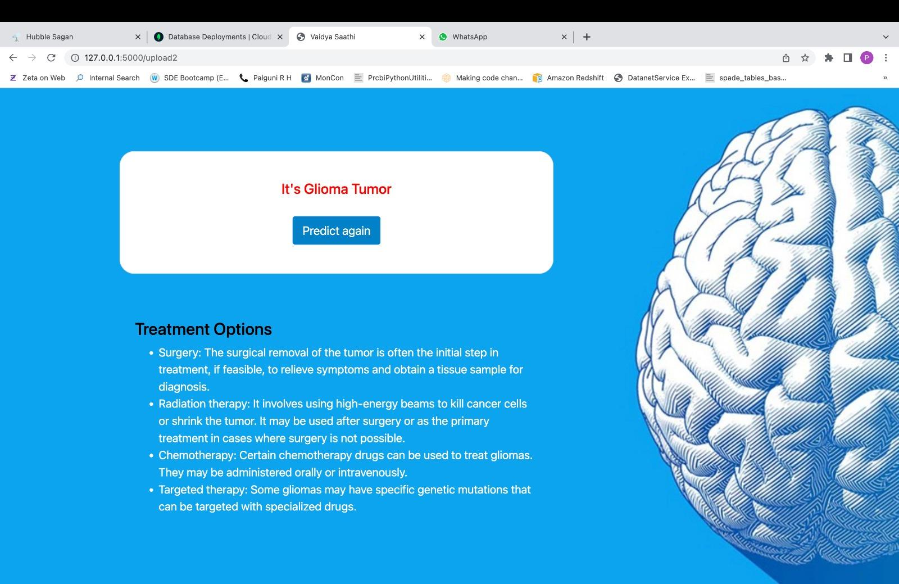
cv
OUTPUT
Department of Computer Science & Engineering, DSCE

Slide 17
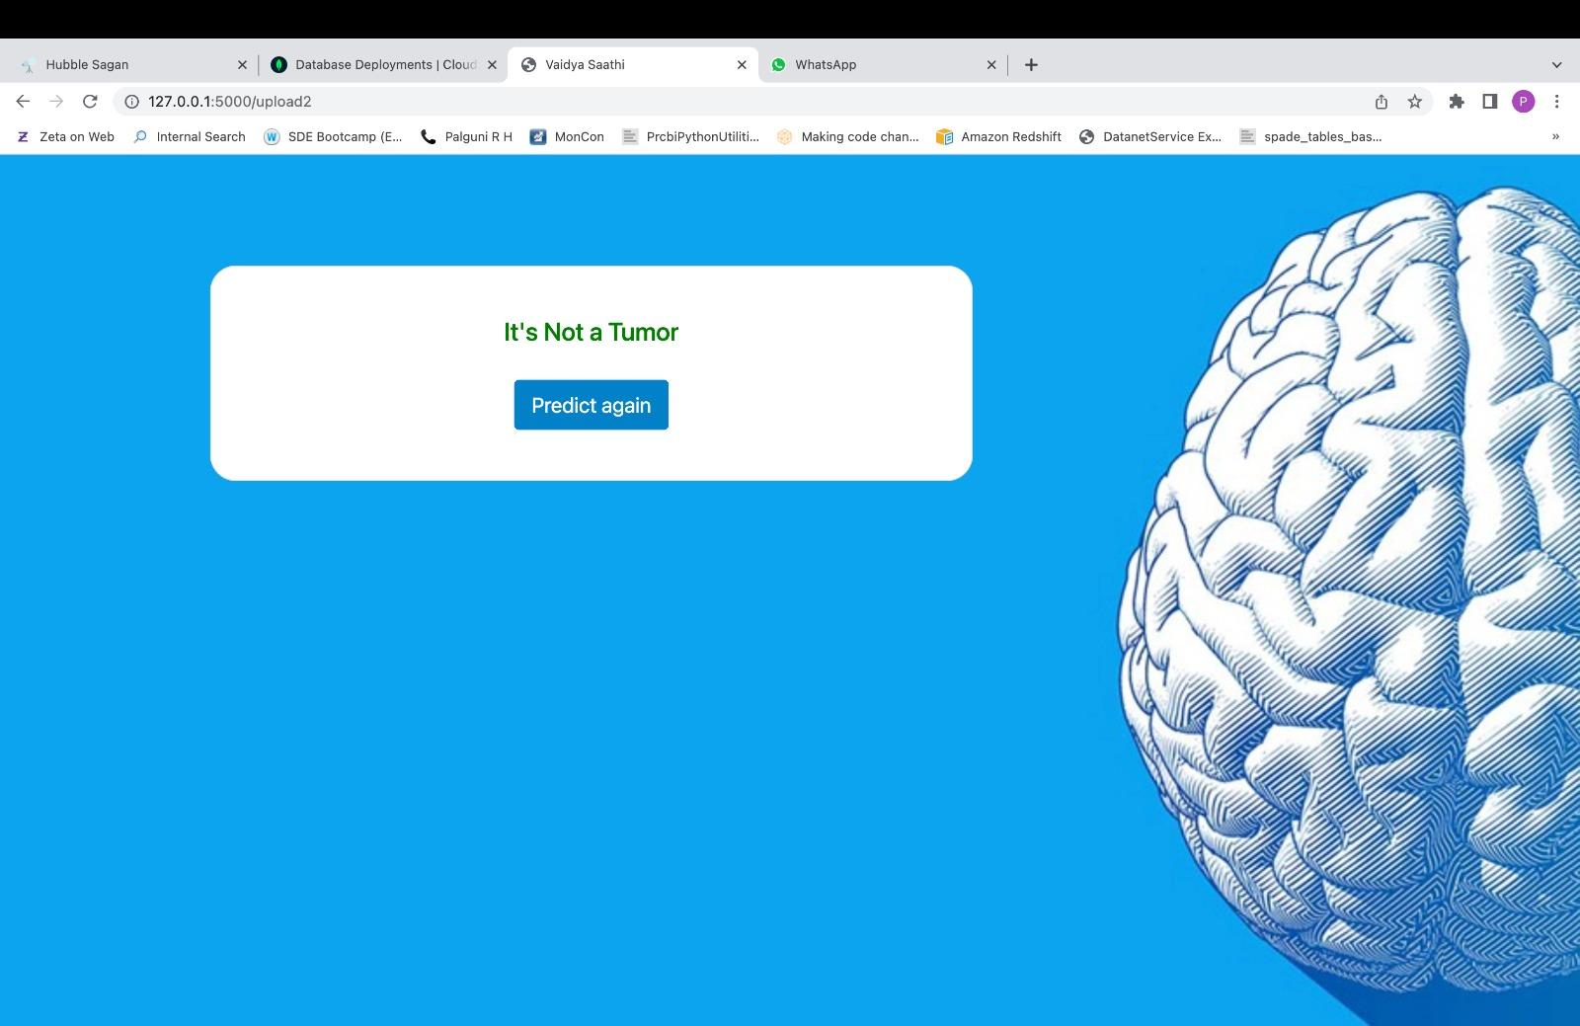
cv
OUTPUT
Department of Computer Science & Engineering, DSCE

Slide 18
cv
CO-GUIDE MEET DETAILS
Meet no. & Date | Suggestions / Improvements | Usage of Suggestions
1st Meet – 14th Jan 2023 | Stressed on maintaining simplicity in choosing technologies | Decided to use HTML , CSS for frontend
2nd Meet – 28th Jan 2023 | Reviewed the literature survey and helped with choosing the better model. | Deep learning model has been implemented using pre-trained EfficientNetB3
3rd Meet – 9th April 2023 | Reviewed the project model and gave suggestions on integration of model with web tools | Flask was implemented as a part of web integration
Department of Computer Science & Engineering, DSCE

Slide 19
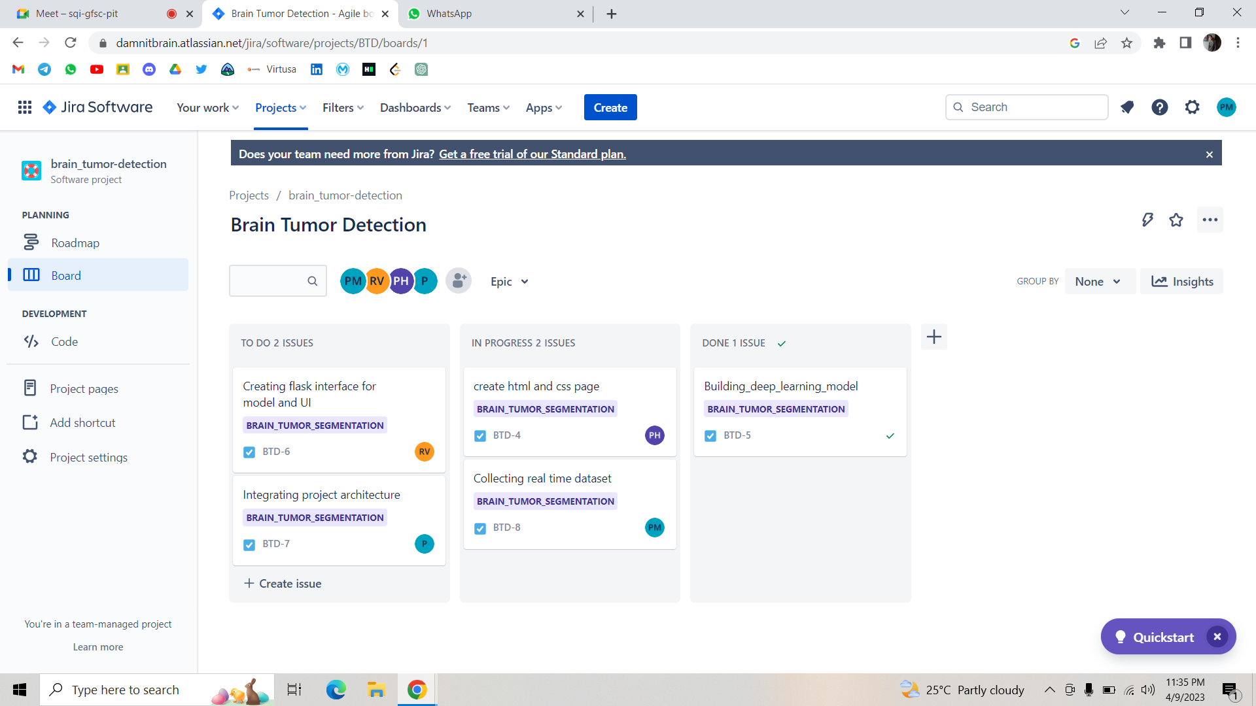
cv
PROJECT TOOL SNAPSHOT
Department of Computer Science & Engineering, DSCE

Slide 20
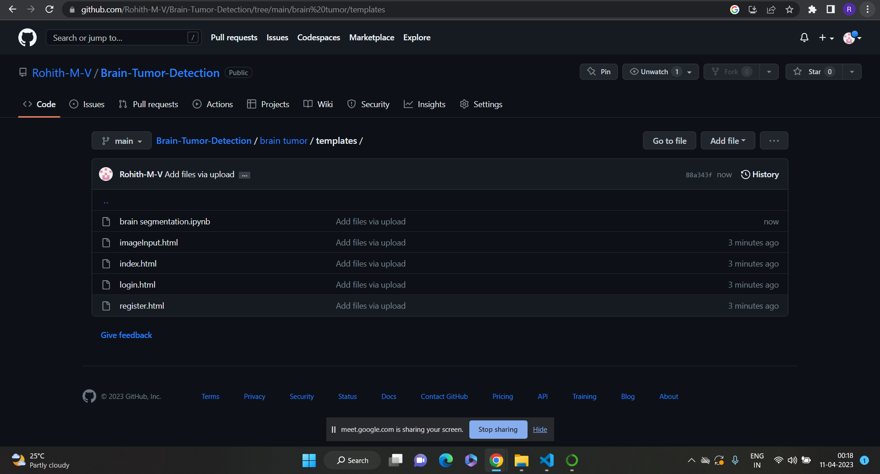
cv
PROJECT TOOL SNAPSHOT
Department of Computer Science & Engineering, DSCE

Slide 21
cv
Thank you
Department of Computer Science & Engineering, DSCE

