Slide 1

cv
NEUROLOGICAL DIAGNOSIS OF HUMAN BRAIN TUMORS
Team members
Palguni R H 1DS19CS108
Rohith M V 1DS19CS131
Pavan 1DS19CS110
Penmetsa Ishwarya 1DS19CS112
Under the guidance of
Prof. Keerthi S,
Assistant Professor,
Dept of Computer Science and Engineering
Department of Computer Science & Engineering, DSCE

Slide 2
cv
INDIVIDUAL CONTRIBUTION
PALGUNI R H Collecting and summarizing the Papers related to Classification Preparation of Presentation | ROHITH M V Collecting and Summarizing the papers related to Segmentation Preparation of Literature Survey
PENMETSA ISHWARYA Collecting and summarizing the Papers related to Pre-Processing Preparation of Presentation | PAVAN Collecting and summarizing the papers related to Feature Extraction Preparation of Literature Survey
Department of Computer Science & Engineering, DSCE

Slide 3
cv
Brain Tumor Identification and Classification of MRI Images using Deep Learning Techniques
ZHESHU JIA, DEYUN CHEN
BASE PAPER
Department of Computer Science & Engineering, DSCE

Slide 4
cv
INTRODUCTION
Traditional Image Processing techniques use the anatomical structure of a human organ, but detecting the brain tumors is challenging. Extensive and repetitive tasks executed by radiologists depends on their expertise, however it's time consuming. An automated segmentation is a helpful solution for the exact segmentation of pathological and healthy tissues and to trace the boundaries between various tissue areas by pathological MRI signal analysis. The model used in the paper to achieve the objective is a Fully-automated heterogeneous segmentation - Support vector machine method (FAHS-SVM). The segmenting function is based on the differences spotted between high level of uniformity in anatomy and the neighboring tissue. ELM(Extreme Learning Machine) is the deep learning algorithm used in the paper. Because of the properties like high resolution, contrast and clear separation of soft tissue, MRI is chosen for the study of brain images. The proposed model achieves 98.51% accuracy.
Department of Computer Science & Engineering, DSCE

Slide 5
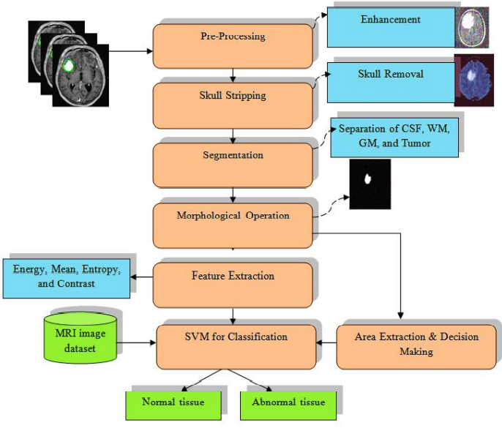
cv
EXISTING SOLUTION
Department of Computer Science & Engineering, DSCE

Slide 6
cv
EXISTING SOLUTION
Steps :
Pre-Processing :
Primary operation is to enhance the quality of the image for the human visual or for the computers.
Improving the MRI image parameters, enhanced SNR ratio, the improvement of the visual look of MRI images, removal of unnecessary noise and the underseen parts from the image, smoothening the region’s inner part and retaining the region edges.
To apply adaptive contrast improvement based on the changed sigmoid feature to enhance the SNR ratio.
Department of Computer Science & Engineering, DSCE

Slide 7
cv
EXISTING SOLUTION
2. Skull Stripping :
Used for effective image analysis.
It’s more practical.
Removing the non-brain tissues from Brain MRI image.
Helps the features like skull, skin and fat to be extracted from the image.
Commonly used techniques are :
1. Automatic skull stripping by image contour.
2. Threshold-based skull stripping
3. Segmentation and morphological stripping of the skull
Department of Computer Science & Engineering, DSCE

Slide 8
cv
3. Morphological operation :
Pre-processed MRI image transformed into a binary image with a threshold of 128.
Pixels values higher than the cutoff are mapped as white and below values are mapped as black.
Wavelet transformation is used for the efficient segmentation of the brain MRI images.
4. Segmentation :
Classification of tissue regions into GM, WM, CSF and tumor regions.
Department of Computer Science & Engineering, DSCE

Slide 9
cv
5. Feature Extraction :
Complex structures like WM, GM and CSF are present.
So, their relevant features have to be obtained.
Features extracted includes Mean, Standard deviation, Entropy, Skewness, Contrast, Energy, Homogenity etc..
Quality Feature Evaluation
Many parameters like SSIM (Structural Similarity Index) , MSE(Mean Square Error), PSNR( Peak Signal to Noise Ratio) are used to compare original image and processed image.
Department of Computer Science & Engineering, DSCE

Slide 10
cv
6. Experimental Result Analysis
1. DICE SIMILARITY CO-EFFICIENT:
Comparison between expert's ground truth and tumor region extracted from algorithmic prediction.
2. SEGMENTATION ACCURACY ANALYSIS :
Texture features are used to improve the accuracy of segmentation. These texture features are evaluated using texture analysis.
3. FRACTIONAL DIMENSION VS MEAN INTENSITY :
The fractal features are measured.
There should be a good separation between fractional dimension and mean intensity.
4. PROBABILITY OF DETECTION RATIO :
Probability detection ratio compares the accurate probabilistic capacity of different algorithms proposed.
5. CLASSIFICATION ERROR :
As size of the tumors increases it becomes difficult to mark the boundaries of the tumor between the tissues.
Department of Computer Science & Engineering, DSCE

Slide 11
cv
LITERATURE SURVEY
Department of Computer Science & Engineering, DSCE

Slide 12
cv
OUTCOMES OF SURVEY
Models available for Pre-processing:
Median filter, Mean Filter, Gaussian filter, Histogram equalization.
Models available for Segmentation :
Fast rCNN, k means Clustering algorithm, Fuzzy C-means
Models available for Classification:
SVM(Support Vector Machine), PNN(Probabilistic Neural Network), NB(Naive-Bayes)
Models available for Feature Extraction :
PCA(Principal Component Analysis), ICA(Independent Component Analysis)
Department of Computer Science & Engineering, DSCE

Slide 13
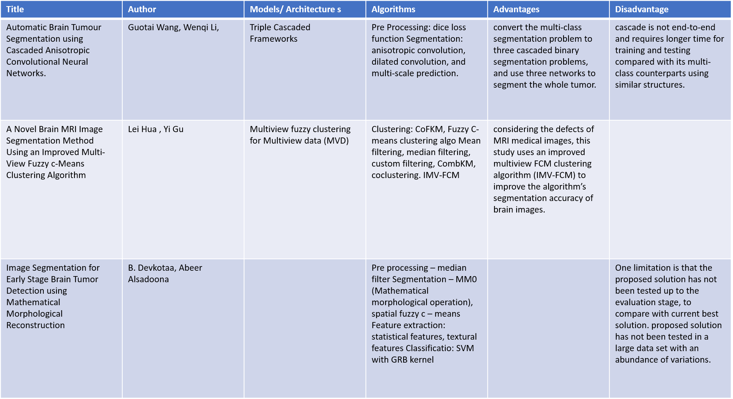
cv
Department of Computer Science & Engineering, DSCE

Slide 14
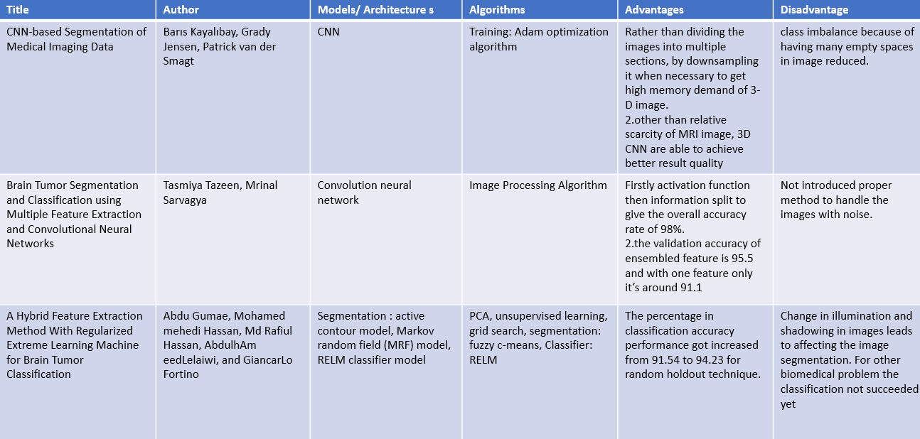
cv
Department of Computer Science & Engineering, DSCE

Slide 15
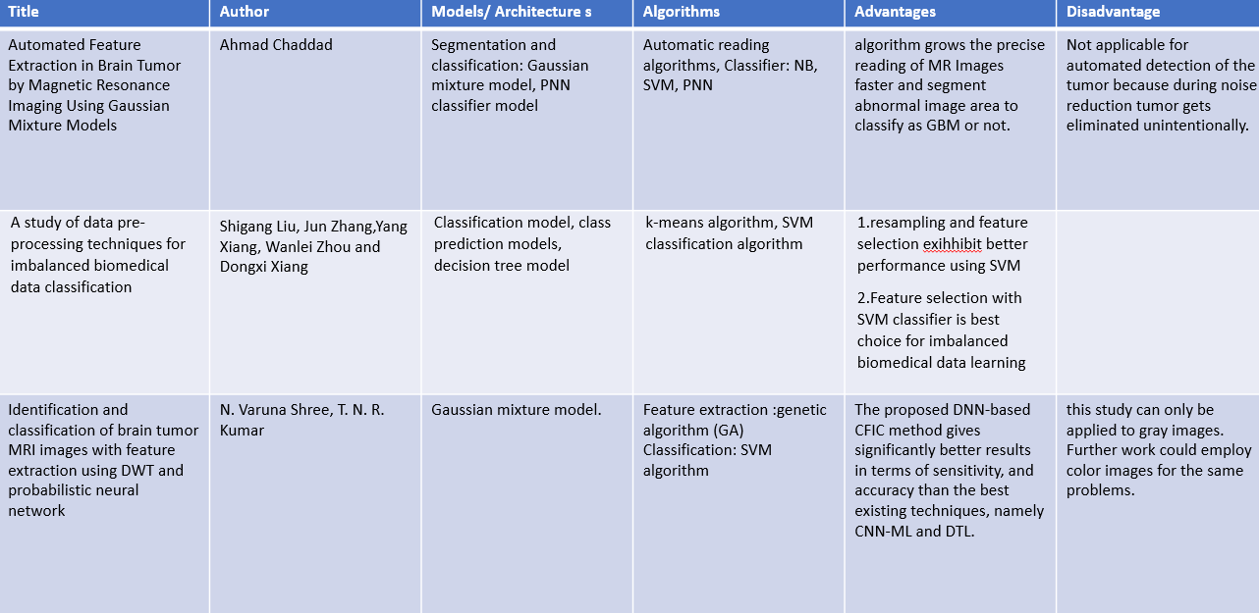
cv
Department of Computer Science & Engineering, DSCE

Slide 16
cv
CONCLUSION
By Preparing this literature survey, we explored many methods of accomplishing our objective of efficient detection of human brain tumors to effectively reduce the death rates. We got a clear notion about advantages and disadvantages of each models that are currently present and helped us to select the one to use in our project.
Department of Computer Science & Engineering, DSCE

