Slide 1

cv
NEUROLOGICAL DIAGNOSIS OF BRAIN TUMOR
Team Members
1. Palguni R H (1DS19CS108)
2. Pavan (1DS19CS110)
3. P Ishwarya (1DS19CS112)
4. Rohith M V (1DS19CS131)
Under the Guidance of
Prof. Keerthi S
Assistant Professor
Dept of Computer Science and Engineering
Department of Computer Science & Engineering, DSCE

Slide 2
cv
INTRODUCTION
Brain tumor is a condition when abnormal cells form within the brain. Tumors in other parts of the body represents uncontrolled cancer cell growth, while in brain, it represents the abandoned brain cell growth, benign(non-cancerous) or malignant(cancerous), which possess the necessity of early diagnosis of a brain tumor, which may reduce the risk of cells becoming cancerous. Benign tumors are similar and does not include any active(cancer) cells, while malignant tumors are heterogeneous and include active(cancer) cells.
Choosing MRI for diagnosis comes with its potential properties, high resolution, contrast and clean separation of soft tissue. Detection of human brain abnormal structures by basic imaging techniques is challenging. An automated segmentation is a helpful solution for the exact segmentation of pathological and healthy tissues and to trace the boundaries between various tissue areas by pathological MRI signal analysis.
Department of Computer Science & Engineering, DSCE

Slide 3
cv
MOTIVATION
According to the survey, Approx 85 thousand people are getting diagnosed for brain tumors every year globally. Out of which, approx. 15 thousand people are losing their lives. But the scary fact is 25% of these death rates are due to late or improper diagnosis of the disease. So a proper detection and diagnosing model if used efficiently can save thousands of lives every year, and this was the key factor which has driven us towards this project.
Department of Computer Science & Engineering, DSCE

Slide 4
cv
PROBLEM STATEMENT
Diagnosis of a brain tumor is a repetitive and extensive task. Earlier diagnosis means earlier treatment which may have positive impact on patient quality of life, and even survival. Building an automated segmentation method for the exact segmentation of pathological and healthy tissues that comprise the MRI image with the optimised accuracy is the need of the day.
Department of Computer Science & Engineering, DSCE

Slide 5
cv
CHALLENGES IN THE CURRENT WORK
In manual system it is hard to detect tumor if tumor is in secondary stage.
Detection of human brain abnormal structures using traditional or basic imaging techniques is challenging.
Very minor features extraction through the MRI images for early diagnosis of brain tumors seems difficult to achieve with current methods.
Risk of improper diagnosis by doctors.
Time-consuming process.
Department of Computer Science & Engineering, DSCE

Slide 6
cv
OBJECTIVES
Building an automated segmentation method for the classification of tissues either as abnormal or as healthy, facilitating the upgradation from manual human brain tumor detection to automated human brain tumor detection.
Optimizing the accuracy of segmentation.
Optimizing the feature extraction required for segmentation.
To accomplish the mission of saving millions of lives.
To build a single-click web-application for doctors, which reduces the overhead of overseeing the MRI images to doctors.
To provide clear diagnosis reports to doctors, which help them to take necessary treatment steps.
Time-effective diagnosis system.
Department of Computer Science & Engineering, DSCE

Slide 7
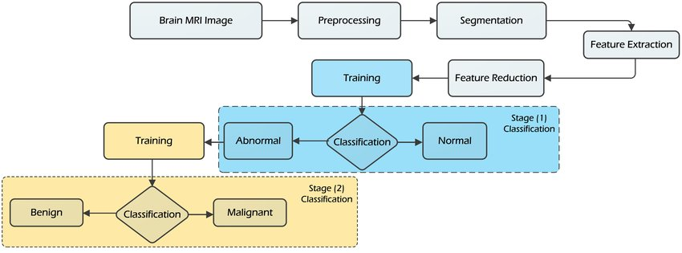
cv
PROPOSED SOLUTION
.
Department of Computer Science & Engineering, DSCE

Slide 8
cv
PROPOSED SOLUTION
Pre-processing:
Improving the quality of image by enhancing SNR ratio, removing unnecessary noise, improvement of visual look
Segmentation:
Segmentation of healthy and pathological tissues using SVM algorithm
Feature extraction:
Calculation of mean, standard deviation, entropy, skewness, energy, contrast and other superior-level image details
Classification:
Classification of tumors into glioblastoma, meningioma, pituitary tumors.
Accuracy evaluation:
Evaluating the accuracy of the proposed model.
Department of Computer Science & Engineering, DSCE

Slide 9
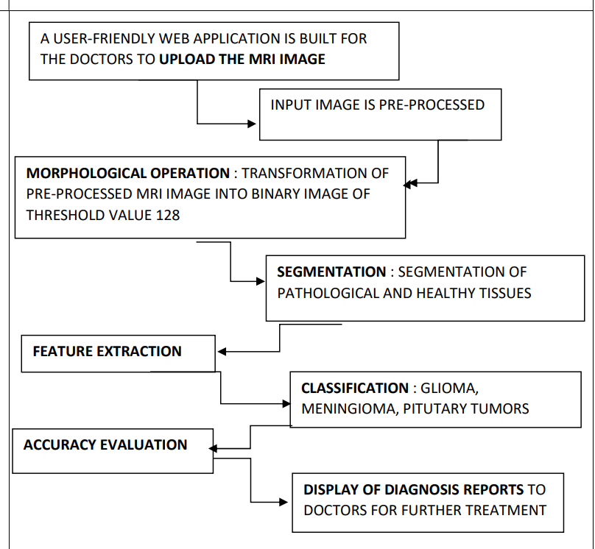
cv
OVERALL IMPLEMENTATION
Department of Computer Science & Engineering, DSCE

Slide 10
cv
APPLICATIONS
Conversion of the manual detection system into fully automated process
since the whole model is implemented under a website, it gives access to upload the mri datasets remotely for diagnosis
Assists doctors in early and accurate diagnosis of brain tumors and helps in its treatment measures.
fastens the whole diagnosis process which saves millions of lives
the whole process is associated with the well defined User interface which makes it easier to handle cases
along with the tumor prediction, the web output would provide the treatment analysis for that particular case which helps doctors a lot in taking proper treatment decision
Department of Computer Science & Engineering, DSCE

Slide 11
cv
CONCLUSION and FUTURE ENHANCEMENTS
So this was our proposed model, which shows high accuracy in detecting tumors, the combination of web dev and machine learning fields gives this project a greater scope which can be used beyond its intended purpose.
As a part of future enhancements, rather than keeping the website solely for tumor detection purpose instead it can serve other medical field requirements like patient’s record maintenance, suggestions about the treatments etc.
Department of Computer Science & Engineering, DSCE

Slide 12
cv
Thank you
Department of Computer Science & Engineering, DSCE

