Slide 1
SMART INDIA HACKATHON 2026 • NTRO • PROBLEM STATEMENT SIH26162
AeroThermal
AI-Based Detection & Classification of Industrial Fires and
Persistent Thermal Sources
NASA FIRMS
OSM + WORLDCOVER
TEMPORAL AI
GIS OVERLAY
Team Name: [Your Team]
1. [Lead] Full-Stack & Geospatial 2. [Name] ML / Classification
3. [Name] GIS & Mapping 4. [Name] Backend & APIs
5. [Name] Frontend & UX 6. [Name] Pitch & Research
LIVE PLATFORM
sih-thermal-intel.vercel.app

Slide 2
THE OPERATIONAL GAP
02
To a satellite, every fire is just a glowing pixel
WILDFIRE?
Misclassified → delayed NDRF response, forest loss
WHAT FIRMS GIVES US TODAY
same pixel
• NASA FIRMS detects thousands of thermal anomalies across India daily (VIIRS 375m / MODIS 1km).
• It reports WHERE and HOW HOT — never WHAT: a refinery flare, a stubble fire, a wildfire, or an illegal kiln look identical.
• Responders waste hours on false alarms; clandestine industrial activity goes unnoticed.
• No industrial-vs-natural segregation exists in any current open system — this is the exact PS 26162 gap.
GAS FLARE?
False industrial alarm → wasted inspection crews
same pixel
STUBBLE BURN?
Seasonal smoke → city air-quality crisis misattributed
same pixel
CLANDESTINE?
Unregistered plant → national-security blind spot
same pixel
One thermal signature. Four completely different responses.

Slide 3
PROPOSED SOLUTION
03
From ambiguous heat pixels to action
1. DETECT & INGEST
2. CONTEXTUALIZE
3. CLASSIFY & EXPLAIN
4. ACT & TRACK
— NASA FIRMS NRT feed: VIIRS SNPP / NOAA-20 (375m), MODIS (1km)
— FRP, brightness temperature, confidence, pass timestamps
— Live-key ingestion + curated scenario replay
— OpenStreetMap Overpass: refineries, flare stacks, power, mining
— ESA WorldCover land-cover class per hotspot pixel
— 60-day persistence baseline for the exact 375m cell
— 7-class taxonomy with confidence % and evidence panel
— Persistence separates stationary flares from transient fires
— Counter-evidence shown honestly for analyst review
— GIS overlay with evidence dossiers per hotspot
— Risk engine: population, highways, hospitals, downwind zone
— Incident lifecycle → agency dispatch → resolution tracking

Slide 4
TECHNICAL ARCHITECTURE
04
End-to-end pipeline — all free & open data
NASA FIRMS
VIIRS/MODIS NRT
OSM OVERPASS
facilities & land-use
ESA WORLDCOVER
land-cover class
PERSISTENCE ENGINE
60-day recurrence
AI CLASSIFIER
7 classes + evidence
GIS OVERLAY
Leaflet + dispatch
EVERY HOTSPOT CARRIES A FULL DOSSIER
FIRMS metrics (FRP 88.4 MW • 85°C • 22.358°N 69.831°E) + facility match (Jamnagar Refinery, 120 m) + persistence (80%, 48/60 passes) + land-cover (Built-up) → CLASSIFICATION: INDUSTRIAL GAS FLARE, 94% confidence, with recommended action routed to the right agency.
Stack: Python stdlib server + REST API • Vercel serverless • Leaflet GIS • GeoJSON export • Zero paid services, zero API keys required for demo mode.

Slide 5
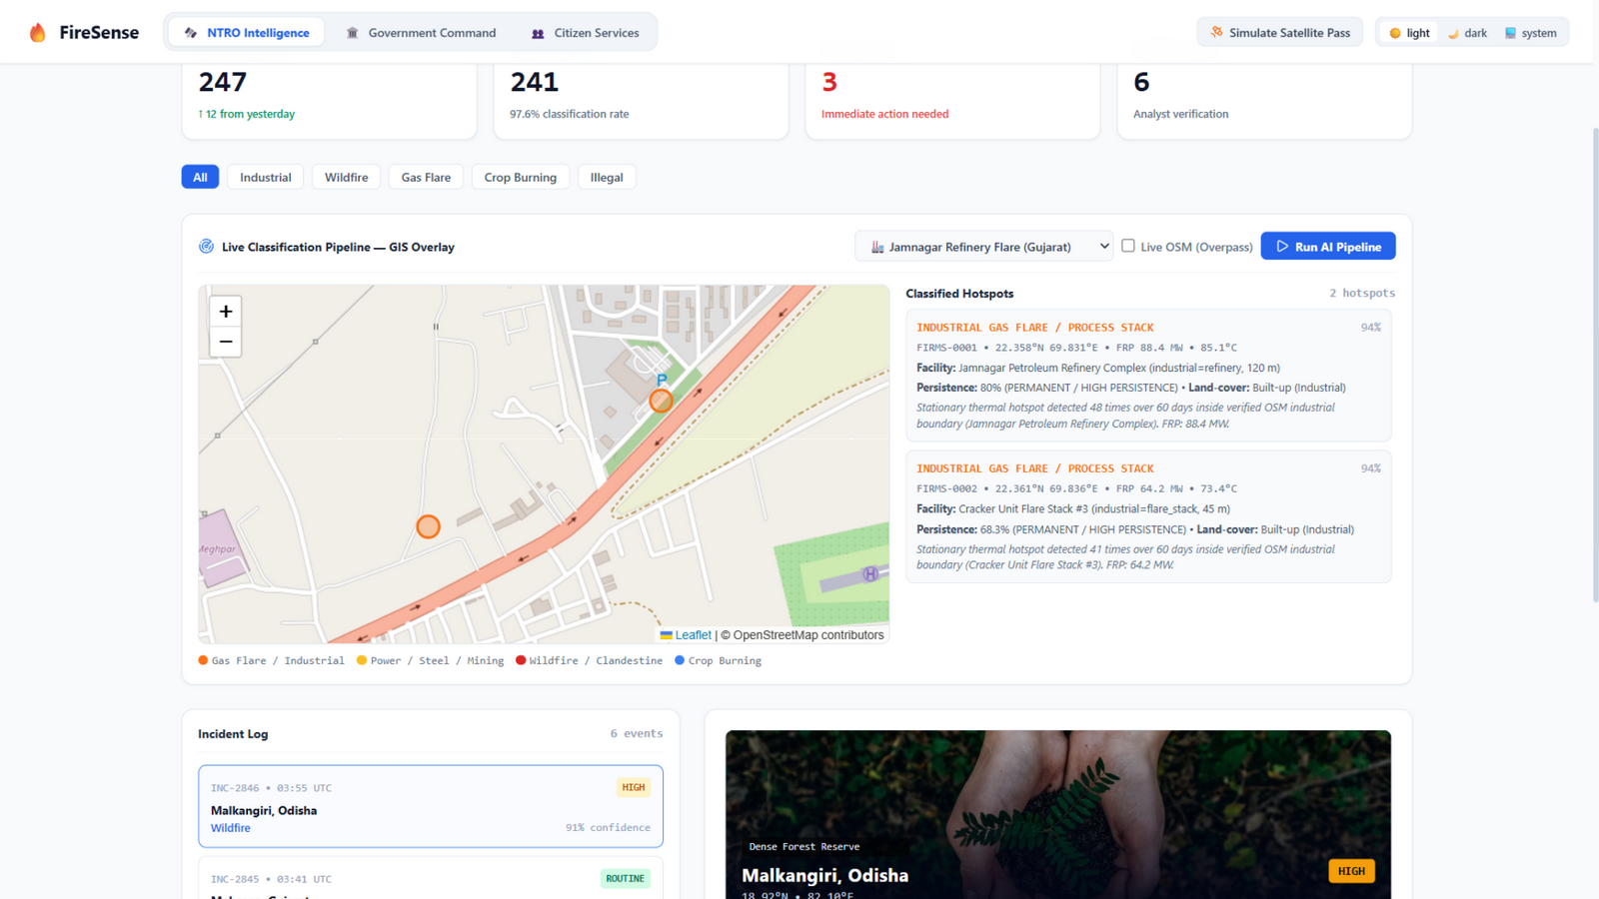
LIVE PRODUCT — NTRO INTELLIGENCE PORTAL
05
GIS overlay with evidence dossiers — live
• Real Leaflet map: hotspots colored by class with pop-up evidence
• Pipeline runs FIRMS → OSM → persistence → WorldCover → class
• Evidence dossier: facility match, distance, persistence %, land-cover
• Live OSM toggle queries Overpass API in real time
• 5 operational Indian scenarios + live FIRMS-key mode
LIVE: Jamnagar refinery flare auto-classified, 94% confidence

Slide 6
CLASSIFICATION TAXONOMY
06
Seven classes — persistence × context, not guesswork
INDUSTRIAL GAS FLARE
Persistent + inside refinery boundary
→ MoEFCC emission log
94%
POWER PLANT / COAL FIRE
Persistent + power-station tag
→ Plant safety + utility
94%
STEEL / SMELTER
Persistent + metallurgical facility
→ Pollution control board
94%
MINING / COAL STOCKYARD
Persistent + quarry land-cover
→ Indian Bureau of Mines
94%
WILDFIRE
High FRP + tree cover + episodic spread
→ Forest Dept + NDRF
91%
STUBBLE BURNING
Transient cluster + cropland + season
→ CAQM / CPCB alert
88%
CLANDESTINE ANOMALY
High persistence + NO registered facility
→ NTRO / UAV recon
88%

Slide 7
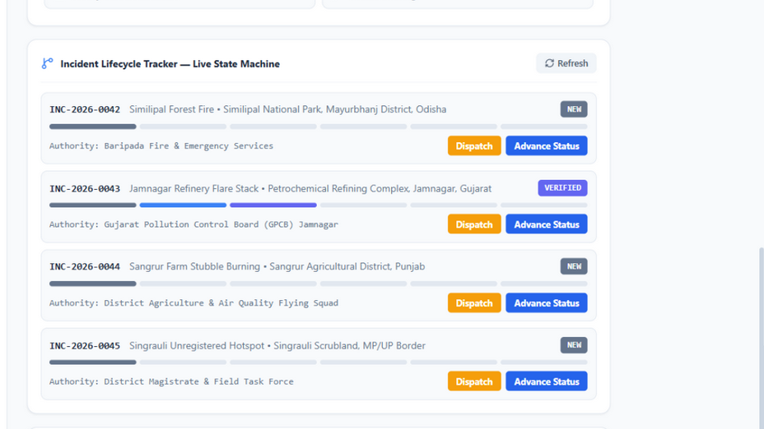
LIVE PRODUCT — GOVERNMENT COMMAND
07
Incident lifecycle state machine & dispatch
• Six-stage state machine backed by REST API + server persistence
• One-click dispatch routes to the correct jurisdiction (fire, GPCB, NDRF, DM)
• Assets-at-risk engine: population, NH corridors, hospitals, downwind corridor
• Citizen Reports Inbox: crowd reports cross-checked vs FIRMS before acting
LIVE: incidents NEW → INVESTIGATING → … → RESOLVED with authority routing

Slide 8
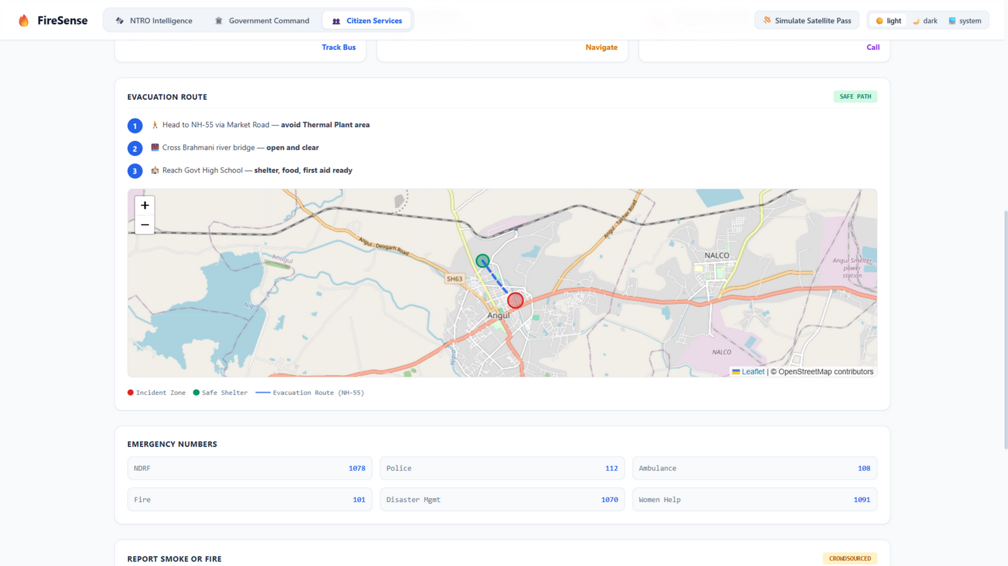
LIVE PRODUCT — CITIZEN SERVICES
08
Citizen eyes + satellite brain
• Multilingual portal (English / Hindi / Odia) with SOS escalation
• Crowdsourced smoke/fire reports with GPS attach
• Reports land in the Command inbox for FIRMS cross-check
• Offline SMS fallback: HELP <PINCODE> → 1078 (zero-data ready)
LIVE: evacuation map — incident zone, safe shelter, NH-55 route

Slide 9
NATIONAL IMPACT
09
Value for every PS stakeholder
NTRO & DEFENCE
DISASTER MGMT (NDRF/SDMA)
AIR QUALITY (CAQM/CPCB)
ENVIRONMENT (MoEFCC)
— Clandestine thermal facility flagging in non-industrial zones
— Persistent-source monitoring grid for critical infrastructure
— Wildfire alerts within one satellite pass (~15 min)
— Assets-at-risk + downwind corridor pre-computed for responders
— Stubble-burn clusters separated from industrial flares — no false industrial blame
— Season-adjusted seasonal burning statistics
— Automatic flare-recurrence logs vs permits for every registered plant
— Audit-ready evidence trail from satellite to action
Zero-cost open data • Deploys anywhere • Works today at sih-thermal-intel.vercel.app

Slide 10
SCIENTIFIC RIGOR
10
What we prove — and what we honestly cannot
✔ SCIENTIFICALLY PROVEN
⚠ HONEST LIMITATIONS
✔ Temporal persistence cleanly separates stationary flares from transient fires (48/60 vs 1-2/60 passes).
✔ Facility + land-cover context resolves flare vs kiln vs wildfire at district scale.
✔ Every classification ships with evidence AND counter-evidence for analyst verification.
✔ Deterministic, explainable rules — no black box, auditable by NTRO.
⚠ VIIRS resolution ceiling (375m–1km): exact facility attribution is probabilistic in dense industrial clusters.
⚠ Ground-truth labels are scarce; land-cover is used as validation proxy.
⚠ Fires co-locating with normal flares (refinery fire vs routine flare) need optical confirmation (Sentinel-2 on roadmap).
⚠ Demo data: curated scenarios + live FIRMS; persistence archive grows with each pass.

Slide 11
DEPLOYMENT ROADMAP
11
From working MVP today to national grid
PHASE 1 — DONE TODAY
PHASE 2 — 6 MONTHS
PHASE 3 — NATIONAL
— Full classification pipeline + 7-class taxonomy (live)
— 3-portal platform on Vercel with server persistence
— Live FIRMS key ingestion + Overpass + WorldCover
— Incident lifecycle, dispatch, citizen reporting loop
— Sentinel-2 20m SWIR optical validation layer
— UAV reconnaissance tasking for clandestine flags
— PostGIS storage + multi-tenant agency accounts
— WhatsApp/SMS alert gateway for district officers
— 24×7 national thermal defence surveillance grid
— Direct integration: NDRF, FSI, CPCB, state SDMA
— Predictive fire-risk modelling from persistence trends
— On-prem deployment for NTRO classified networks

Slide 12
WHY AEROTHERMAL WINS
Not a slide-ware prototype.
A working national platform — live now.
DELIVERABLE 1
Industrial fires segregated from forest/agricultural fires with explainable evidence — exactly as the PS demands.
DELIVERABLE 2
GIS solution: classified hotspots as a live map overlay, with storage, dispatch and monitoring built in.
THE KILLER FEATURE
Persistence-based clandestine detection — thermal infrastructure that doesn't officially exist, flagged for NTRO.
Live demo: sih-thermal-intel.vercel.app • NASA FIRMS • OpenStreetMap • ESA WorldCover

