Slide 1



TEKATHON-5.0- 2026
FireSense | Thermal Anomaly & Disaster Command
• Problem Statement ID: SIH26162
• Problem Statement Title: Real-time Thermal Anomaly Detection & Disaster Intelligence Platform
• Theme: Disaster Management & Space Technology
• PS Category: Software | Project: FireSense (AeroThermal)

Slide 2


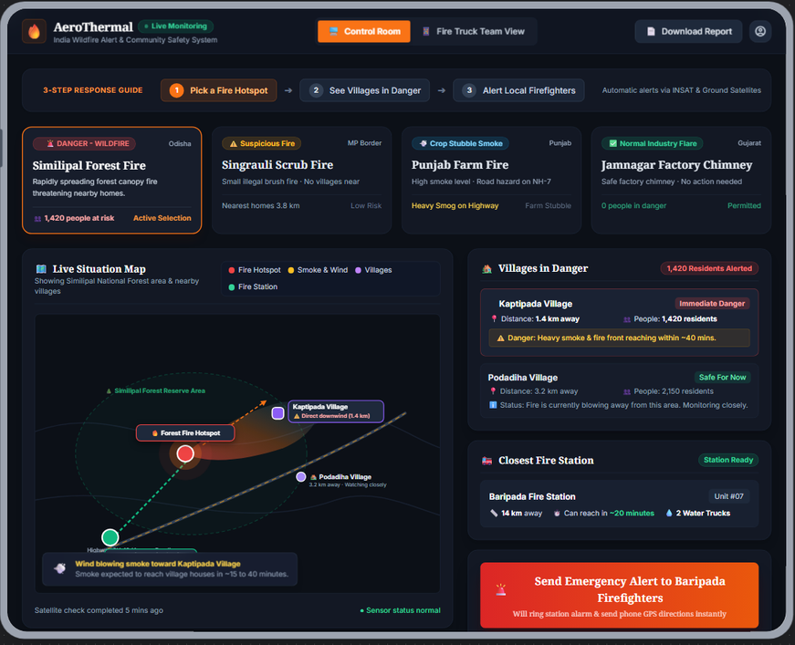
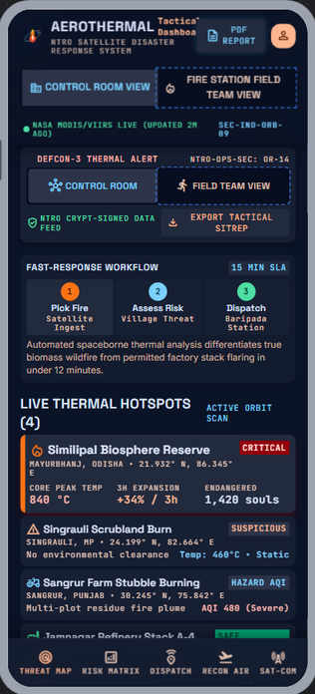
PROPOSED SOLUTION
AeroThermal — Satellite-to-Ground Incident & Disaster Response
Detect → Classify → Alert → Respond → Track
Turns NASA FIRMS satellite hotspots into classified incidents — Wildfire, Industrial, Gas Flare, Crop Burning, or Illegal.
End-to-End 3-Portal Ecosystem: NTRO Intelligence (Satellite AI) → Government Command (NDRF Dispatch) → Citizen Services (Ground Safety).
False-alarm safeguard: Multi-pass repeat signal + facility cadastre match filters licensed flares (>85% confidence threshold).
Zero-Data Life Safety: Offline SMS broadcast (1078) and vernacular safe routing (Hindi/Odia/English) when internet towers fail.
🔭 Detect
🧠 Classify
🚨 Alert
🚒 Respond
✅ Track
Our Website & APP UI
CONTROL ROOM
FIRE STATION
FIELD TEAM
🛰️ NTRO Intelligence
VIIRS/MODIS 375m pass, 97.6% auto-classification, 91% confidence & wind-spread vector.
🏛️ Government Command
Real-time situational awareness, 4-state tracking, NDRF resource bars, & 1-click dispatch.
👥 Citizen Services
Multi-language (English/Hindi/Odia), 1-tap SOS rescue triage, safe evacuation path, & SMS 1078.
Live Status Sync — Control Room ⇄ Field Responder View
4 Demo Scenarios
Similipal Forest Fire
Jamnagar Refinery
Punjab Farm Burning
Singrauli Hotspot
WILDFIRE — 1,420 people at risk
FACTORY FLARE — zero threat
CROP SMOKE — CAQM alert
UNKNOWN — NTRO / drone check
2
@TEKATHON-5.0- Template
Notes:
1

Slide 3
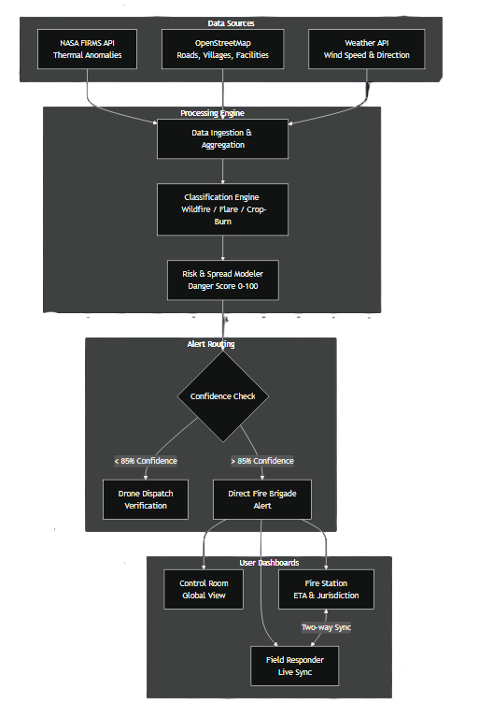
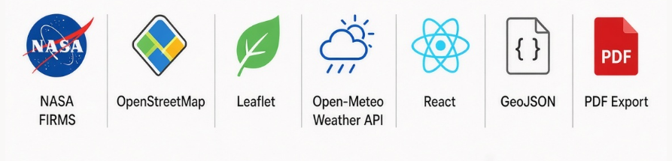
AeroThermal
TECHNICAL APPROACH
Risk Scoring & Confidence-Gated Alert Pipeline
1
2
3
4
5
Satellite Detect
Classify + Score
Verify Confidence
Context & Spread
Alert & Track
NASA FIRMS Hotspot Ingestion
(VIIRS 375m & MODIS 1km, 3-hr pass)
AI Multi-Class Categorization
Wildfire / Industrial / Flare / Crop-Burn
Confidence & Threat Gating
Peak temp (623°C), repeat pass & cadastre match
Downwind Spread & Impact Mapping
Surface wind vector + population at risk (398K)
Actionable Dispatch & Relief Sync
NDRF deployment, safe citizen routing & SMS 1078
Confidence Gate: >85% → Direct Fire-Brigade Alert · <85% → Drone Verification First
Persistence Check: Fire Frequency vs 60-Day Baseline (Anomaly Flag)
Technology Stack
3
@TEKATHON-5.0- Template
Notes:
2

Slide 4
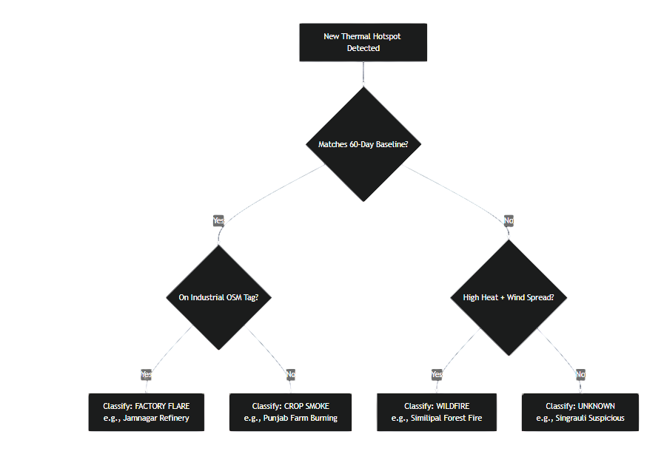
AeroThermal
FEASIBILITY AND VIABILITY
FEASIBILITY
VIABILITY
Classification Decision Tree
Operates on NASA FIRMS near-real-time satellite telemetry, OpenStreetMap, and Open-Meteo weather APIs.
Zero new sensor deployment: Leverages pre-existing space orbits and standard mobile browsers with offline SMS gateway.
Live working prototype deployed on edge infrastructure (sih-thermal-intel.vercel.app) with full 3-portal sync.
Unified 3-tier operational hierarchy: NTRO Space Analysts → State Incident Commanders → NDRF/Fire → Local Citizens.
Scalable to all Indian states: Pre-mapped zones across Odisha, Gujarat, Punjab, and Haryana industrial/forest corridors.
Audit & reporting compliance: Downloadable executive command memos, GeoJSON corridors, and live status logs.
CHALLENGES & RISKS
STRATEGIES
Distinguishing routine licensed industrial flares (e.g. Jamnagar/Mehsana) from uncontrolled forest wildfires.
Field internet connectivity failure in remote forest reserves during active disasters preventing app usage.
Coordination latency across multiple civil and defense agencies (NDRF, State Police, Forest Dept, District Collectors).
AI Confidence Engine (>85% auto-dispatch, <85% drone scout) + National Industrial Cadastre facility database matching.
Zero-Data Cellular Broadcast: Automated offline SMS routing (HELP <Pincode> to 1078) gives shelter routes without internet.
1-Click Command Center with pre-formatted public alerts, district collector memos, and real-time NDRF resource tracking.
4
@TEKATHON-5.0- Template
Notes:
3

Slide 5



AeroThermal
IMPACT AND BENEFITS
From Satellite Pixel to Fire Engine on the Road — Tracked End-to-End
Every incident delivers actionable intelligence: fire classification, danger level, population at risk, and deployed NDRF assets.
Operational Example: Angul Industrial Fire — 82K population at risk, 3 NDRF teams deployed, Brahmani bridge evacuation corridor kept clear.
SOCIAL
ECONOMIC
ENVIRONMENTAL
Sub-10 minute emergency response time: 1-tap SOS triage links directly to nearest deployed NDRF battalion with live ETA.
Vernacular accessibility: Full citizen services in Hindi, Odia, and English ensures rural communities are guided safely.
Saves millions in emergency deployment costs by filtering out false alarms and licensed industrial flares.
Zero hardware capex for government agencies: Runs purely on NASA satellite passes and open infrastructure.
Rapid wildfire containment in critical ecological reserves (Similipal & Malkangiri) limits forest and wildlife devastation.
Crop-burning tracking across Punjab & Haryana feeds CAQM action, directly combating North Indian winter smog.
5
@TEKATHON-5.0- Template
Notes:
4

Slide 6
AeroThermal
RESEARCH AND REFERENCES
Sources
LIVE PROTOTYPE
1. Live Deployed Prototype & Codebase
Live Web Platform: https://sih-thermal-intel.vercel.app
GitHub Repository: https://github.com/PaliiiXRAY/sih-thermal-intel
2. NASA FIRMS (Primary Satellite Telemetry)
NASA FIRMS Official Portal: https://firms.modaps.eosdis.nasa.gov/
Active Fire Attributes (MODIS 1km & VIIRS 375m I-band)
https://www.earthdata.nasa.gov/data/tools/firms
3. Surface Meteorology & Infrastructure
OpenStreetMap Overpass API: https://dev.overpass-api.de/
Open-Meteo High-Resolution Weather Model: https://open-meteo.com/
4. Disaster Response Frameworks
NDRF & NDMA Standard Operating Procedures for Wildfire & Industrial Hazards
National Disaster Management Authority (NDMA): https://ndma.gov.in/
https://leafletjs.com/
5. Supporting Context
NASA LANCE (Land, Atmosphere Near real-time Capability for EO)
https://www.earthdata.nasa.gov/data/tools/firms
sih-thermal-intel.vercel.app
Live Control Room, Fire Station & Field Team views with 4 working demo scenarios.
Team: AeroThermal
Problem Statement ID: SIH26162
Agency Partner: NTRO
6
@TEKATHON-5.0- Template
Notes:
5

