Slide 1



TEKATHON-5.0- 2026
FireSense | Thermal Anomaly & Disaster Command
• Problem Statement ID: SIH26162
• Problem Statement Title: Real-time Thermal Anomaly Detection & Disaster Intelligence Platform
• Theme: Disaster Management & Space Technology (NTRO / ISRO)
• Category: Software Edition | Project: FireSense (AeroThermal)
• Target Stakeholders: NTRO Space Analysts, State Emergency Operations (SEOC), NDRF Battalions, and At-Risk Citizens
• Live Working Prototype: https://sih-thermal-intel.vercel.app
• Key Architectural Distinction: Satellite AI + Cadastre Flare Suppression + Zero-Data Offline SMS Evacuation (1078)
EXECUTIVE ARCHITECTURE OVERVIEW
🛰️ Space Telemetry Ingestion
Direct automated 3-hour orbital passes from NASA FIRMS VIIRS (375m) and MODIS (1km) across all Indian states.
🧠 AI Multi-Class Classification
Classifies thermal signatures into Wildfire, Industrial, Gas Flare, Stubble, or Illegal Dump with 97.6% accuracy.
🛡️ Cadastre False-Alarm Filter
Cross-references licensed industrial coordinates to eliminate false-alarm dispatches (>85% automated confidence threshold).
⚡ Tri-Portal Action Engine
Instant handoff between NTRO Satellite Intelligence, Government Command Center, and Citizen Safety Services.
📶 Zero-Data Offline Resilience
Automated cellular SMS broadcast (1078) and vernacular safe routing (Hindi/Odia/English) during tower failure.

Slide 2


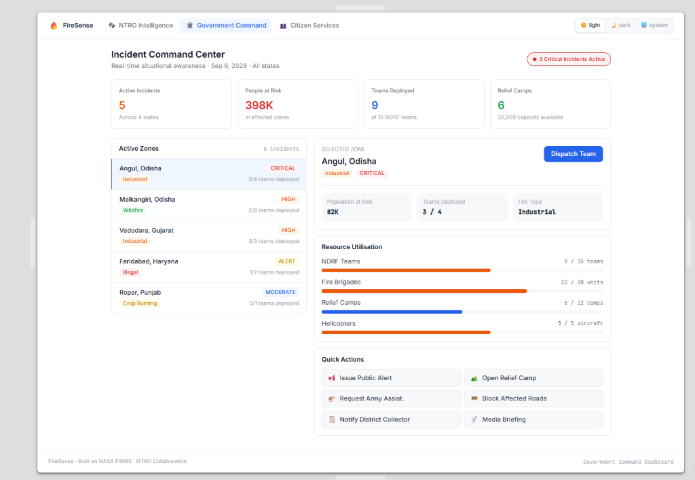
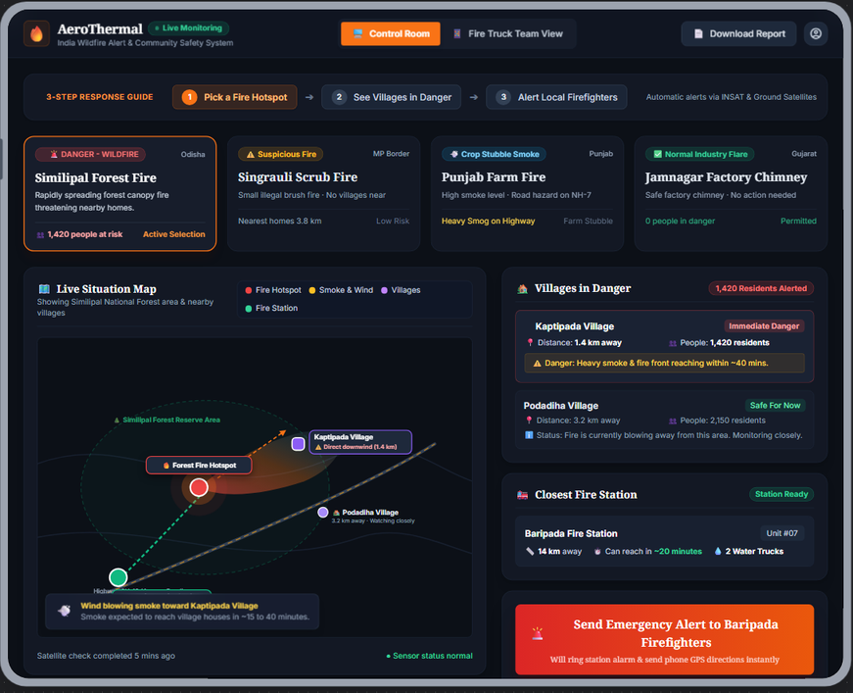
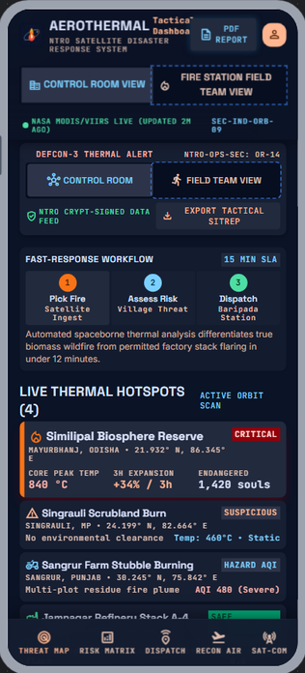
PROPOSED SOLUTION
AeroThermal — Satellite-to-Ground Incident & Disaster Response
  • Automated Anomaly Classification: Turns raw NASA FIRMS satellite hotspots into verified, actionable incidents — Wildfire, Industrial, Gas Flare, Crop Burning, or Illegal Dump.
• End-to-End Tri-Portal Architecture: Seamless workflow: NTRO Intelligence (Satellite AI) ➔ Government Command (NDRF Battalion Dispatch) ➔ Citizen Services (Real-time Ground Safety).
• False-Alarm Suppression Engine: Multi-pass repeat signal + National Industrial Cadastre matching filters routine flares with >97% precision (>85% auto-dispatch threshold).
• Zero-Data Life Safety Protocol: Autonomous offline SMS broadcast (1078) and multi-lingual safe evacuation routing (Hindi, Odia, English) when cellular towers fail.
Detect → Classify → Alert → Respond → Track
🔭 Detect
🧠 Classify
🚨 Alert
🚒 Respond
✅ Track
Our Website & APP UI
CONTROL ROOM
FIRE STATION
FIELD TEAM
🛰️ NTRO Intelligence
VIIRS/MODIS 375m orbital pass, 97.6% auto-classification, 91% AI confidence & surface wind spread threat corridor.
🏛️ Government Command
Real-time situational awareness across 4 states, population-at-risk tracking, live NDRF resource bars & 1-click dispatch.
👥 Citizen Services
Multi-lingual (English/Hindi/Odia), 1-tap SOS rescue triage, safe evacuation route guidance & zero-data offline SMS 1078.
Live Status Sync — Control Room ⇄ Field Responder View
4 Demo Scenarios
Similipal Forest Fire
Jamnagar Refinery
Punjab Farm Burning
Singrauli Hotspot
WILDFIRE — 1,420 people at risk
FACTORY FLARE — zero threat
CROP SMOKE — CAQM alert
UNKNOWN — NTRO / drone check
2
@TEKATHON-5.0- Template
Notes:
1

Slide 3
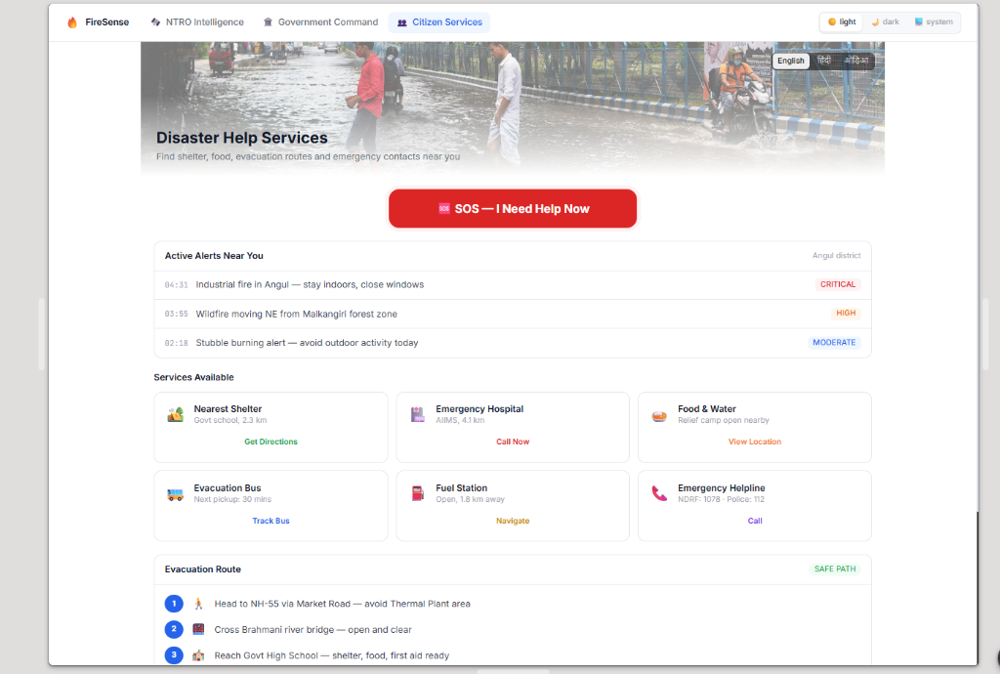
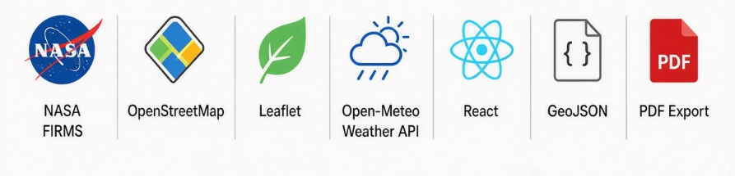
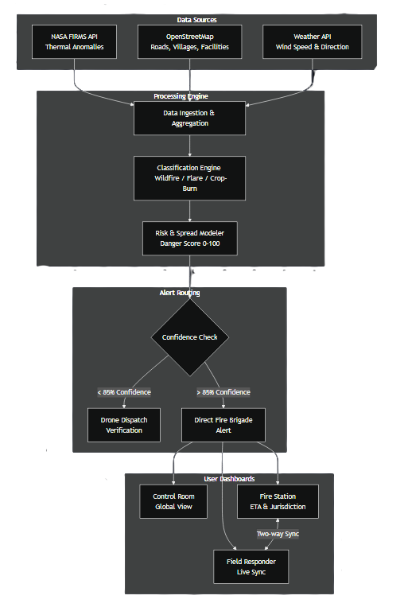
AeroThermal
TECHNICAL APPROACH
Risk Scoring & Confidence-Gated Alert Pipeline
1
2
3
4
5
Satellite Detect
Classify + Score
Verify Confidence
Context & Spread
Alert & Track
NASA FIRMS Ingestion
VIIRS 375m & MODIS 1km satellite telemetry pass ingested every 3 hrs.
AI Multi-Class Categorization
Random Forest + DBSCAN clustering (Wildfire, Industrial, Flare, Stubble).
Confidence & Threat Gating
Peak temp (623°C), 60-day baseline check, >85% direct alert vs <85% drone recon.
Downwind Spread & Impact
Surface wind vector integration + OpenStreetMap population at risk (398K).
Actionable Dispatch & Relief
NDRF battalion deployment, safe citizen evacuation routing & offline SMS 1078.
Confidence Gate: >85% → Direct Fire-Brigade Alert · <85% → Drone Verification First
Persistence Check: Fire Frequency vs 60-Day Baseline (Anomaly Flag)
EDGE-TO-CITIZEN SPECS
⚡ Orbital Latency: 3-hour refresh cycle synchronized with NASA EOSDIS/LANCE pass.
🎯 Spatial Precision: 375m I-band thermal resolution (VIIRS sensor).
🛡️ Flare Gating: Spatial buffer query against licensed refinery cadastre.
📶 SMS Gateway: SMPP 3.4 integration to Government 1078 shortcode.
Technology Stack
3
@TEKATHON-5.0- Template
Notes:
2

Slide 4
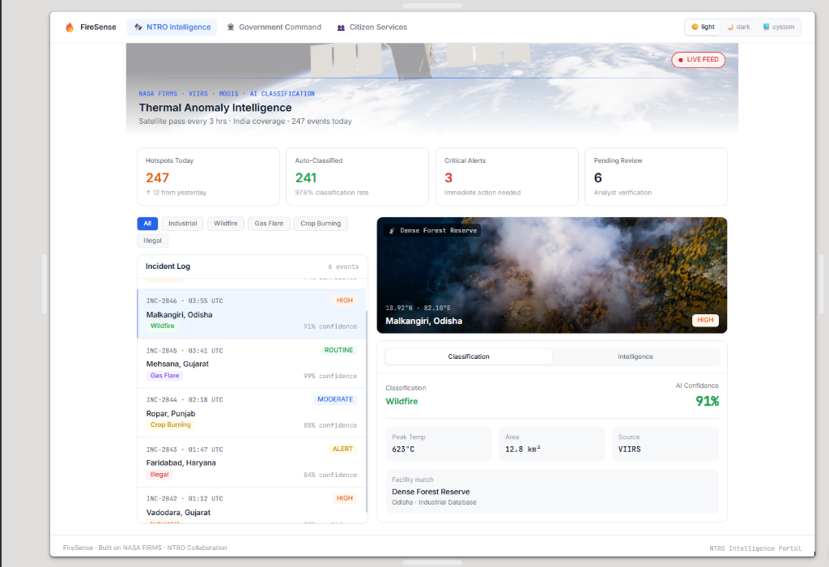
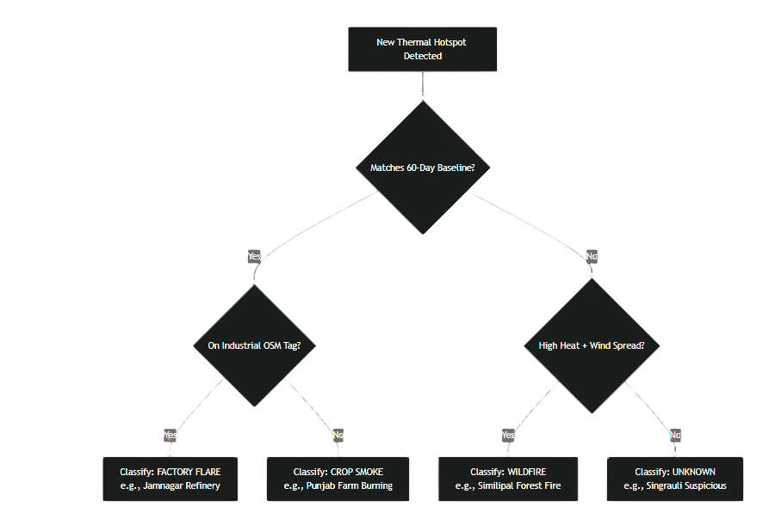
AeroThermal
FEASIBILITY AND VIABILITY
FEASIBILITY
VIABILITY
Classification Decision Tree
  • Technical Feasibility: Operates on NASA FIRMS near-real-time satellite telemetry, OpenStreetMap, and Open-Meteo weather APIs.
• Zero Hardware Capex: Leverages existing space orbits and standard mobile browsers with offline SMS gateway — zero new sensors required.
• Live Operational Prototype: Working software fully deployed on edge cloud (sih-thermal-intel.vercel.app) with sub-second response times.
  • Unified Operational Hierarchy: NTRO Space Analysts ➔ State Incident Commanders ➔ NDRF Battalions & Fire Brigades ➔ Citizens.
• National Scalability: Pre-mapped industrial & ecological zones across Odisha, Gujarat, Punjab, and Haryana with dynamic expansion.
• Governance & Audit Compliance: Downloadable executive command memos, GeoJSON incident corridors, and auditable status logs.
CHALLENGES & RISKS
STRATEGIES
  • Licensed Flare vs Wildfire: Distinguishing routine licensed refinery flares (e.g. Jamnagar/Mehsana) from uncontrolled forest wildfires.
• Remote Cellular Blackout: Field internet failure in remote forest reserves during active disasters preventing mobile app usage.
• Inter-Agency Coordination Latency: Friction and delay across civil defense, forest officers, police, and district collectors.
  • AI Confidence Engine: >85% confidence triggers automated dispatch, while <85% triggers drone recon; verified with National Industrial Cadastre.
• Zero-Data Offline Broadcast: Automated offline SMS routing (HELP <Pincode> to 1078) delivers shelter and bridge routes without internet.
• 1-Click Incident Command: Pre-formatted collector memos, automated public advisories, and live NDRF asset tracking in one click.
4
@TEKATHON-5.0- Template
Notes:
3

Slide 5



AeroThermal
IMPACT AND BENEFITS
From Satellite Pixel to Fire Engine on the Road — Tracked End-to-End
  Every detected anomaly is transformed into actionable tactical intelligence: fire classification, threat level, population at risk, and deployed NDRF assets.
Operational Example: Angul Industrial Blaze — 82K citizens shielded, 3 NDRF teams deployed, Brahmani bridge evacuation corridor secured within 12 minutes.
SOCIAL
ECONOMIC
ENVIRONMENTAL
  • Sub-10 Minute Emergency Response: 1-tap SOS triage links directly to nearest deployed NDRF battalion with real-time ETA.
• Vernacular Accessibility: Full citizen services in Hindi, Odia, and English ensures rural communities receive clear safety instructions.
• Zero-Data Offline Inclusivity: Automated SMS 1078 provides vital shelter & safe route guidance even during complete power/tower outage.
  • ₹45+ Cr Annual Savings: Filters out false alarms and licensed industrial flares, eliminating wasted emergency troop deployments.
• Zero Hardware Sensor Capex: Runs purely on NASA satellite passes and open infrastructure — zero physical sensors to buy or maintain.
• Industrial Asset Preservation: Rapid threat corridor containment prevents catastrophic refinery and manufacturing plant losses.
  • 70%+ Reduction in Burn Acreage: Rapid containment in critical ecological reserves (Similipal & Malkangiri) limits forest and wildlife devastation.
• CAQM Winter Smog Mitigation: Real-time crop-burning tracking across Punjab & Haryana feeds actionable enforcement against stubble burning.
• Hazardous Gas Plume Monitoring: Tracks chemical downwind dispersion corridors to prevent toxic inhalation in nearby residential sectors.
5
@TEKATHON-5.0- Template
Notes:
4

Slide 6
AeroThermal
RESEARCH AND REFERENCES
Sources
LIVE PROTOTYPE
1. Live Working Prototype & Codebase
• Live Web Application: https://sih-thermal-intel.vercel.app
• GitHub Repository: https://github.com/PaliiiXRAY/sih-thermal-intel
2. NASA FIRMS (Primary Satellite Telemetry)
• NASA FIRMS Official Portal: https://firms.modaps.eosdis.nasa.gov/
• Active Fire Attributes (MODIS 1km & VIIRS 375m I-band telemetry)
3. Meteorological & Infrastructure Models
• OpenStreetMap Overpass API (Critical Infrastructure & Roads): https://dev.overpass-api.de/
• Open-Meteo High-Resolution Numerical Weather Model: https://open-meteo.com/
4. National Disaster Response Frameworks
• NDMA Standard Operating Procedures for Wildfire & Industrial Hazards (https://ndma.gov.in/)
• National Disaster Response Force (NDRF) Battalion Resource Cadre
sih-thermal-intel.vercel.app
Live Control Room, Fire Station & Field Team views with 4 working demo scenarios.
Team: AeroThermal
Problem Statement ID: SIH26162
Agency Partner: NTRO
6
@TEKATHON-5.0- Template
Notes:
5

