Slide 1

Customer Relationship Management (CRM)
Presented by:
Palistha Maharjan

Slide 2
Contents:
What is CRM?
Objectives of CRM
Aspects of CRM
Tracking and Analyzing Data in CRM
Sales Force Automation

Slide 3
What is CRM?
the development and maintenance of mutually beneficial long-term relationships with strategically significant customers
Focuses on providing and maintaining quality service for customers,
wide set of tools, technologies, and procedures promote the relationship with the customer to increase sales.

Slide 4
What is CRM?
It can include:
Call handling
Sales tracking
Transaction support

Slide 5
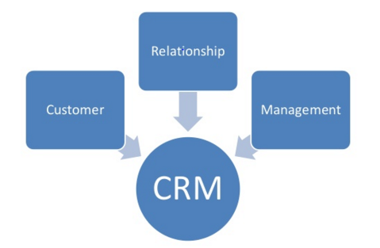
Components of CRM

Slide 6
Objectives of CRM:
Customer Satisfaction
Run an Efficient Business
Gaining New Customers
Boost sales

Slide 7
ASPECTS OF CRM
Operational
Collaborative
Analytical

Slide 8

Operational
Front-office business
Contact history is recorded
No communication gap
E.g.- call centers

Slide 9
Collaborative
Direct communication
Cost reduction
Service improvement
E.g.- mail, internet

Slide 10
Analytical
Analysis of customer data
Design and target marketing campaigns
Product and service decision making
Management decisions

Slide 11
Tracking and Analyzing Data in CRM
Employ tracking devices
Personalize each visitor’s experience
Data mining
Customer registration

Slide 12
Sales Force Automation
involves streamlining many of the tasks involved in the sales process.
It includes
Contact Management Systems
Lead Tracking Applications

Slide 13
Open Source CRM Systems
SugarCRM
vTiger
Splendid CRM
Xtuple
XRMS
CiviCRM

Slide 14




TOP CRM Companies

Slide 15
Concluding in the end…..
CRM helps in
Customer life-cycle
Customer life-time value

Slide 16
References:
[1] http://www.slideshare.net/KrishmaSandesra/crm-final-ppt-25955522
[2] https://www.trustradius.com/c
[3] http://www.slideshare.net/atulchaudhary/new-crm-presentation-1258608

Slide 17
THANK YOU

