Slide 1
State-wise Student Progression Analysis
School to College to University Journey
Comprehensive analysis of student progression patterns across Indian states with
focus on dropout rates, gender gaps, and policy recommendations
-By
Pallabi Biswas

Slide 2
Introduction
Understanding Student Progression Pathways
💡Context :
Tracking student progression from school through college to university is crucial for understanding
Educational system effectiveness and identifying barriers to higher education access.
🔍 Importance :
This analysis helps policymakers identify states with successful progression models, understand dropout
patterns, address gender disparities, and develop targeted interventions to improve higher education
enrollment rates across India.

Slide 3
Project Objectives
Key Goals & Focus Areas
Dropout Analysis :
Identify critical transition points where students discontinue education from school to university level
across different states.
State Comparison :
Compare progression rates between states to identify best practices and areas requiring intervention.
Gender Gap Assessment :
Analyze male vs female enrollment patterns and progression rates to address gender-based educational
disparities.

Slide 4
Research Methodology
Systematic Data Analysis Framework
Data Collection
Data Processing
Visualization
Analysis
Gather data from UDISE+
and AISHE datasets
covering 36 states/UTs
across all education levels.
Clean, standardize,
and integrate datasets to ensure consistency across different data sources.
Create interactive dashboards
in Power BI for comprehensive
state-wise analysis and
trend identification.
Perform statistical analysis to
identify progression patterns,
dropout factors, and
gender disparities.

Slide 5
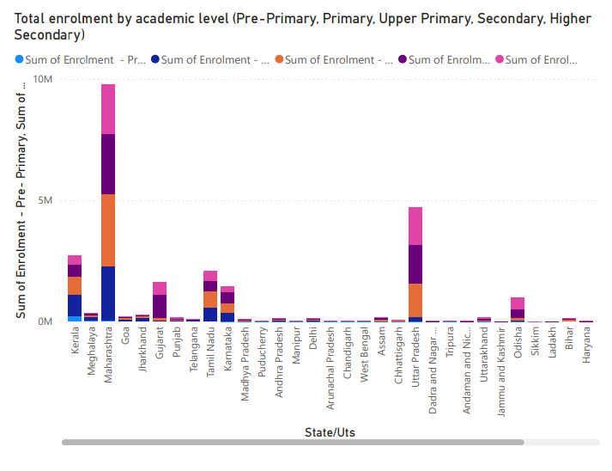
Total enrolment by academic level (Pre-Primary, Primary, Upper Primary,
Secondary, Higher Secondary)
This chart visualizes total student enrolment across different academic levels, highlighting the distribution from Pre-Primary to Higher Secondary and showing the progression of students through the school system.

Slide 6
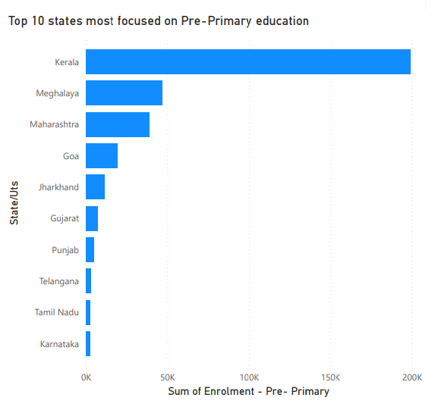
Top 10 states most focused on Pre-Primary education
This chart highlights the top 10 states with the highest enrolment in Pre-Primary education, showcasing regions that place strong emphasis on early childhood learning.

Slide 7
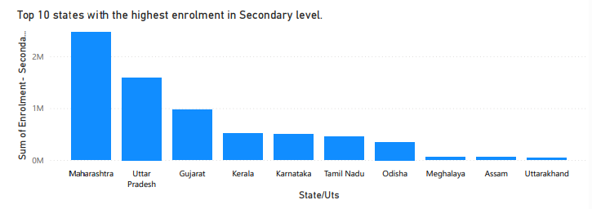
Top 10 states with the highest enrolment in Secondary level.
This chart shows the top 10 states with the highest enrolment at the Secondary level, reflecting stronger student retention and transition from elementary education.

Slide 8
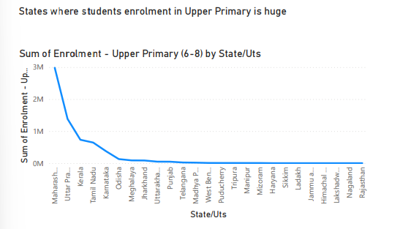
States where students enrolment in Upper Primary is huge
The line chart highlights states with
significantly high enrolment in the
Upper Primary level, indicating
strong progression of students
beyond the Primary stage.

Slide 9
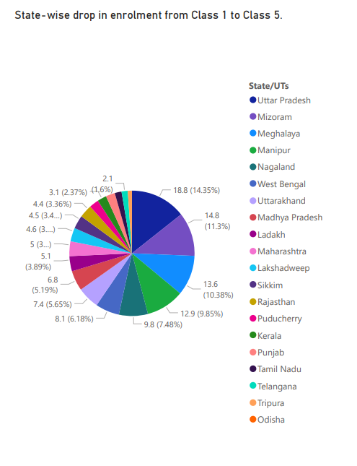
State-wise drop in enrolment from Class 1 to Class 5.
The pie chart shows the state-wise share of student dropouts between Class 1 and Class 5, highlighting regions where early school retention is a major challenge.

Slide 10
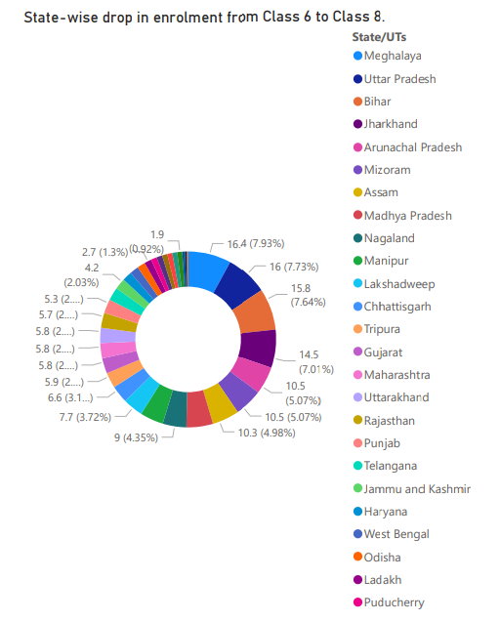
State-wise drop in enrolment from Class 6 to Class 8
The donut chart highlights the
state-wise drop in student
enrolment from Class 6 to Class 8,
emphasizing the regions where
middle school retention remains
a key concern.

Slide 11
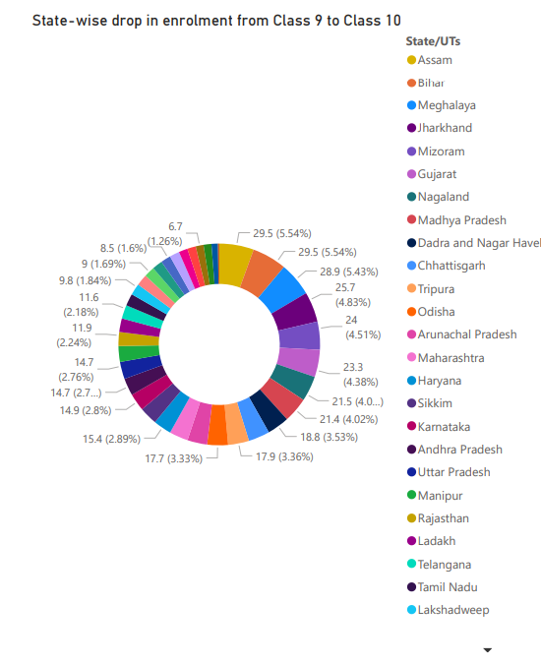
State-wise drop in enrolment from Class 9 to Class 10.
This chart highlights state-wise student dropouts
between Class 9 and Class 10, with Assam, Bihar,
and Meghalaya recording the highest dropout
rates, indicating critical challenges in retaining
students at the secondary level.

Slide 12
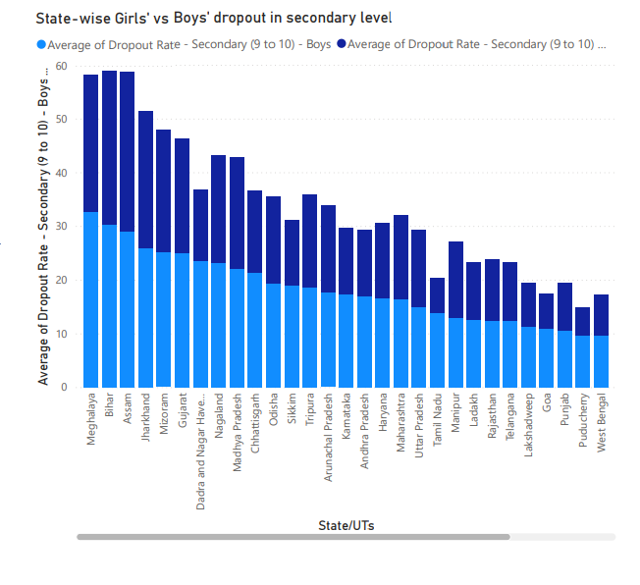
State-wise Girls' vs Boys' dropout in secondary level
This visualization compares dropout rates of
boys and girls at the secondary level across
states. The data highlights gender disparities,
with certain states showing higher female
dropout rates, reflecting socio-economic and
cultural barriers.

Slide 13
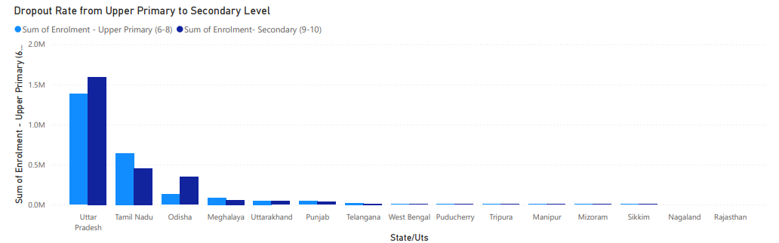
Dropout Rate from Upper Primary to Secondary Level
This chart shows the percentage of students who leave school when transitioning from
Class 8 to Class 9. States like Bihar and Assam show higher dropout rates,
underlining weak student retention at a crucial stage.

Slide 14
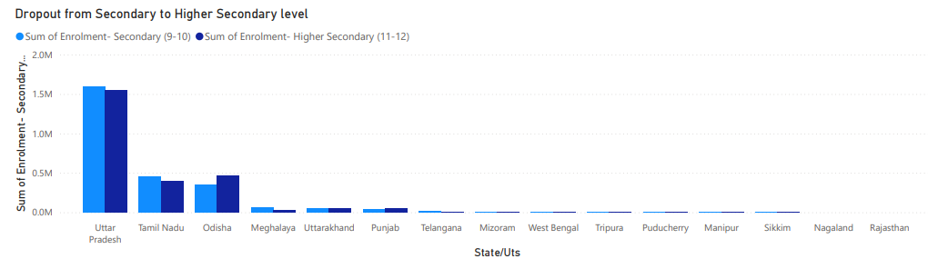
Dropout from Secondary to Higher Secondary level
This analysis tracks student attrition between Class 10 and Class 11.
The trend reveals that despite completing secondary education,
many students do not enter higher secondary, particularly
in rural and underdeveloped regions.

Slide 15
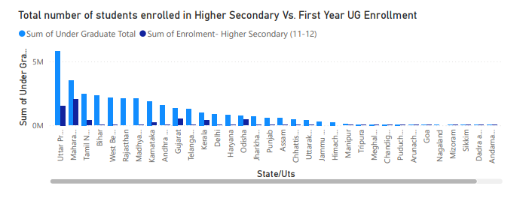
Total number of students enrolled in
Higher Secondary Vs. First Year UG Enrollment
This comparison illustrates the number of students in higher secondary
versus those entering first-year undergraduate courses. The sharp fall indicates
a gap in progression from school to higher education.

Slide 16
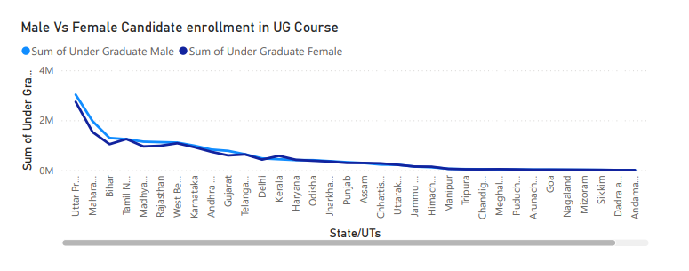
Male Vs Female Candidate enrollment in UG Course
This analysis compares male and female participation in undergraduate education.
While overall enrolments are large, the gender gap varies state to state,
showing disparities in access to higher education.

Slide 17
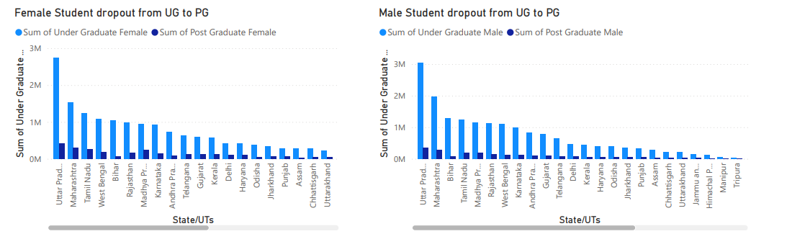
Female Student dropout from UG to PG
Male Student dropout from UG to PG
This chart measures how many female students Discontinue studies after UG and do not move into PG courses. It reflects barriers like
early marriage, financial constraints,
and lack of opportunities.
This visualization highlights dropout of male
students between UG and PG. Unlike females,
male dropout is often linked to early
employment, migration, and
economic responsibilities.

Slide 18
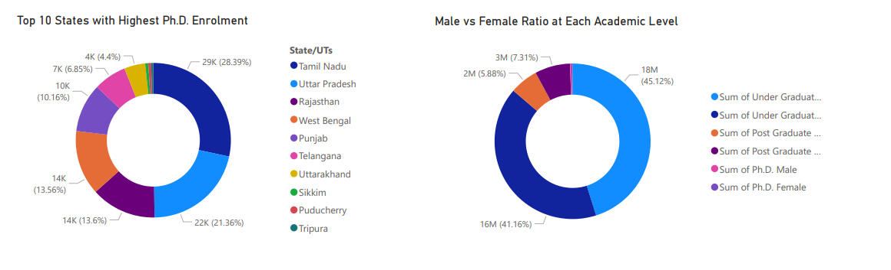
Top 10 States with Highest Ph.D. Enrolment
Male vs Female Ratio at Each Academic Level
This chart ranks the top states with maximum Ph.D.
enrolment. It highlights educationally advanced states
like Maharashtra, Tamil Nadu, and
Karnataka leading in research-level education.
This visualization tracks gender ratio across
levels—school, UG, PG, and Ph.D. It reveals how female representation steadily declines
at higher academic levels.

Slide 19
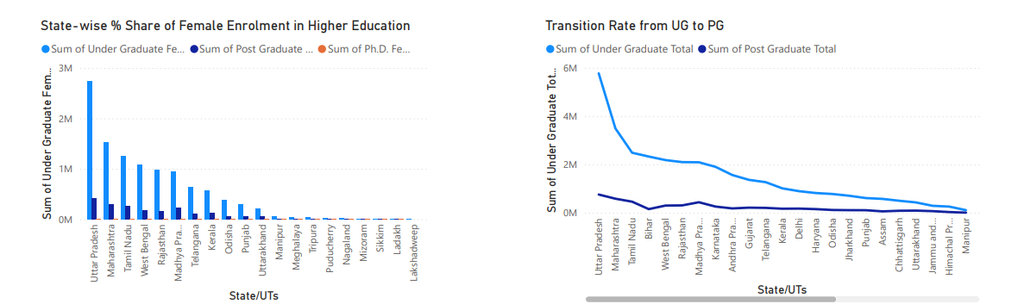
State-wise % Share of Female
Enrolment in Higher Education
Transition Rate from UG to PG
This chart depicts how female enrolment contributes
to total higher education participation in each state.
States like Kerala and Telangana show higher
female shares compared to northern counterparts.
This shows how many PG students move into
doctoral studies. The transition rate is generally low,
with only a few states supporting
higher research participation.

Slide 20
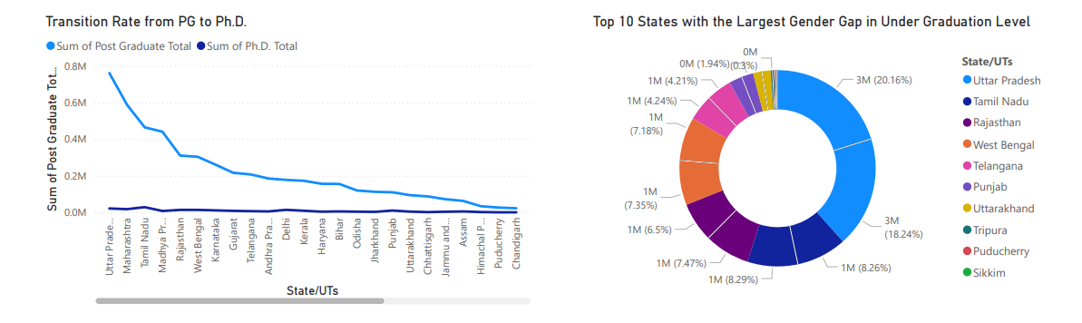
Top 10 States with the Largest Gender Gap in
Under Graduation Level
Transition Rate from PG to Ph.D.
This shows how many PG students move into
doctoral studies. The transition rate is generally low,
with only a few states supporting
higher research participation.
This chart identifies states where male-female enrolment gaps are widest at UG level. Such gaps indicate unequal opportunities for women in undergraduate education.

Slide 21
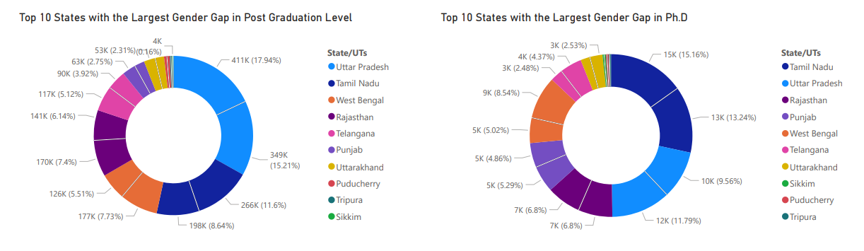
Top 10 States with the Largest Gender
Gap in Post Graduation Level
Top 10 States with the Largest Gender
Gap in Ph.D.
This visualization focuses on PG education
where gender disparities widen further. It highlights
states where fewer women continue
into advanced studies.
This chart captures gender imbalance in
research-level education. Male dominance
in Ph.D. enrolment is evident, raising concerns about
inclusivity in higher education research.

Slide 22
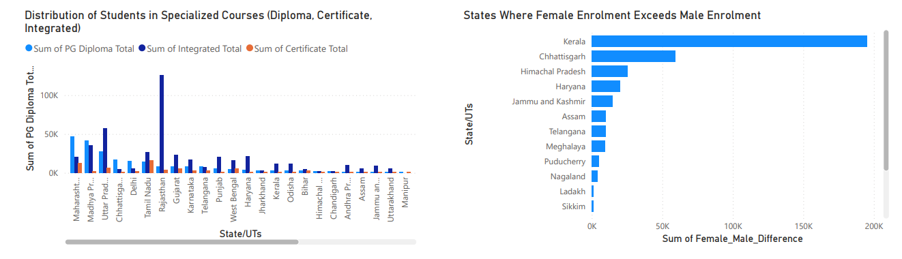
Distribution of Students in Specialized
Courses (Diploma, Certificate, Integrated)
States Where Female Enrolment Exceeds
Male Enrolment
This analysis examines how students are
distributed across non-traditional courses
like diplomas, certificates, and integrated
programs. It reflects diversification
in education pathways.
This visualization highlights progressive states where women outnumber men in higher education enrolment. It is an encouraging trend pointing towards gender empowerment in education.

Slide 23
Major Findings
Critical Insights from State-wise Analysis
High Performing States
Kerala, Tamil Nadu, and Maharashtra show highest progression rates with 75-80% transition from
school to university education.
Challenge States
Bihar, Uttar Pradesh, and Jharkhand face significant dropout challenges with only 35-45% progression
to higher education.
Gender Paradox
While female enrollment improves at school level, significant gaps persist in STEM fields and
Postgraduate education.

Slide 24
Policy Recommendations
Strategic Interventions for Improvement
💡Immediate Actions
Establish state-specific intervention programs targeting high dropout regions, enhance scholarship schemes for underprivileged students, and create bridge courses for smooth transitions.
🔍 Long-term Strategies
Develop comprehensive tracking systems from school to university, strengthen vocational education pathways,
address infrastructure gaps in rural areas, and implement gender-sensitive policies to reduce disparities
in STEM education.

Slide 25
Conclusion
Transforming India's Education Landscape
💡 Key Takeaways State-wise analysis reveals significant disparities in student progression, with southern states
outperforming northern and eastern regions in higher education access.
🔍 Future Outlook Systematic tracking of student progression is essential for evidence-based policy making.
Targeted interventions addressing regional, gender, and socioeconomic disparities will be
crucial for achieving 50% GER by 2035 as envisioned in NEP 2020.

Slide 26
Thank You
Questions & Discussion
Project Team: Education Analytics Division | Contact: https://classroomtech.in | Ph: 8981838547 |
Kolkata, India

