Slide 1



Power BI
Github
Internship Under :
Phone:
8981838547 Website:
https://classroomtech.in LinkedIn:
https://www.linkedin.com/company/classroom-tech/ Duration:
2 months 1st August 2025 to 30th September 2025

Slide 2
PROJECT TITLE - STATE-WISE STUDENT PROGRESSION ANALYSIS
PRESENTED BY : PALLABI BISWAS
COLLEGE : SISTER NIVEDITA UNIVERSITY
PROGRAM : BACHELOR OF TECHNOLOGY
STREAM : COMPUTER SCIENCE AND ENGINEERING
SEMESTER : 7TH SEMESTER

Slide 3
State-wise Student Progression Analysis
School to College to University Journey
Comprehensive analysis of student progression patterns across Indian states with
focus on dropout rates, gender gaps, and policy recommendations

Slide 4
ACKNOWLEDGEMENT
I would like to express my sincere gratitude to all those who supported me in completing this project, “State-wise Student Progression Analysis: School, College, University”. I am deeply thankful to my institute and mentors for their valuable guidance, encouragement, and constructive feedback throughout this work.
I also acknowledge the use of reliable data sources such as UDISE and AISHE which made this analysis possible. These datasets provided a strong foundation for understanding student enrolment, dropout trends, and progression across different educational stages. I am grateful to the Government of India and associated institutions for making such valuable data accessible for research and learning purposes.
Finally, I extend my appreciation to my peers and colleagues for their constant support and motivation during the preparation of this project.

Slide 5
TABLE OF CONTENTS
SECTION TITLE | PAGE NO
INTRODUCTION | PAGE – 6
OBJECTIVE/PROBLEM STATEMENT | PAGE – 7
DATASET OVERVIEW | PAGE – 8
TOOLS | PAGE – 9
RESEARCH METHODOLOGY | PAGE – 10
DETAILED SLIDE FOR EACH VISUALIZATION | PAGE – 11 to 34
MAJOR FINDINGS | PAGE – 35
CONCLUSION | PAGE – 36
GITHUB REPOSITORY LINK | PAGE – 37
REFERENCES | PAGE - 38

Slide 6
Introduction
Understanding Student Progression Pathways
Context :
Tracking student progression from school through college to university is crucial for understanding
Educational system effectiveness and identifying barriers to higher education access.
Importance :
This analysis helps policymakers identify states with successful progression models, understand dropout
patterns, address gender disparities, and develop targeted interventions to improve higher education
enrollment rates across India.

Slide 7
OBJECTIVE/PROBLEM STATEMENT
Goal :
The goal of this project is to analyze the progression of students across different stages of education in
India — from Pre-Primary to Higher Education — and identify dropout patterns, enrolment trends,
and state-level variations using Power BI interactive dashboards.
Key Objectives :
Dropout Analysis : Identify critical transition points where students discontinue education from school
to university level across different states.
State Comparison : Compare progression rates between states to identify best practices and areas
requiring intervention.
Gender Gap Assessment : Analyze male vs female enrollment patterns and progression rates to address
gender-based educational disparities.

Slide 8
DATASET OVERVIEW
Source :
UDISE and AISHE
This project is based on data collected from two major sources: UDISE (Unified District Information System for Education) and AISHE (All India Survey on Higher Education). The UDISE datasets provide comprehensive enrolment details from pre-primary to higher secondary education across different states and union territories of India. These datasets capture state-wise enrolment figures, allowing for a deeper analysis of progression, retention, and dropout rates within school education.
The AISHE dataset complements this by offering insights into enrolment trends in higher education, covering
undergraduate, postgraduate, diploma, certificate, and Ph.D. levels. It highlights gender distribution, course preferences, and state-wise variations in access to higher studies. Together, the two UDISE datasets and one AISHE dataset form the backbone of this project, enabling a holistic understanding of student progression from school to higher education in India.

Slide 9
TOOLS
Power BI
Helps in data cleaning, transformation, and integration of UDISE and AISHE datasets for smooth analysis.
Provides interactive visualizations (charts, maps, dashboards) to clearly present enrolment and dropout trends.
Enables insightful comparisons across states, education levels, and gender, making patterns easier to interpret.
GitHub
Acts as a version control system, storing project files, datasets, and documentation safely.
Facilitates collaboration and transparency, making the project accessible to peers and mentors.
Provides a portfolio showcase, demonstrating technical and analytical skills for academic or career opportunities.

Slide 10
Research Methodology
Systematic Data Analysis Framework
Data Collection
Data Processing
Visualization
Analysis
Gather data from UDISE+
and AISHE datasets
covering 36 states/UTs
across all education levels.
Clean, standardize,
and integrate datasets to ensure consistency across different data sources.
Create interactive dashboards
in Power BI for comprehensive
state-wise analysis and
trend identification.
Perform statistical analysis to
identify progression patterns,
dropout factors, and
gender disparities.

Slide 11
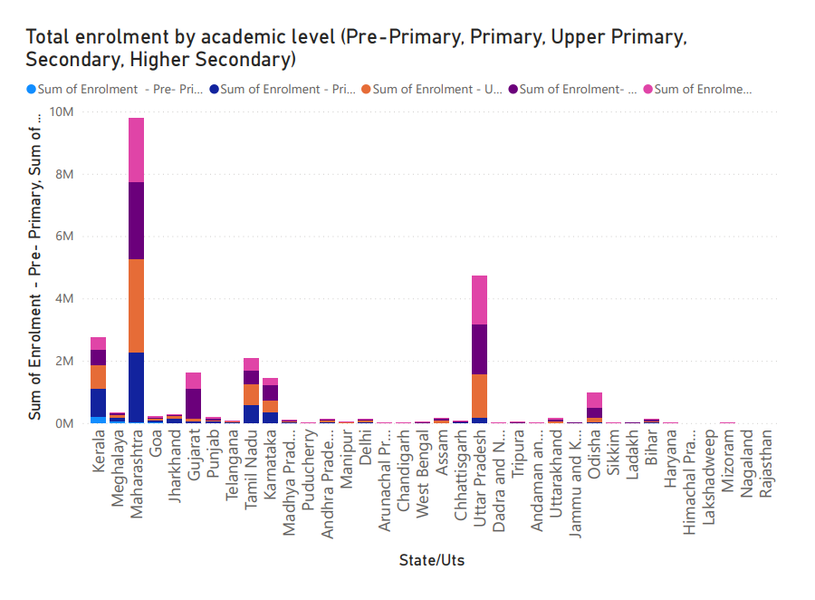
Total enrolment by academic level (Pre-Primary, Primary, Upper Primary,
Secondary, Higher Secondary)
This chart visualizes total student enrolment across different academic levels, highlighting the distribution from Pre-Primary to Higher Secondary and showing the progression of students through the school system.

Slide 12
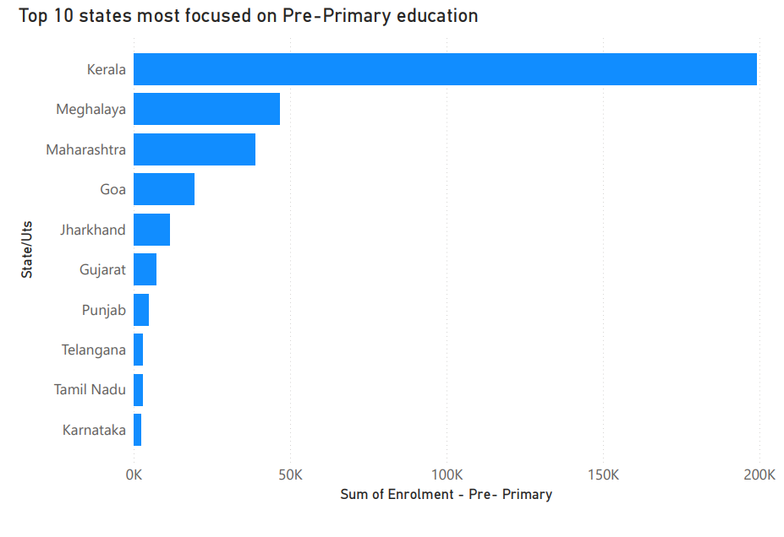
Top 10 states most focused on Pre-Primary education
This chart highlights the top 10 states with the highest enrolment in Pre-Primary education, showcasing regions that place strong emphasis on early childhood learning.

Slide 13
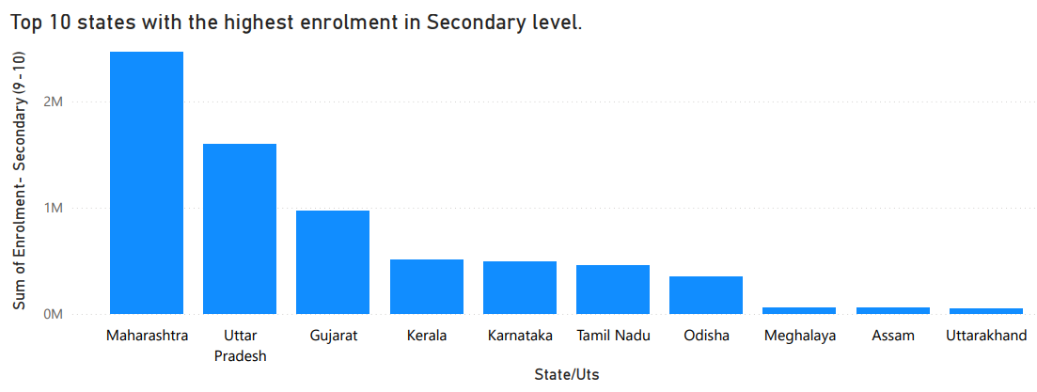
Top 10 states with the highest enrolment in Secondary level.
This chart shows the top 10 states with the highest enrolment at the Secondary level, reflecting stronger student retention and transition from elementary education.

Slide 14
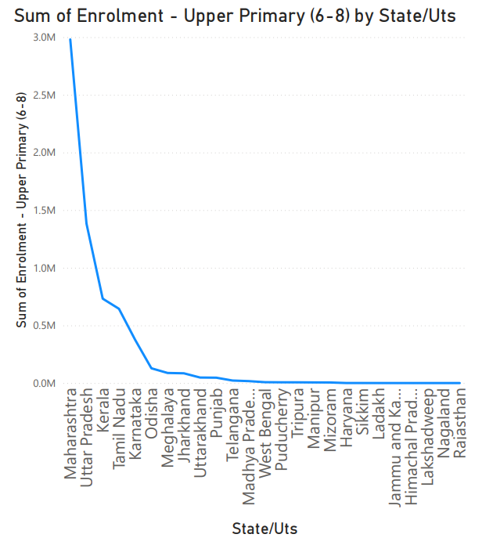
States where students enrolment in Upper Primary is huge
The line chart highlights states with significantly high enrolment in the Upper Primary level, indicating strong progression of students beyond the Primary stage.

Slide 15
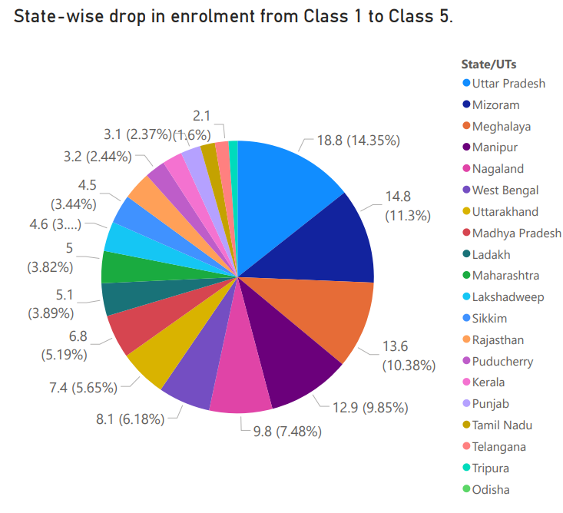
State-wise drop in enrolment from Class 1 to Class 5.
The pie chart shows the state-wise share of student dropouts between Class 1 and Class 5, highlighting regions where early school retention is a major challenge.

Slide 16
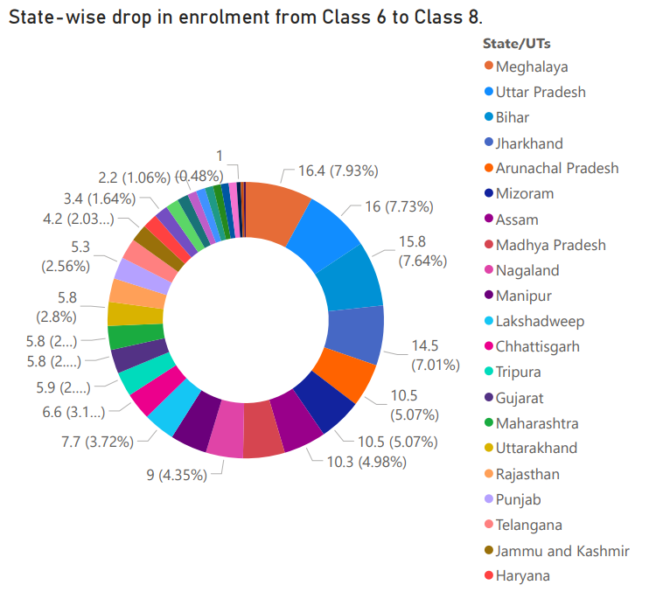
State-wise drop in enrolment from Class 6 to Class 8
The donut chart highlights the state-wise drop in student enrolment from Class 6 to Class 8,
emphasizing the regions where middle school retention remains a key concern.

Slide 17
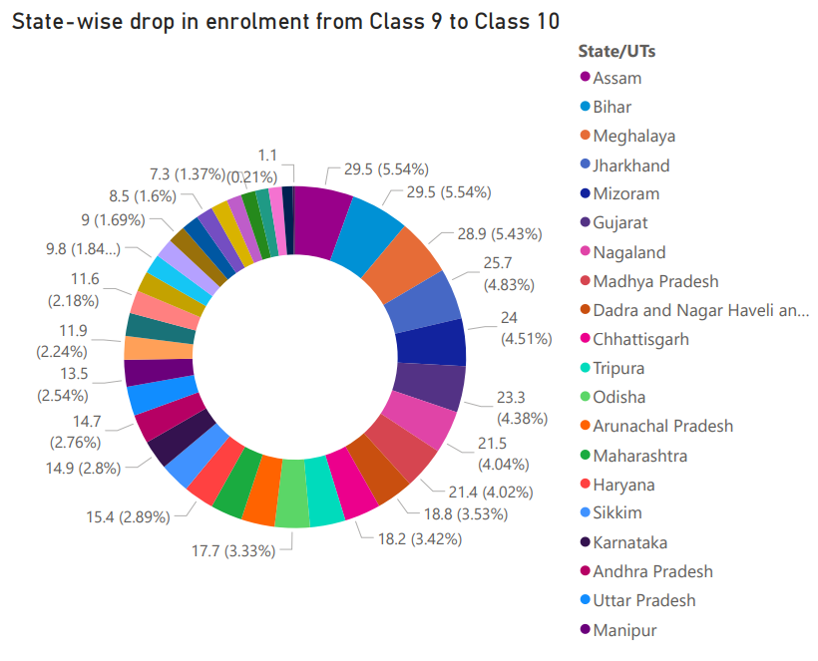
State-wise drop in enrolment from Class 9 to Class 10.
This chart highlights state-wise student dropouts between Class 9 and Class 10, with Assam, Bihar, and Meghalaya recording the highest dropout rates, indicating critical challenges in retaining students at the secondary level.

Slide 18
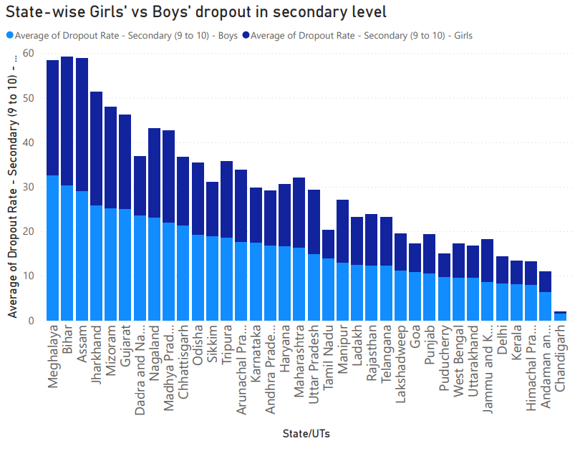
State-wise Girls' vs Boys' dropout in secondary level
This visualization compares dropout rates of boys and girls at the secondary level across states. The data highlights gender disparities, with certain states showing higher female dropout rates, reflecting socioeconomic and cultural barriers.

Slide 19
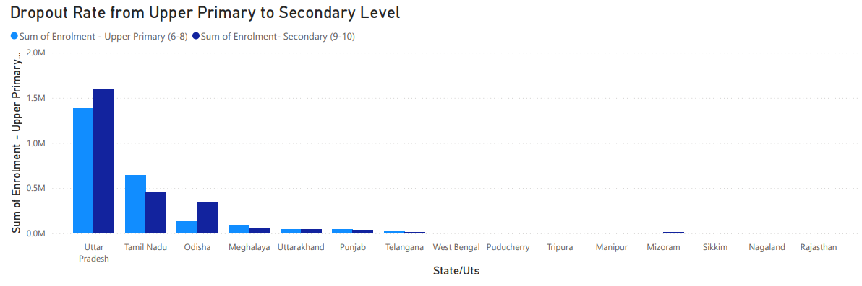
Dropout Rate from Upper Primary to Secondary Level
This chart shows the percentage of students who leave school when transitioning from Class 8 to Class 9. States like Bihar and Assam show higher dropout rates, underlining weak student retention at a crucial stage.

Slide 20
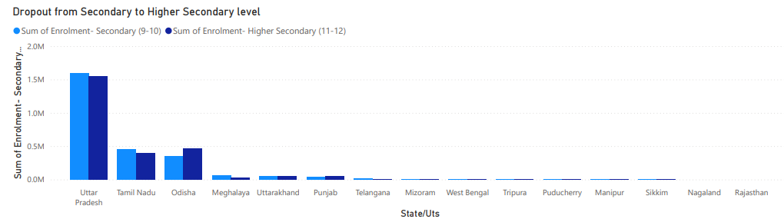
Dropout from Secondary to Higher Secondary level
This analysis tracks student attrition between Class 10 and Class 11. The trend reveals that despite completing secondary education, many students do not enter higher secondary, particularly in rural and underdeveloped regions.

Slide 21
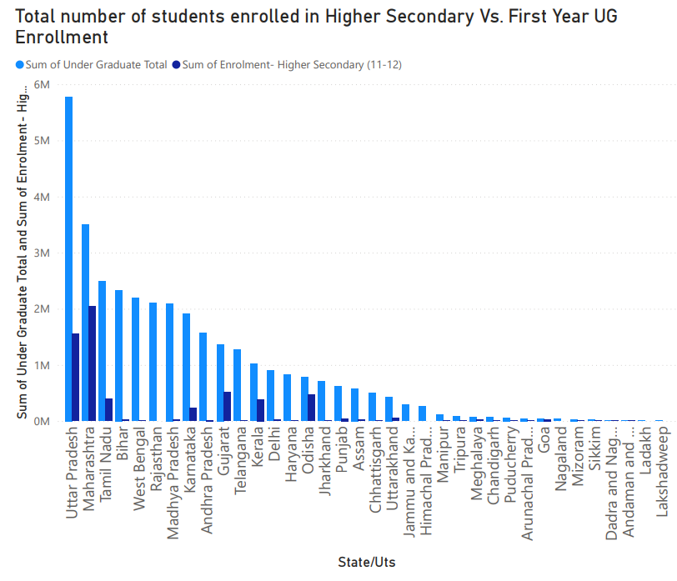
Total number of students enrolled in
Higher Secondary Vs. First Year UG Enrollment
This comparison illustrates the number of students in higher secondary versus those entering first-year undergraduate courses. The sharp fall indicates a gap in progression from school to higher education.

Slide 22
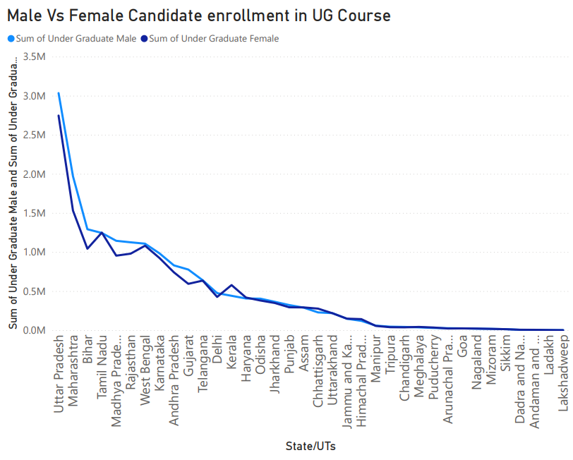
Male Vs Female Candidate enrollment in UG Course
This analysis compares male and female participation in undergraduate education.
While overall enrolments are large, the gender gap varies state to state,
showing disparities in access to higher education.

Slide 23
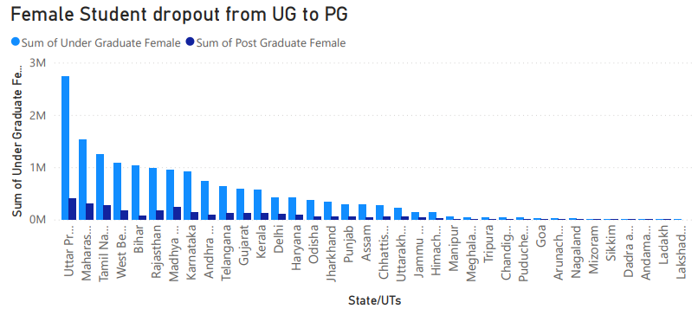
Female Student dropout from UG to PG
This chart measures how many female students Discontinue studies after UG and do not move into PG courses. It reflects barriers like early marriage, financial constraints, and lack of opportunities.

Slide 24
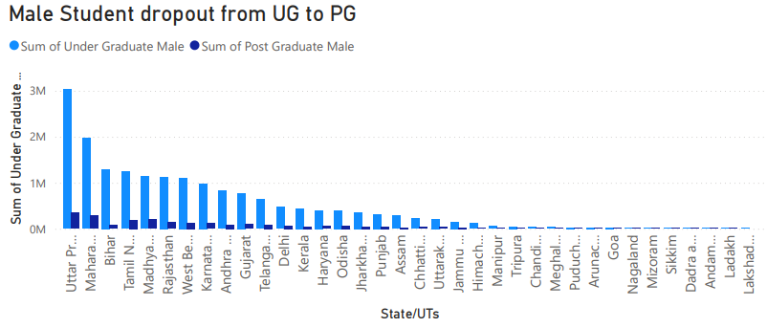
Male Student dropout from UG to PG
This visualization highlights dropout of male students between UG and PG. Unlike females, male dropout is often linked to early employment, migration, and economic responsibilities.

Slide 25
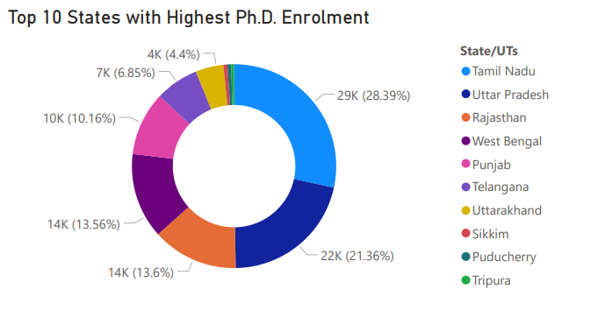
Top 10 States with Highest Ph.D. Enrolment
This chart ranks the top states with maximum Ph.D. enrolment. It highlights educationally advanced states like Maharashtra, Tamil Nadu, and Karnataka leading in research-level education.

Slide 26
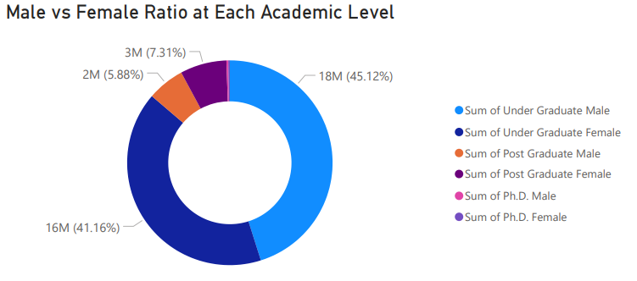
Male vs Female Ratio at Each Academic Level
This visualization tracks gender ratio across levels—school, UG, PG, and Ph.D. It reveals how female representation steadily declines at higher academic levels.

Slide 27
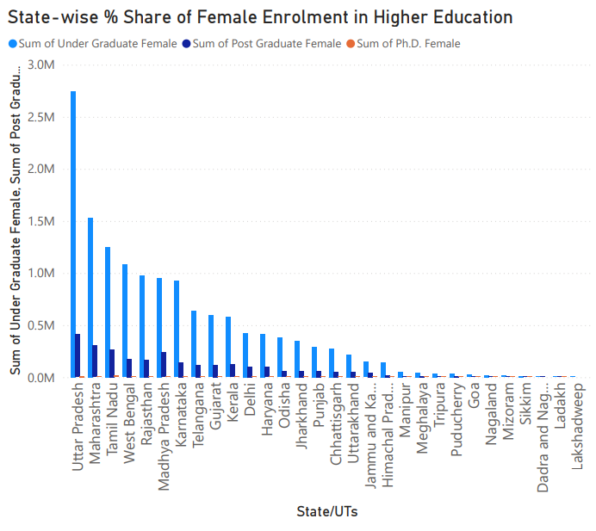
State-wise % Share of Female Enrolment in Higher Education
This chart depicts how female enrolment contributes to total higher education participation in each state. States like Kerala and Telangana show higher female shares compared to northern counterparts.

Slide 28
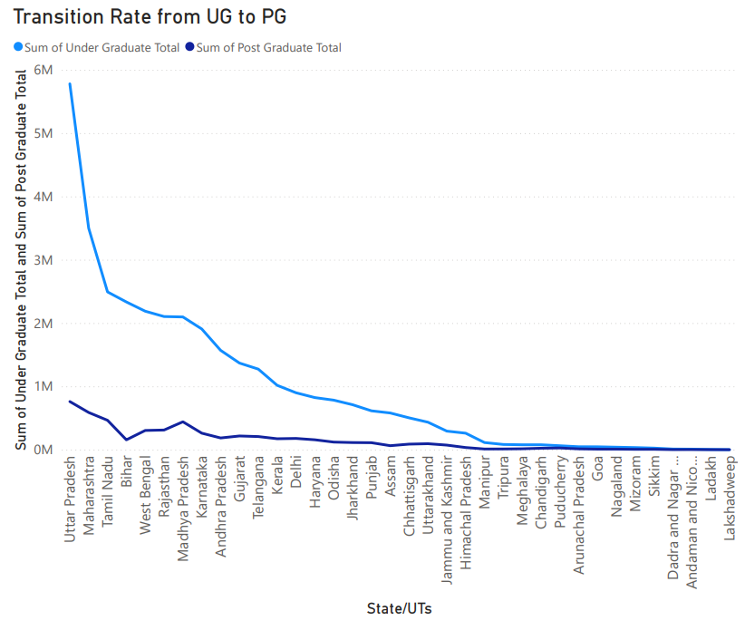
Transition Rate from UG to PG
The graph shows the enrolment gap between Undergraduate (UG) and Postgraduate (PG) students across Indian states and UTs. States like Uttar Pradesh, Maharashtra, and Tamil Nadu have the highest UG enrolments, but only a small portion of these students continue to PG studies. The sharp decline in PG numbers compared to UG highlights the low transition rate. Overall, the chart reflects how progression from UG to PG is limited despite large UG enrolments.

Slide 29
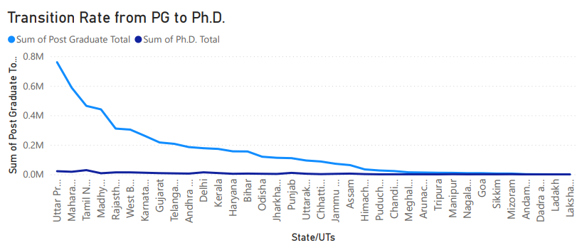
Transition Rate from PG to Ph.D.
This shows how many PG students move into doctoral studies. The transition rate is generally low, with only a few states supporting higher research participation.

Slide 30
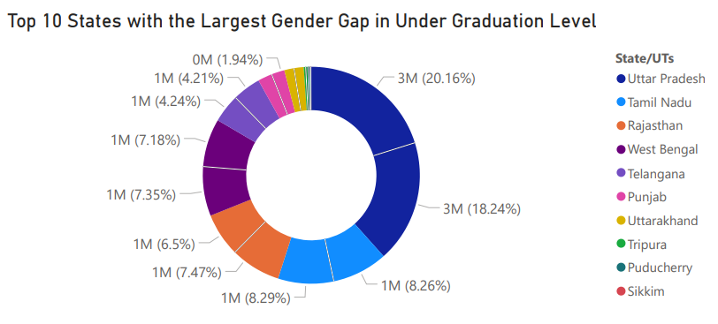
Top 10 States with the Largest Gender Gap in
Under Graduation Level
This chart identifies states where male-female enrolment gaps are widest at UG level. Such gaps indicate unequal opportunities for women in undergraduate education.

Slide 31
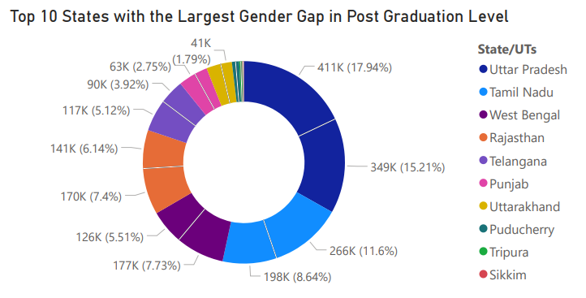
Top 10 States with the Largest Gender Gap in Post Graduation Level
This visualization focuses on PG education where gender disparities widen further. It highlights states where fewer women continue into advanced studies.

Slide 32
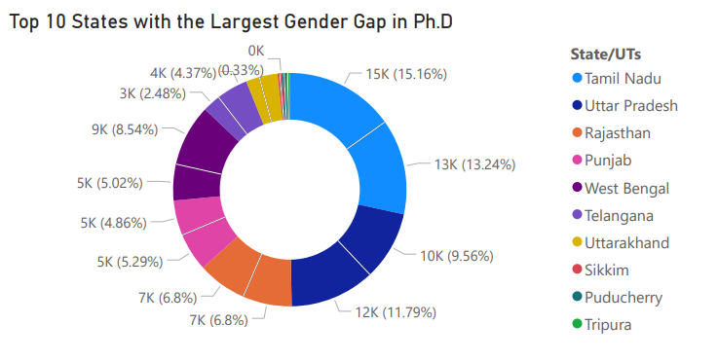
Top 10 States with the Largest Gender Gap in Ph.D.
This chart captures gender imbalance in research-level education. Male dominance in Ph.D. enrolment is evident, raising concerns about
inclusivity in higher education research.

Slide 33
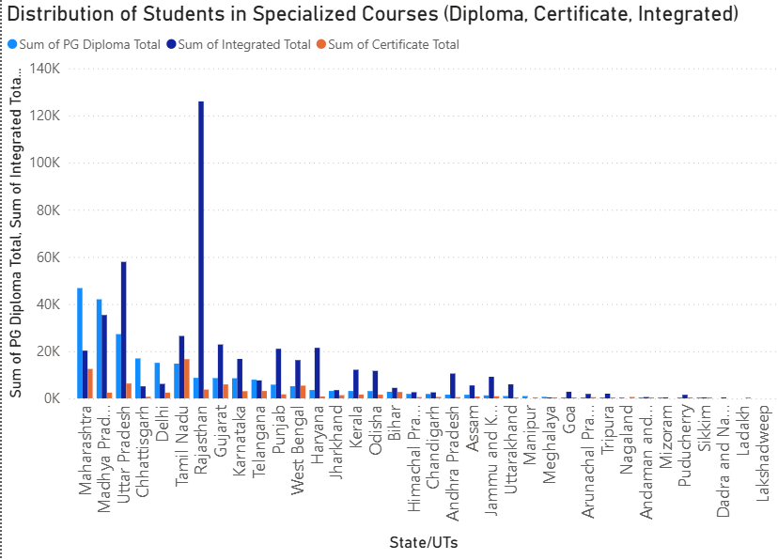
Distribution of Students in Specialized Courses (Diploma, Certificate, Integrated)
This analysis examines how students are distributed across non-traditional courses like diplomas, certificates, and integrated programs. It reflects diversification
in education pathways.

Slide 34
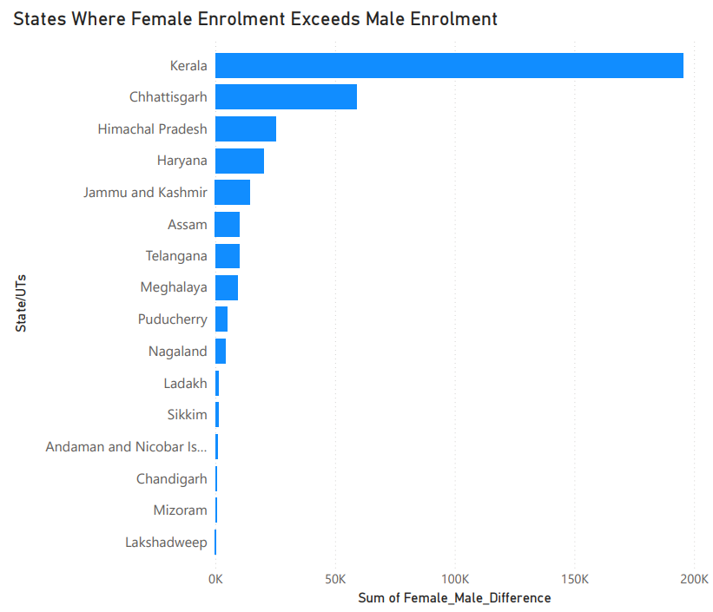
States Where Female Enrolment Exceeds Male Enrolment
This visualization highlights progressive states where women outnumber men in higher education enrolment. It is an encouraging trend pointing towards gender empowerment in education.

Slide 35
Major Findings
Critical Insights from State-wise Analysis
High Performing States
Kerala, Tamil Nadu, and Maharashtra show highest progression rates with 75-80% transition from
school to university education.
Challenge States
Bihar, Uttar Pradesh, and Jharkhand face significant dropout challenges with only 35-45% progression
to higher education.
Gender Paradox
While female enrollment improves at school level, significant gaps persist in STEM fields and
Postgraduate education.

Slide 36
Conclusion
Transforming India's Education Landscape
Key Takeaways
State-wise analysis reveals significant disparities in student progression, with southern states outperforming northern and eastern regions in higher education access.
Future Outlook Systematic tracking of student progression is essential for evidence-based policy making. Targeted interventions addressing regional, gender, and socioeconomic disparities will be crucial for achieving 50% GER by 2035 as envisioned in NEP 2020.

Slide 37
GITHUB REPOSITORY LINK
This repository link contains the complete Power BI report and the datasets used for analysis. Feel free to explore the project files from the link below:
https://github.com/Palla04/Education_Data_Analysis

Slide 38
REFERENCES
Dataset Source: Kaggle
Power BI Documentation:
https://learn.microsoft.com/en-us/power-bi/
GitHub Repository (Project Files):
https://github.com/Palla04/Education_Data_Analysis

Slide 39
Thank You
Name : PALLABI BISWAS
Contact: pallabibiswas4002@gmail.com| https://www.linkedin.com/in/pallabi-biswas-26151a255/ | Ph: 7908697385

