Slide 1

Real-Time Facial Emotion Recognition System Using Machine Learning
GROUP NUMBER : 37
NAME, STREAM, ENROLLMENT and REGISTRATION numbers of GROUP MEMBERS :
Asmita Ghorai – BTech CSE (2212200001142), (220010317574)
Pallabi Biswas – BTech CSE (2212200001084), (220010788506)
Ratri Dey – BTech CSE (2212200001070),(220010988119)
Riddhi Basu – BTech CSE (2212200001146),(220011009400)
DEPARTMENT : “Computer Science and Engineering”
INSTITUTION : “Sister Nivedita University”
NAME OF SUPERVISOR with AFFILIATION :
Dr. BIDYUT SAHA , Department of Computer Science and Engineering, Sister Nivedita University

Slide 2
INTRODUCTION
🔹Overview of the Project
The project focuses on developing a Real-Time Facial Emotion Recognition System using Deep Learning techniques. It captures live video through a webcam, detects human faces, and classifies emotions such as angry, disgust, fear, happy, neutral, sad, and surprise using a Convolutional Neural Network (CNN). Additionally, the system is designed to continuously capture and store emotional data throughout the day for further analysis.
🔹Motivation / Background
Understanding human emotions plays a crucial role in improving communication, learning environments, and mental well-being. In settings like classrooms or workplaces, it is difficult for teachers or supervisors to manually monitor the emotional state of individuals in real time. This creates a need for an automated, intelligent system that can accurately analyze and track emotions without human intervention.
🔹 Problem Statement
Manual detection and interpretation of facial emotions in real-time scenarios is challenging, time-consuming, and often inaccurate. There is a need for a system that can not only detect emotions in real time but also continuously monitor, capture, and store emotional patterns throughout the day to help in tracking mental health, engagement levels, and behavioral trends.

Slide 3
PROBLEM IDENTIFICATION
The problem mainly lies in the difficulty of detecting and interpreting human emotions manually in real-time scenarios. Existing methods are time-consuming, less accurate, and lack automation. Moreover, current systems do not continuously capture, monitor, or store emotional data throughout the day, making it difficult to track mental health patterns and emotional trends effectively.
Difficulty in Manual Emotion Detection Real-time detection and interpretation of facial emotions is complex, time-consuming, and error-prone
Absence of Emotional Trend Analysis No proper mechanism to analyze stored emotional data for identifying patterns and mental state
PROBLEM STATEMENT
Lack of Automation and Scalability Existing methods rely on manual or semi-automated approaches, making them inefficient for continuous monitoring
High Dependency on Complex Systems Many models require heavy infrastructure, making real-time local deployment difficult

Slide 4
OBJECTIVES
🔆 Primary and Secondary Objectives
Primary Objective: To develop a machine learning-based real-time facial emotion recognition system that can detect human faces and classify emotions such as angry, disgust, fear, happy, neutral, sad, and surprise using a CNN-based model with high accuracy.
Secondary Objectives:
To implement face detection and preprocessing using OpenCV techniques
To utilize a multi-layer Convolutional Neural Network (CNN) for efficient feature extraction and classification
To enable real-time emotion detection using webcam input
To continuously capture, monitor, and store emotional data throughout the day
To analyze emotional patterns over time for tracking engagement and mental state
To improve system performance using data augmentation and optimization techniques
🔆 Scope of the Project
The system is designed to detect and classify facial emotions and also maintain a record of emotions throughout the day for trend analysis. However, the scope is limited to facial expressions only and does not include other behavioral factors such as voice, body language, or eye tracking. Large-scale deployment and full classroom integration are beyond the current scope.

Slide 5
LITERATURE REVIEW / EXISTING SYSTEM
🔎Summary of Existing Solutions or Related Work
Traditional facial emotion recognition methods used handcrafted features like LBP and HOG with classifiers such as SVM, but they lacked accuracy in complex scenarios. With advancements in deep learning, Convolutional Neural Networks (CNNs) have significantly improved performance by automatically extracting features. Many systems use pre-trained models like VGGNet and ResNet for better accuracy. However, most existing solutions are trained on controlled datasets and struggle in real-world conditions.
🔰Gaps Identified
While the reviewed research showed promising results, several important gaps still remain:
Limited real-time implementation in practical environments like classrooms.
Lack of true real-time monitoring capability
Identification limited to only one factor (e.g., only eye contact or only lip movement)
Use of high-complexity deep learning architectures that are not suitable for normal desktop system
Most systems do not store or track emotions over time for mental health analysis
These limitations highlight the need for an automated, real-time system capable of accurately detecting, monitoring, and tracking emotions over time.

Slide 6
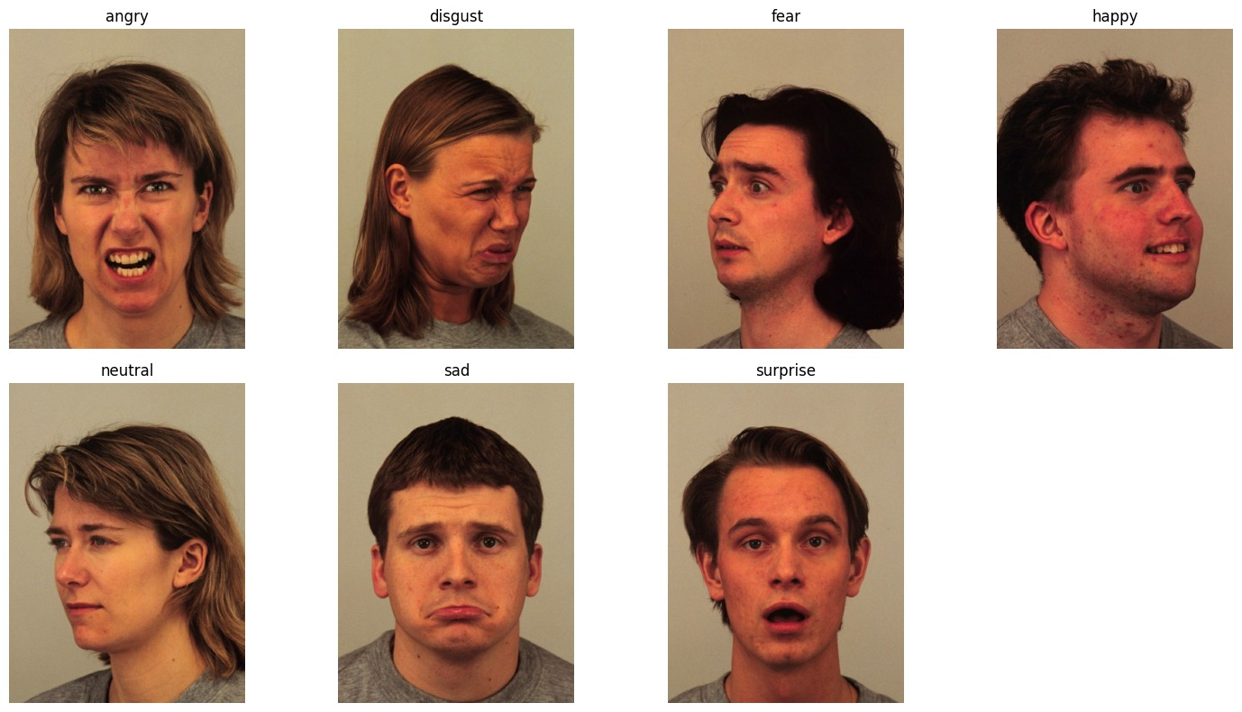
PROPOSED METHODOLOGY
📌Research Design
The project follows a Supervised machine learning approach to detect and classify facial emotions into seven categories using a CNN model, with real-time monitoring and emotion tracking.
The design includes:
📌 STEP 1 : Data Collection Method
The data was collected from a publicly available dataset:
Dataset: Face Emotion Detection Dataset
Classes: angry, disgust, fear, happy, neutral, sad, surprise
(Each class contains 400+ images)
Source: Kaggle
URL: https://www.kaggle.com/datasets/biswas2022/face-emotion-detection/settings
Dataset Acquisition
(Load raw dataset, analyze classes)
Preprocessing & Cleaning
(Face detection, cropping, resizing, normalization)
Dataset Preparation
(Balancing, splitting train/validation, augmentation)
Model Building(CNN architecture)
(custom layers)
Training & Validation
(Early stopping, checkpoint, LR reduction)
Evaluation (Accuracy, Loss, Confusion Matrix)
Result
Interpretation
(Graphs, predictions, insights)
dataset

Slide 7
📌 STEP 2 : Data Preprocessing and Augmentation
Preprocessing
Image Resizing : All images are resized to a fixed dimension (96×96) to ensure uniform input for the model.
Normalization : Pixel values are scaled from 0–255 to 0–1 to improve model performance and faster convergence.
Dataset Splitting : The dataset is divided into training and validation sets to evaluate model accuracy.
Augmentation
Rotation & Zoom : Images are rotated and zoomed to handle different angles and scales.
Horizontal Flip : Flipping increases data variation and improves generalization.
Reduce Overfitting : Helps the model learn better and perform well on unseen data.
📌 STEP 3 : Model Building (CNN) and Training
Building
CNN Architecture : Custom CNN with 3 Conv + MaxPooling layers (32, 64, 128 filters) .
Feature & Classification Layers : Flatten layer with Dense (128, ReLU) and Dropout (0.4).
Output & Optimization : Softmax layer (7 classes) with Adam optimizer and EarlyStopping.
Training
Loss Function : Categorical Crossentropy for multi-class classification.
Optimizer & Metrics : Adam optimizer with accuracy as evaluation metric.
Training Process : Model trained for approximately 100–150 epochs.
📌 STEP 4 : Model Evaluation & Saving
Performance Evaluation : Generated accuracy & loss graphs and used confusion matrix to analyze model performance .
Model Saving :Saved the best-performing model (best_model.h5) for real-time prediction.

Slide 8
📌Techniques/Technologies Used
📌High-Level Workflow Diagram
Model Training
Adam Optimizer (Low LR)
Sparse Categorical Crossentropy
EarlyStopping & Checkpoint
Dataset Collection (Kaggle FED Dataset)
Data Preprocessing
Face Detection (Haar Cascade)
Cropping & Resizing (224×224)
Normalization & Augmentation
Train/Validation Split
Model Design (CNN + Transfer Learning)
Freeze Initial Layers
BatchNorm & Dropout Layers
Custom Dense Layers (7 Classes)
Evaluation & Validation
Accuracy & Loss Curves
Top-K Accuracy
Confusion Matrix
Emotion Classification (7 Classes Prediction) Real-Time Deployment Ready
Programming & Model : Python, CNN (Convolutional Neural Network), Transfer Learning
Libraries : TensorFlow/Keras, OpenCV, NumPy, Matplotlib
Platform : Google Colab (training), VS Code (deployment)
CHALLENGES FACED
SOLUTIONS IMPLEMENTED
Overfitting : High training accuracy but lower validation accuracy.
Misclassification : Confusion between emotions like Neutral, Fear, and Surprise .
Real-Time Prediction Issue : Model performed well on images but less accurate on webcam .
Lighting & Detection Issues : Poor lighting and face detection affected prediction quality.
Overfitting Solution : Used Dropout layers, Data Augmentation, and optimized learning rate .
Misclassification Fix : Analyzed confusion matrix, balanced dataset, and improved preprocessing .
Real-Time Issue Fix : Ensured same preprocessing as training (resize 96×96, normalization) for accurate webcam prediction.
Lighting Problem Fix : Improved lighting conditions and accurate face cropping.

Slide 9
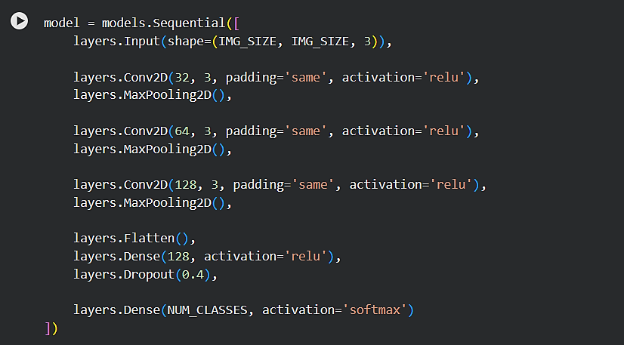
IMPLEMENTATION
🟣 Model Development, Training & Evaluation
CNN Model Development
Built a CNN using Conv2D and MaxPooling layers for feature extraction
Used Dense layers for classification of 7 emotion classes,
Applied Dropout and regularization to reduce overfitting.
Model Training
Trained the model on training and validation datasets
Epochs: 120, Batch size: 32
Used Adam optimizer and monitored training & validation accuracy
Model Evaluation
Evaluated performance using accuracy and loss curves
Used Top-K accuracy to check if correct label is within top predictions
Analyzed model performance for reliability and generalization
Custom CNN Architecture
3 Conv layers (32, 64, 128) for feature extraction
MaxPooling for dimensionality reduction
Dense + Dropout (0.4) to reduce overfitting
Softmax layer for 7-class emotion classification

Slide 10
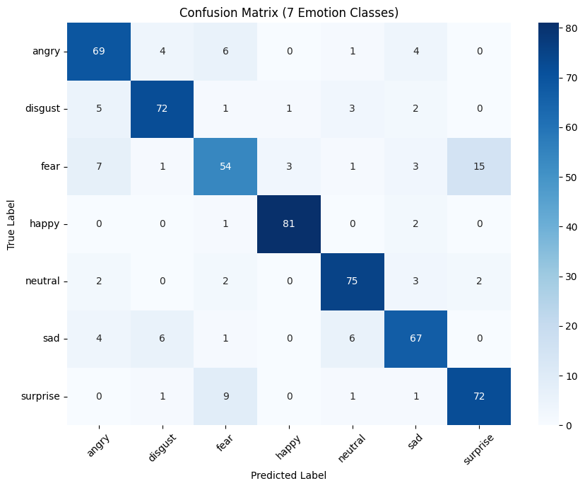
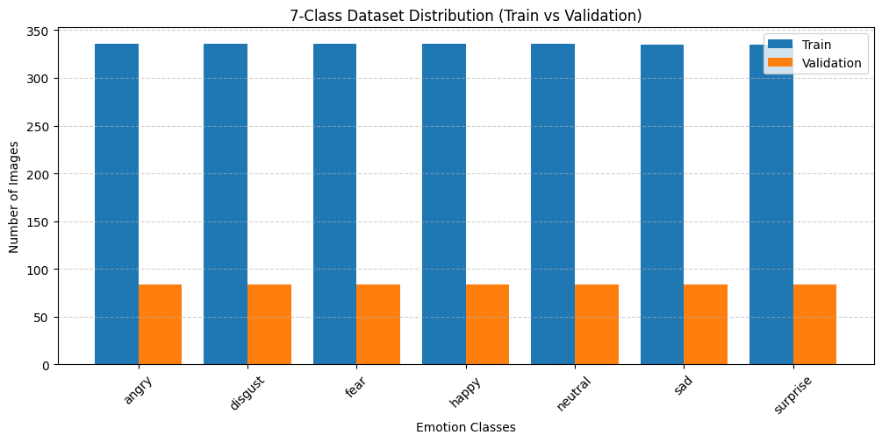
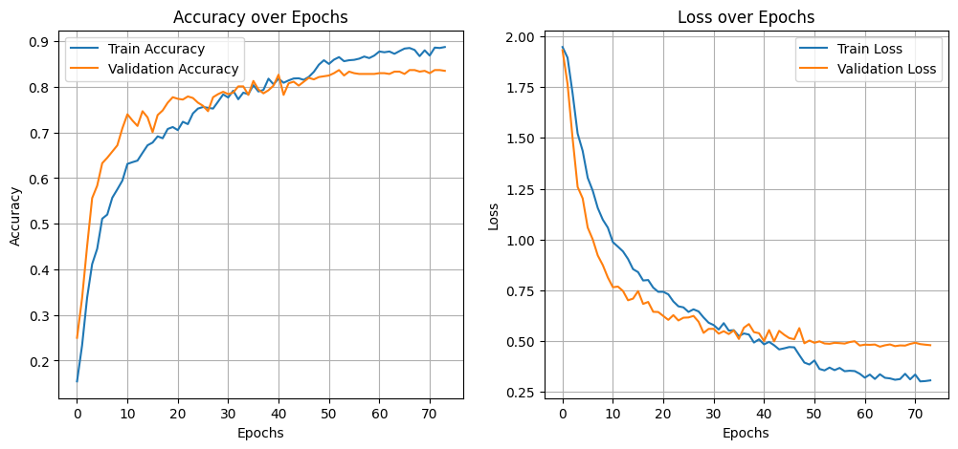
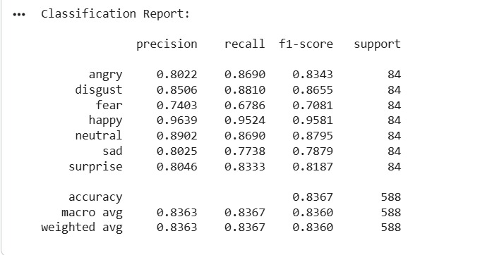
OUTCOME
🔎Expected Results: Based on the experiments conducted:
Final Training Accuracy : 0.9123
Final Validation Accuracy : 0.840
📊 TRAIN ACCURACY
Top-2 Accuracy (Train): 99.32%
Top-3 Accuracy (Train): 99.91%
Expected trends:
Data augmentation and preprocessing improve model generalization and reduce overfitting.
The model shows stable learning with consistent accuracy after sufficient training epochs.
📊 VALIDATION ACCURACY
Top-2 Accuracy (Val): 95.41%
Top-3 Accuracy (Val): 98.47%
Confusion Matrix
Train Validation Distribution
Accuracy Loss Graph
Classification Report

Slide 11
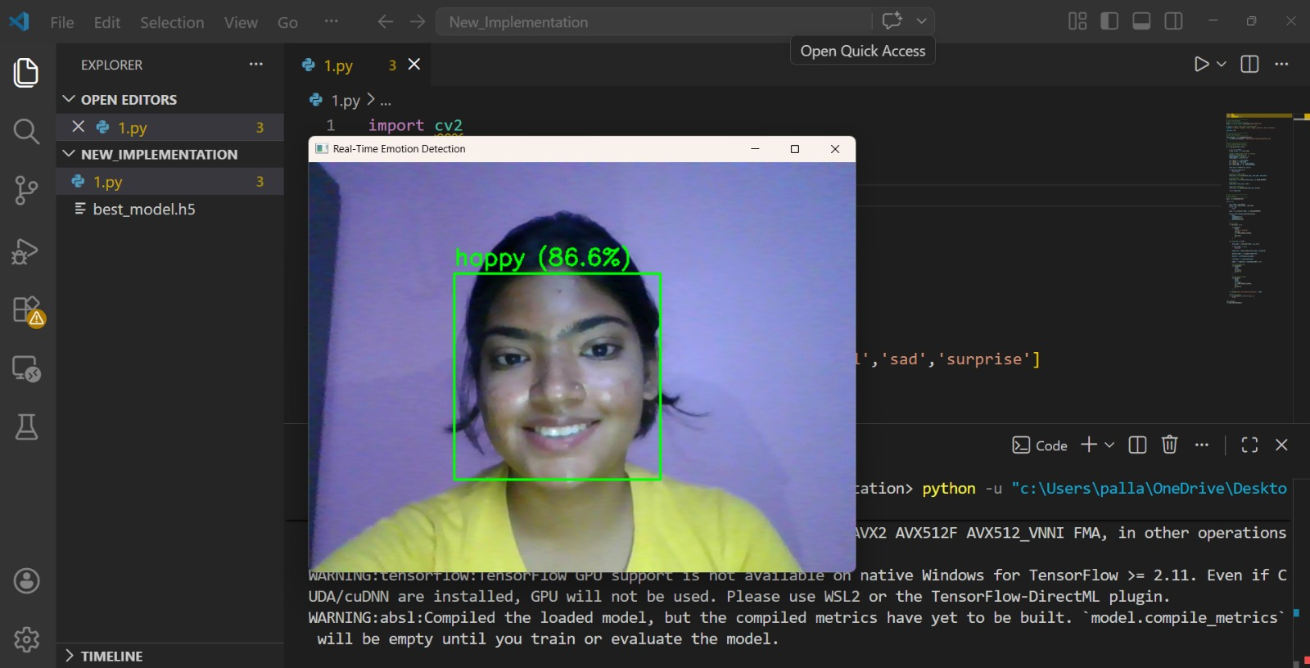
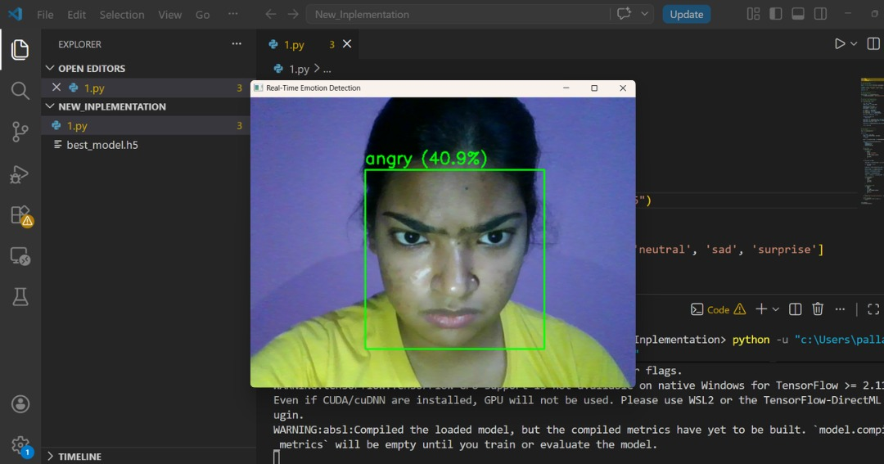
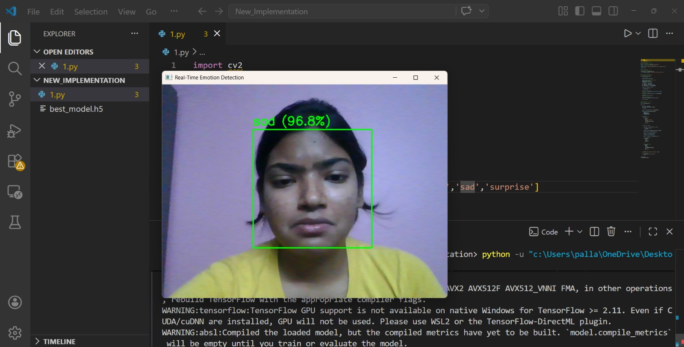
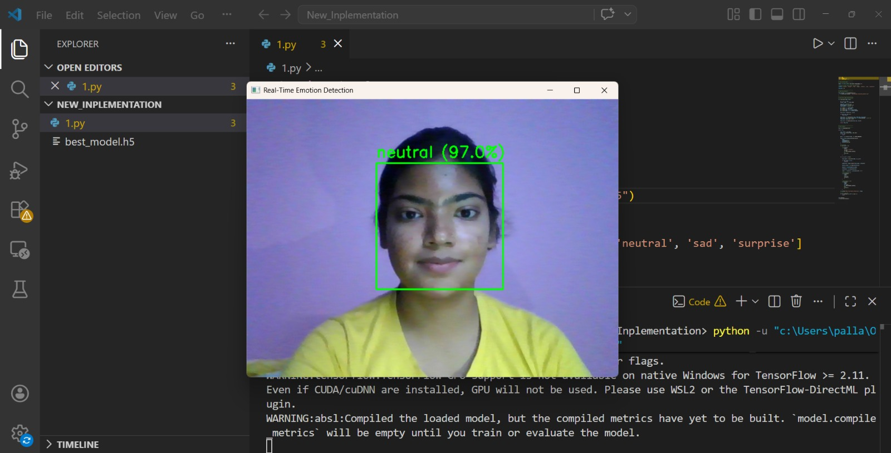
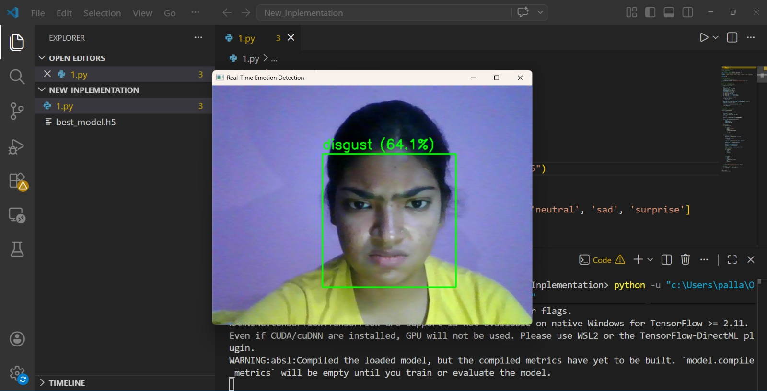
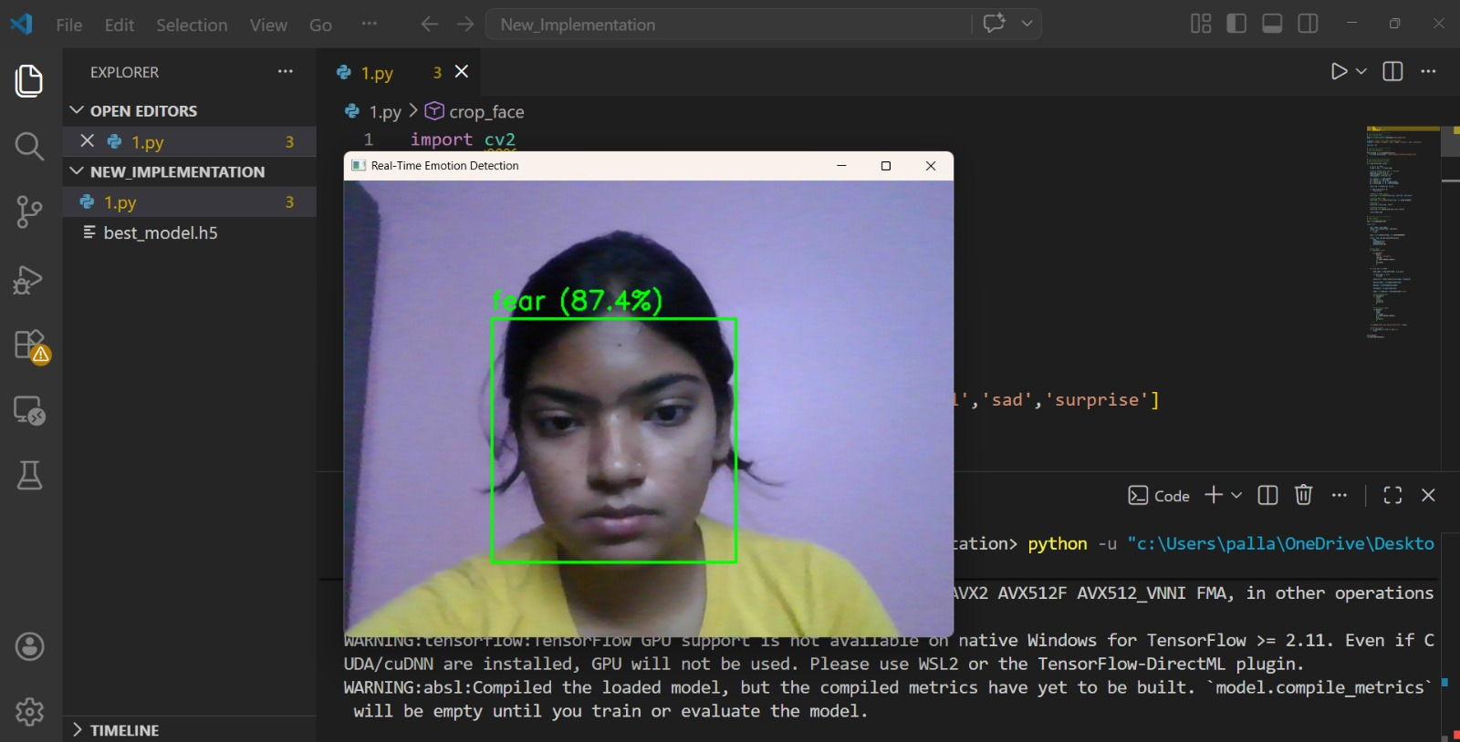
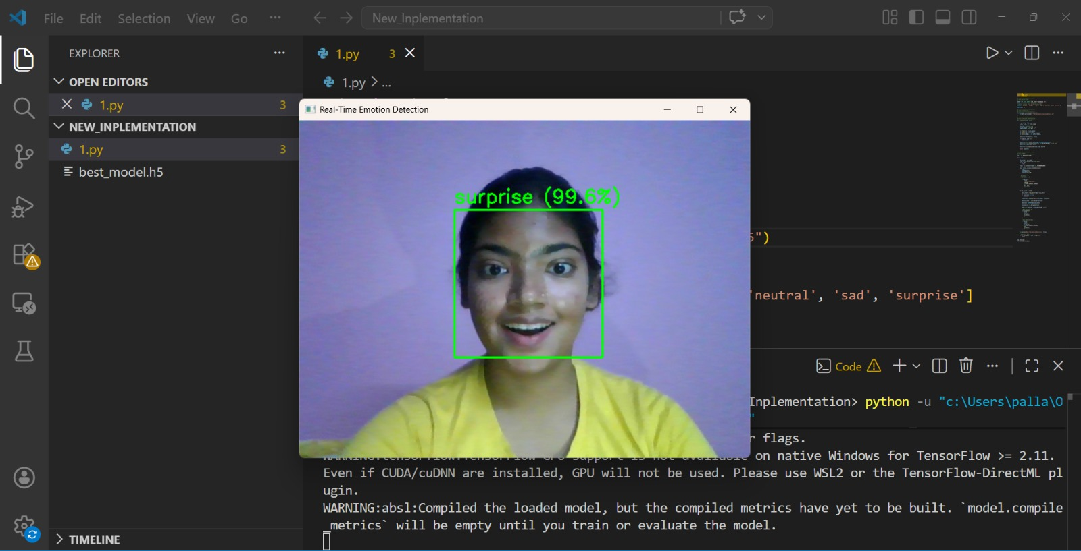
Real-Time Emotion Detection: Live Webcam Output
M

Slide 12
CONCLUSION
Successfully developed a real-time facial emotion recognition system using CNN architecture
The model effectively detects and classifies 7 different emotions from facial expressions
SUMMARY
OF KEY
POINTS
Applied preprocessing, data augmentation, and transfer learning to improve accuracy and performance
Implemented evaluation techniques such as accuracy, loss graphs, and confusion matrix for validation
Enabled continuous monitoring and storage of emotional data to analyze patterns over time
Overall, the system provides an automated, efficient, and scalable solution for emotion analysis

Slide 13
🔒LIMITATIONS
Despite achieving satisfactory performance, the proposed system has certain limitations :-
Model performance may be affected by variations in lighting conditions, facial orientation, and occlusion
Dataset may not fully represent real-world diversity, affecting generalization
System currently supports single-face detection and is limited in multi-person scenarios
Real-time performance depends on system hardware and processing capability
Similar emotions (e.g., fear and surprise) may be misclassified due to overlapping features
Continuous emotion tracking is basic and lacks advanced analytical insights
💡FUTURE WORKS
Integration with Video Conferencing Can be integrated with platforms like Google Meet or Zoom for real-time emotion analysis
Participant Engagement Monitoring Helps track attention levels and provide feedback during meetings
Background Emotion Detection System Develop a desktop application for Windows/Linux that runs automatically
Real-Time Continuous Monitoring System runs in background, accesses webcam (with permission), and detects emotions in real time
This work highlights the potential of intelligent systems while opening paths for further advancements in accuracy, scalability, and real-time applications

Slide 14
🔗REFERENCES
Gupta S, Kumar P, Tekchandani RK (2023) Facial emotion recognition based real-time learner engagement detection system in online learning context using deep learning models. Multimed Tools Appl 82:11365–11394. https://doi.org/10.1007/s11042-022-13558-9
Rawal N, Stock-Homburg RM (2022) Facial Emotion Expressions in Human-Robot Interaction: A Survey. Int J of Soc Robotics 14:1583–1604. https://doi.org/10.1007/s12369-022-00867-0
Debnath T, Reza MM, Rahman A et al. (2022) Four-layer ConvNet to facial emotion recognition with minimal epochs and the significance of data diversity. Scientific Reports 12:6991. https://doi.org/10.1038/s41598-022-11173-0
Huang ZY, Chiang CC, Chen JH et al. (2023) A study on computer vision for facial emotion recognition. Scientific Reports 13:8425. https://doi.org/10.1038/s41598-023-35446-4
Białek C, Matiolański A, Grega M (2023) An efficient approach to face emotion recognition with convolutional neural networks. Electronics 12(12):2707. https://doi.org/10.3390/electronics12122707
😊ACKNOWLDGEMENT
We would like to express our sincere gratitude to our project guide, Dr. BIDYUT SAHA for his continuous support, valuable guidance, and encouragement throughout the development of this project. His insights and suggestions greatly contributed to the successful completion of our work.
We also thank the Department of Computer Science and Engineering for providing the necessary resources and a supportive environment.
We are grateful to our parents, peers and classmates for their cooperation, feedback, and support during various stages of the project.
Lastly, we acknowledge the use of tools and technologies such as Python, TensorFlow, Keras, Google Colab and OpenCV, which played a crucial role in the implementation of this project.

Slide 15
THANK YOU

