Slide 1

Real-Time Classroom Monitoring System For Student Performance Using Machine Learning
GROUP NUMBER : 37
NAME, STREAM, ENROLLMENT and REGISTRATION numbers of GROUP MEMBERS :
Asmita Ghorai – BTech CSE (2212200001142), (220010317574)
Pallabi Biswas – BTech CSE (2212200001084), (220010788506)
Ratri Dey – BTech CSE (2212200001070),(220010988119)
Riddhi Basu – BTech CSE (2212200001146),(220011009400)
DEPARTMENT : “Computer Science and Engineering”
INSTITUTION : “Sister Nivedita University”
NAME OF SUPERVISOR with AFFILIATION :
Dr. BIDYUT SAHA , Department of Computer Science and Engineering, Sister Nivedita University

Slide 2
INTRODUCTION
💡OVERVIEW OF PROJECT / BACKGROUND AND CONTEXT
Traditional classroom assessments often fail to capture students’ real-time engagement, emotions, and understanding during the lesson. With machine learning and computer vision, it is now possible to analyze facial expressions, eye movement, and behaviour from live video feeds to understand how students are reacting during class. This project focuses on creating a system that monitors these behavioural cues continuously to provide a clearer picture of students’ learning states.
🔒IMPORTANCE
The system offers valuable insights that help teachers identify early signs of distraction, confusion, boredom, or academic struggle. By providing automated, real-time analytics, it reduces the limitations of manual monitoring and enables more adaptive teaching strategies. It also supports personalized learning, improves classroom management, and creates a data-driven approach to enhancing student performance and participation.

Slide 3
LITERATURE SURVEY
🔎Summary of Relevant Research
We reviewed several papers related to real-time classroom monitoring, emotion detection, and student engagement analysis using machine learning. Most studies focused on facial expression recognition, eye tracking, and head-pose estimation to understand students’ emotional and attentiveness levels. Deep learning models such as CNNs, Haar Cascades, and VGGNet were frequently used to classify emotions like happy, confused, bored, or sad. Some research also used body movement patterns to measure attention. However, many of these systems were tested only in controlled lab settings, did not work in real time, or focused on just one behaviour instead of combining both emotional and physical cues.
🔰Gaps in Existing Knowledge or Applications
While the reviewed research showed promising results, several important gaps still remain:
Most systems are tested in controlled environments, not in real classrooms where lighting, movement, and camera angles vary.
Many studies lack true real-time performance, making them difficult to use during live teaching sessions.
Existing models often analyze only one factor, such as facial emotion or eye movement, instead of combining multiple cues like facial expressions, head pose, and engagement.
Few systems are optimized for low-cost or portable setups, making deployment difficult in schools with limited resources.
Few solutions are designed for practical use in everyday teaching.
These are the key limitations that highlight the need for more robust, real-time, and classroom-friendly solutions.

Slide 4

PROBLEM IDENTIFICATION
Detect and analyze students’ facial expressions to identify emotional states.
Support personalized learning with detailed behavioural insights.
Monitor eye movement, lip movement, and head direction to measure attentiveness.
Description of the Problem
Traditional classroom monitoring methods—such as teacher observations, attendance, or exam performance—do not capture students’ real-time engagement, attention levels, or emotional states during lessons. Teachers often fail to notice when students are distracted, confused, bored, or struggling, especially in large classrooms. Manual monitoring is time-consuming, subjective, and often inaccurate.
There is a need for an automated, intelligent system that can continuously analyze student behaviour using machine learning to provide immediate insights into classroom performance.
Help teachers recognize students who need more attention or support.
OBJECTIVES/
GOALS
Classify each student as attentive or inattentive based on behaviour.
Build a scalable, low-maintenance solution for physical and digital classrooms.
Generate daily, weekly, and monthly engagement reports for each student.
Identify students who may be struggling academically or emotionally early.

Slide 5
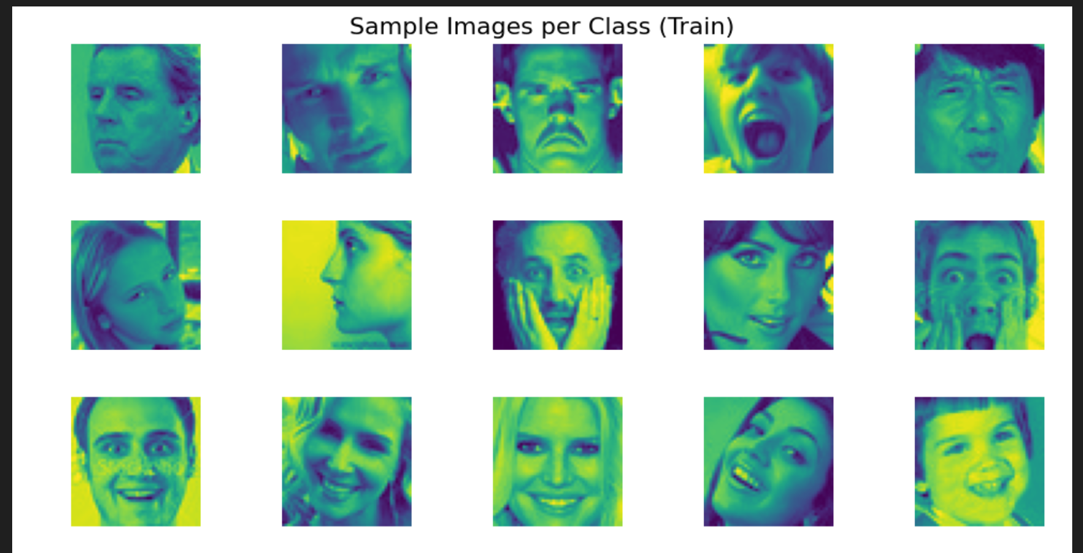
PROPOSED METHODOLOGY
📌Research Design
The project follows a supervised machine learning research design. The main objective is to classify human facial expressions into Positive, Neutral, and Negative sentiment categories using a CNN-based deep learning model.
The design includes:
📌Data Collection Method
The data was collected from a publicly available dataset:
Dataset: Face Expression Recognition Dataset
Source: Kaggle
URL: https://www.kaggle.com/datasets/jonathanoheix/face-expression-recognition-dataset
Dataset Acquisition
Preprocessing & Cleaning
Balancing the Dataset
Model Building(CNN architecture)
Training & Validation
Evaluation (Accuracy, Loss, Confusion Matrix)
Result
Interpretation
dataset

Slide 6
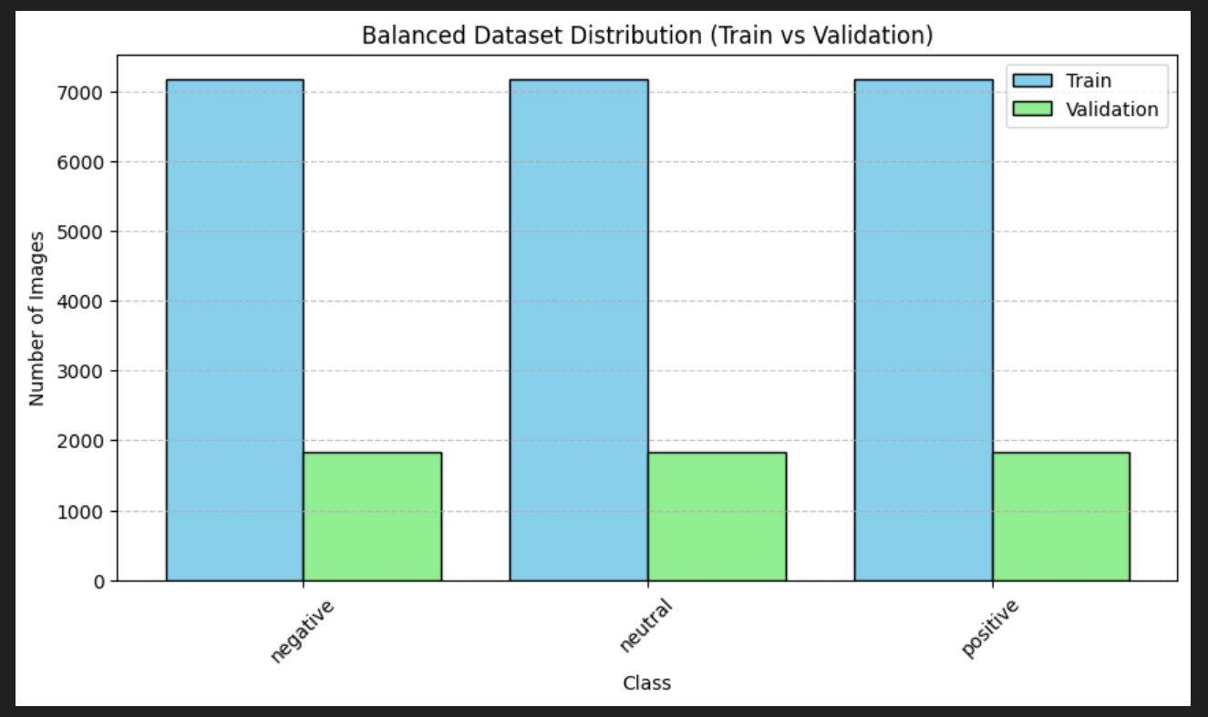
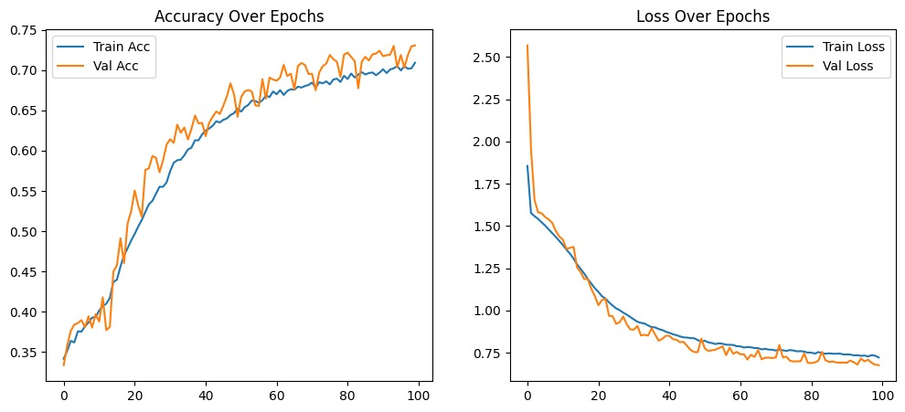
📌Data Preprocessing The following preprocessing steps were applied:
Sentiment-based folder restructuring : Images were grouped into 3 folders based on sentiment mapping.
Train–Validation Split Provided by the Dataset : The original dataset’s split structure was used.
Dataset Balancing (Undersampling) : Each class within each split was balanced by selecting an equal number of samples from the minority class.
Image Resizing : All images were resized to 48×48×3.
Normalization : Pixel intensities scaled to the range [0,1] using layers.Rescaling (1./255).
Data Augmentation : 1. Random flip, 2. Random rotation, 3. Random zoom, 4. Random contrast.
📌Data Analysis Steps
Class Distribution Visualization : A bar chart shows that all classes now have equal numbers after balancing.
Training Curve Analysis : Accuracy and loss plots show steady improvement, confirming stable learning.
Confusion Matrix Analysis : Shows model performance across sentiment categories with normalization
Bar chart

Slide 7
📌Techniques/Technologies Used
💡Technologies
Python
TensorFlow / Keras
NumPy
Matplotlib
Seaborn
Scikit-learn
Google Colab (GPU runtime)
💡 Machine Learning Techniques
Convolutional Neural Networks (CNNs)
Data Augmentation
Batch Normalization
Dropout Regularization
L2 Regularization
Adam Optimizer
Sparse Categorical Crossentropy Loss
📌High-Level Workflow Diagram
Dataset Collection (Kaggle FER Dataset)
Data Preprocessing
Emotion → SentimentMapping
Balancing (undersampling)
Train/Validation structuring
Normalization & Augmentation
Model Training (100 Epochs)
Adam +
CrossEntropy
Evaluation &
Validation
Accuracy/Loss Curves
Confusion Matrix
Final Model
(Sentiment Class.)
CNNModelDesign
Conv Layers
BatchNorm
Dropouts

Slide 8
🔰MODEL SUMMARY
STAGE/LAYER | TYPE & PARAMETERS | OUTPUT SHAPE | NOTES
Input | Input Layer | (None, IMG_SIZE, IMG_SIZE, 3) | _
Augmentation | Data Augmentation | (None, IMG_SIZE, IMG_SIZE, 3) | _
Block 1 | Conv2D (3×3, 32) → BatchNorm → Conv2D (3×3, 32) → MaxPool (2×2) → Dropout (0.25) | (None, IMG_SIZE/2, IMG_SIZE/2, 32) | _
Block 2 | Conv2D (3×3, 64) → BatchNorm → Conv2D (3×3, 64) → MaxPool (2×2) → Dropout (0.35) | (None, IMG_SIZE/4, IMG_SIZE/4, 64) | _
Block 3 | Conv2D (3×3, 128) → BatchNorm → MaxPool (2×2) → Dropout (0.4) | (None, IMG_SIZE/8, IMG_SIZE/8, 128) | _
Flatten | Flatten | (None, …) | _
Dense | Dense (256) + L2(0.001) | (None, 256) | _
Dropout | Dropout (0.5) | (None, 256) | _
Output | Dense (3) + Softmax | (None, 3) | 3 classes
TOTAL NUMBER
OF
PARAMETERS:
1,320,547

Slide 9
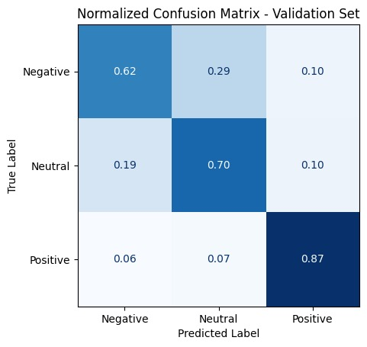
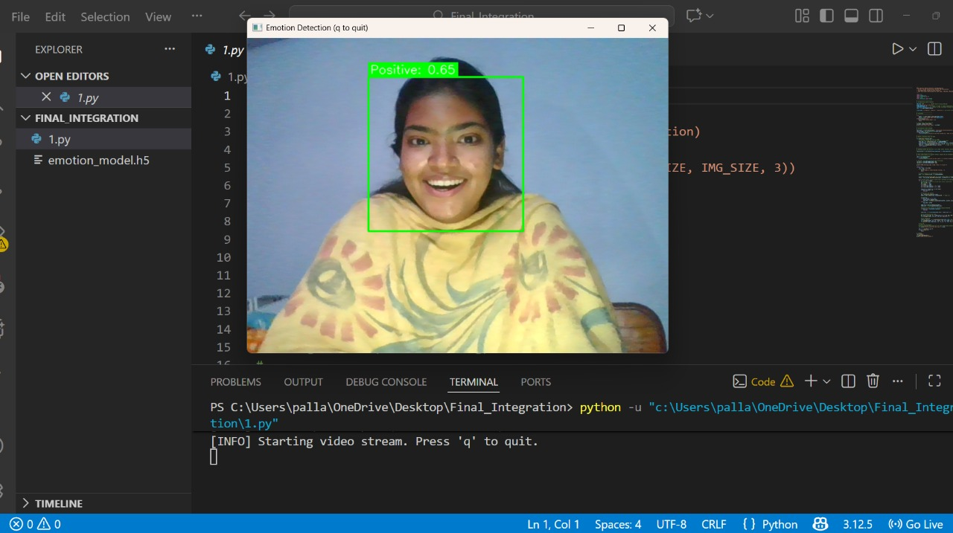
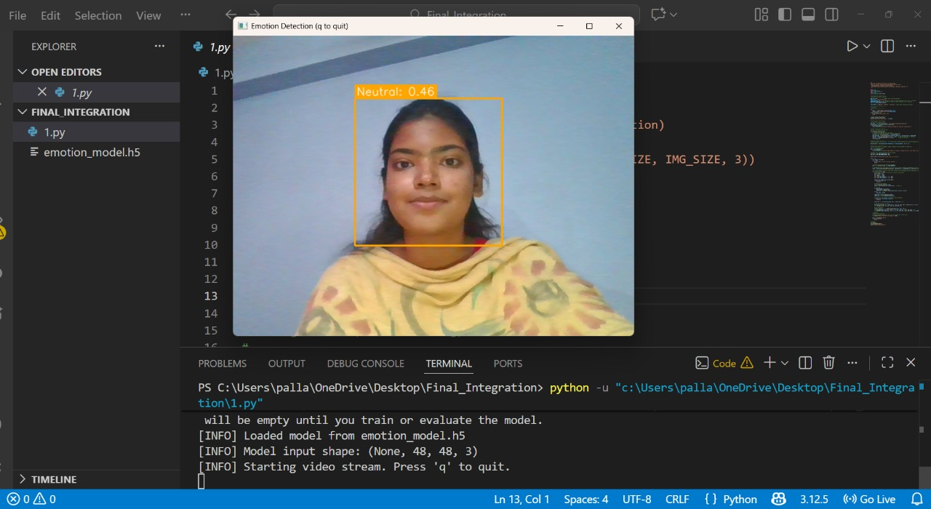
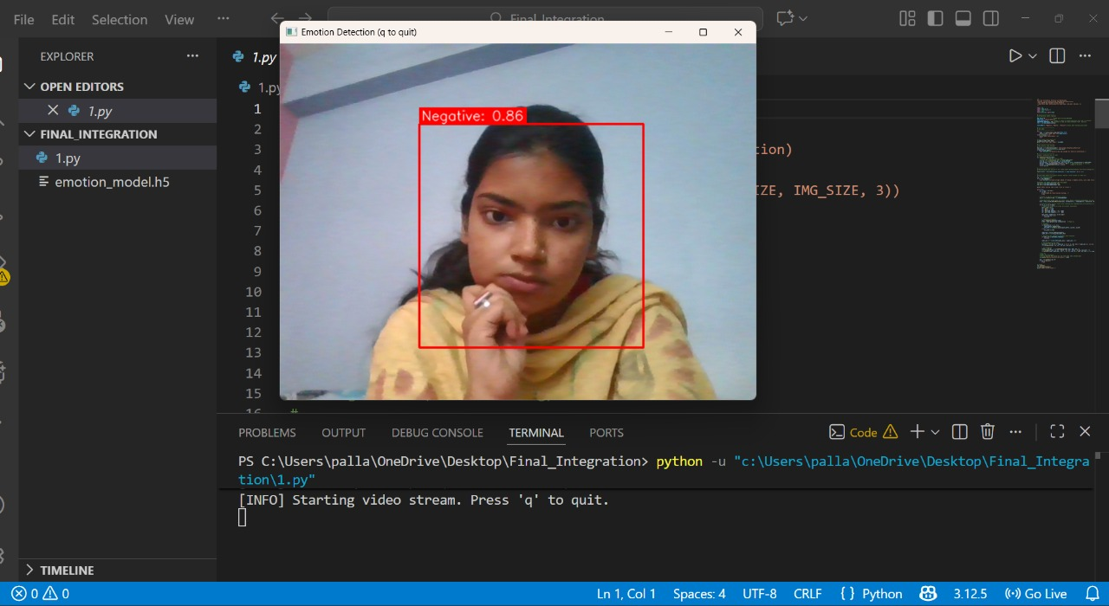
OUTCOME
🔎Expected Results: Based on the experiments conducted:
Training Accuracy: ~71%
Validation Accuracy: ~73%
Good generalization (validation accuracy > training accuracy slightly)
Positive class performs best (precision/recall highest in confusion matrix)
Negative class shows most confusion with Neutral, due to subtle facial cues.
Expected trends:
Augmentation reduces overfitting
100 epochs provide stable convergence
Real-Time Emotion Detection: Live Webcam Output
POSITIVE
NEUTRAL
NEGATIVE

Slide 10
💡Potential Impact
Improves classroom engagement by detecting student attention levels in real time and helping teachers quickly identify bored, distracted, or confused students.
Supports personalized teaching by showing which topics trigger negative emotions and which ones engage students, allowing instructors to adjust their style instantly.
Enhances learning outcomes through data-driven insights that track class mood trends, overall participation, and emotional patterns over time.
Helps early intervention by identifying consistently disengaged or distressed students so teachers can provide timely support before performance drops.
Reduces manual monitoring by automating attendance, attention tracking, and emotion analysis, saving teachers time and improving classroom efficiency.

Slide 11
SIGNIFICANCE
💡Practical Applications
Enhances real-time monitoring of student engagement and performance.
Helps teachers identify struggling students early for timely intervention.
Automates data collection, reducing manual workload for educators.
Supports personalized learning through continuous performance insights.
Improves classroom management and teaching effectiveness.
🔆Contribution to the Field
Academic Contribution : Strengthens research in learning analytics using an AI-based model.
Innovation in ML Applications : Introduces real-time machine learning for immediate classroom insights.
Technological Development : Provides a scalable prototype suitable for future Smart Classroom systems.
Research Foundation : Serves as a baseline model for future AI-driven education research.
Implementation Feasibility : Demonstrates a practical and easy-to-integrate ML solution for institutions.
Data Contribution : Generates structured engagement and performance data useful for further studies.

Slide 12
CONCLUSION
The project builds a machine learning system to monitor students’ real-time engagement.
SUMMARY
OF KEY
POINTS
Dataset was preprocessed, balanced, normalized, and trained for accurate sentiment detection.
A CNN model classifies emotions into Positive, Neutral, and Negative categories.
The system helps teachers identify distracted or struggling students early.
Strengthens the use of AI and data analytics in modern education
Offers a scalable foundation for future smart classroom applications

Slide 13
📌Future Directions
Integration of Real-Time Video Processing : Implement live classroom video analysis instead of using only static images to make the monitoring system fully real-time and dynamic.
Multi-Modal Behaviour Analysis : Add additional behavioural cues such as body posture, hand movements, voice tone, and gesture recognition to improve engagement detection accuracy.
Student-Specific Learning Profiles : Build personalized learning dashboards that track each student’s long-term emotional and attentiveness patterns.
Deployment in Smart Classrooms : Extend the model to work on low-cost embedded devices or smart cameras for easy integration in real classroom environments.
Teacher Feedback Loop : Introduce a recommendation system that suggests teaching strategy improvements based on detected student engagement levels.
Scalability for Large Classrooms : Optimize the system to detect and track multiple students simultaneously, even in crowded or low-light conditions.
Enhanced Model Accuracy : Use advanced deep learning architectures like ResNet, MobileNet, or Vision Transformers to achieve higher prediction accuracy.
With continued development, this system can become a powerful tool that reshapes modern education and enhances student success.

Slide 14
THANK YOU

