Slide 1

Fraud Monitoring System for Insurance Claims
G JAYAPRAKASH VARMA ( 192111687 )
P SHESHADRI ( 192111392 )

Slide 2
INTRODUCTION
Insurance Fraud – False claims or misleading information to gain financial benefits.
Impact – Causes financial losses, higher premiums, and reduced trust.
Challenges – Manual detection is slow, inefficient, and error-prone.
Solution – AI-powered fraud monitoring for real-time detection.
Objective – Reduce fraud, improve efficiency, and enhance security.
Types of Fraud – Includes claim fraud, staged accidents, and insider fraud.
Key Benefits – Faster claim processing, reduced fraudulent payouts, and improved accuracy.

Slide 3
Objective of Fraud Monitoring System for Insurance Claims
The primary objective of the Fraud Monitoring System is to detect, prevent, and minimize fraudulent insurance claims.
by using advanced technologies like AI, machine learning, and real-time data analysis.
This helps insurance companies reduce financial losses, improve claim processing efficiency.
ensure fair settlements while maintaining trust and transparency in the insurance industry.

Slide 4
The Growing Problem of Insurance Fraud
Insurance fraud is on the rise, costing billions annually. It impacts premiums and trust in the industry. Fraudsters employ increasingly sophisticated methods. Early detection and prevention are critical.
Financial Impact
Billions lost each year due to fraudulent claims. Increased premiums for honest policyholders.
Evolving Tactics
From staged accidents to inflated claims, tactics are always improving. Staying ahead of the curve is challenging.

Slide 5
Core Components and Technologies Used
The system uses advanced technologies. These include data mining, predictive modeling, and AI. Key components include a data warehouse, analytics engine, and reporting dashboard.
Data Warehouse
Stores and manages large volumes of claims data efficiently.
Analytics Engine
Performs real-time analysis and anomaly detection.
Reporting Dashboard
Offers a clear overview of fraud trends and system performance.

Slide 6
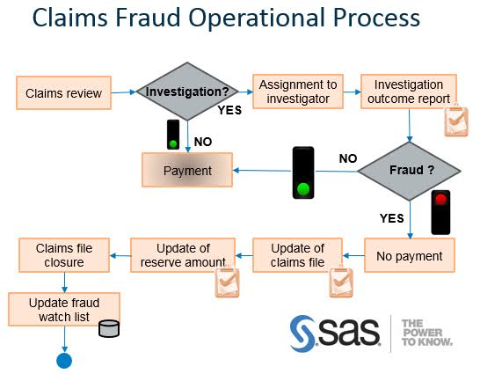
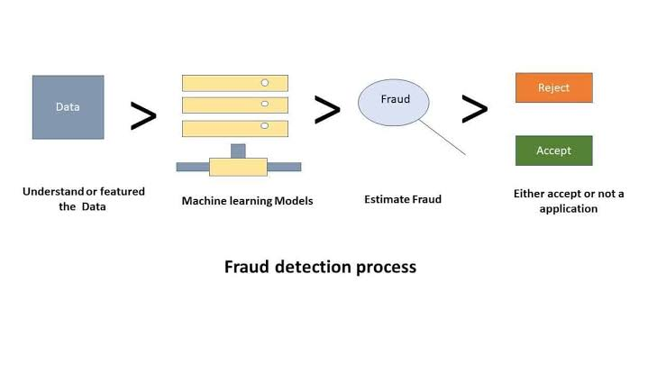
SYSTEM ARCHITECTURE

Slide 7
Comprehensive Solution
Our system offers real-time detection and prevention. It provides a layered approach to combat fraud. It combines advanced analytics, machine learning, and rule-based systems.
Real-Time Analysis
Quickly identifies suspicious claims before they are paid out.
Machine Learning
Adapts to new fraud patterns and improves accuracy.
Rule-Based System
Flags claims that violate predefined rules and parameters.

Slide 8
Implementation Strategies and Best Practices
Successful implementation requires a phased approach. Start with a pilot program and expand gradually. Ensure data quality and train staff. Monitor system performance and adjust as needed.
Data Quality
Pilot Program
Staff Training
Performance Monitoring

Slide 9
Real-Time Data Analysis and Security Concerns
Real-time analysis is critical for fraud prevention. Our system monitors claims data continuously. It identifies unusual patterns and flags suspicious activities instantly.
Data Ingestion , Claims data is continuously ingested into the system.
Pattern Recognition , The system identifies suspicious patterns and anomalies.
Alert Generation , Alerts are generated for potentially fraudulent claims.
Investigation ,Analysts review alerts and investigate potential fraud.
We prioritize data privacy and security. Our system complies with regulations. It uses encryption and access controls. Regular audits ensure compliance.
These measures protect sensitive information and maintain trust

Slide 10
Conclusion
Detects and prevents fraudulent claims.
Uses AI and real-time alerts for quick action.
Reduces financial losses for insurers.
Identify potential fraud risks before claims are filed.
Speeds up processing of genuine claims.
Identifies fraud patterns through data analysis.
Continuously improves with advanced technology.

