Slide 1

MACHINE LEARNING USING PYTHON

Slide 2
INTERVIEW ATTENDANCE PREDICTION
Group Members:
PALLAB CHAKRABORTY, RCC INSTITUTE OF INFORMATION TECHNOLOGY
ANIKET CHATTOPADHYAY, RCC INSTITUTE OF INFORMATION TECHNOLOGY
SOHAM MANDAL, RCC INSTITUTE OF INFORMATION TECHNOLOGY
CHANDRABALI BISHNU, RCC INSTITUTE OF INFORMATION TECHNOLOGY
CAMELIA MAHATO, RCC INSTITUTE OF INFORMATION TECHNOLOGY

Slide 3
Table of Contents
Acknowledgement
Project Objective
Project Scope
Data Description
Model Building
Code
Future Scope of Improvements
Project Certificate

Slide 4
ACKNOWLEDGEMENT
I take this opportunity to express my profound gratitude and deep regards to my faculty Mr. Titas Ghosh for his exemplary guidance, monitoring and constant encouragement throughout the course of this project. The blessing, help and guidance given by him/her time to time shall carry me a long way in the journey of life on which I am about to embark.
I am obliged to my project team members for the valuable information provided by them in their respective fields. I am grateful for their cooperation during the period of my assignment.

Slide 5
Project Objective
PROBLEM
Given a dataset about the candidates who are shortlisted to appear for an Interview we’ve to predict whether the given candidate would turn up on the day of the interview. A lot of information about the candidate is given who have probably answered some questions and given information about themselves like their location and skill sets, martial status etc.
OBJECTIVE
To prepare a model to predict if the candidate will turn up on the day of interview.
SOLVING STRATEGY
We first try to clean the data then analyze column by column the data and apply necessary transformation to be used in algorithms.

Slide 6
Project Scope
The model we’re aiming to create will work with the data entered by the candidates themselves and some information regarding them like their current location and marital status. With this data we’re going to predict if a candidate will turn up on the day of the interview.

Slide 7
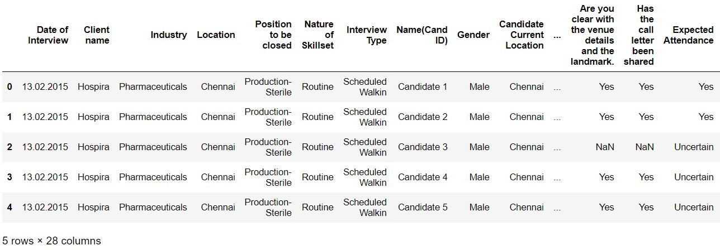
DATA DESCRIPTION
The dataset contains 28 columns ,all of which are categorical values except for the Name column .
The dataset contains 1234 rows containing information the candidate filled about themselves.
There are many unformatted dates and lots of values are missing from columns which we’ve marks and dealt with intuitively.

Slide 8
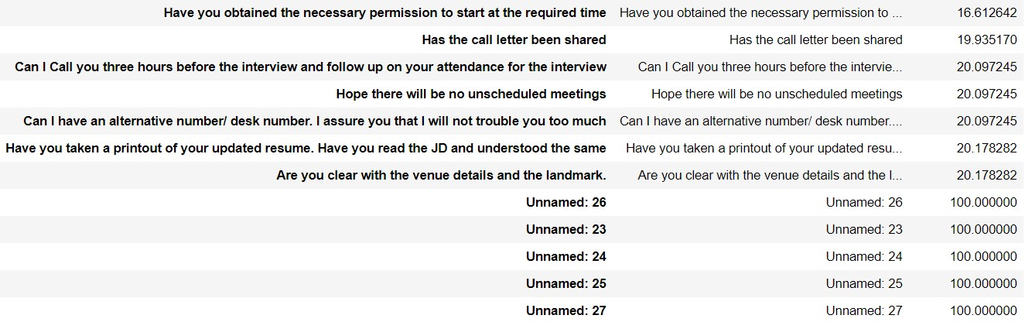
DATA DESCRIPTION CONT..
On observation there are 5 unnamed columns and they have no values (NaN).
The question/enquiries also do not have ~20% of the values which we can deal with in different ways .
One of the rows also did not have any values which is dropped.

Slide 9
Data Cleansing
We begin by renaming the columns to remove white spaces then we analyse each column
The data column in first formatted into the correct format DD-MM-YYYY and is then split into month and day of the week to take into account.
The NaN values of each enquiry columns are dealt with by replacing the NaN with “uncertain”. There is better scope to fill these values by analysing other columns .
Each of the categorical columns are converted into categorical values and then one hot encoded to form the processed data frame ready to be fed into a model .

Slide 10
Model Building
The one hot encoding leaves us with 145 columns, from which we apply feature selection methods to extract and find columns which are relevant to the final result.
We employ methods like selectKbest, variance threshold and mutual information for t he same.
Using these we obtain about 8-10 features are used in the following models to predict the outcome:
Naïve Bayes’ Classifier
Random Forest Classifier
Logistic Regression

Slide 11
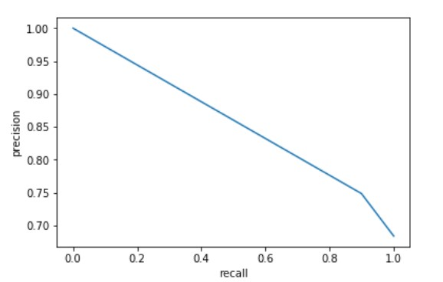
Naïve Bayes
Naive Bayes classifiers are a family of simple "probabilistic classifiers" based on applying Bayes' theorem with strong (naive) independence assumptions between the features.
accuracy : 70.0 precision : 72.0 recall : 86.0
f1-score : 78.0
AUC : 64.0

Slide 12
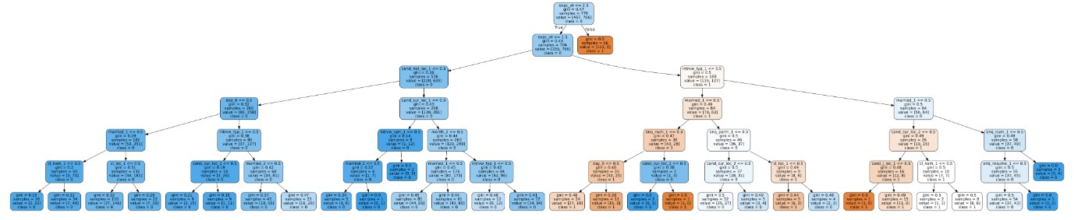
Random Forest
Random forests or random decision forests are an ensemble learning method for classification, regression and other tasks that operates by constructing a multitude of decision trees at training time and outputting the class that is the mode of the classes (classification) or mean prediction (regression) of the individual trees. Random decision forests correct for decision trees' habit of overfitting to their training set.
accuracy 69.83 precision 72.13 recall 78.79 roc_auc 70.23

Slide 13
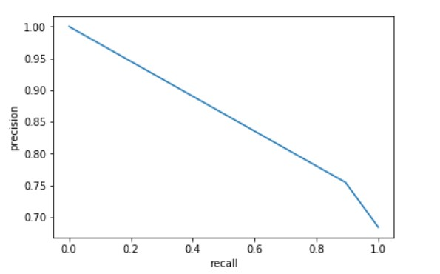
Logistic Regression
Logistic regression is a statistical model that in its basic form uses a logistic function to model a binary dependent variable, although many more complex extensions exist.
accuracy : 68.0 precision : 72.0 recall : 85.0
f1-score : 77.0
AUC : 62.0

Slide 14
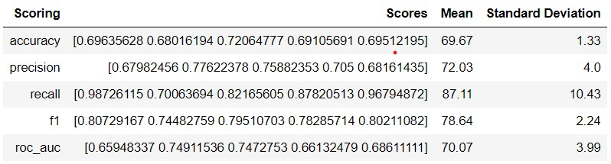
Conclusion
From the above results, random forest classifier is giving the best results. All three classifiers have similar precision and accuracy score but the roc_auc score is highest for the random forest classifier at 70.

Slide 15
THANK YOU

