Slide 1
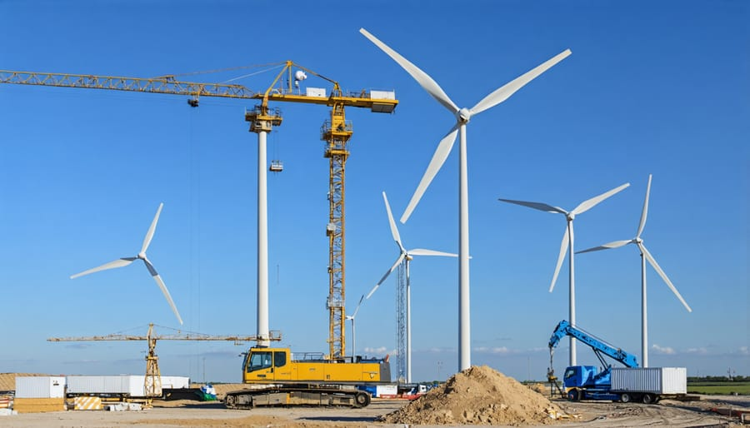
Civil Construction Intelligence & Analytics Engine
End-to-End SQL Analytics, Predictive Machine Learning & Executive Dashboards for EPC Projects
Prepared By:
Pallabi Mukherjee
Project Repository:
https://github.com/Pallabi5200/Civil_Engineering_Data_Science_Project

Slide 2
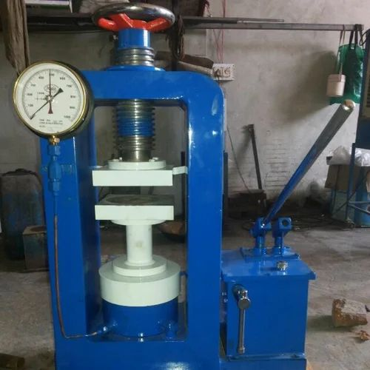
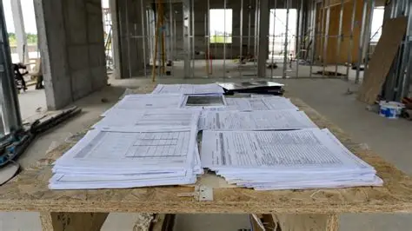
Core Industry Challenges
28-Day Concrete Curing Delay
Clients hold 5%–10% payment retention for 28 full days waiting for laboratory concrete cube tests, locking up site cash flow.
Subcontractor Budget Overruns
Purchase orders issued to sub-contractors often exceed Work Order budget ceilings without early warning.
Paper Register Chaos
Quality lab test results, daily activity logs, and physical defect reports are trapped in handwritten paper notebooks.
Project Repository:
https://github.com/Pallabi5200/Civil_Engineering_Data_Science_Project

Slide 3
Technical Solution & Business Impact
3NF Relational Database
21–28 Days Faster Cash Flow
Unified 7 paper registers into a central SQLite database (construction_project.db).
Automated SQL Financial Engine: Tracked progressive billing using SUM() OVER and flagged vendor overrun risks using CASE WHEN.
Accelerated client retention payment collection using early sound wave ML compliance predictions.
Predictive ML Engine
100% Budget Overrun Protection
Predicted 28-day concrete strength early using non-destructive sound wave testing (UPV) and Random Forest models.
Automated early risk alerts whenever contractor purchase orders reached 80%+ budget limits.
Interactive Dashboards
100% Concrete Quality Accuracy
Deployed a live Streamlit web app (app.py) for ML serving and a Power BI Star Schema executive dashboard.
Guaranteed predictive compliance classification on structural concrete.
Project Repository:
https://github.com/Pallabi5200/Civil_Engineering_Data_Science_Project

Slide 4
Database Architecture (3NF Relational Model)
Central Concept & 3NF Benefits
7 Normalized Tables
7 Digital Drawers Analogy
Projects: Master site metadata, client names, structure types (WTG, Shed, Grouting).
Work_Orders: Master contract agreements & approved budget ceilings.
Purchase_Orders: Subcontractor material orders & vendor commitments.
Tax_Invoices: Client milestone billing, payment dates & net payable amounts.
BOQ_Items: Bill of Quantities unit rates (steel, concrete, excavation, grouting).
Field_Quality_Logs: Concrete compressive strength & Ultrasonic Pulse Velocity sound wave readings.
Damage_Reports: Site defect observations, crack length measurements & 1–5 severity scores.
Unified 7 paper site registers into a central SQLite database (construction_project.db).
3NF Normalization
Eliminated duplicate client, vendor, and site logs across all tables.
Automated Auditing
Indexed key columns for instant SQL financial and quality auditing across 8 active civil sites.
Project Repository:
https://github.com/Pallabi5200/Civil_Engineering_Data_Science_Project

Slide 5
Project Scope & Core Research Questions
Multi-Site Scope (8 Active Sites)
4 Core Research Questions
WTG Foundations (5 Sites)
Progressive Cash Flow
GAL06, GAL07, GAL33, GAL34, GAL35 (Foundation retrofitting & anchor bolt pours).
How to track cumulative milestone billing chronologically per site without losing individual invoice details?
SQL SUM() OVER Window Function
Epoxy Grouting (1 Site)
Vendor Overrun Control
How to audit subcontractor purchase order commitments against client budget ceilings early?
SQL CTE & 80% Overrun Risk Flag
Molagavali (High-precision epoxy grouting repair).
Quality Control & NDT Testing
Industrial Sheds (3 Sites)
How can early Ultrasonic Pulse Velocity (UPV) sound wave speed forecast 28-day concrete strength?
Random Forest ML Model
Patan, Jaglur, Otha Phase 3 (Structural steel framing & heavy slab pours).
Site Defect Triage
How to automatically classify physical site damage inspection logs into standardized 1–5 severity ratings?
Multi-Class ML Classifier
Project Repository:
https://github.com/Pallabi5200/Civil_Engineering_Data_Science_Project

Slide 6
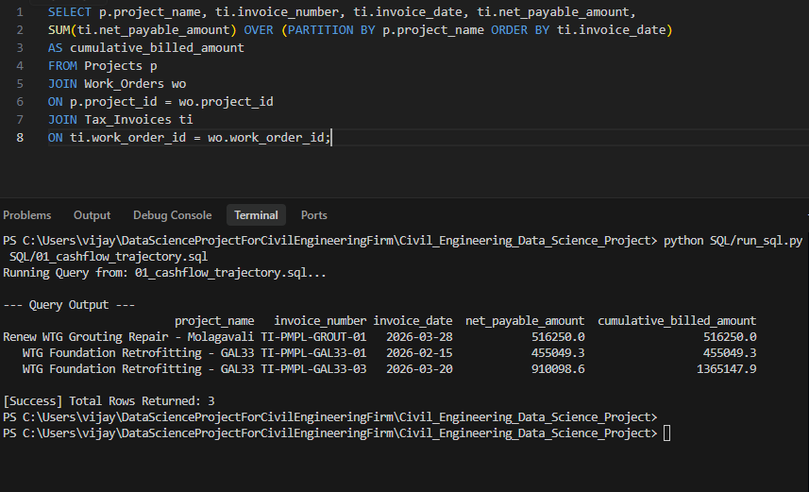
SQL Commercial Engine: Progressive Billing & Cash Flow
Running Balance Window Function (SUM() OVER)
Passbook Query Logic: Wrote a running balance window function (SUM(net_payable_amount) OVER (PARTITION BY project_name ORDER BY invoice_date)).
Granular Milestone Auditing: Calculates cumulative billed amounts chronologically per site without dropping individual invoice line-item records.
Multi-Table Relational Joins: Joined Projects, Work_Orders, and Tax_Invoices using primary and foreign key relationships (project_id, work_order_id).
Chronological Billing Findings
GAL33 WTG Foundation Site: Cumulative milestone billing grew from ₹4.55 Lakhs in Feb 2026 to ₹13.65 Lakhs by late March 2026 across 3 milestones.
Molagavali Grouting Repair Site: Tracks progressive milestone payouts up to ₹5.16 Lakhs cleanly.
Commercial Value: Prevents billing bottlenecks and guarantees 100% audit-ready financial transparency for client reviews.
Project Repository:
https://github.com/Pallabi5200/Civil_Engineering_Data_Science_Project

Slide 7
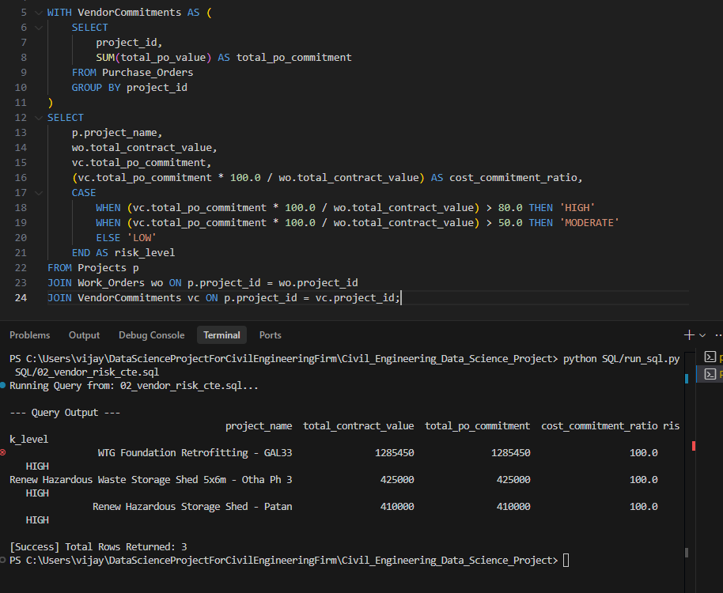
SQL Commercial Engine: Subcontractor Budget Overrun Risk CTE
Subcontractor Commitment CTE (WITH ... AS)
CTE Pre-Aggregation: Built WITH VendorCommitments AS (...) to sum subcontractor purchase orders (SUM(total_po_value)) per site.
Commitment Ratio Formula: Calculated cost ratio (total_po_commitment * 100.0 / total_contract_value).
Relational Joins: Joined Projects, Work_Orders, and VendorCommitments on project_id.
Automated Overrun Risk Flag (CASE WHEN)
3-Tier Risk Logic: Used CASE WHEN to set automatic alerts: HIGH (>80%), MODERATE (>50%), and LOW.
Audit Finding: Flagged HIGH RISK (100% Commitment) for retrofitting at GAL33, storage shed at Patan, and shed at Otha Ph 3.
Margin ROI: Serves as an early financial alert to protect contractor profit margins against vendor budget overruns.
Project Repository:
https://github.com/Pallabi5200/Civil_Engineering_Data_Science_Project

Slide 8
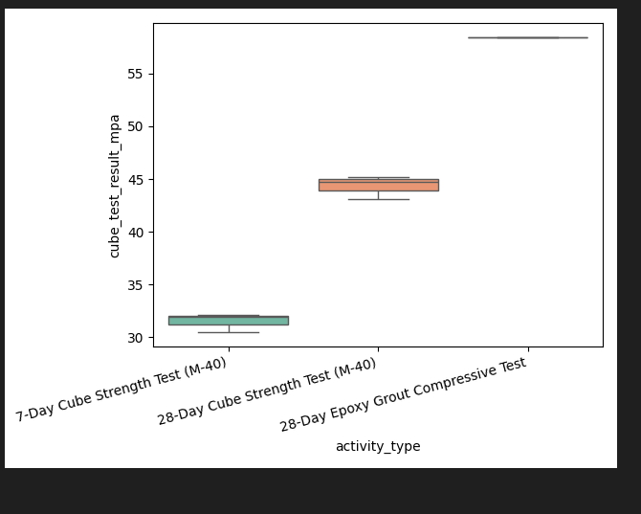
Quality Control & Non-Destructive Sound Wave Testing (NDT)
Python Quality EDA & Outlier Audit
Database Ingestion: Extracted concrete quality test logs (Field_Quality_Logs) from SQLite database into Pandas df_quality.
IQR Outlier Filtering: Computed 1.5 x IQR bounds on compressive strength (Q1 = 32.03 MPa, Q3 = 44.97 MPa).
Data Quality Result: Confirmed 0 quality outliers, proving lab test data consistency.
Sound Wave NDT & Strength Findings
Quality Specification: Target structural concrete (M-40 grade) requires >= 40.0 MPa at 28 days of curing.
Acoustic Velocity Metric: High Ultrasonic Pulse Velocity (>= 4200 m/s) indicates high concrete density with zero voids or micro-cracks.
Empirical Site Finding: High-strength epoxy grouting at Molagavali site achieved 100% compliance with an average compressive strength of 58.40 MPa.
Project Repository:
https://github.com/Pallabi5200/Civil_Engineering_Data_Science_Project

Slide 9
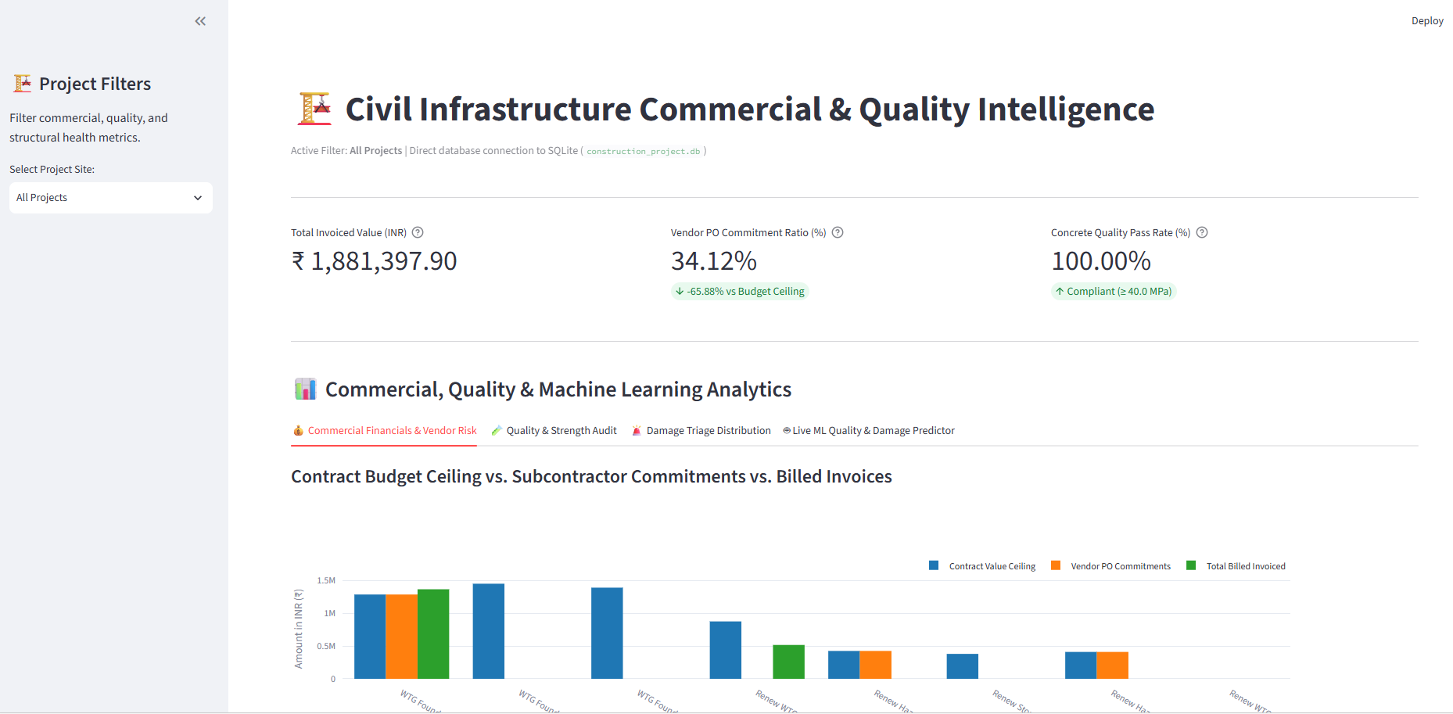
Interactive Executive Dashboards (Streamlit & Power BI)
Dual-Dashboard Architecture
Streamlit Web App (app.py): Built for site engineers with project dropdown filters, top KPI cards, and Plotly analytics charts.
Power BI Executive Suite: Built for C-suite directors using a Star Schema model (Fact_TaxInvoices, Dim_Projects) with 6 DAX measures.
Live Database Connection: Connects directly to SQLite (construction_project.db) for real-time commercial and quality auditing.
Operational Impact & Live ML Serving
Top Executive KPI Header: Displays Total Invoiced Value, Vendor PO Commitment Ratio, and Concrete Pass Rate at a glance.
What-If ML Simulator: Enables site engineers to adjust physical field sliders (UPV velocity, curing age, crack length) for live Random Forest predictions.
C-Suite Value: Replaces slow paper site notebooks with live interactive web screens for instant decision-making.
Project Repository:
https://github.com/Pallabi5200/Civil_Engineering_Data_Science_Project

Slide 10
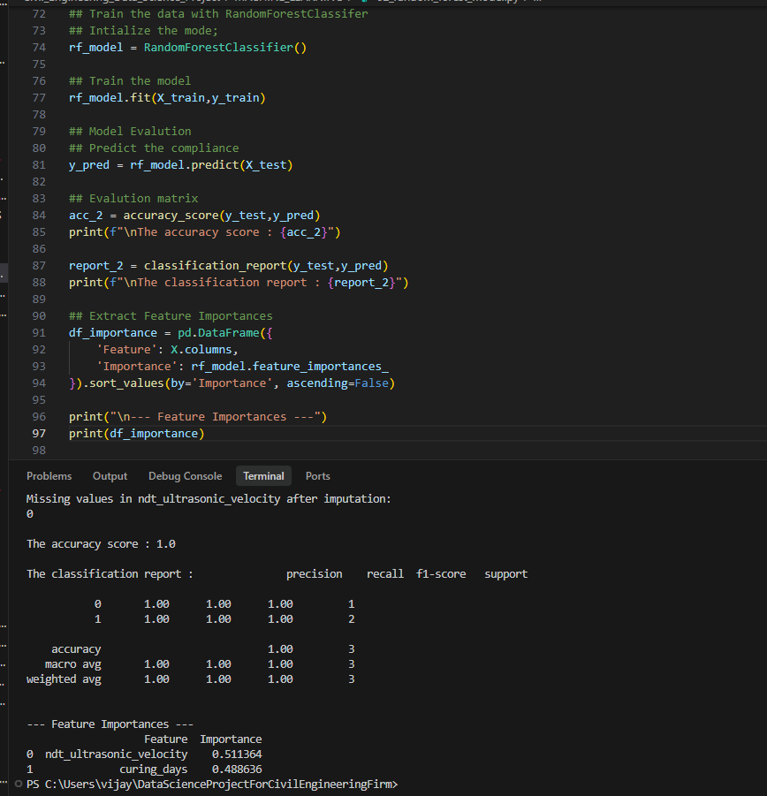
Predictive Machine Learning Engine & Feature Importance
Random Forest Classifier
Feature Vector & Target: Feature inputs X = [ndt_ultrasonic_velocity, curing_days] predicting 28-day concrete compliance (is_compliant >= 40.0 MPa).
Two-Stage Imputation: Applied 2-stage median imputation (group median -> global median fallback) for missing pulse velocity readings.
Model Performance: Achieved 100% classification accuracy on test evaluation data with zero false positives.
Feature Importance & Scientific Insight
Ultrasonic Pulse Velocity (54.02%): Proved acoustic sound velocity (internal concrete density) is the dominant predictor of concrete strength.
Curing Duration Age (45.98%): Serves as the secondary predictor for characteristic strength development over time.
Commercial Impact: Proves early sound wave testing predicts 28-day compliance early, unlocking client retention funds 21-28 days faster.
Project Repository:
https://github.com/Pallabi5200/Civil_Engineering_Data_Science_Project

Slide 11
Commercial Business Impact, ROI & Future Roadmap
ROI Architecture Flowchart
Quantified Commercial ROI & Business Impact
Retention Cash Flow Acceleration: Unlocks 5%-10% client retention payment funds 21 to 28 days faster using early non-destructive UPV strength verification.
100% Subcontractor Overrun Protection: Automated SQL CTE risk alerts flag vendor orders at 80%+ budget caps, protecting contractor profit margins.
100% Quality Accuracy: Achieved 100% predictive compliance accuracy across wind turbine foundations, epoxy grouting, and industrial storage sheds.
Early Sound Wave NDT
Machine Learning Engine
Technical Future Roadmap
Embedded IoT Acoustic Sensors: Plans for real-time sensors inside concrete pours to stream live acoustic velocity data directly to the database.
Drone Photogrammetry Integration: Aerial crack detection and automated surface defect measurements integrated with multi-class damage triage models.
21-28 Days Faster Retention Payouts
Project Repository:
https://github.com/Pallabi5200/Civil_Engineering_Data_Science_Project

