Slide 1
BTP
Spectral Reconstruction from RGB images
Guide: Dr. Viswanath P
Members: Praveen P Vishruth T Dinesh kumar K
Harsha vardhan S

Slide 2
TABLE OF CONTENTS
01
02
03
INTRODUCTION
PREVIOUS WORK
WORK DONE
04
04
05
RESULTS
EVALUATION
WEB APPLICATION

Slide 3
INTRODUCTION
RGB images are taken from the 380 nm - 750 nm wavelength range of visible spectrum of light.
Here we want to reconstruct 31 spectral images in range of 380 nm - 750 nm wavelength.
Bands we are focusing on are :
[400 410 420 430 440 450 460 470 480 490 500 510 520 530 540 550 560 570 580 590 600 610 620 630 640 650 660 670 680 690 700]

Slide 4
Previous Work
.
Dataset collection, Data Preprocessing like changing its resolution to make it easy for further processing.
We built a GAN based model for the spectral images generation.
Generator of the GAN was built using the U-Net architecture.
Discriminator was built using a the Patch GAN.
Used NTIRE 2020 dataset for training of the models.
Resolution was set from 512x512 to 256x256 due to memory constraints.
Among 31 spectral channels we generated first 3 channels as the output of the Generator network.

Slide 5
Work Done
We implemented 3 different GAN models with variation in their Generator models.
Deep ConvNet is the first model in which Generator is U-Net with normal GAN loss functions are used for training. All the training parameters are manually selected.
HyperUNet, it is very similar to first model but here we did hyper parameter optimization for the lambda (penalty constant).It is optimized on rmse values of the model.
Resnet, Generator of this GAN model contains ResBlocks instead of U-Net. 1 Initial Layer and 3 ResBlocks Layers and 1 Final Layer.

Slide 6
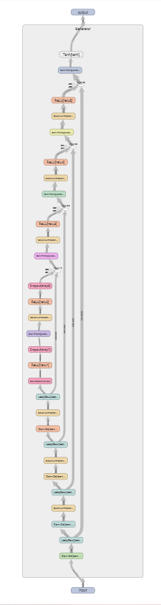
Generator (U-Net architecture)
For the Generator we used the U-Net architecture , it involves downsampling of 3x256x256 images to bottleneck layer (512x8x8) from there again upsampling will be done to retain 3x256x256.

Slide 7
Generator (Resnet architecture)
Initial convolution layer and 3 resnet blocks and final convolution layer.
Each resnet block contains 1 conv layer, batch normalization and then relu activation function.
256x256x3 --→ 256x256x64 --→ 256x256x128 --→ 256x256x256 --→ 256x256x512 --→ 256x256x3.
Keeping the resolution same we changed the depth of the image in each layer.

Slide 8
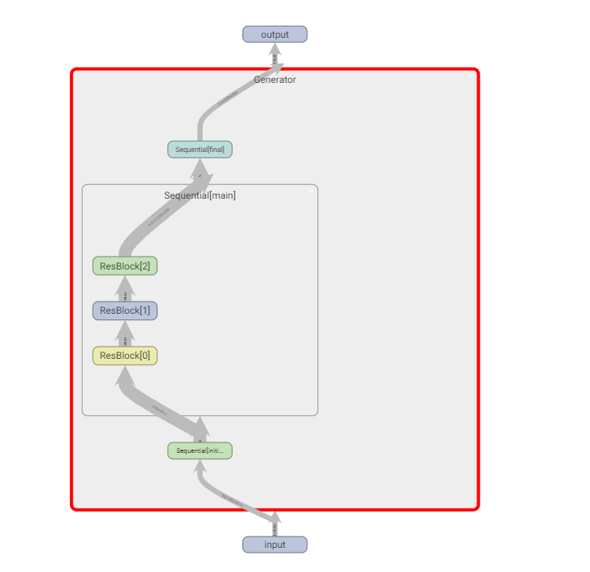
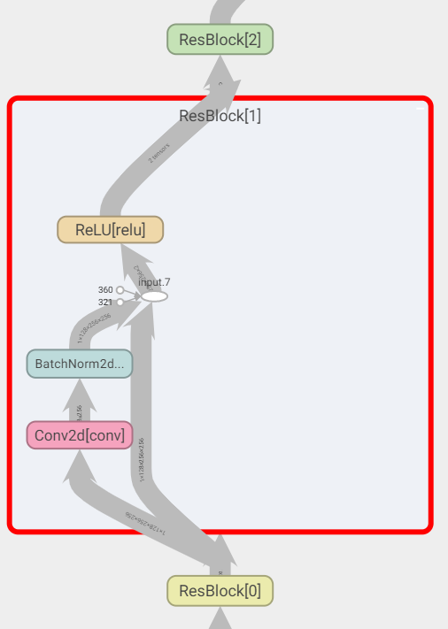
Generator (Resnet architecture)

Slide 9
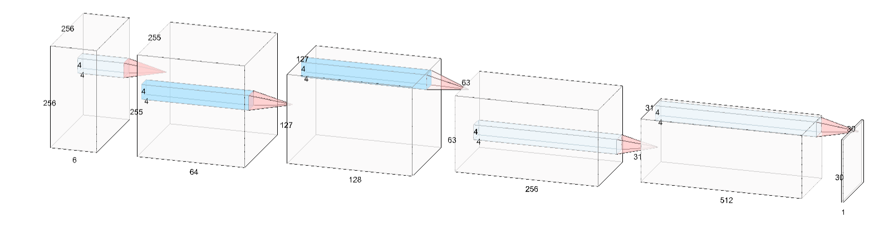
Discriminator (Patch GAN architecture )
For the Discriminator network we used the Patch GAN.
From the given input after applying some downsampling , it will outputs 30x30x1 patch with probability of the patch being real.
For the real image our target is to get patch of 1’s and for fake images our target is to get patch of 0’s.
Each cell in the patch corresponds to 70x70 patch in input.

Slide 10
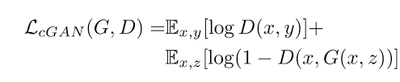


Generator Loss Functions
Generator Loss function.
Adversarial loss ----→
L1 Loss
Total Loss ---→
Optimizer Used : Adam, learning rate 2e-4 , betas = (0.5,0.999).

Slide 11
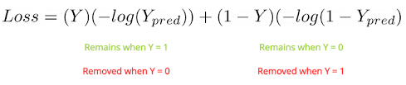
Discriminator Loss Function
Discriminator Loss Function.
Optimizer used : Adam , learning rate 2e-4 , betas = (0.5,0.999).

Slide 12
Dataset Information
NTIRE 2020 Spectral Reconstruction.
31 spectral channels from 400nm to 700nm.
train : validation : test 450 : 10 : 10.
Cave multispectral images dataset.
31 spectral channels from 400nm to 700nm.
train : validation : test 22 : 5 : 5.
NUS multispectral images dataset.
31 spectral channels from 400nm to 700nm.
train : validation : test 50 : 8 : 8.

Slide 13


Evaluation Metrics
RMSE
Root mean square error.
Pgtic and Precic denote the value of the c spectral channel of the i-th pixel in the ground truth and the reconstructed image
|Pgt| is the size of the ground truth image (pixel count × number of spectral channels).
RRMSE
Relative root mean square error.
This indicator is calculated by dividing RMSE with average value of measured data.
Relative RMSE by dividing the error by the ground truth pixels value, thus preventing a bias towards low errors in lower pixel values.

Slide 14
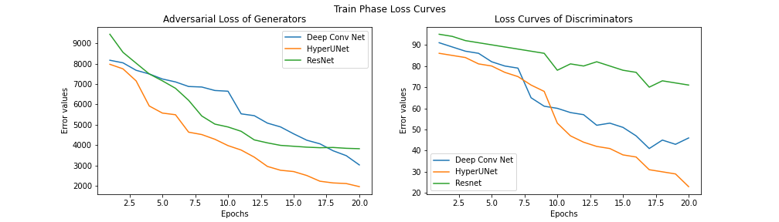
Loss Curves of Generators and Discriminators

Slide 15
Results and Evaluation
 |  | NTIRE 2020 dataset (Primary) |  | CAVE dataset |  | NUS dataset
 |  | train | valid | train | valid | train | valid
Deep ConvNet | RMSE | 16.451 | 17.998 | 17.451 | 16.998 | 16.221 | 17.023
 | rRMSE | 0.767 | 0.643 | 0.737 | 0.713 | 0.761 | 0.839
Hyper UNet | RMSE | 5.148 | 5.023 | 7.993 | 7.148 | 5.392 | 5.109
 | rRMSE | 0.473 | 0.464 | 0.703 | 0.695 | 0.656 | 0.612
Res Net | RMSE | 10.352 | 11.821 | 14.894 | 15.821 | 14.237 | 15.452
 | rRMSE | 0.631 | 0.642 | 0.731 | 0.732 | 0.791 | 0.603

Slide 16
Results and Evaluation
Comparing the HyperNet with existing models
 | NTIRE 2020 |  |  |  | CAVE dataset |  |  |  | NUS dataset
 | Arad | A+ | CNN | HyperNet | Arad | A+ | CNN | HyperNet | Arad | A+ | CNN | HyperNet
RMSE | – | – | – | 5.085 | 5.61 | 2.74 | 2.55 | 7.0705 | 4.44 | 2.92 | 2.86 | 5.7505
rRMSE | – | – | – | 0.418 | 0.499 | 0.426 | 0.469 | 0.769 | 0.190 | 0.142 | 0.152 | 0.684

Slide 17
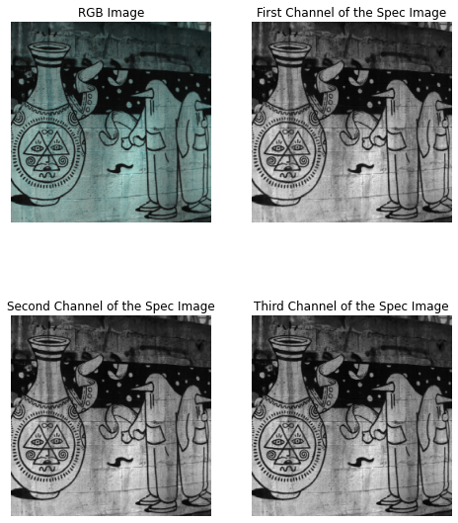
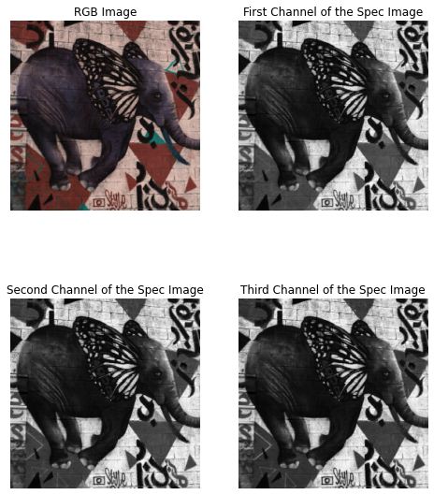
Outputs Spectral Images Of HyperNet
First image contains images from 430 nm, 440 nm, 450 nm.
Second image contains images from 560 nm, 570 nm, 580 nm.

Slide 18
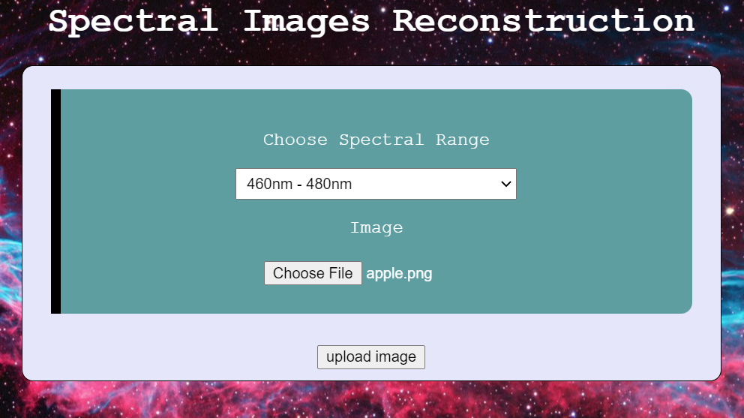
Web Application Demo
Web application was built using django framework.
HyperUNet model weights are saved and used in the backend.

Slide 19
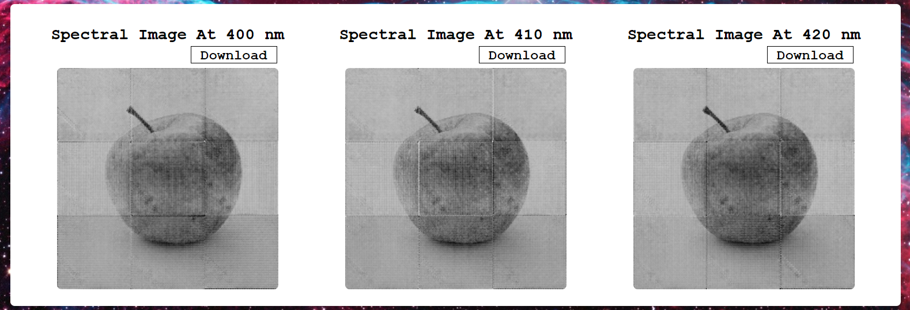
Web Application Demo
This is the final Output Generated Images. We can download them directly.

Slide 20
References
Can, Yigit Baran, and Radu Timofte. "An efficient CNN for spectral reconstruction from RGB images." arXiv preprint arXiv:1804.04647 (2018).
Zhao, Yuzhi, et al. "Hierarchical regression network for spectral reconstruction from RGB images." Proceedings of the IEEE/CVF Conference on Computer Vision and Pattern Recognition Workshops. 2020.
Koundinya, Sriharsha, et al. "2d-3d cnn based architectures for spectral reconstruction from rgb images." Proceedings of the IEEE Conference on Computer Vision and Pattern Recognition Workshops. 2018.
Stiebel, Tarek, et al. "Reconstructing spectral images from rgb-images using a convolutional neural network." Proceedings of the IEEE Conference on Computer Vision and Pattern Recognition Workshops. 2018.
Arad, Boaz, et al. "Ntire 2020 challenge on spectral reconstruction from an rgb image." Proceedings of the IEEE/CVF Conference on Computer Vision and Pattern Recognition Workshops. 2020.

Slide 21
References
Goodfellow, Ian J., Jean Pouget-Abadie, Mehdi Mirza, Bing Xu, David Warde-Farley, Sherjil Ozair, Aaron Courville, and Yoshua Bengio. "Generative adversarial networks." arXiv preprint arXiv:1406.2661 (2014).
Isola, Phillip, Jun-Yan Zhu, Tinghui Zhou, and Alexei A. Efros. "Image-to-image translation with conditional adversarial networks." In Proceedings of the IEEE conference on computer vision and pattern recognition, pp. 1125-1134. 2017.
Liu, Xu, et al. "Multispectral image reconstruction from color images using enhanced variational autoencoder and generative adversarial network." IEEE Access 9 (2020): 1666-1679.
Aeschbacher, Jonas, Jiqing Wu, and Radu Timofte. "In defense of shallow learned spectral reconstruction from rgb images." Proceedings of the IEEE International Conference on Computer Vision Workshops. 2017.

Slide 22
THANK
YOU!!!!!

